Slide 1

Introducing Trauma Informed Care

Slide 2

Training Topics for Staff
ACEs
Resiliency
Vicarious Trauma
Compassion Fatigue Survey
Self Care
Language and health outcomes of trauma

Slide 3
Trauma Informed Office
Choosing and modifying a Trauma and Resiliency questionnaire
Staffing
Creating workflows
Documentation
Communication- positive messages
Surveying staff after each staff meeting
Suggestion boxes
Creating Community Resource Referral

Slide 4
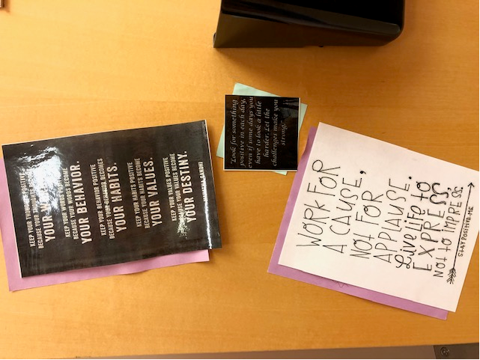
Trauma Informed Office

Slide 5
Trauma Informed Office
Ice breakers
Team building
Support groups

Slide 6

Trauma Informed Office

Slide 7
Trauma Informed Office
Partnering with Community Resources
4C’s/Head start
NAMI
CPI
SAY
Youth Connections
Parks and Rec
Community Action Partnership
WIC
CPS

Slide 8
Trauma Informed Office
Expanding staff:
.8 FTE Mental Health provider
.5 FTE Clinical Team Assistant

Slide 9


Parent Advisory Group
Monthly Groups
Lunch
Incentives
Child care

Slide 10

When to Screen?
Yearly Well Child Exams starting at age 4 mos
All new patients
Anytime there are concerns:
Sleep/Eating/Toilet issues
Developmental Delay
ADHD symptoms
Behavior problems
Morbid Obesity

Slide 11
Roles
Medical Assistants:
Questionnaires given in exam room for pts
0-11yrs of age to parent
Questionnaires given in exam room to pts 12 yrs and older and roomed alone
Documents in EHR all positive answers
Shreds the questionnaire

Slide 12
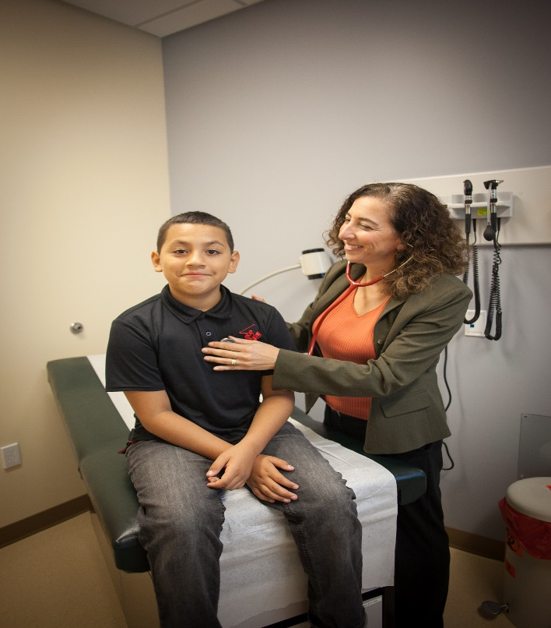
Roles
Provider:
scores
Updates problem list (ICD10 Z91.49)
Reviews positives with patient/family
MH referral- card to call for appt
OR
Community Resource referral

Slide 13
Roles
Clinical Team Assistant:
MH referral- send a letter and follow up with a phone call
Community Resource- give family information on resource, follows up with family 2 weeks later
Monthly Parent Advisory Group

Slide 14

Roles
Site Leadership:
Checking in with staff and being available to talk

Slide 15
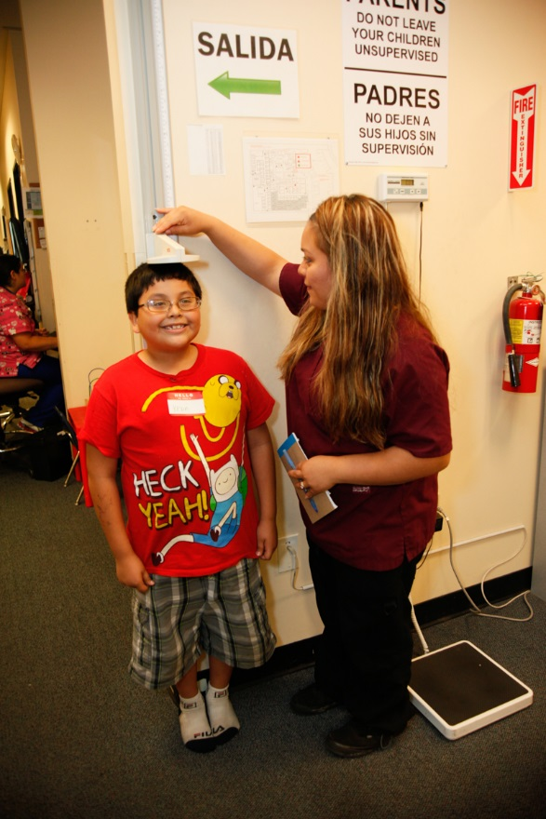
Ongoing
Refresher trainings for staff
Positive messaging
Brown bag lunches
Support groups
Debriefs

Slide 16


QUESTIONS???

