Slide 1
Methods for Developing Fundamental Change
Process Flow Mapping
Denise Armstorff
June 3, 2019

Slide 2
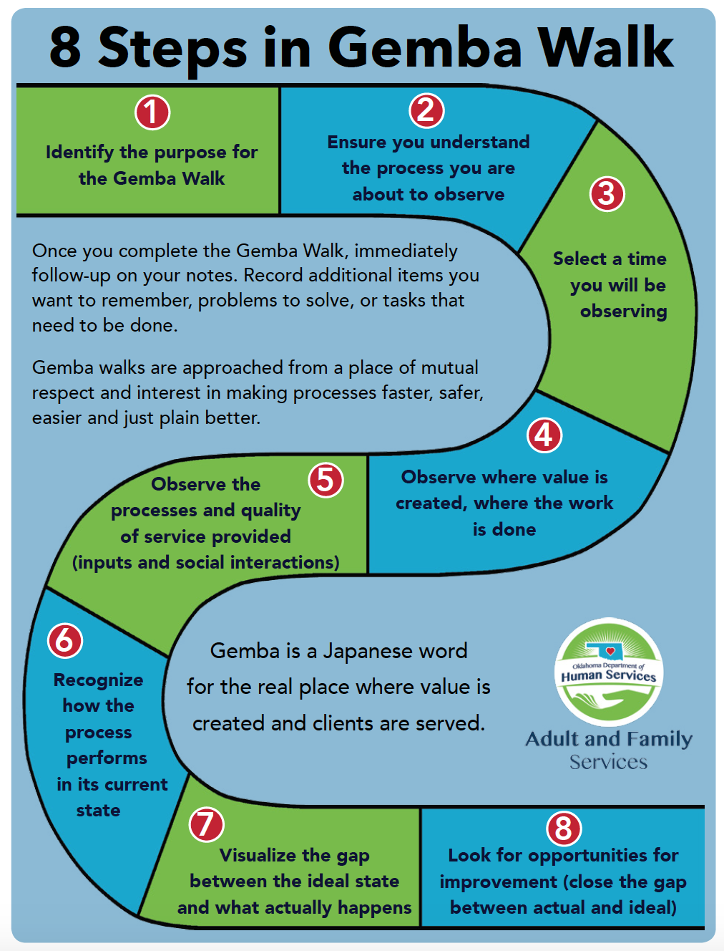
“Go and See” Site Visits
“Go and See” where work is done
Tell the people at the site what to expect (e.g. that they should show processes instead of tell, etc.)
Ask open ended questions, listen
Show respect: Approach from a place of mutual interest in making processes better for staff and patients
Debrief & record in your notes:
Anything you want to remember
Problems to solve
Tasks that need to be completed

Slide 3
Sample Worksheet: Site Visit Observation Notes
Site Visit Team Members: _________________________________ |  |  | Date: ____________________ | Date: ____________________
Site: ______________________________ |  | Process Observed: _________________________
Start Time/End Time | Step Name | Role Responsible | Opportunities Observed

Slide 4
Potential Opportunity Areas
Confusion
Motion
Waiting / Delay
Overprocessing
Inventory
Process Failure
Overproduction
Notes:
Confusion: Having to clarify information or instructions that are not clear
Motion/Conveyance: Physical movement required to get a task done or more people from place to place
Waiting/Delay: Spending time doing nothing but waiting for something to happen
Overprocessing: Doing more activities than necessary to complete a piece of work
Inventory: Supplies are obsolete, duplicated, or unnessessary
Process Failure
Overproduction: Doing more work than necessary

Slide 5
Think about an experience . . .
Frustrated/irritated
Excited/surprised

Slide 6
Change vs. Improvement
“All improvement requires change, but not every change is an improvement.”
The improvement Guide, Langley, etal., Chapter 6 , p. 109

Slide 7
Who will benefit from our change?

Slide 8
Typical Solutions in Developing Change
More of the Same
People
Money
Time
Exhortations to work harder
Inspection
Doesn’t alter the way the work is accomplished
Utopia Syndrome
The search for perfection
Action paralysis
Motivated by fear of failure
8
Notes:
More of the same - More people, more money, more time, more exhortation to work harder
Inspection – can improve the issues for a while, but adds costs and complexity to the system and can actually make the system worse
Utopia Syndrome – The search of perfection causes action paralysis, which is motivated by fear of failure. As long as people are working on perfection they will not have time to test new ideas. In order to change, people must embrace the fact that things will most likely not go as planned and be willing to learn from those experiences.

Slide 9
Change
The process or result of making or becoming different
“Different” is not the same as “improvement”

Slide 10
Reactive vs. Fundamental Change
Reactive (First Order Changes)
Routinely made to solve immediate problems
Keeps system running at the current level of performance
Returns system to prior condition
Immediate/short-term impact
Fundamental Changes (Second Order Changes)
Creates new system of performance
Designs/re-designs some aspect of the system
Fundamentally alters the system
Long-term impact

Slide 11
Methods for Developing Fundamental Change
Logical thinking about the current system
Benchmarking or learning from others
Using technology
Creative thinking
Using change concepts
Langley, G. J. (2014). The improvement guide: A practical approach to enhancing organizational performance. San Francisco, CA: Jossey-Bass.
11

Slide 12
Logical Thinking About the Current System
Assessing “current” state

Slide 13
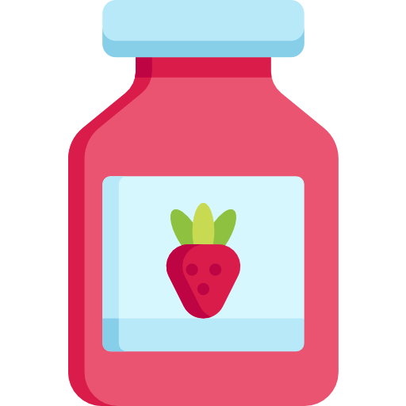
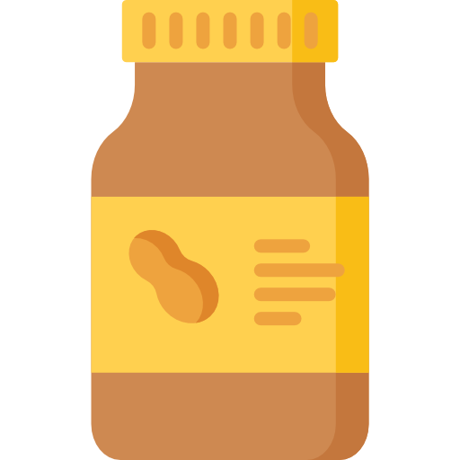
Peanut Butter and Jelly
Write down the steps to prepare a peanut butter and jelly sandwich

Slide 14
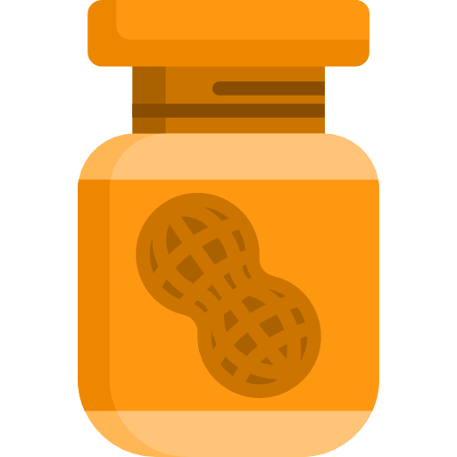
What did we learn from this activity?

Slide 15
What is a Process?
From Dictionary.com:
“A systematic series of actions directed to some end.”
“A continuous action, operation, or series of changes taking place in a definite manner.”
Notes:
15

Slide 16
What is Process Flow Mapping?
Visual representation of a process or work flow
Depicts each step sequentially
Source for understanding what needs to be improved
Inputs
Tasks
Outputs
Notes:
16
Process mapping is… it shows

Slide 17
Developing a Process Flow Map
Gather
Gather the subject matter experts
Create
Create a high-level process (Less than 10 steps)
Develop
Develop a detailed process flow map of the ACTUAL process (not as it should be)
Analyze
Analyze for accuracy and completeness
Identify
Identify areas for improvement

Slide 18
Gather Subject Matter Experts
Representatives who will provide firsthand accounts of how the process REALLY works

Slide 19
Process Flow Mapping: Begin with High-level Process
Shop for ingredients
Gather ingredients and supplies
Assemble sandwich
Notes:
Flowchart on chart pad at front of room

Slide 20
Mapping the Detail

Slide 21
Walk into kitchen
Gather ingredients (peanut butter, jelly, and bread)
Gather utensils (plate, knife, and spoon)
Remove twisty tie or plastic cinch from plastic bread
Twist and remove lids from peanut butter and jelly jars
Is there an inside seal on the jar?
Yes
Remove the seal and dispose of same
No
Scoop out peanut butter onto the blade of knife
Dip knife into peanut butter
Pick up the knife by the handle
Lay the two slices of bread f-ace up, and side-by-side
Remove two slices of bread from the package (skip the heel)
No
Spread peanut butter on the face of one slice of bread
Does peanut butter cover face of bread slice?
Wipe peanut butter from knife by spreading on the plain slice of bread
Dip knife into jelly
Scoop out jelly onto the blade of the knife
Spread jelly on the face of the remaining plain one slice of bread
Yes
No
Slide bread splice w/peanut butter into one hand (peanut butter side up)
Lift bread slice w/peanut butter using two hands, fingers on edges
Rest blade of knife on edge of plate w/handle on counter
Yes
Does jelly cover face of bread slice?
Mentally plan alignment of bread pattern shapes
Flip slice bread with peanut butter onto slice of bread with jelly (peanut butter facing jelly)
Do you want to cut crusts off?
Pick up the knife by the handle
Carefully use knife to remove crusts of bread on all four sides of the sandwich
Use blade to cut sandwich on diagonal, forming two triangles
Pick up the knife by the handle
Cut sandwich in ½?
Rest blade of knife on edge of plate w/handle on counter
No
Yes
Enjoy sandwich!

Slide 22
Process Mapping Symbols
Start and End: Oval used to show inputs (materials, information or action) that starts a process and outputs (the results) at the end of a process
Activity: Rectangle represents one task/ activity/step in the process
Decision: Diamond represents a decision point in the process
Break: A circle identifies a break in the process
Notes:
There are MANY more process flow map symbols, but we are sticking to the basics here.

Slide 23
Stick Notes are a Process Flow Mapper’s Best Friend!

Slide 24
Process Flow Map – High Level ED Admission to Hospital Bed
Physician signs admission orders
Bed is assigned
ED RN hands-off to hospital unit RN
Patient transported from ED to hospital bed
Patient in hospital bed

Slide 25
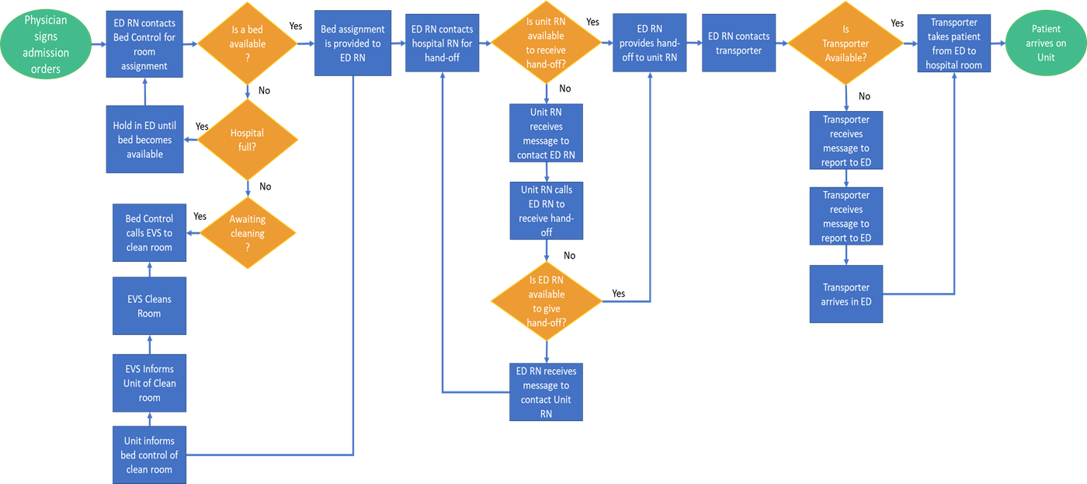
Process Flow Map – Detailed ED Admission to Hospital Bed

Slide 26
Think About Your Upcoming Site Visit
What process/systems would you like to observe?
What are you “wondering” about?
What is your “gut” feeling about where the problems in your system lie?
What parts of the process do you “think” can be improved?
Make some predictions about what you think you will see

Slide 27
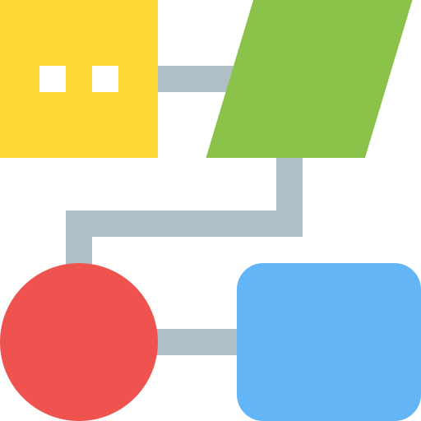
Develop a “Current State” Process Flow Map
Develop a Process Flow Map
Select a process that you would like to observe during your site visit
Identify the high-level steps first
Develop detailed steps/decision points
Use post-its and blank chart pad on the wall
If you don’t REALLY know because experts are not at the table, use your best guess

Slide 28
Next Steps
If possible, gather the experts and repeat this activity
How did the experts’ version of “current state” differ from your own?
Use the “current state” process flow map to identify:
Differences in what you THOUGHT current state was and what REALLY is
Who the system benefits (is the patient at the center of this process?)
Critical steps (what must occur to get the desired outcome)
Differences in sequencing and/or style, e.g., how does the process vary when someone different performs the activity/task (how does it impact the desired outcome?)
Bottlenecks (sometimes found at points of decision), waste, redundancies, and work-arounds

