Slide 1
Exploring models to finance CHC activities related to social determinants of health
Laura Gottlieb, MD, MPH
Social Interventions Research and Evaluation Network
University of California, San Francisco
August 23, 2018
Appreciations to Hugh Alderwick, Blue Shield of CA Foundation, and Center for Care Innovations
SIRENetwork.ucsf.edu
Notes:
I am Laura Gottlieb. I’m the director of the Social Interventions Research and Evaluation Network (SIREN) and in the Dept of Family and Community Medicine at UCSF. SIREN is a research institute focused on research at the intersection of social and medical care delivery. Megan and Veenu asked me to come to today’s final symposium to share with you a little about two projects we’ve been working on, the first directly for CCI and the second more broadly for BSCF, that relate to payment models that support activities around social determinants of health. The projects really focus on bettering understand how safety net health care institutions are paying for the exciting work they are taking on on-the-ground that is focused on supporting patients by both providing and strengthening social resources.
But before I describe those studies, I want to start by saying that I did not initially use this as the title for this talk.

Slide 2
Ways CHCs “scramble and make crazy” to finance upstream work
SIRENetwork.ucsf.edu
Notes:
I started instead with what I think is a really succinct summary of our findings that comes from David Derauf, who has a near 30 year tenure as CEO of Kokua Kalihi Valley Health Center in Hawaii. When I interviewed David about the range of inspiring activities KKV is engaged in, including an extensive community health worker program, he responded with one simple sentence: “Laura” he said, “the answer is that we Scramble and Make Crazy”.
So now that I gave away a small part of my punch line, let me go back to the beginning…..

Slide 3
Background and rationale
siren

Slide 4
Notes:
It will come as no surprise that there is an extraordinary amount of excitement about the intersection of health and social care delivery.. We’ve seen social care funding demonstrations, conferences, reports, webinars, and research studies, and new tools emerging from large and small health care organizations, professional medical groups, policy-makers, payers, researchers, and health IT companies. The list on this slide is in no way exhaustive of the many organizations not only starting to use the language of integrated social and medical care but to experiment around better integration.

Slide 5
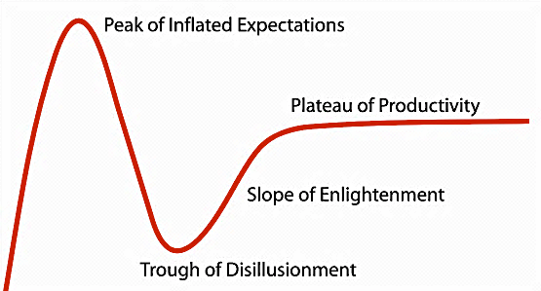
SDH on the health care innovation curve
★
Time
Notes:
Though innovation in this field abounds—that we might even think that social risk interventions are going to improve everything that ails the US health care system.
But the truth is that we’re really just at the beginning of what is likely to be a long social determinants innovation cycle in health care. [CLICK] For those of you already familiar with the Gartner Hype Cycle, which was developed to represent the maturity of emerging technology innovations not specific to health care, you may recognize this feeling of excitement. We’re in the first phase of innovation: the peak of inflated expectations [CLICK] where early publicity produces stories of success. But that peak is often followed by a trough of disillusionment, where early innovations don’t consistently deliver. I suspect the intention of everyone in this room is to use research to shape what Gartner then called the slope of enlightenment and reach the plateau of productivity. [CLICK]
But as we move toward the plateau of productivity, we’re going to need to know not only what interventions works, but also how we’re going to pay for them!

Slide 6
Various policy initiatives are creating new opportunities to fund social interventions
Payment reforms—Accountable Care Organizations (ACOs) and other value-based payment models
National initiatives—e.g. Accountable Health Communities
State-level reforms—e.g. Medicaid 1115 waivers, State Innovation Models (SIMs), etc.
siren
Notes:
So the good news is that there a string of policy initiatives that theoretically are creating new opportunities to fund these kinds of programs.
But we don’t know if this funding is actually reaching CHCs.
And we have no idea what other sources of funding CHCs are using to supplement those Medicaid programs.

Slide 7
Tale of two studies
siren

Slide 8
First study: Medicaid
Objective: To understand how Medicaid funding is being used to identify and help address patients’ social needs under state-level reforms in OR and CA—not specific to CHCs.
Oregon
Coordinated care organizations (CCOs) established in 2012 with responsibility for improving care and reducing costs for patients in geographically-defined areas
Alternative payment models being used for providers—including capitation for Federally Qualified Health Centers (FQHCs)
California
Whole Person Care (WPC) pilots launched in 2016 to coordinate health care, behavioral health and social services for CA’s most vulnerable Medicaid beneficiaries
County partnerships of health departments, managed care plans, providers and community based organizations (CBOs)
Notes:
One study focused on Medicaid payment and delivery system reforms in OR and CA
Sites: purposive sample of geographically-based communities involved in each state’s reforms—3x coordinated care organization (COO) areas in Oregon and 3x whole person care counties in California. Sites selected to ensure diversity of geographical region, rural/urban areas, Medicaid population size and county-level political affiliation
Data: in-depth interviews (n=55), typically in person, and visits with:
Medicaid payers (e.g. Medicaid Care plans and CCOs) (n=13)
Medicaid providers (e.g. health centers and hospitals) (n=19)
Government agencies (e.g. county health departments) (n=14)
CBOs (e.g. housing agencies, food banks, relief nurseries) (n=9)

Slide 9
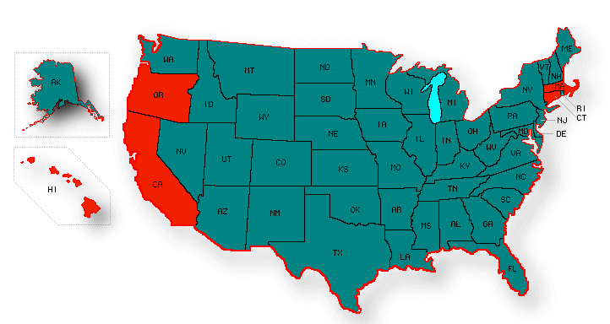
Second study: Community Health Centers
Objective: Describe range of financing strategies exemplar CHCs (not exclusive to FQs) employ to support their upstream work.
Notes:
The second study was more specific to community health centers. Were they able to access those Medicaid dollars? If so, how? And if they didn’t support all their costs, what other funding sources are they leveraging to support these programs?
Interviews with about 25 leading experts around CHCs, philanthropy, Medicaid funding and 5 CHCs that have done innovative work around social needs to get their view from on the ground about how they find finding to support this work.
CHC sites: Roots CHC in Oakland, Kokua Kahili Valley in HI, Fairhaven CHC in CT, Benton CHC in OR, and Dimock CHC in Boston

Slide 10
Preliminary Findings
siren

Slide 11
Study 1: Medicaid dollars are being used to support….
Service-level interventions
Housing/housing supports
Food insecurity
Income and benefits
Transportation
Legal needs
Criminal justice and re-entry
Education and employment
IPV
Capacity-building interventions
Data sharing and analysis
Building CBO capacity
Staff training New roles (e.g. CHWs)
Community engagement
New facilities and capital costs (e.g. medical respite)
Notes:
Counties in both CA and OR that were interviewed for study 1—the Medicaid study--were actually using Medicaid $s to implement a wide range of interventions related to patients’ social needs. This included service level interventions and capacity-building interventions.
And interventions were being undertaken in CHCs, but also across Medicaid managed care and other county-level programs—including jails, schools, dental offices. So these activities were not exclusive to CHCs, but sometimes touching them because not surprisingly, that’s often where the most vulnerable patients were physically located.

Slide 12
Different types of Medicaid $s are used in different ways
Traditional Medicaid
Provider rates
Medicaid Administrative Activities (MAA)
Targeted Case Management (TCM)
And many more…
Alternative Medicaid
FQHC APM (OR)
Whole Person Care $s (CA)
Flex $s (OR)
Incentive $s (OR)
Medicaid savings
Coordinated Care Organization (CCO) or managed care contracts (OR and CA)
From WPC $s/contracts (CA)
Less flexibility
More flexibility
Notes:
Medicaid $s are often braided with state and local $s
E.g. Local match dollars, state and county taxes, foundation funding, etc.
Interventions vary in scope depending on local context and available funding
Just because a program is listed here, though, doesn’t mean it was a great way to get dollars to support these programs. A lot of people in OR, for instance, mentioned the Flexible Spending program in their CCOs that could be used to pay for specific social needs. For instance, you could get a patient an air conditioner or a taxi voucher or shoes.
But it turns out that Flexible Spending in OR totaled less than .07% of their combined budgets in the state over the last few years. So that’s not a whole lot of money going into a direct service program under that Alternative Medicaid spending program.

Slide 13
Example: WPC county in CA
Activity | Funding
Care coordination for high risk patients | MCO benefit
Housing navigator outreach with homeless clients and landlords | 1115 $s (PPM)
Permanent supportive housing, including onsite support and rental costs(!) | 1115 $s (PPM)
Additional units purchased to boost community housing supply (for supportive housing) | County funds—savings from 1115
siren
Notes:
Boundaries between health care and social services were increasingly blurred
Health care organizations in all sites were building internal resources to address patients’ social needs. Eg:
hiring CHWs, care navigators, peer support workers
implementing social needs screening and referral systems
They were contracting with CBOs to provide social supports. Eg:
with housing organizations to work with homeless patients
with attorneys to help patients access benefits
Most sites were also investing in community capacity. Eg:
working with landlords to improve accommodation standards
using savings to invest in CBO projects and infrastructure
[Note: unintended consequences and costs for CBOs—e.g. salary implications, contract management, insurance requirements]

Slide 14
But all faced major barriers to addressing patients’ social needs, too
Social needs continue to outstrip resources—lack of social supports/access
”We’re doing our best to piece together interventions that are just scratching the surface.”
Funding boundaries—complexity, ambiguity, lines in the sand
”it’s just like, none of this would be necessary if CMS would get over itself and allow us to spend Medicaid dollars to buy housing.”
Sustainability—limitations of using savings, waiver timelines, rates
“I don’t think we have a specific plan on how these services will continue after 2020.”

Slide 15
Findings: Study 2 (CHCs)
We heard CHC leaders describe those same funding sources being used to support their upstream work:
Traditional federal sources (e.g. FQ RAP rates and HRSA enabling services grants, MAA/TCM)
Alternative Medicaid sources (waivers)
Medicaid Shared Savings programs (PCMH+)
siren
Notes:
Remember, we essentially set out to develop a typology of financing strategies that CHCs use to support upstream interventions. So we talked with clinics doing a lot of this work in order to understand the range of funding sources that they use.
Some of the strategies they mentioned included the three Medicaid sources that we had identified in the first study. So some Medicaid expansion dollars have enabled clinics to hire more social support staff or staff at all, who then are charged with activities like social screening.
Traditional federal sources (for FQs, includes FQ rate and enabling services grants from HRSA)—e.g. Fairview supports CHWs through operations dollars
Alternative Medicaid sources—e.g. paying for CHWs in Oregon through APMs, paying for air conditioners through flexible funds, supporting housing navigators through MA
CT: paying for CHWs using Medicaid shared savings—right now only upside risk, but likely to change
That was complex enough! But then we asked folks about dollars they are finding outside of Medicaid. And what I learned was that the ways that CHCs find to support upstream interventions look an awful lot like the way that people launder money and finance terrorism….

Slide 16
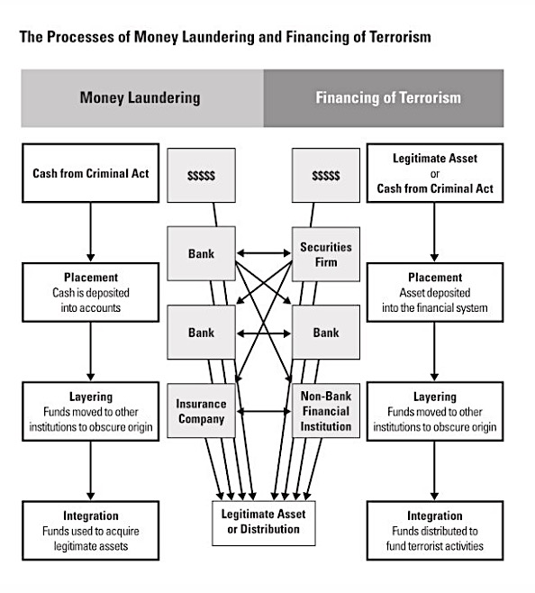
Notes:
I’m only sort of kidding.

Slide 17
Range of mechanisms used to support CHWs
Medicaid Administrative Activities/TCM
FQHC rates and HRSA grants
Whole Person Care waiver
Medicaid Shared Savings (PCMH+)
Notes:
In all seriousness, what we found was really that in any one health center—and sometimes for any one program--there were typically a large number of different funding sources being engaged—some that were Medicaid-related and others that were not.
Examples:
CT, MA, OR just leveraging their existing staff to do more around SDH. CT: Funding from Medicaid and HRSA is most stable source so they haven’t ventured too far from that.
CA (Roots), with Medicaid expansion, they were enrolling many more people in Medicaid, which gave them a surge in MAA funding opportunities, which matches local funding spent on Medicaid enrollment. But that isn’t available to FQHCs because their administrative activities/enrollment are rolled up in their HRSA GRANTS.
Benton county used APM dollars to support more staff to do social screening
SNAP Education and Training Grants support workforce training program at Roots
Probation Department supported additional workforce training
Roots: Selling soap through a creative Social Enterprise
City and county bond measures in Alameda supported social interventions
Private philanthropy supports REACH platform installation at Dimock FQHC in MA
ACO Program infrastructure supported REACH subsequently
County social service Agency grants supported Roots
Some are 1 year programs (PSI in CT, grants) but others are multi-year. None is forever....

Slide 18
Range of mechanisms used to support CHWs
Medicaid Administrative Activities/TCM | Department of Probation | County Social Service Agency grants
FQHC rates and HRSA grants | Department of Agriculture (SNAP E&T) | ACO Program Infrastructure Investment
Whole Person Care waiver | City and county bond measures | Social enterprise
Medicaid Shared Savings (PCMH+) | Accountable Health Communities | State Preventive Service Initiative for partnerships w/ CBOs
Plus volunteers and philanthropy….
Notes:
In all seriousness, what we found was really that in any one health center—and sometimes for any one program--there were typically a large number of different funding sources being engaged—some that were Medicaid-related and others that were not.
Examples:
CT, MA, OR just leveraging their existing staff to do more around SDH. CT: Funding from Medicaid and HRSA is most stable source so they haven’t ventured too far from that.
CA (Roots), with Medicaid expansion, they were enrolling many more people in Medicaid, which gave them a surge in MAA funding opportunities, which matches local funding spent on Medicaid enrollment. But that isn’t available to FQHCs because their administrative activities/enrollment are rolled up in their HRSA GRANTS.
Benton county used APM dollars to support more staff to do social screening
SNAP Education and Training Grants support workforce training program at Roots
Probation Department supported additional workforce training
Roots: Selling soap through a creative Social Enterprise
City and county bond measures in Alameda supported social interventions
Private philanthropy supports REACH platform installation at Dimock FQHC in MA
ACO Program infrastructure supported REACH subsequently
County social service Agency grants supported Roots
Some are 1 year programs (PSI in CT, grants) but others are multi-year. None is forever....

Slide 19
Study 2
“We submit 120 grants per year and get about 80 of them.”
Well, the funding has been different every year. Well…the funding has been stable, but the source has changed....
“We've clearly grown in the last eight years from 0 to 9, but…(because they’re funded through many different programs) the 9 CHWs are doing 9 different things.”
“Without reliable yearly funding, one cannot guarantee that there isn't a six-month gap in between where it's hard to sustain a position..”

Slide 20
Study 2
“[How do we fund the positions?] With paper clips, baling wire, and gray hair. So I have a board in my office and it’s covered with orange sticky notes that are the funding streams.”
It's a hodgepodge…but it's a hodgepodge that we've been able to historically pull together, featuring volunteers and different grants…and then increasingly we're hopefully going to be having it funded through these value-based payment models.
Notes:
And in case you weren’t getting the gist of those, I just threw in another couple of qutes that I think also capture the challenges CHCs encounter when funding this work.

Slide 21
Discussion questions
Do you know your SDH program costs?
What Medicaid and more non-traditional sources are you currently using to support your program?
How are you planning to support your program in months/years to come?
Who needs to be engaged in your organization to take advantage of different funding opportunities?
What do you think the policy solutions should be to enable CHCs to do upstream work?
siren
Notes:
Are there ways to move from
“scramble and make crazy” to more sustainably support these programs?

