Slide 1
LAI Buprenorphine (Sublocade)
Steven Hochman, MD, MPH, MAT Lead Provider at JWCH Institute/Wesley Health Centers
Ginny Eck, MAT Project Director at JWCH Institute/Wesley Health Centers

Slide 2
Disclosures
I have no financial disclosures to report
I will not be discussing the off-label use of medications
There will one picture of my children in this presentation

Slide 3
My Story: Imposter Syndrome

Slide 4
Another tool in the toolbox
Don’t have to remember/be burdened by daily med
Don’t have to worry about meds being lost, stolen, or confiscated
Good for travel (and incarceration)
No risk for diversion
Reduces possibility for accidental exposures, especially a home with children
Long term overdose protection

Slide 5
How it works

Slide 6
I’m not trying to talk you out of it, but…
You have to get to clinic
The injection is not pleasant
Getting poked with a needle is no fun
15-20 seconds of burning (exothermic chemical reaction)
Topical anesthetic (lidocaine or cold spray)
Ice packs
Perpendicular vs oblique angle of injection
Pre-injection subdermal lidocaine injection
Local reactions and “the bump”
Breakthrough cravings are not uncommon in the first few months
Loss of acute pain control from transmucosal products

Slide 7
Initiating therapy
Prior to first injection, patient must be on a stable dose of transmucosal buprenorphine
Package labeling: 7 days
Sublocade Rapid Initiation Study (unpublished): 26 patients given Sublocade 300mg after tolerating a single 4mg dose of transmucosal buprenorphine
Start from abstinence – no data, but maybe ok
I always provide supplemental Suboxone from breakthrough cravings
Suboxone 8/2mg SL films #30, take 1 film SL daily for breakthrough cravings

Slide 8
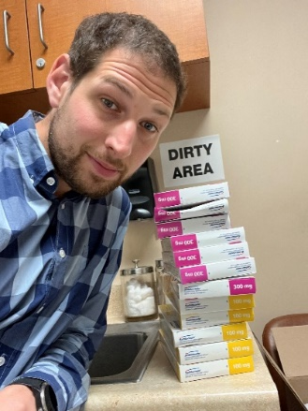
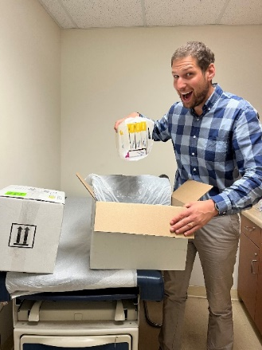
Ordering
Specialty pharmacy
Buy and bill
No prep work
Order medication on a patient-by-patient basis
Medication is overnight shipped to your DEA address
Medication cannot be given to anyone other than who it was ordered for
Lots of administrative prep work and time
Bulk buy medication from specialty distributor (up front cost to clinic)
Distribute to patients as needed and then bill insurance

Slide 9
Storage and Administration
Store in the refrigerator
Warm at least 15 minutes before use
Discard if left out more than 7 days
DEA storage requirements
“Securely locked, substantially constructed cabinet”
Rotate subcutaneous injection sites
Abdominal quadrants (product recommended)
Flanks
Back of the upper arms
Avoid pressure points
Don’t rub it (and there’s no crying in baseball)

Slide 10
Dosing
300mg subQ monthly x2 then 100mg subQ thereafter
Achieves buprenorphine concentration >2ng/mL on day 1
Steady state buprenorphine concentration 2-3 ng/mL
300mg monthly maintenance dosing achieves steady state buprenorphine concentration 5-6 ng/mL
Choosing the right dose is a clinic decision
Administration window 26-45 days
From 100mg maintenance, can administer single 300mg dose to cover two months
Buprenorphine Concentration (ng/mL)
Weeks

Slide 11
Discontinuing therapy
There’s nothin’ to it but to do it...
Following 6 maintenance doses of 300mg, serum buprenorphine concentrations remain >2 ng/mL for at least 6 months
Following 6 maintenance doses of 100mg, serum buprenorphine concentrations remain >2 ng/mL for at least 2 months
Patients may test positive for buprenorphine for more than 1 year following last injection
Sublocade as a tool for weaning from transmucosal buprenorphine
No data or recommendations, but people are doing it
Single dose (300mg or 100mg) and let the medication wean itself

Slide 12
Case 1
Kevin is a 32-year-old man. He uses crystal meth for energy to get more deliveries done during the day, and fentanyl in the evening so his girlfriend doesn’t catch him high on crystal. He reports fentanyl overdoses 2-3 times per month for the last year or so. He has been prescribed bup/nal for the last several months, but he never seems to have it with him.
Has now been on LAI buprenorphine for 13 consecutive months. Continues to use crystal meth most days, but now uses fentanyl only about every other day. ZERO overdoses in the last year+.
TAKEAWAY: LAI buprenorphine provides great overdose protection.

Slide 13
Case 2
Vano is a 52-year-old man with a 40-year history of IV heroin use. Has been doing well on bup/nal for 6 months but requires TID dosing which is inconvenient and he is interested in trying LAI buprenorphine.
He had some breakthrough cravings during the first two months of LAI buprenorphine 300mg and used most of his supplemental strips. He was transitioned to 100mg monthly at month 3 and started using supplemental strips daily. At month 5 his dose was increased to 300mg and he has been stable, extremely satisfied, and rarely requires supplemental strips for the last 6 months.
TAKEAWAY: Patients using high doses of opiates and/or mainly IV route of administration often require the 300mg maintenance dose of LAI buprenorphine, and I no longer make them prove that with cravings before doing it.

Slide 14
Case 3
Charles is a 57-year-old man with chronic pain. He has a 40+ year history of opiate use disorder; prescription oxycodone at first, but now mostly heroin. He has been generally stable on bup/nal SL QID for the last 3 years, but requests to try LAI buprenorphine.
He was my first patient and did not get the “not trying to talk you out of it speech” or supplemental strips. He had a terrible first month with uncontrolled pain and breakthrough cravings and refused to ever try LAI buprenorphine again.
TAKEAWAY 1: Patients using transmucosal buprenorphine for pain control often lose a safe and effective tool for acute pain management with LAI buprenorphine.
TAKEAWAY 2: Preparing patients for what to expect and having a plan in place is key (for everything we do).

Slide 15
Case 4
John is a 39-year-old man with heavy use of IV heroin and fentanyl for the last 5 years. He has been chronically homeless for this period of time. Admitted to the local county hospital with CVA and discharged with follow-up in our MAT program. During first month on transmucosal bup/nal he required 3 early refills for lost or stolen medication and was in the ED twice for overdose. Though he was skeptical, he agreed to try LAI buprenorphine instead and has now been stable for 13 months with almost no illicit opiate use. He enrolled in a temporary housing program and is close to a permanent housing match. Actively rehabbing with PT/OT, treated chronic HCV infection, and considering a job as a SAC.
7 patients started on LAI buprenorphine living in either shelters or on the street. 4 discontinued (2 after first dose). 3 remain enrolled, all have been stable 11+ months
TAKEAWAY: LAI buprenorphine is very hit-or-miss among unstable/unhoused patients.

Slide 16
Thank you and questions
Please feel free to reach out with more questions or concerns stevendhochman@gmail.com

Slide 17
References
Clinicaltrials.gov (internet). Bethesda (MD). National Library of Medicine (US). 2000- . Identifyer NCT03993392, Sublocade Rapid Initiation Study. 2019 June 19. Available from: https://clinicaltrials.gov/ct2/show/study/NCT03993392?cond=buprenorphine+rapid&draw=2&rank=2
FDA Presentation on Sublocade: https://www.fda.gov/media/109777/download
Sublocade [package insert]. North Chesterfield, VA: Indivior Inc.; 2021.

