Slide 1

Resiliency and ACE’s at the Dutton Campus
12/13/2019

Slide 2
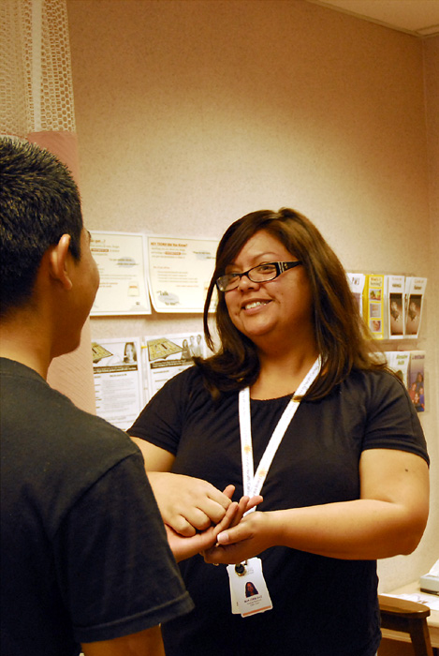
The Dutton Campus
Opened March 5th, 2017
Designed for team based care
Imbedded Behavioral health, Wellness services, Groups and Substance use treatment, Dental
Specialty services include care for the intellectually, developmentally disabled, podiatry, surgery, Podiatry, Epilepsy Clinic

Slide 3
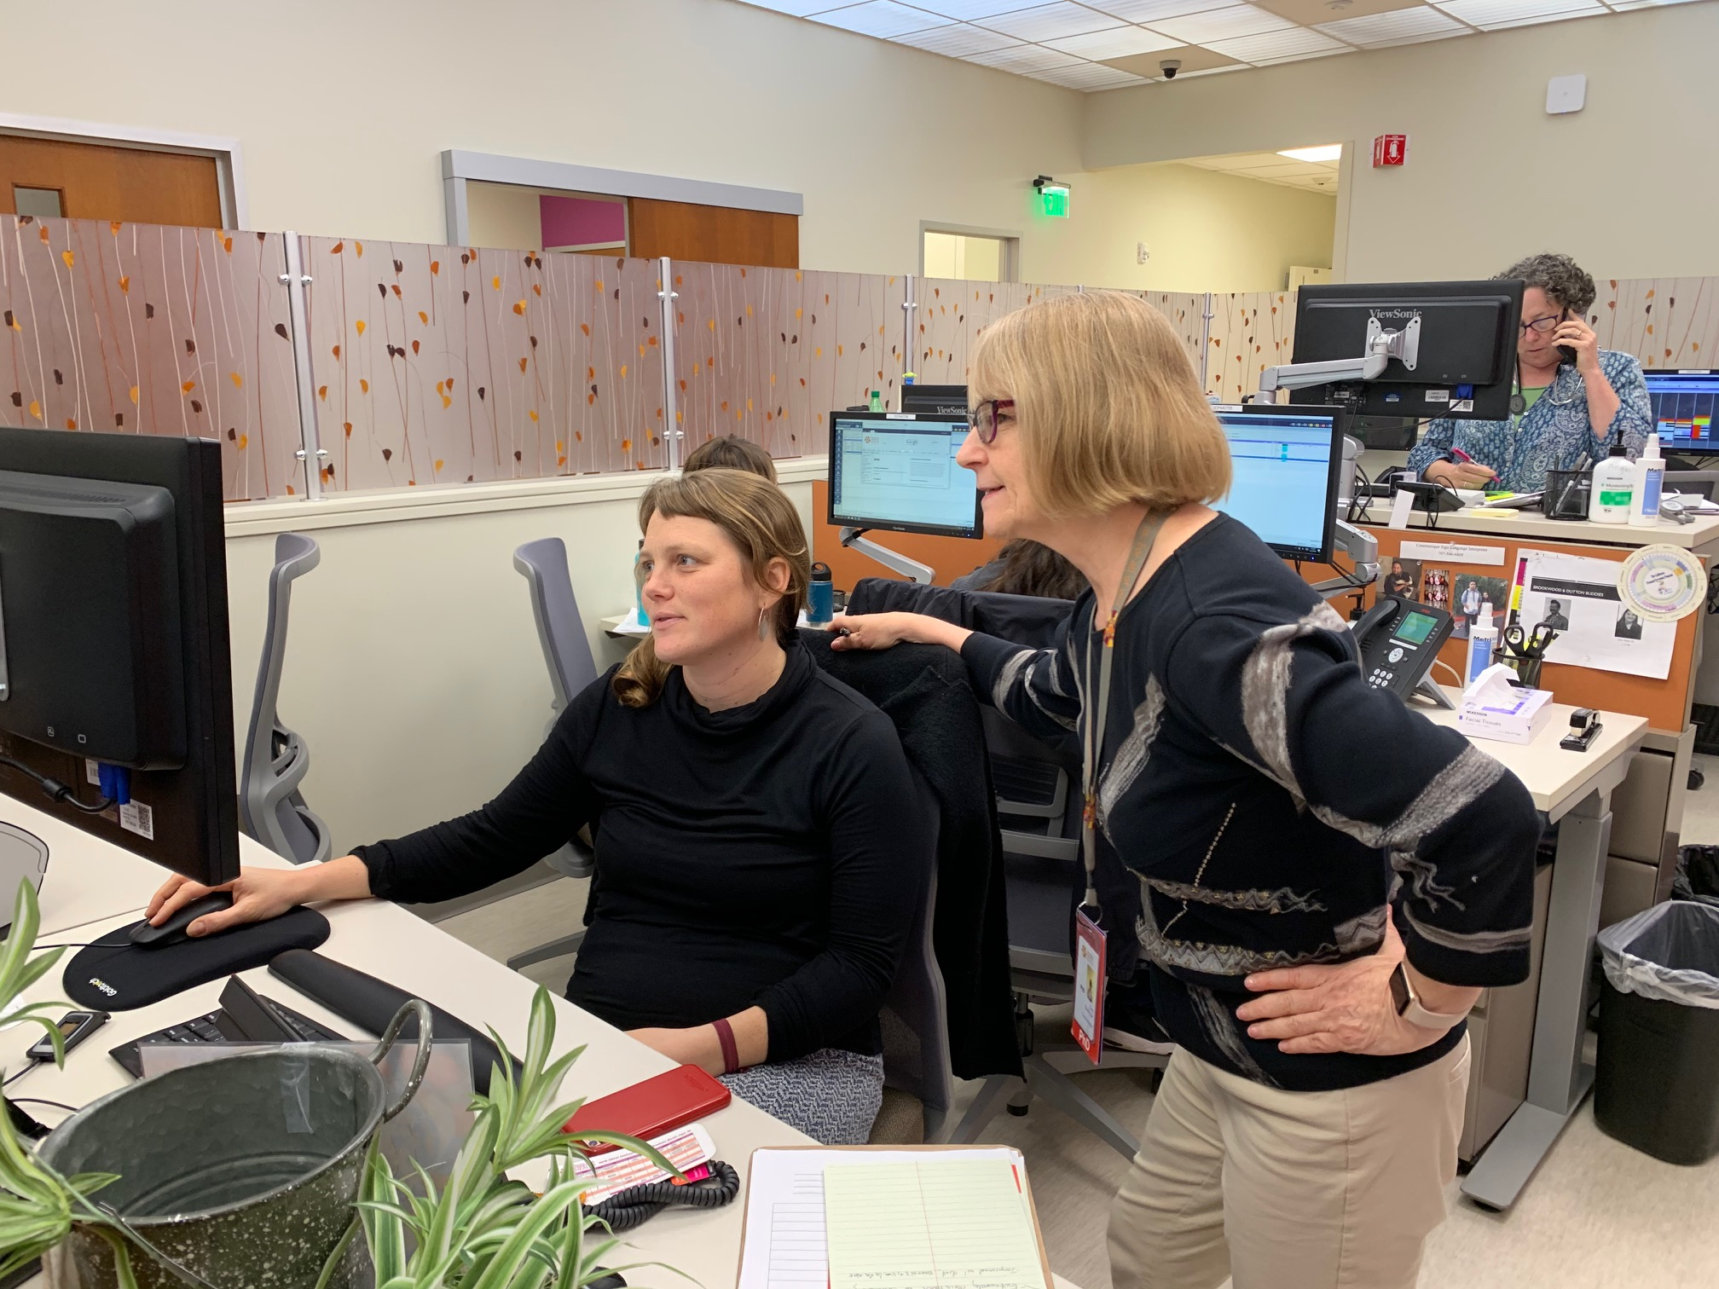
Population:
Care for 18,000 unique patients
19,000 visits per year
Emphasis on Whole Person Care delivered as a team

Slide 4
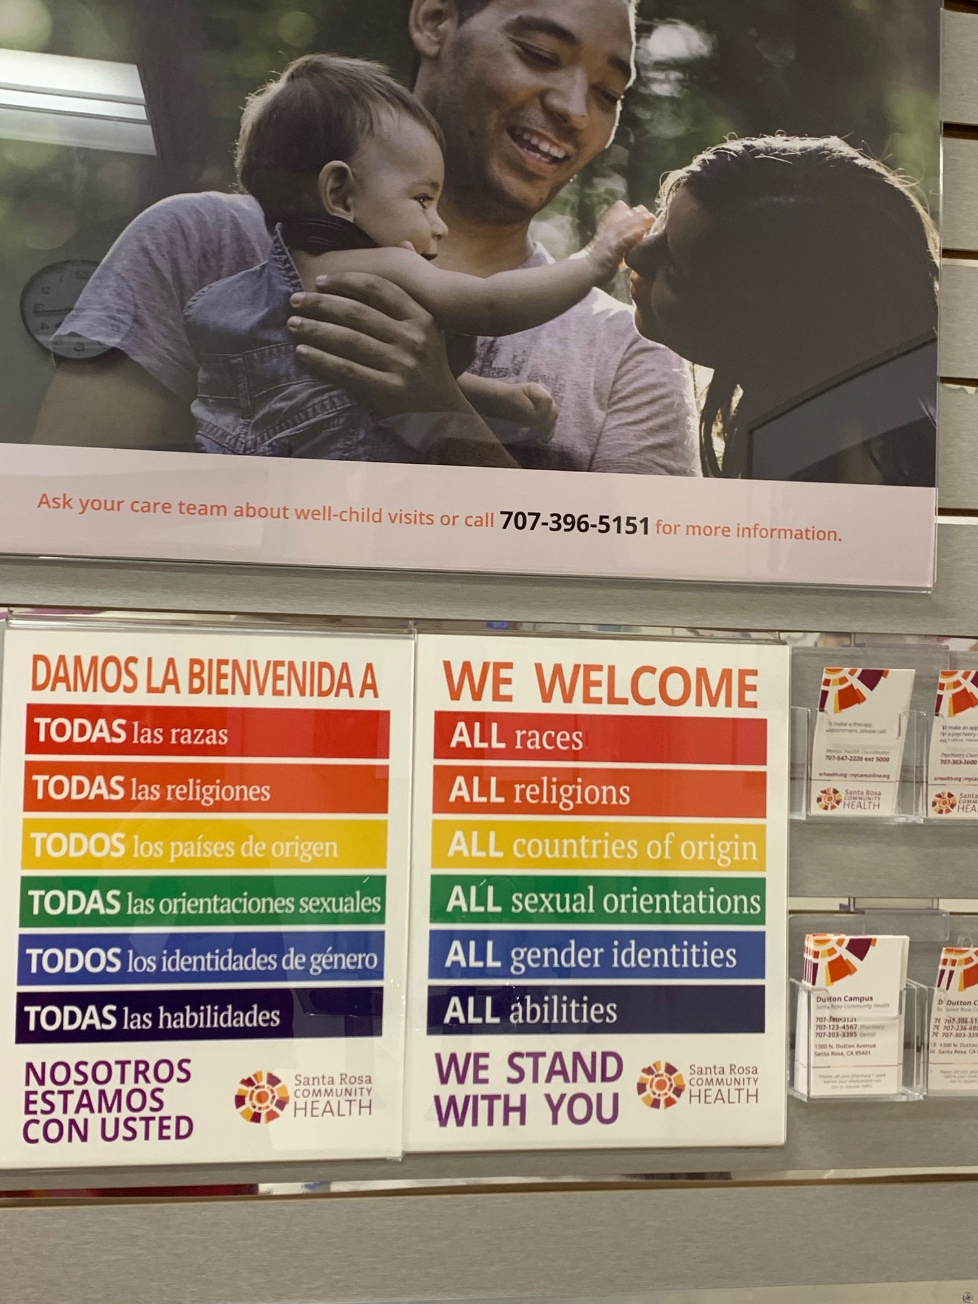
Excellent, culturally responsive care accessible to all
Compassion and respect
Safe and supportive learning environment where employees can do their best work in a way that embraces diversity
Advocate for health care as a human right as it is fundamental to social justice.

Slide 5

Programs:
.
Primary care delivered as a team
Integrated Dental, Behavioral Health
Persons with Intellectual and Developmental Disabilities
Medication Assisted Treatment
Strong care coordination and Population Management
Prompt Access
FNP residency

Slide 6
Groups
Therapeutic Yoga with Osteopathic touch
Irest Yoga
Yoga for Health
Food as Medicine
Ear acupuncture
Seeking safety
QiGong
Diabetes Management
Weight loss Group

Slide 7
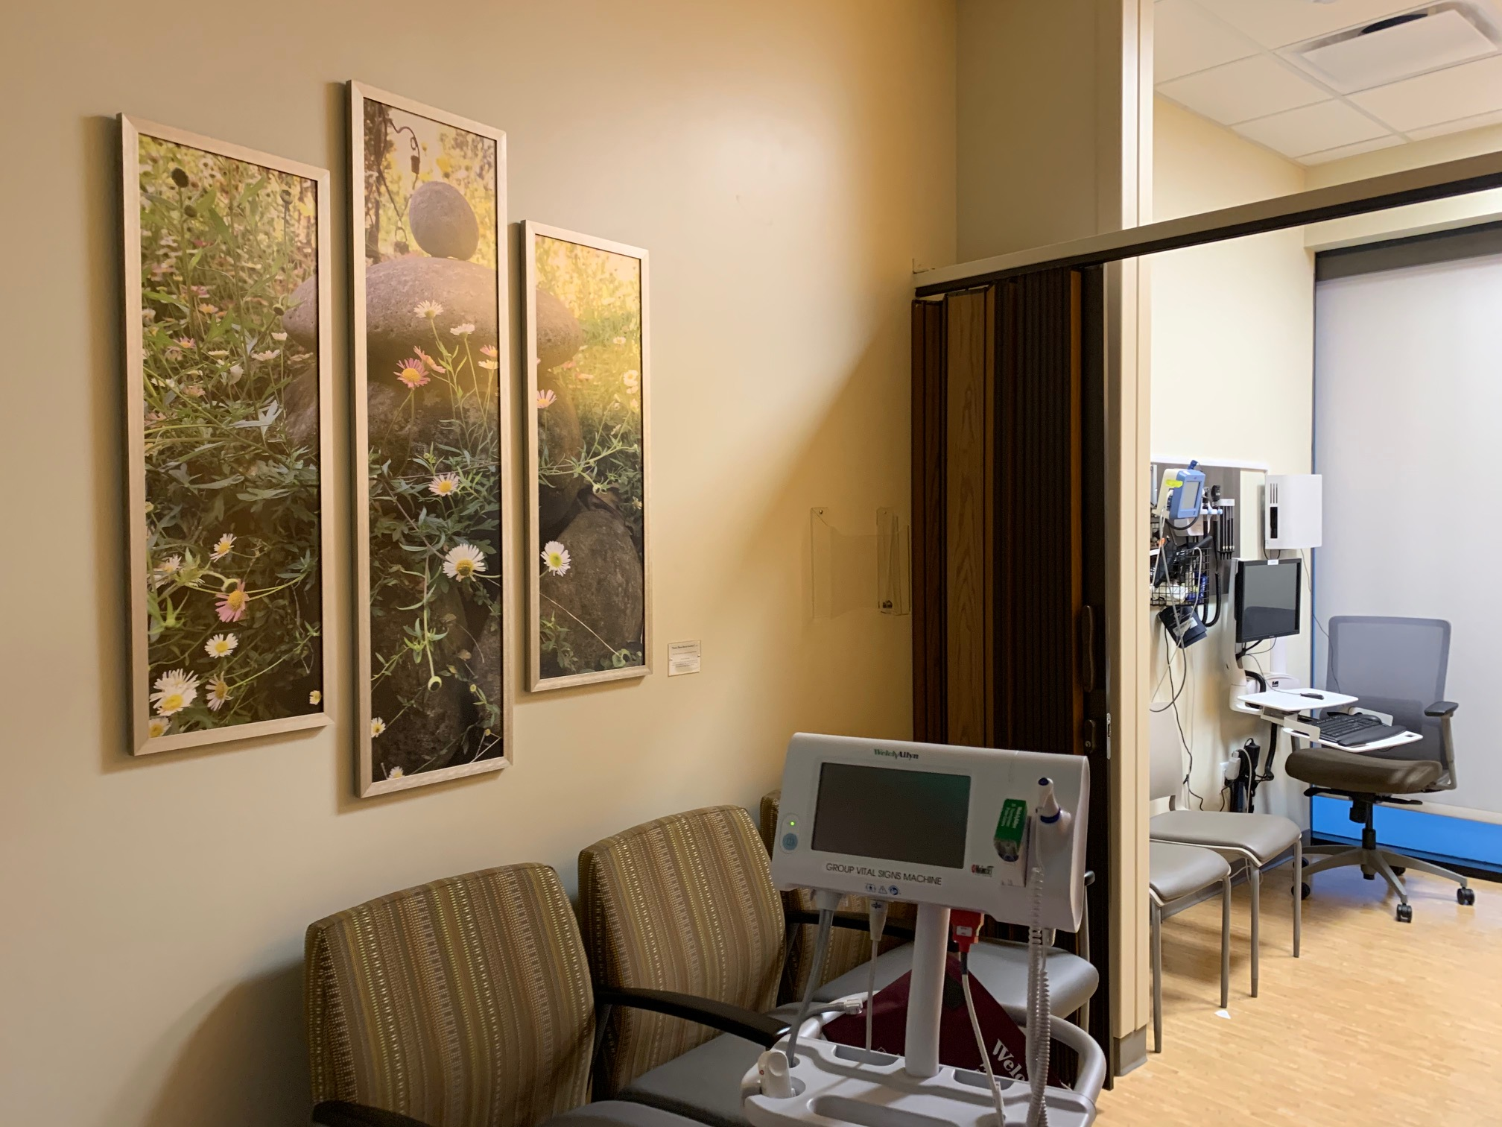
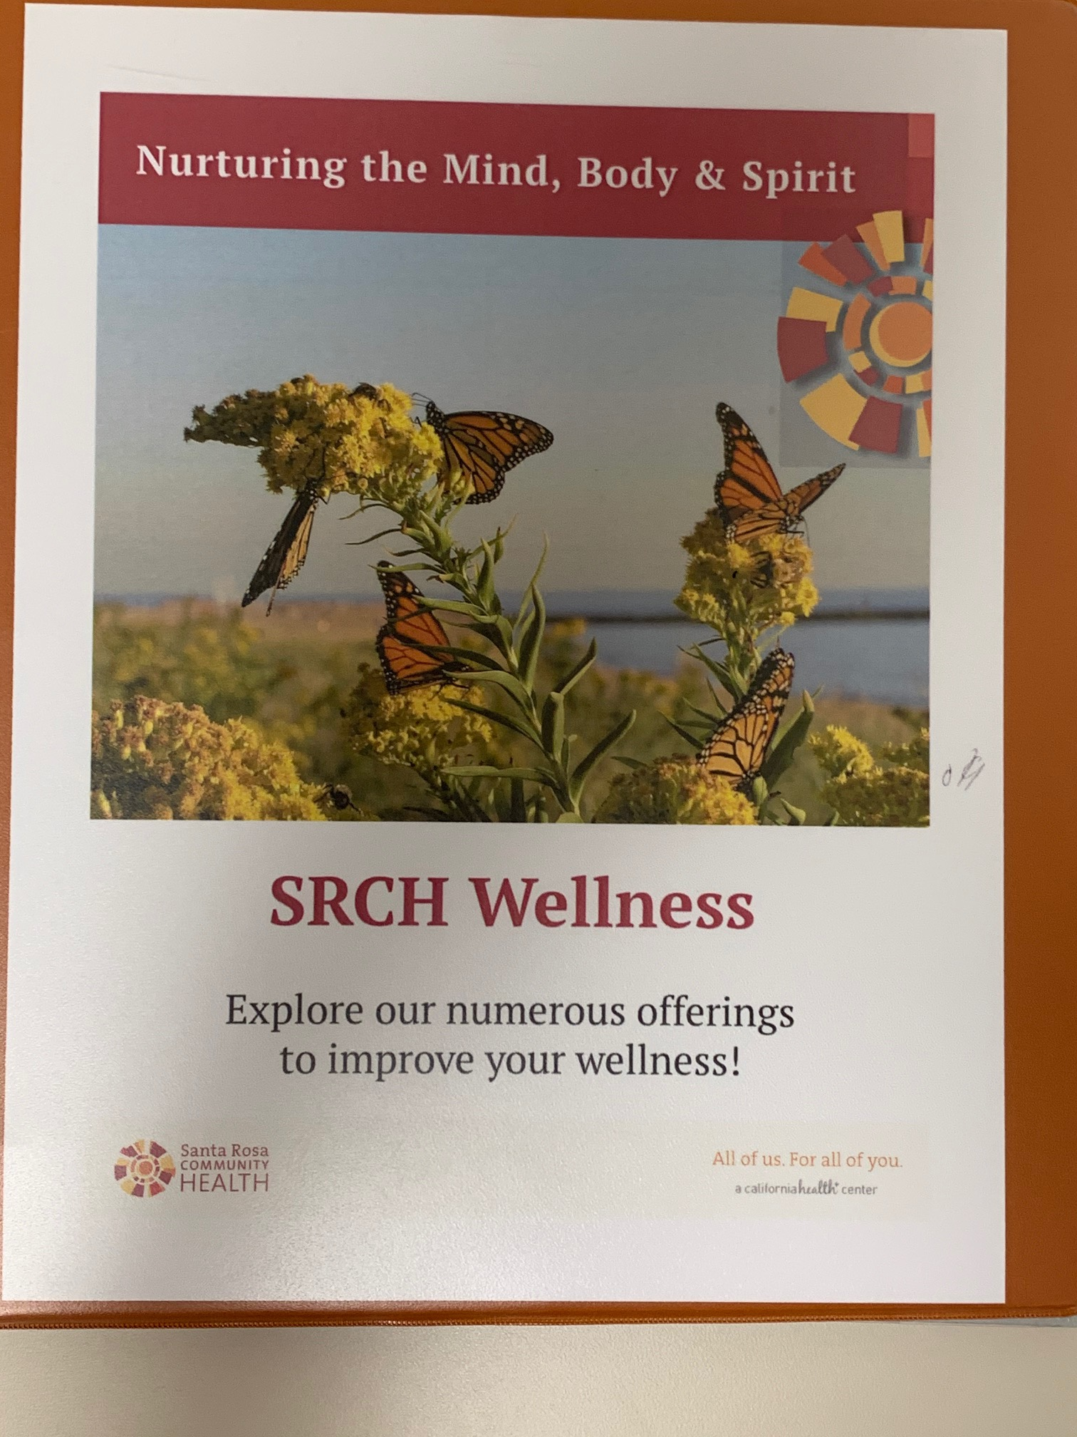
Healing Therapies
Acupunture/ Ear acupuncture
Chiropractic
Osteopathy
Massage
Naturopathy
Integrative Medicine

Slide 8
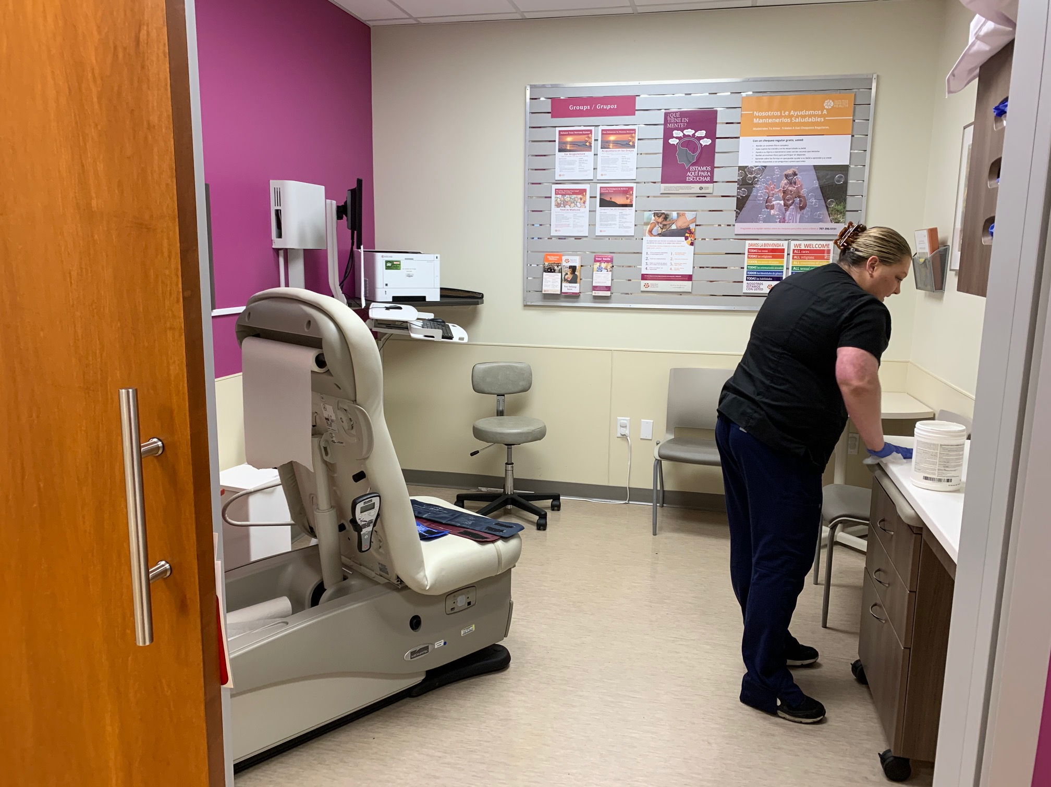
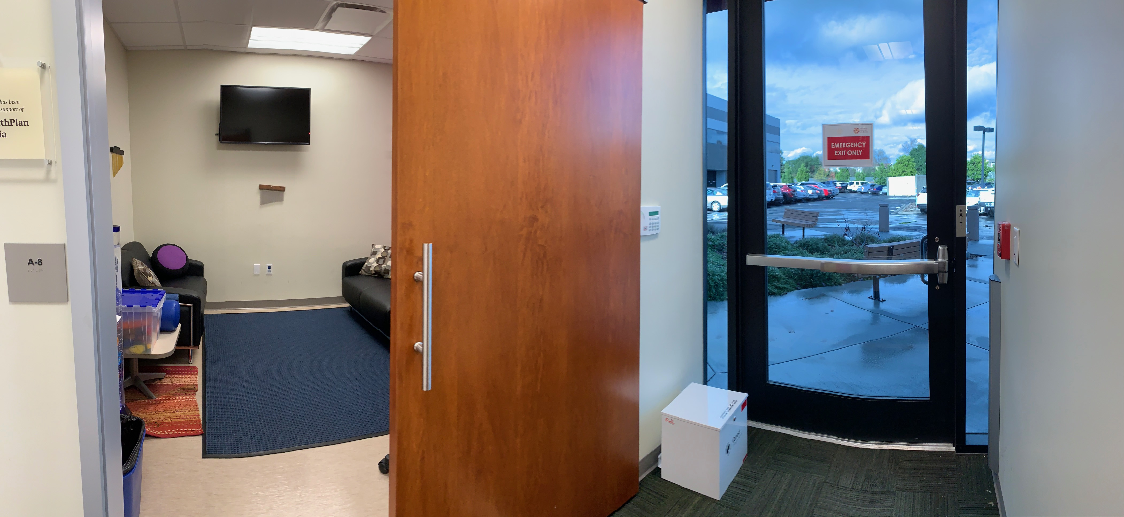
Persons with Intellectual and Developmental Disabilities
.

Slide 9
Dental at Dutton
Open and single operatory rooms
Behavioral Health coverage for bravery coaching
IDD specialty room with wheelchair lift/weighted blankets/video’s for patients
Specialty trained in desensitization and oral sedation
Integrates with primary care for same day well-child and urgent dental visits

Slide 10
Resiliency for Staff
Supporting Dutton Staff
 |  | Mindfulness Behavioral health support with patients Amistad Group

Slide 11
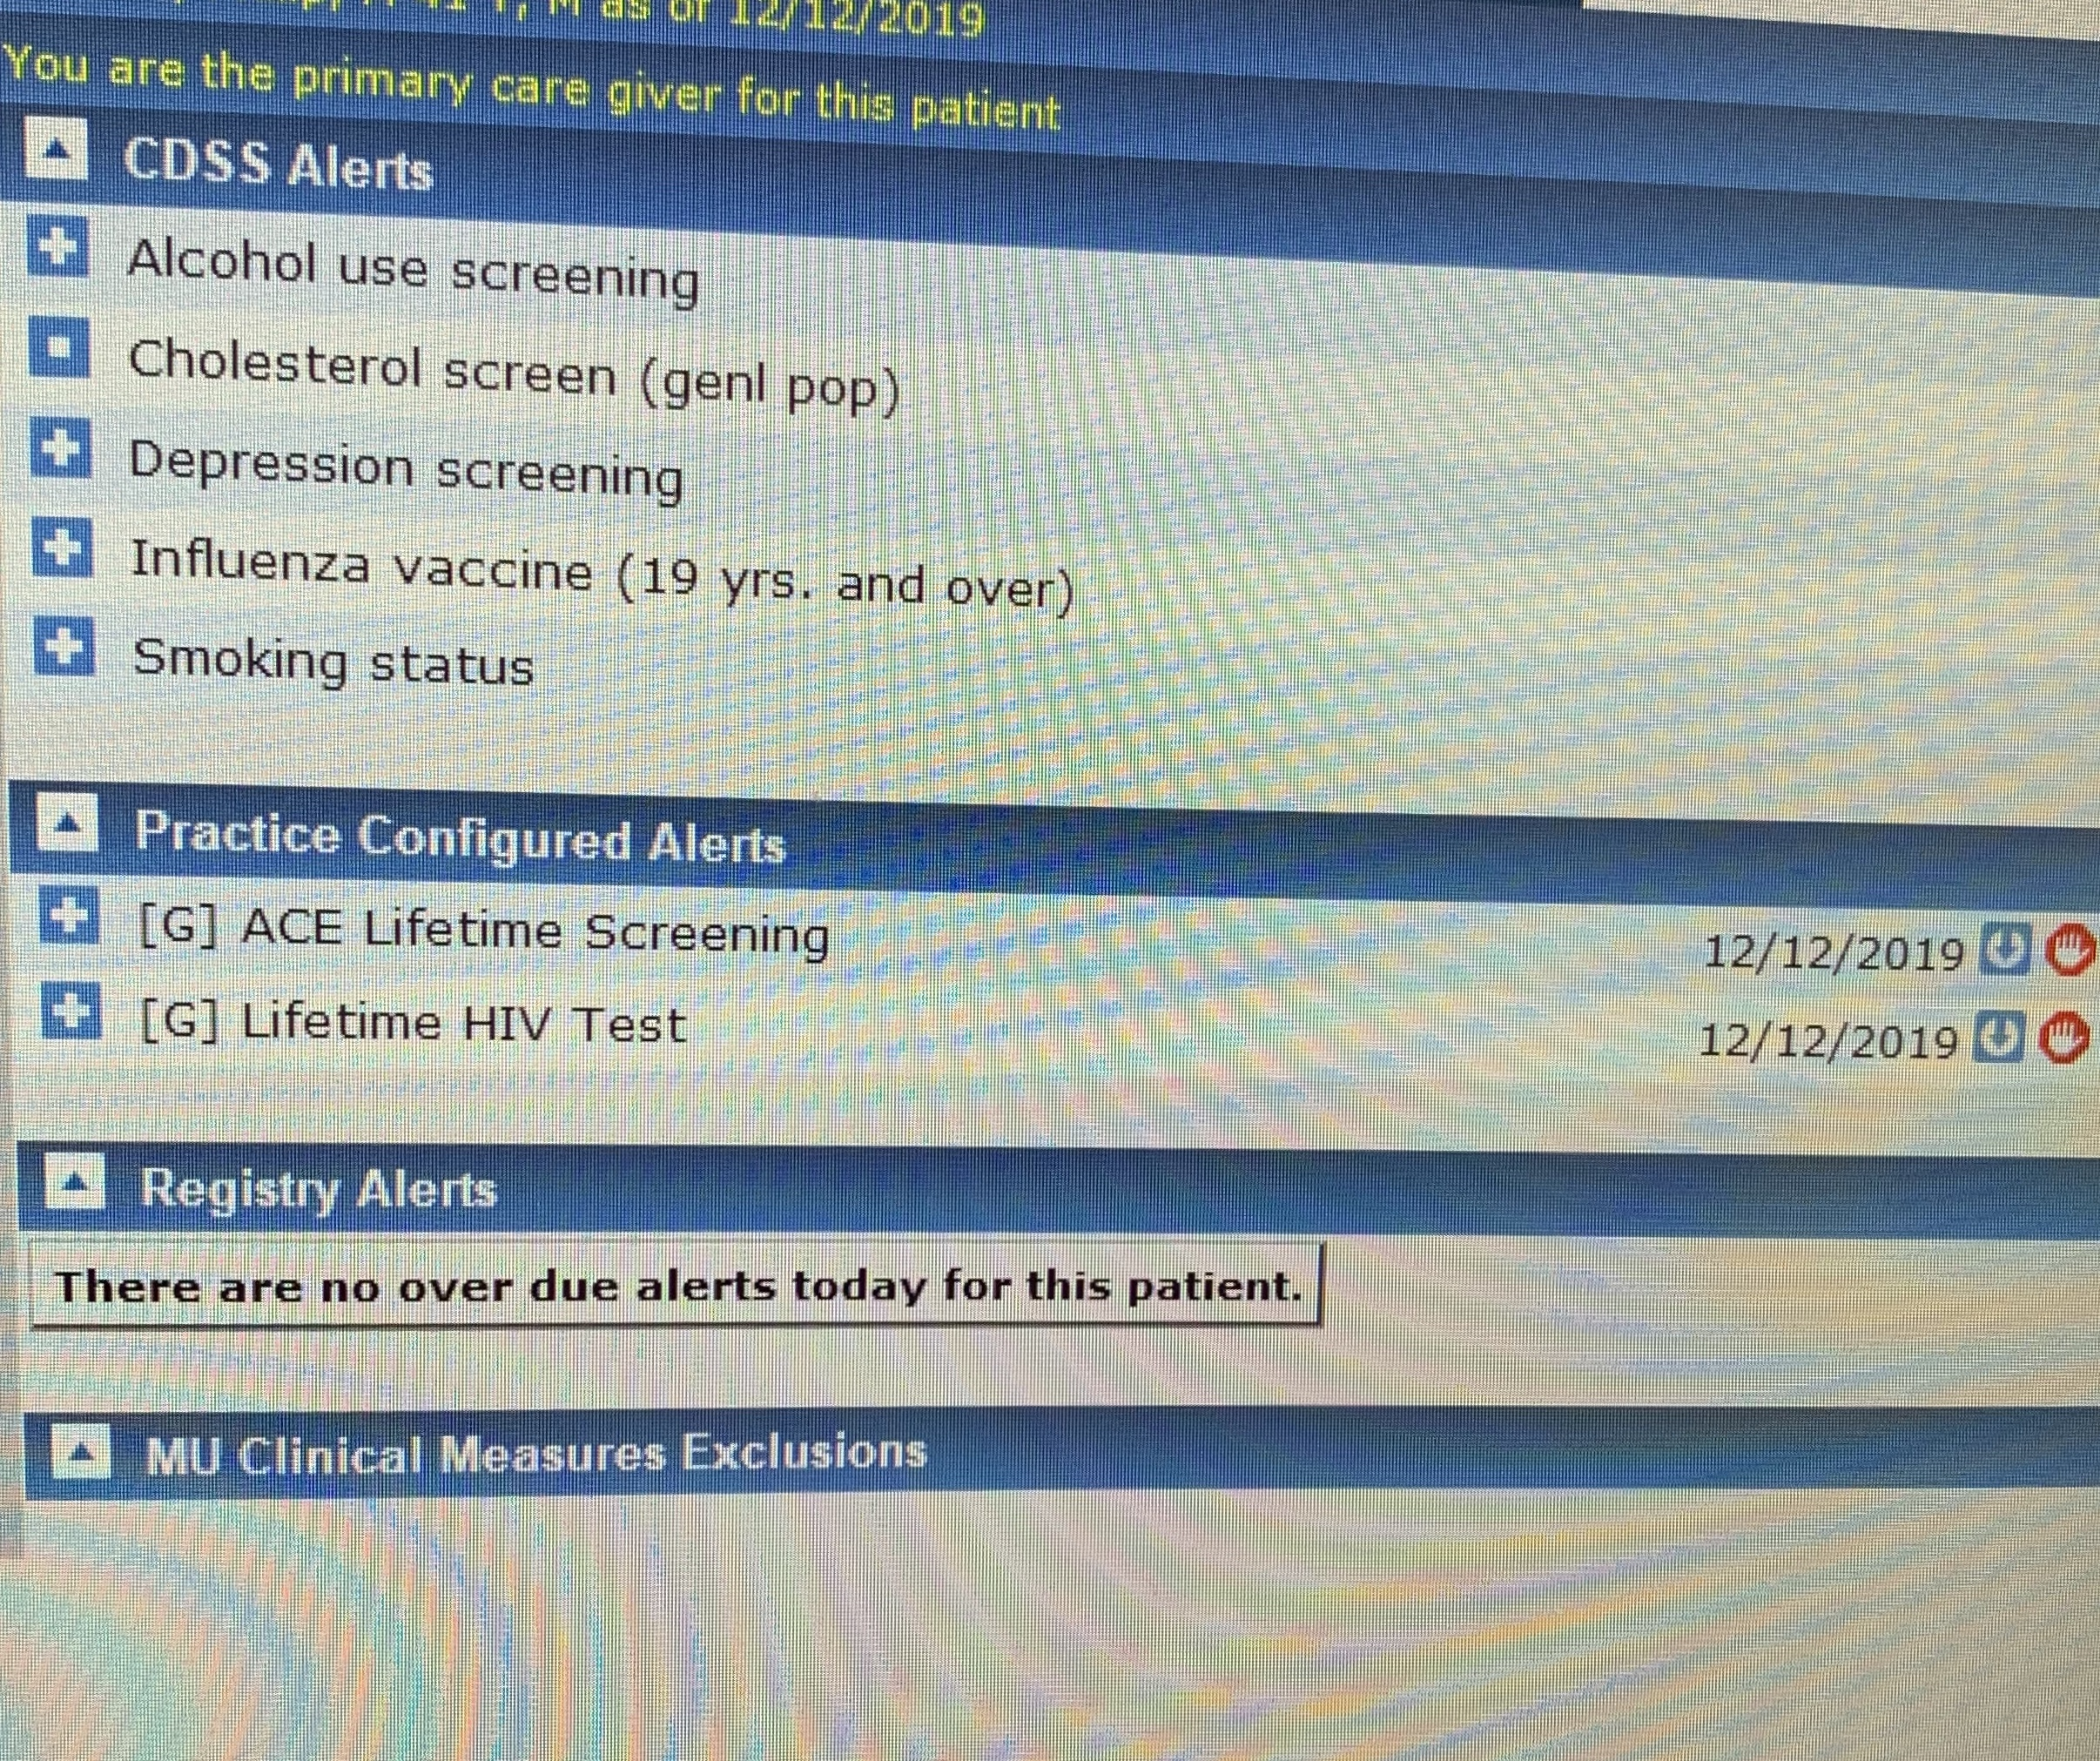
Ace’s
The Challenge

Slide 12
Workflow at Dutton
Training in ACE’s in 2017,2019
Adults only
Second Patient of the shift
MA gives questionnaire in exam room and documents in the chart
Clinician comments and documents in chart, Personal History of Psychological Trauma, V15.41 for Score >4.

Slide 13
Clinician Comments
It really has not been such a big deal and I feel it has brought me closer to my patients
My Patient was surprised and seemed pleased I was asking
One patient with severe BPD was very triggered by the questions and dysregulated
I have had some deep conversations that the questions have stimulated.

Slide 14
2020 Goal
Develop a work flow to give all adults survey over the next year
Expand to pediatrics population at Dutton
Improve education for parents on how to raise resilient children

Slide 15
Questions?

