Slide 1

Registration Manual
DRAFT
DRAFT
Proposal: More required information – i.e., more hard stops…

Slide 2
Staff Equipment & Access Needed
PC & assigned Scanner – full size for Registration HSS; also recommend full size for each Front Desk COA
  Full size works for documents and cards (IDs, photos, insurance cards)
  Card size works only for IDs, photos, insurance cards. Note: if front desk scans documents, will need full size – have to have room at each workstation.
Scanners can be finicky, jam sometimes, must be individually assigned to PCs to work properly.
Copier – need access to a copier (for example, for cards in case scanner jams)
Signature pads – recommending several forms for e-signature
Logon (not shared) for websites: CalWin; One-E-App (CMSP by county); MediCal; CHCN (Community Health Center Network); MediCal managed care plan websites (specific to county)
How much privacy? Group agrees privacy is needed, even for FPACT; no consensus how much is needed.

Slide 3
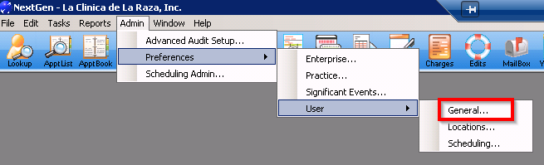
Setting Up User Preferences
Batches, Printers, Locations
Click Admin -> Preferences -> User -> General

Slide 4
Setting Up User Preferences -- Batches
If you will be taking payments, from the General tab:
a. Check-on Prompt for session settings,
b. Check-on Toolbar captions,
c. Check-on Toolbar tooltips,
d. Check-on Only show batches secured to me,
e. Check-on Place the active batch first in the list.

Slide 5
Setting Up User Preferences -- Printers
From the Printing tab:
a. Check-on Print Preview
b. Check-on, Prompt for options dialog
Set Default Printer & Labels:
Right click on Default Printer or Label Templates
Select Open
Select the desired printer.
Note: Printer ending in “ze” are for label printing only. Printer ending in “hp” are for letter size documents.
Set number of copies
Click OK

Slide 6
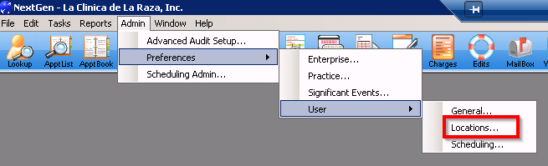
Setting Up User Preferences - Locations
Set your preferred locations:
Click Admin -> Preferences -> User -> Locations
Scroll down until you find your location
Check-on the location(s) you desire
Highlight the location and click on the double blue arrow pointing up so that the location highlighted is at the top of the list
Click OK

Slide 7
Patient Information
Needed to Register as New Patient
Current personal identification (government issued, with photo)
Proof of address (can be driver’s license, vehicle registration, utility bill, etc.)
Birth certificates for minor children – to ensure that kids “belong” to person registering, & to establish family unit if couple is unmarried.
Marriage certificate (helpful if no birth certificates).
Income information – taxes, paystubs, self-attestation
Insurance cards

Slide 8
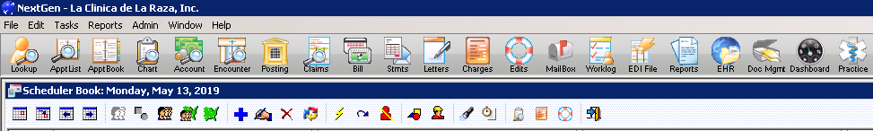
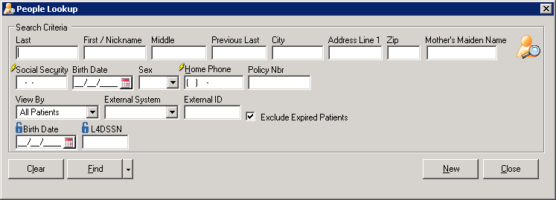

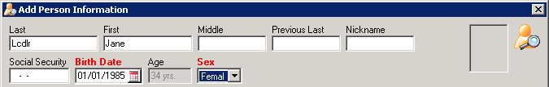
Minimal Registration
Create a “Globe” in NextGen
Click on People Lookup on the far left of tool bar (circled);
Enter Search Criteria – last name, first name, birth date (DOB) -- to see if patient already exists, to avoid duplicate records;
Patient names and DOBs can be slightly different than on patient IDs or by patient report – check twice!
If patient does not exist, click New (circled) and create a globe by typing last name, first name, DOB and patient sex.
Best practice to enter phone number as well, especially if using “globe” to make a registration or medical appt.

Slide 9
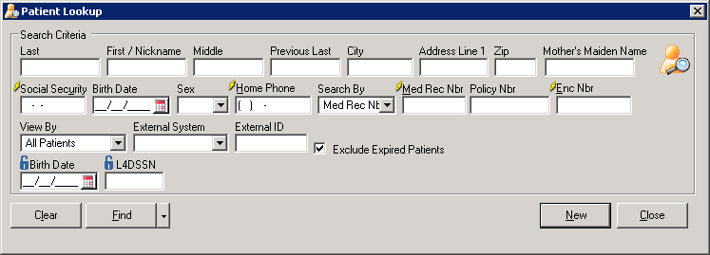
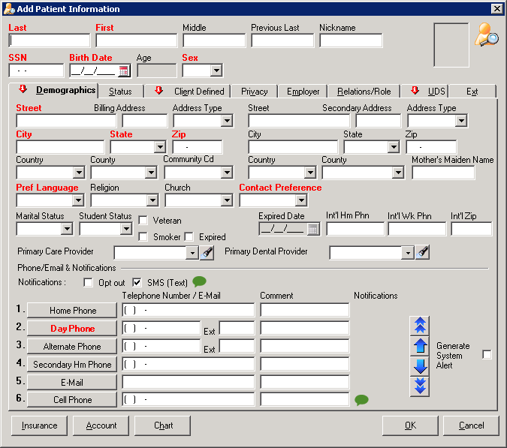
Registration
Create a “Chart” in NextGen
Enter Search Criteria – last name, first name, birth date (DOB) -- to see if patient already exists, to avoid duplicate records;
Patient names and DOBs can be slightly different than on patient IDs or by patient report – check twice!
If patient does not exist in system, click New (circled);
Create a chart by entering all information in red;
Can also pull up existing patient globe; system will prompt to enter additional information, including head of household in UDS tab.
Choose New to select other registered patient as head of household or choose Self;
Immediately click “Chart” in UDS tab to create Chart.

Slide 10
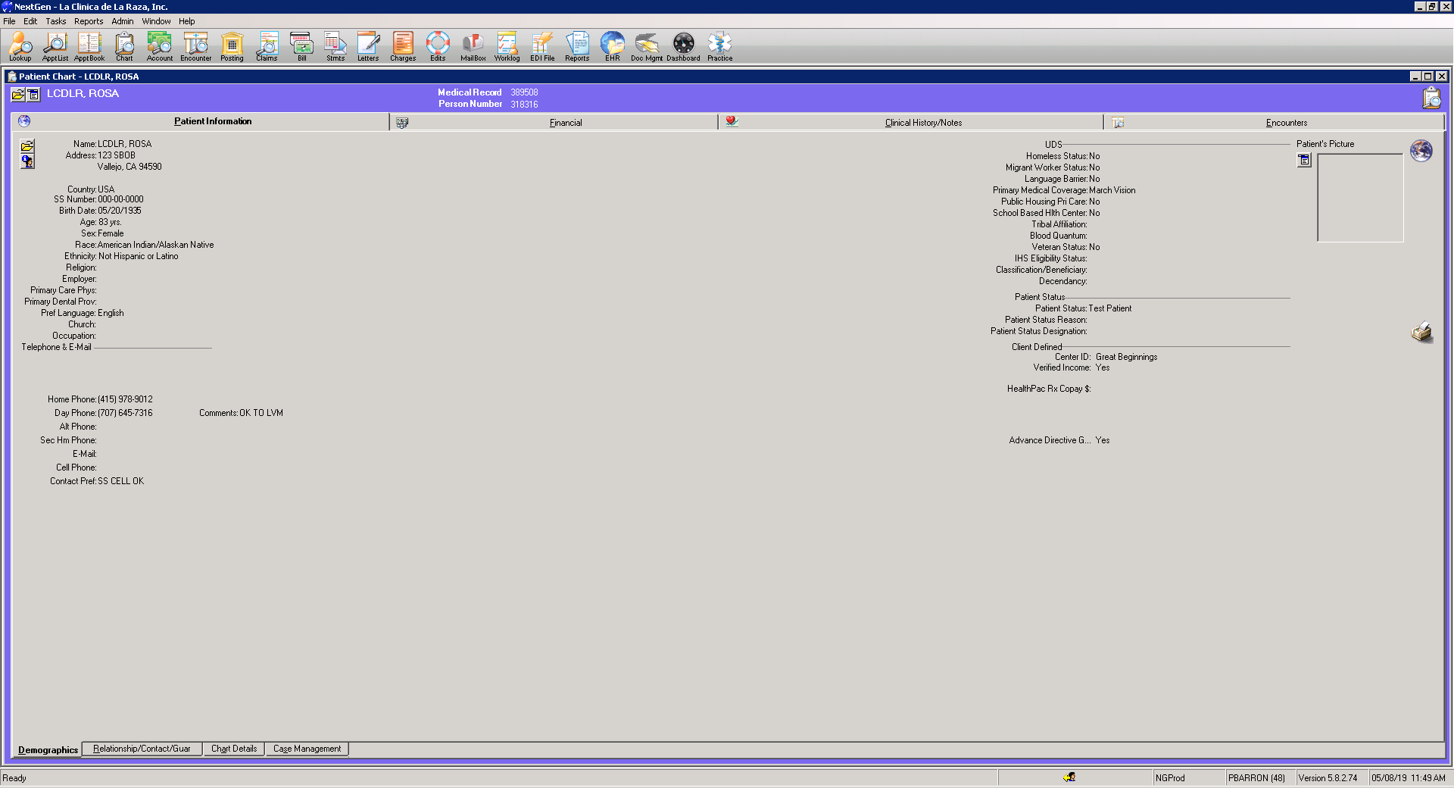




Demographics
To make changes to existing patient chart:
2
Scan patient ID photo
Make sure image is clear!
Rescan if needed
1

Slide 11
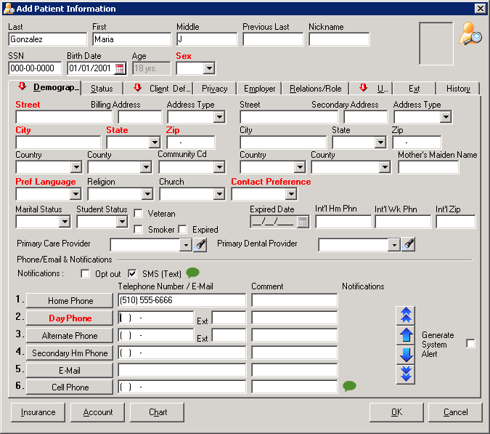
Demographics
Demographics
Fill out last name(s) exactly as listed on ID & insurance card;
Fill out first & middle name(s) exactly as listed on ID & insurance card;
First and last names must match patient’s insurance information. Adjust as needed.
Ask for SSN ; use 000-00-0000 if patient does not have one.
Enter DOB exactly as listed on ID & insurance card. DOB must match patient’s insurance information. Adjust as needed.
Enter sex at birth: current options are M / F / Undif / Unknown
Sex choices will change to: M (cis) / F (cis) / M (trans) / F (trans) / NB (non-binary)

Slide 12
Demographics
Demographics
Fill out all address information;
Select preferred language – as specific as possible;
Select contact preference – best practice to use cell phone;
Ask re: veteran status, select if applicable (also add veteran status in UDS tab);
(Expired is used when patient has died; requires expired date, approx. date is OK);

Slide 13
Demographics
Demographics
Best practice to choose primary care provider (PCP) at 1st registration – require?
Best practice to obtain cell phone and select SMS (text);
Separate consent for SMS (text), or roll into consent document?
Complete all phone options; if home, day, cell are the same, copy and paste # in each;
Enter e-mail address; or decline@decline.com; no NG patient portal, will have My Chart with Epic.
Add any comments to right of numbers;
Centralize emergency contacts with phone #s (future request)

Slide 14
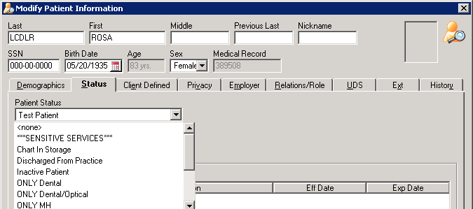
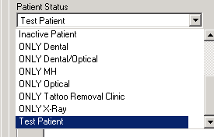
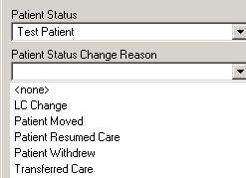
Demographics
Patient Status
Pick a patient status if appropriate;
Discharged and Inactive Statuses important for data purposes;
For Discharged and Inactive, pick a reason from drop down;
If patient seen for specific services only, indicate by ONLY Dental, etc.

Slide 15
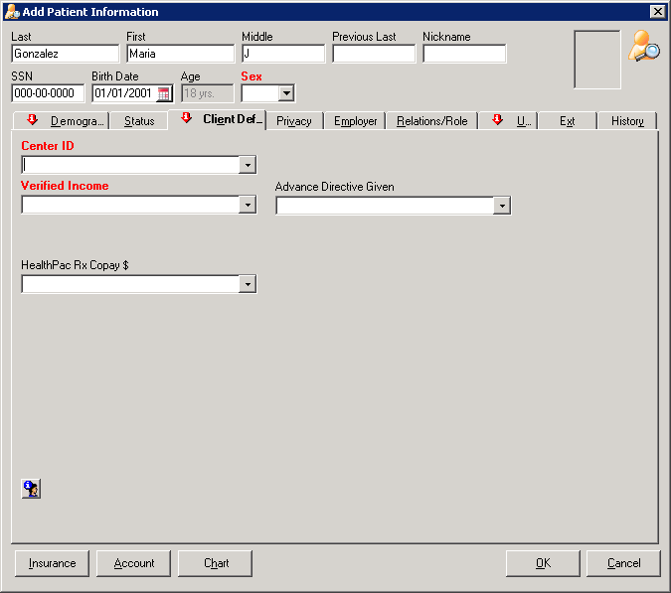
Demographics
Client Defined (Center ID, Income, Adv Dirs)
Pick a Center ID; very important for site-level provider panel reports, etc.;
Verified income is a Yes / No / Refused field. It does not link to the sliding fee scale.
We define “income verified” as either taxes, pay stubs or self-attestation of income;
Self-attestation form OK alone, or do we need letter also?
We collect income for all patients, regardless of insurance status;
Advance Directive Given is a Yes / No field. This is an important field for reporting purposes; it should be considered a required field.

Slide 16
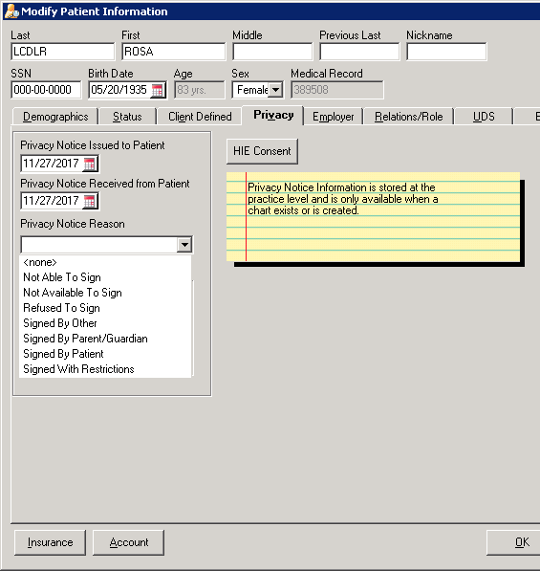
Demographics
Privacy
Privacy
Privacy notice fields are currently not required by NG, but they will be in the future; please consider required and enter dates and reason.
Dates are often the same
Privacy notice should be given to patient at 1st registration appointment; if not possible (phone registration, adult not present), must be given at check-in for first appointment with provider (?)
NG reminds with alert if patient has not signed privacy notice – easy to click past this alert.
Can an adult sign for spouse? What do “Signed by Other” & “Not Available to Sign” mean?

Slide 17
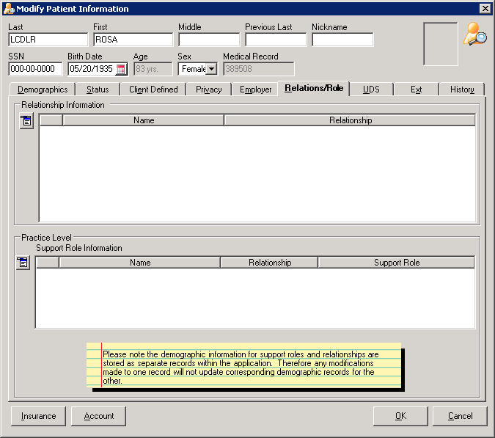
Demographics
Relationships
Do not use Employer field at this time;
Continue to Relationship Information fields; enter spouse, children, any additional family members. In order to connect family members, they must be registered patients or globes.
Note that connecting parent’s record to child in parent record does not connect child’s record to parent. Must connect family members in each separate record.
Do not have to complete before UDS fields; however, best practice is to connect all family members at 1st registration appointment.

Slide 18
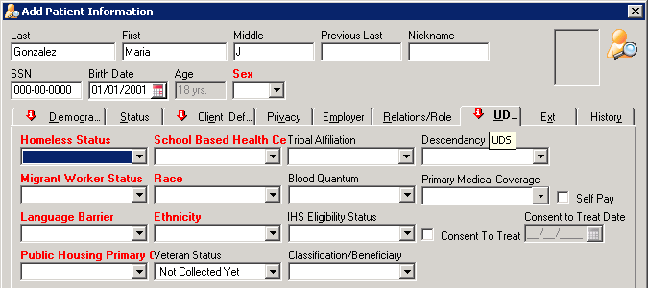
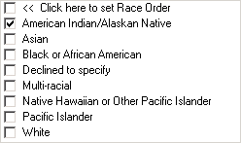
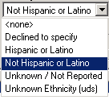
Demographics
UDS, Consent to Treat, Sliding Scale
UDS fields are very important for federal grant reporting. All in red are required; also consider Veteran Status to be required.
Language barrier (Yes / No) is defined as patient preferring a non-English language for medical interactions. If you are speaking to patient in a language other than English, the answer is “Yes”.
Race–see dropdown menu and select one or more--is defined by federal guidelines. Hispanic is considered to be an Ethnicity.
Ethnicity – see dropdown menu and select Hispanic, Not Hispanic or Declined (rarely).
Select primary medical coverage; most common are MediCal Full Scope, CHCN Blue Cross, Medicare, Family Planning SOFP, HealthPAC, CMSP, etc.
If no coverage, check Self Pay.

Slide 19
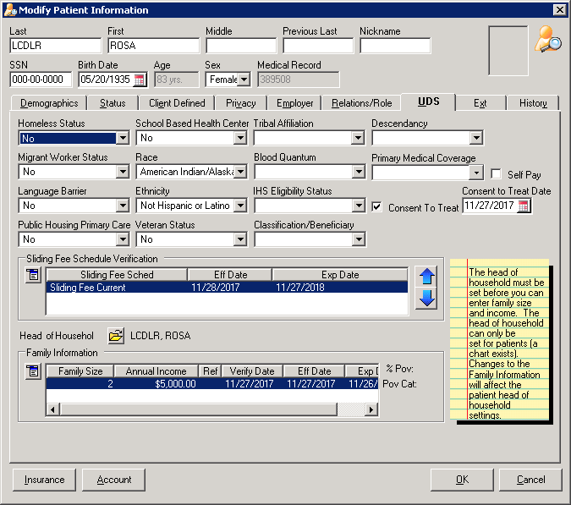

Demographics
UDS, Consent to Treat, Sliding Scale
Consent to Treat (circled) is very important – parent must sign for self and children at 1st registration appt; cannot sign for spouse (confirm);
Consider a required field; non-present spouse must sign at 1st medical appt (Who will check & date?);
Enter Head of Household (circled);
Must connect all family to Head of Household for sliding scale to update in each record;
Sliding Fee Schedule is required for all self-pay patients as well as all insured patients, unless patient refuses;
Document any patient refusal – see next slide.

Slide 20
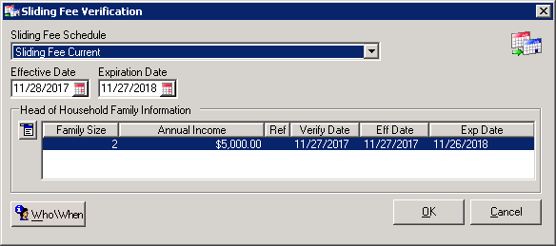
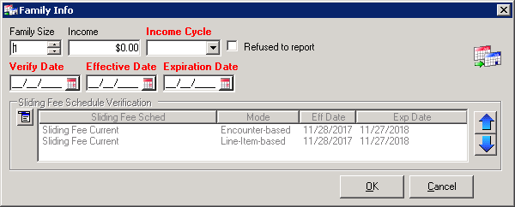
Demographics
UDS, Consent to Treat, Sliding Scale
In Verification, select “New” from drop-down, fill out all information and click OK;
Mark if patient refuses to report;
Confirm information copied to Family Information below Head of Household;
Note: information in Verification and Family Info boxes must match exactly or sliding scale will not take effect;
With verification (including self-attestation?), sliding scale is good for 1 year;
Can backdate 3 months for retroactive reduction of charges;
No temporary sliding scale?

Slide 21
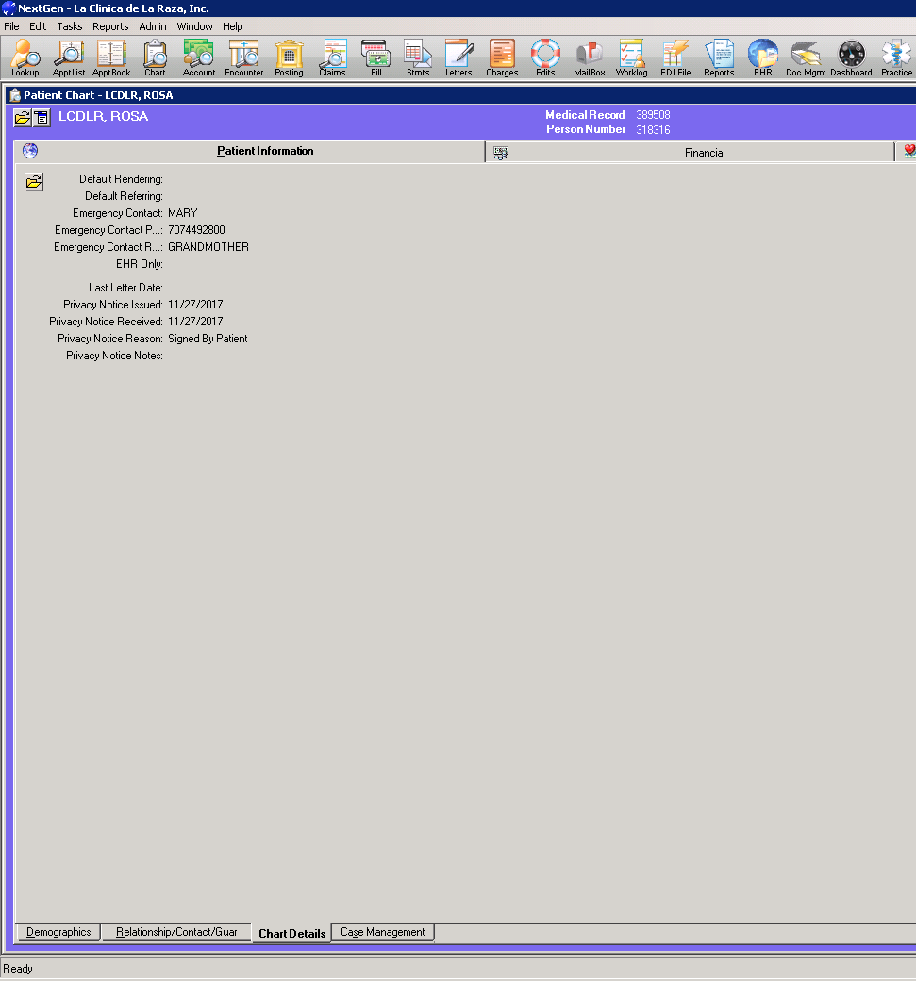

Chart Details
2
Emergency Contacts, Marketing Plan and Privacy Notice are in Chart Details;
Best practice to complete this information prior to adding insurance information.
1

Slide 22
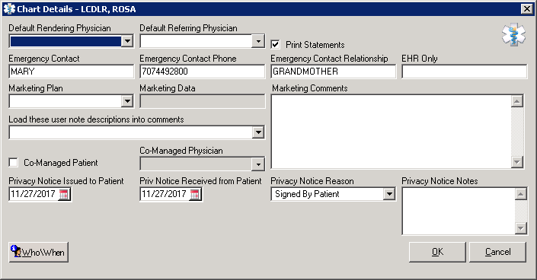
Chart Details
Emerg Contact, Marketing Plan, Privacy Notice
Should emergency contact information be required?
No dropdown choices -- emergency contact, phone number & relationship are all free text;
Information does not currently transfer to EHR.

Slide 23
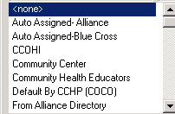
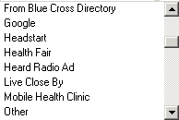
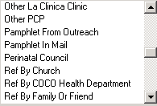
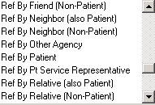
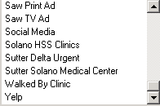
Chart Details
Emerg Contact, Marketing Plan, Privacy Notice
Should this information be required?
<8% of 2018 new registrations included Marketing Plan information;
Many “Marketing Plan” choices (too many?) – pick from dropdown menu;
Marketing Data (i.e., site) required for some choices;
Can add comments; not searchable (?).

Slide 24
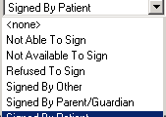
Chart Details
Emerg Contact, Marketing Plan, Privacy Notice
Should privacy notice be required?
NG reminds with alert if patient has not signed privacy notice – easy to click past this alert.
Date issued and date received usually the same;
Privacy information entered here does transfer to EHR.
Can an adult sign for spouse? What do “Signed by Other”, “Not Able to Sign”, & “Not Available to Sign” mean?

Slide 25
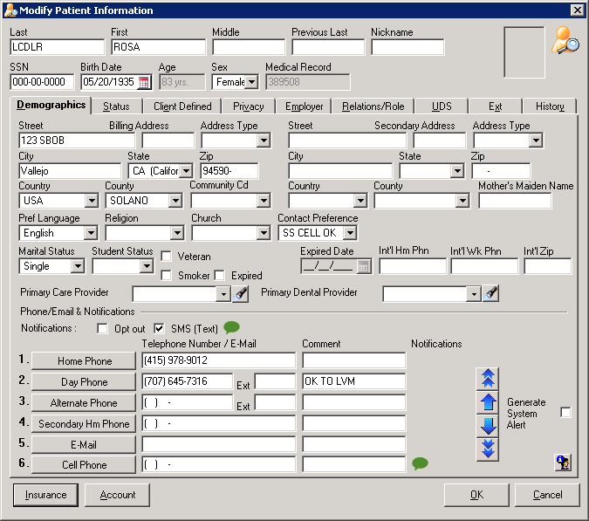
Demographics
Insurance

Slide 26
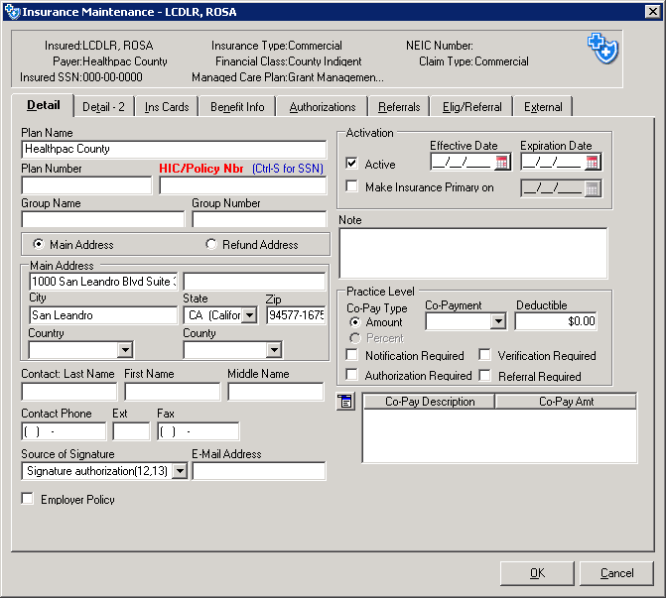
Demographics
Insurance
HIC / Policy Nbr is only (current) required field. Recommend requiring Plan # & Effective Date;
Also require co-pay field? ($0 for all MediCal; $15 for some CMSP; varies for commercial insurances)

Slide 27
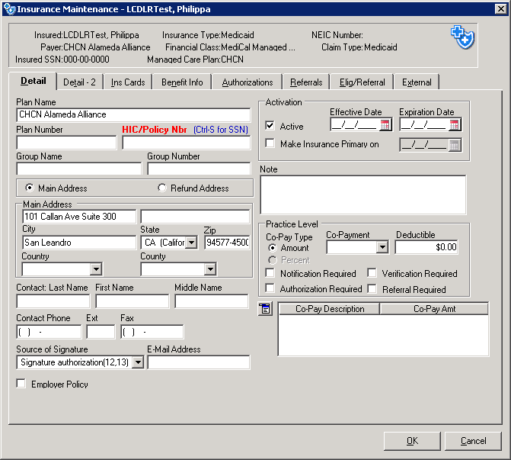
Demographics
Insurance with “Assignment”
How / when is PCP assignment information gathered?
How / when is it changed?
Strong recommendation to assign patients to LC at new registration or before first medical appointment.

Slide 28
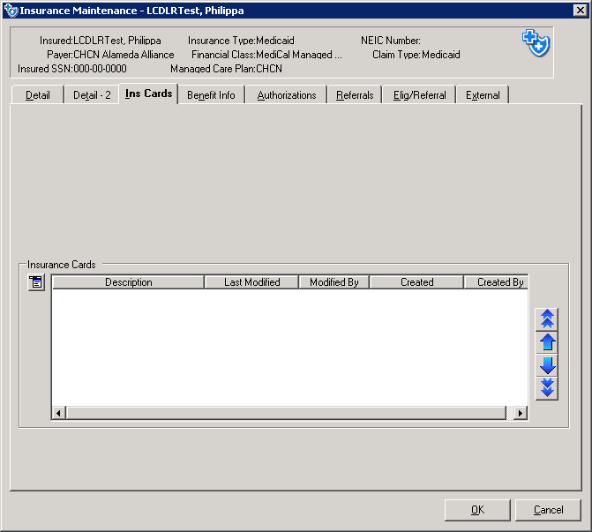


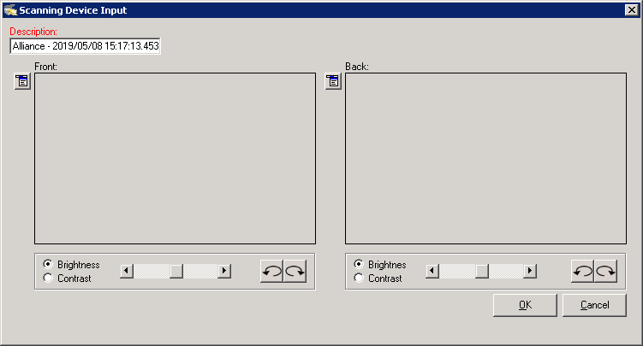
Demographics
Insurance
From Insurance Detail, go to Ins Cards tab;
Scan insurance cards, front and back;
Back of card has lots of important information for billing purposes;
Repeat for each card;
Make sure images are clear!
Rescan if needed.
1
2

Slide 29
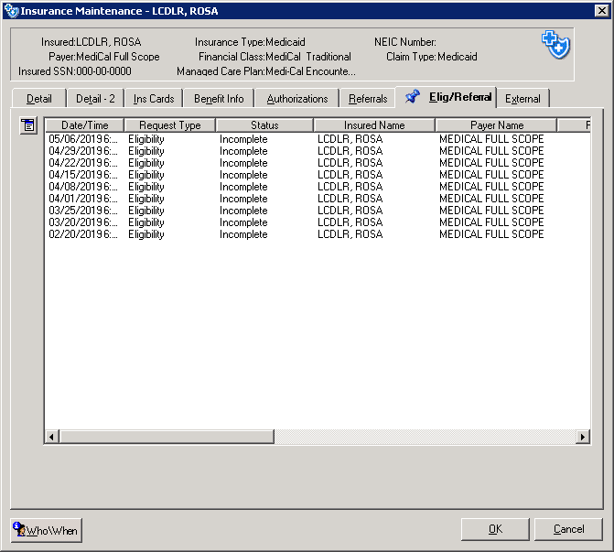
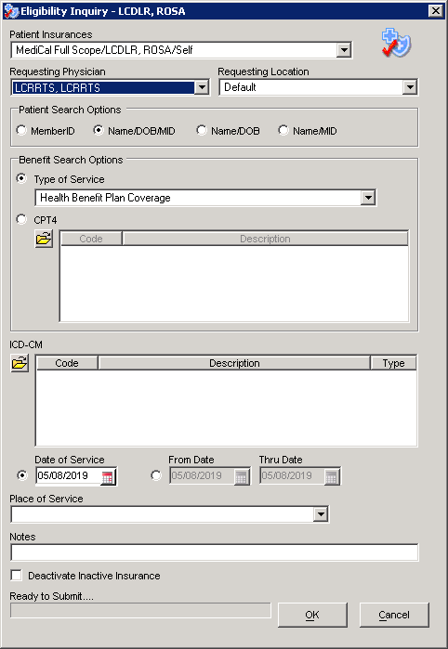
Demographics
Insurance
From Ins Cards tab, go to Elig/Referral tab;
Best practice to check eligibility within EMR;
From drop-down menu, select “Eligibility Inquiry”;
Fill out Requesting Physician “LCRRTS, LCRRTS”, “Default” Location, Type of Service “Health Benefit Plan Coverage” and click OK.
System checks eligibility in real time against requested insurance (MediCal, Medicare, etc.) website & returns eligibility response;
Repeat for each card;
If patient is not eligible, check information, correct & try again.
1
1
2
3

Slide 30
Patient Signatures Required
Signed Consents
Consent for Treatment (#170)
Privacy Notice (#8093); patient receives HIPAA brochure (#8092)
Advance Directives (#498, #498.3); patient receives brochure
Patient data sheet (print from NextGen); patient signs to confirm data entered is accurate, it includes Consent for Treatment at bottom of form.
Patient Registration Form (#106); includes several consents on 2nd page.
Other Signed Forms
Patient Rights & Responsibilities (#77)
Statement of Income -- Sliding Scale (#2004)
FPACT, EWC, CHDP/Gateway Application Forms (as needed)
Staying Healthy Assessment (SHA), VFC, Vaccine Contraindication Forms (Solano County practice)

Slide 31
Review: What’s in Reg Packets
 | Alameda | CoCo | Solano
Consent for Treatment (#107)
Pt Rights & Resps (#77) | ✓ | ✓ | ✓
Welcome Letter & Site Brochure (#252, 258, etc.) |  | ✓ | ✓
HIPAA Brochure (#8092) | ✓ | ✓ | ✓
Privacy Notice (#8093) | ✓ | ✓ | ✓
Patient Data Sheet (NG printout)** | ✓ | ✓
Statement of Income – Sliding Scale (#2004) | ✓ | ✓ | ✓
Staying Healthy Assessment, VFC, Vax Contraindications |  |  | ✓
Advance Directives (#498, 498.3) | ✓ | ✓ | ✓
Patient Registration Form (#106) |  |  | ✓
FPACT, EWC, CHDP Forms (as needed) | ✓ | ✓ | ✓
** In-person registrations

Slide 32
Special Registration Types
Special Situations
Phone Registrations – Can work well for patient access, suggest requiring dates for all consents (i.e., hard stop until checked off & dates filled in);
SBHC Registrations – PhB to shadow 3 SBHCs (2 visits set up), gather specific workflows;
Optical Registrations – Optical only;
Dental Registrations – Dental only;
Sensitive Services – More information needed. How used now? What are requirements? How should we set up and use Sensitive Services going forward?
Prenatal Patients – PhB to shadow PPS staff.

Slide 33
Workflows for Insurance Eligibility Verification
Current Processes – Noted Differences by County

Slide 34
Insurance Eligibility Checking Processes
Before DOS
All scheduled appointments – insurance eligibility for the first two listed insurances is checked two days prior by NextGen internal process; eligibility results are dropped into each patient’s Elig/Referral tab under active primary and secondary insurances.
Front desk staff do a manual check one day before for each scheduled patient; usually check on insurance websites. If insurance is expired, call patient to collect updated information or give option of rescheduling appointment. Often combined with appointment reminder calls.
Solano County – each front desk COA is assigned to 2 providers, checks patient eligibility in these 2 schedules for next 3 days. When insurance is verified, types “Active” in appointment description; doesn’t check again until DOS.
  Note: for patients who are aware their insurance is not active, there is a very high no-show rate. Even worse when patients told at check-in; accounts for many walk-outs on DOS.

Slide 35
Insurance Eligibility Checking Processes
On DOS
On DOS, front desk COA runs insurance coverage on each insurance website; generally don’t use information pre-loaded by NextGen internal process or use NextGen to do on-demand eligibility checking.
  Note: some newer staff are unaware of pre-loaded data and unaware of on-demand eligibility checking through NextGen.
If FPACT is expired (can tell by dates in insurance detail), ask patient to fill out and sign FPACT form. COA updates FPACT on MediCal website, adds new insurance information to patient Insurance Listing, scans FPACT form to Billing / Reg forms, attaches to same-day encounter.

Slide 36
Insurance Eligibility Checking Processes
Questions / Special Cases
At the end of the month, have to have special processes. Can’t check MediCal, etc., at end of one month for DOS in next month.
Patient’s HPAC / CMSP is expired – what is the process?
Patient’s sliding scale is expired – what is the process?
Patient assignment – patient’s coverage is good, but is assigned to another provider… what is the process?

