Slide 1
Trauma Informed Integrated Behavioral Health in primary care
Maryellen Curran, PhD
Director of Integrated Behavioral Health
Notes:
Introduce speakers. Deirdre Bernard-Pearl, Maryellen Curran, Molly Reed.
Who is in the room – how many of you are in Medicine? Behavioral or Mental Health? Management? Community Organizations? Parent Representatives?
We hope everyone will enjoy our plan to begin and end our session with a simple breathing exercise. We will take a ten minute break in the middle, and will offer 10 minutes of gentle chair and standing yoga after the break.

Slide 2
Highlights to share today -
SRCH offering for our patients with mental health needs including:
Individual Mental Health psychotherapy
Mental Health Group therapy
Psychiatry Consultation/Collaboration
In person & Telepsychiatry for complex mental health patients
Behavioral Health in primary care teams
Complimentary Alternative Medicine support
________________________________________________________
ACEs screening and follow up in BH and MH
Resilience and care of staff to prevent vicarious or secondary trauma

Slide 3
Integrated Behavioral Health
Traditional: Coordinated care in silos
Progressive: Co-location of services
GOAL: Integration of behavioral health in primary care

Slide 4
Coordinated
Never meet in person, traditional referral system, little collaboration
Communicate when driven by patient issues
Co-located
Communicate regularly about shared patients by phone, email or shared medical record
Collaboration driven by plans for difficult patients
Integrated
Communicate consistently at system, team & individual levels
Collaboration driven by shared concept of team care
Go beyond to full BH integration as primary care teammates, consultants, shared medical visits

Slide 5
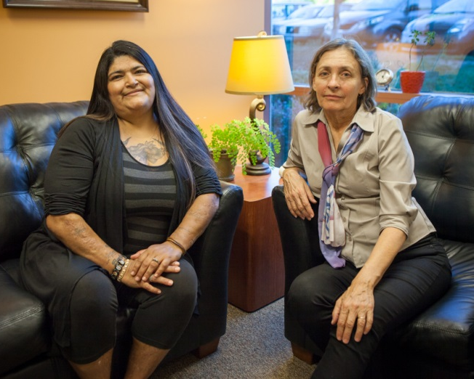
Pediatric Integrated
Behavioral Health
BH Clinician available for “BH consultations” throughout the day
Brief interventions in exam rooms
Not such “sacred” therapy sessions;
“please interrupt me!”
Consultation between providers in the moment, with patient still in clinic
Warm handoffs for therapy
Treatment planning, community resources, discussion of psychiatric medications
Crisis interventions if needed

Slide 6
Behavioral Health Integration
Current Programs:
New Beginnings Program( high risk OB-Gyn)
BH in Dental clinics- Anxiety Coaching- 5 hours/week
SAFE team (medication assisted treatment)
Now in 3 main campuses, PCBH with flip visits with health psychology focus
(Pediatric and Teen clinics “just interrupt me” warm handoff model) primarily because of size and number of clinicians

Slide 7
Moving Forward: Integrated Behavioral Health at 3-4 primary care sites for both adults and children
2018- Introduced the PCBH model at Lombardi and Dutton campuses- first a pilot, now an established model
2019-2020- Applied the model to the newly reopened Vista campus, with Phase 1 in the Santa Rosa Family Medicine team
Phase 2 & 3 to follow in the other two pods
2020-2021 Expansion to our homeless campus- Brookwood

Slide 8
Introducing BH Flip Visit Model
Goal: Booking 3-4 flip visits per shifts at each site
Available also for traditional BH consultations which include warm handoffs, risk assessments, referrals for resources, brief interventions for substance abuse
Added to PCP schedules as an extra visit
Charting in PCP note as a BH shared visit
$ Benefit: additional medical visits per site

Slide 9
Typical consults & flip visit targets
Motivational Interviewing foundation of ALL VISITS
Anxiety
Depression
Chronic Pain
Insomnia (CBT-i)
Smoking cessation
Medication compliance
New starts of SSRI & follow up
Medication non-compliance
New diagnoses – diabetes, COPD, CHF
Uncontrolled A1Cs
Diagnostic clarification prior to psychiatry referral

Slide 10
Lots of research about PCBH -2018 research supports BH Integration
The first was a primary care clinic predominately serving low-income patients: 100 individuals participated. The second was primary care in the context of military treatment centers: 539 individuals participated. Results: Results show that 61% of the patients in the low-income primary care clinic would not attend a specialty mental health appointment versus 30% in the military population.

Slide 11
Costs/Benefits of BH Integration
Preliminary provider satisfaction survey
Patient satisfaction
Fewer referrals to therapy without sufficient motivation or desire
Increase in usage of psychiatrists collaborative/consultative approach resulting in improved prescribing confidence in PCPs

Slide 12
Mental health groups available across sites
Anxiety & Depression (Spanish)
Familias Felices (Spanish)
Healthy Kids (obesity, Spanish & English)
Teen CBT & support (Spanish)
Teen girls support
Mindfulness Depression
Seeking Safety (PTSD) Spanish & English)
Living with Chronic Pain (mindfulness based)
HIV Support
DBT mindfulness/skills
Choices for Change (Dual diagnosis)
MAT behavior change and education
Recovery Support ( consumer led)
Circle of Security (parents of young children)

Slide 13
Complimentary Alternative Medicine Groups
Qi Gong for stress management
Qi Gong for early recovery
NADA – acupuncture in group format for anxiety & addiction
Yoga (x3) for overall stress management
Mindful Movement for Chronic Pain
I Rest (Integral Restoration) Guided Meditation for anxiety, trauma, chronic pain & insomnia

Slide 14
BH Integration at its best!
https://youtu.be/NFgtc5lxbPI

Slide 15
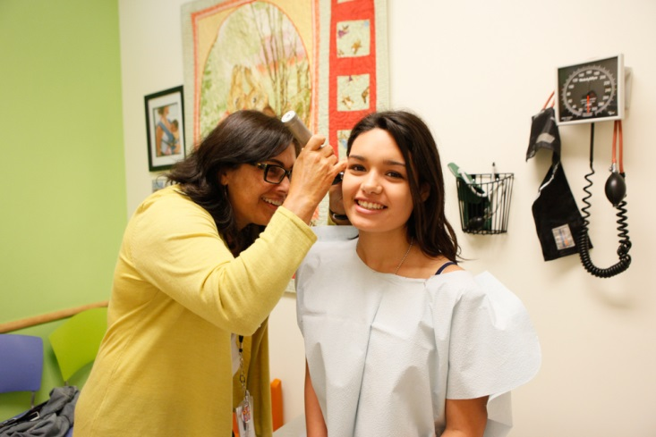
What does ACE screening mean for staff?
Prepare for universal ACE & resiliency screening-getting ready for the information you will receive
Behavioral health clinicians available to support patients with high ACE scores, either within the visit or to follow up with mental health visits
Provide culturally competent integrated behavioral health services- “If you ask, you must be prepared to act!”
Prepare to prevent vicarious trauma in providers & staff

Slide 16
Easily available consultation for high ACE scoring patients
At Pediatric campuses, the flow to do in the moment support and direction to either therapy or resources
Parents also screened may need their own support, in addition to children
At all age campuses, calling in a BH Consultant can also be immediate and with potential for brief flip visits with primary care providers
PCPs trained to ask the right questions of patients with trauma
For adults, “And how do those experiences impact you now?”

Slide 17
Critical awareness that comes with ACE screenings
Vicarious or secondary trauma
Compassion Satisfaction
Compassion Fatigue
Building Resilience

Slide 18
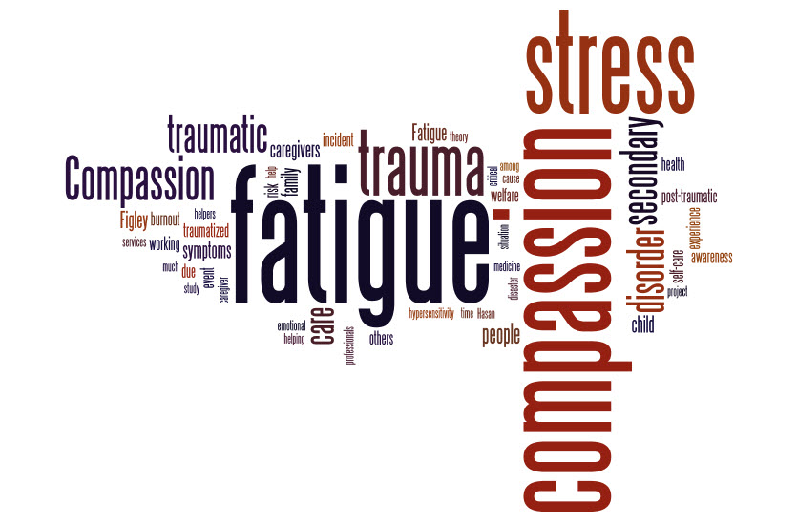
Vicarious trauma
AKA compassion fatigue, secondary trauma & secondary stress reaction
Occurs when a helping professional develops trauma symptoms as a result of working with traumatized people
It can result from a one-time exposure or an accumulation of exposure (the most common form)
Notes:
Also known as compassion fatigue, secondary trauma and secondary stress reaction different than burn out which tends to result in numbing, avoidance, loss of hope.

Slide 19
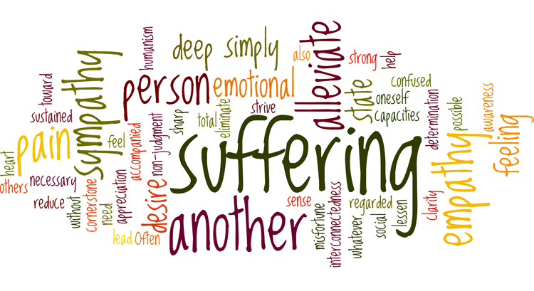
Vicarious trauma
A normal & natural part of trauma work, not a sign of individual deficiency (Perlman & Saakvitne, 1995)
It impacts thoughts, feelings & behaviors
It can be permanently transformative if not addressed

Slide 20
“If your compassion does not include yourself, it is incomplete.”
Buddha

Slide 21
Compassion Model
Professional Quality of Life: Working with ACEs
Compassion Satisfaction
Compassion Fatigue
Burnout
Secondary Trauma

Slide 22
Compassion satisfaction
Positive aspects of helping
Pleasure & satisfaction derived from working in helping, care-giving systems
May be related to:
Providing care
The system
Work with colleagues
Beliefs about self
Altruism

Slide 23
Compassion fatigue
Negative aspects of helping
Negative aspects of working in helping systems may be related to:
Providing care
The system
Work with colleagues
Beliefs about self
Burnout
Work-related trauma

Slide 24
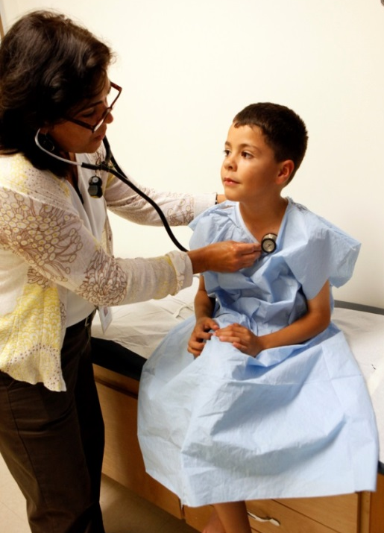
People bring themselves
People bring a personal past & present state to everything they do
Personal schemas & beliefs
Personal stigma beliefs
Personal social support systems
Positive support
Negative support

Slide 25
Individual risk factors for vicarious trauma: everyone is different
What affects one person may not affect someone else in the same way
Personal life experience & other factors unique to each person are significant
What affects you today may not affect you tomorrow
Notes:
Service providers who are Trauma survivors may identify more closely with particular types of pain or loss and may be more vulnerable to experiencing vicarious trauma
People who are struggling with a number of stressors in their personal lives (difficulties in interpersonal relationships, financial stress, health challenges) may be more vulnerable.

Slide 26
Many ways to feel vicarious trauma
COGNITIVELY
Distressing dreams or fantasies
Diminished concentration
Inability to trust self/situations
PHYSICALLY
Fatigue
Chronic headaches
Aches and pains
BEHAVIORALLY
Irritability
Impatience
Sleep disturbance
INTERPERSONALLY
Isolation from friends/family
Intolerance
Less interest in intimacy or sex
SPIRITUALLY
Loss of purpose
Lack of enthusiasm for life
Disconnection from nature
EMOTIONALLY
Crying more easily or frequently
Inadequacy
Feeling emotionally depleted

Slide 27
People are more susceptible to vicarious trauma when they:
Avoid dealing with challenges or difficult feelings
Blame others when challenged
Withdraw from others at times of difficulty

Slide 28
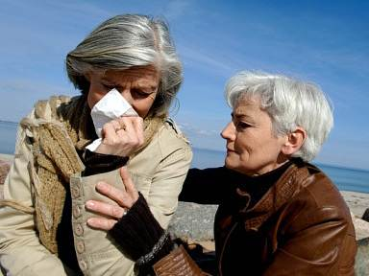
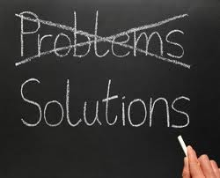
People are less susceptible to vicarious trauma when they:
Ask for support from others
Try to gain understanding about what is happening
Are proactive in trying to solve challenges

Slide 29
Cultural factors & vicarious trauma
In community
Not understanding cross-cultural differences can:
Cause providers to feel frustrated, confused, offended, misunderstood and/or devalued by clients
Cause clients to feel frustrated, confused, offended, misconstrued, and/or devalued by providers
In society
Society’s attitudes towards those being served can amplify the impact of working with a traumatized population
Notes:
skip

Slide 30
Unaddressed vicarious trauma can result in the inability to pay attention to distressing stories because we feel overwhelmed & unable to hear. This can result in directing people to talk about less distressing material… in essence, silencing them.

Slide 31
Self-care builds Resilience
Resilience is:
“The capacity to spring back, rebound, successfully adapt in the face of adversity and develop social competence despite exposure to severe stress.”
Rivkin & Hoopoman (1991)

Slide 32
Personal self-care
An effective self-care plan incorporates:
MINDFULNESS
CONNECTION/SUPPORT
BALANCE

Slide 33
Mindfulness
Requires slowing down, focusing inward & asking:
How am I feeling?
What is my stress level?
What types of thoughts are going through my head?
Are my behaviors & actions consistent with my values?
What do I need to do to take care of myself?
MINDFULNESS
Notes:
(Feeling present and connected)

Slide 34
Connect & gain support
For professionals to remain effective & get the best possible outcomes for clinical care, it’s essential to make sure they have access to the help & support they need to protect themselves.
CONNECTION/SUPPORT

Slide 35
Balance
It’s important to have a clear distinction between work life & personal life.
Healthy balance increases productivity, improves quality of client care & enhances well-being. We need to rest, play and escape as well as to work.
BALANCE
Notes:
Although empathy and genuine connection are critical in working with trauma survivors, providers need to be able to make a separation that allows them to nurture their mind, body, soul and spirit. If providers are not connected to themselves, then they will not be as effective in connecting with clients.

Slide 36
QUESTIONS
???

