Slide 1
Taking Action Together for Healthier Communities
Mayra Serrano, MPH, CHES
Manager
Center of Community Alliance for Research & Education (CCARE)
City of Hope, Department of Population Sciences

Slide 2
Leading Together
100 Million Healthier Lives SCALE (Spreading Community Accelerators through Learning & Evaluation) Initiative
Foundations of Community of Solutions Skills
How to unleash community transformations that can create sustained improvements in population health, well-being, and equity.
Leading Together
The skills of working together, grounded in seeing the community as a dynamic network of interacting people, organizations, structures, and systems that are related to a place. It is necessary to lead together with others in a community to create effective, equitable change.
Notes:
In the first phase of SCALE, the SCALE Implementation Team, together with communities and the evaluation team, identified a core set of skills (Community of Solutions skills). These skills lead to a core set of behaviors, systems, and processes that appear to catalyze transformational change in communities (Community of Solutions behaviors, systems and processes). Over time, these promise, in turn, to lead to a sustainable transformation in communities toward a Culture of Health (Culture of Health outcomes).

Slide 3
Building of Relationships
City of Hope, City of Duarte, and the Duarte Unified School District have a long history of working together to develop and implement health promotion programs designed to increase community members’ opportunity for healthy lifestyles.
Since 2008, the members of the partnership have implemented the Eat, Move, Live program. The program is aimed at decreasing the obesity epidemic and chronic diseases in the low-income populations by promoting the consumption of a more plant-based diet and increasing physical activity.
City of Duarte organized the program and led the Teen Nutrition Council, City of Hope health educators led the adult EML program, and the Duarte Unified School District assisted in recruitment and provided in-kind support.
As a result of our ongoing collaborations, we decided to co-lead the Teen Nutrition Council with the City of Duarte. City of Hope provided direct, hands-on training and provide various resources to develop leadership skills among the Peer Health Promoters.
Notes:
Needs Additional Info. Will work on it on Monday!

Slide 4
Building a Culture of Health
Hospital-community partnerships can create a greater impact by aligning resources, knowledge, skills and expertise.
Able to address the social determinants of health
Leveraging existing assets in the community is an effective way to strengthen partnerships.
Notes:
Working on related issues & targeting the same populations
Creatis an opportunity to align efforts, reduce duplication and silos, optimize financial resources and, ultimately, improve the overall health and well-being of the community.
Hospitals
Expertise in improving health
Often largest employers in their communities
Established strong reputations as major community stakeholders
Community Partners
Expertise in community needs and assets
People with lived experience
Have insight to offer about the system as it is experienced by consumers

Slide 5
Notes:
Poll Title: Have you applied Youth Participatory Action Research or Community-Based Participatory Research (CBPR)? https://www.polleverywhere.com/multiple_choice_polls/HFaKs13VE7og9sG

Slide 6
Defining YPAR
“Youth-led participatory action research is an approach to scientific inquiry and social change grounded in principles of equity that engages young people in identifying problems relevant to their own lives, conducting research to understand the problems, and advocating for changes based on research evidence” (Ozer et al. 2016, pg. 190)
Ozer, E. J. Youth-led participatory action research: Developmental and equity perspectives. In S. S. Horn, M. D. Ruck, & L. S. Liben (eds.), Advances in Child Development and Behavior, 50, Burlington: Academic Press, 2016, pp. 189-207.

Slide 7
Youth as Researchers
“The silenced are not just incidental to the curiosity of the researcher but are the masters of inquiry into the underlying causes of the events in their world. In this context research becomes a means of moving them beyond silence into a quest to proclaim the world.” (Freire, 1982)
As quoted in http://publicscienceproject.org/about/

Slide 8
Notes:
Poll Title: Do you currently engage youth or community members in your programs or work? https://www.polleverywhere.com/multiple_choice_polls/qmCRcYMsaa5kDQR

Slide 9
Teen Nutrition Council
Community health promoter programs, especially when youth driven can be force for achieving health equity.
The Teen Nutrition Council (TNC) program empowers teens to be health change agents in Los Angeles County Service Planning Area 3 (San Gabriel Valley) using the Youth Participatory Research Approach.
The TNC was developed in response to the dire health outcomes in this community:
21% of children in grades 5th ,7th, and 9th are obese¹
50% of children eat fast-food at least once a week¹
36% of children consume at least one sugar sweetened beverage (SSB) a day²
22% of children age 6-17 years obtain the recommended amount of exercise each week¹

Slide 10
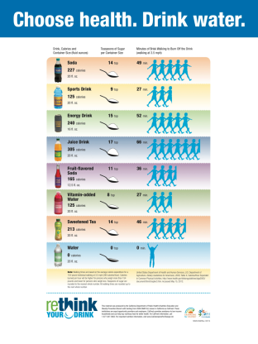
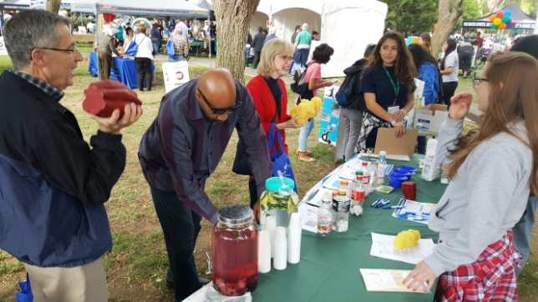
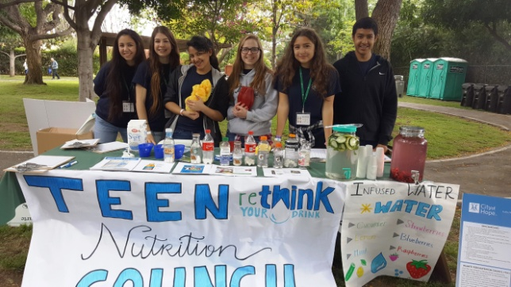
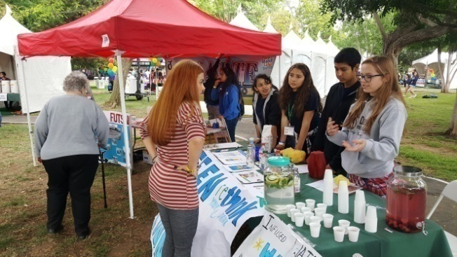
Teen Nutrition Council
The Teen Nutrition Council’s mission is to:
Increase students' awareness and responsible decision-making regarding health and wellness by incorporating leadership skills in research, advocacy, and social determinants of health.
Empower teens to be active community members and gain confidence in engaging policy makers and community stakeholders to enable policy and systemic change.
Aid in the dissemination of factual information regarding current health issues (i.e. obesity, physical activity, etc.) affecting their peers and the broader community.
Notes:
Photovoice , a community assessment tool using photos from the communities' perspective that frame the contexts of their daily lives.

Slide 11
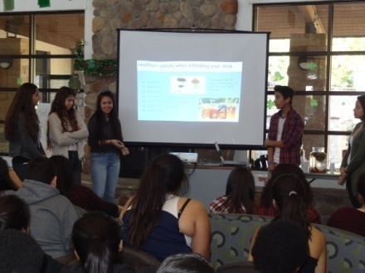
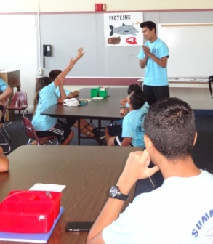
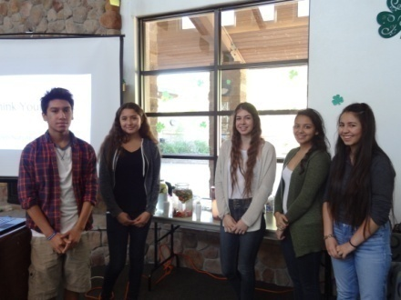
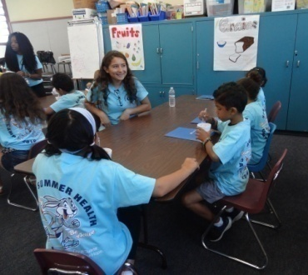
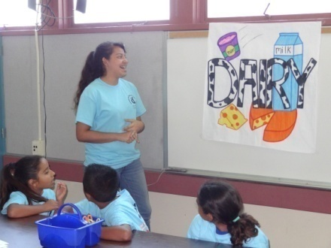
Objectives
Educate and advocate for consumption of recommended amounts of fruits and vegetables by low-income (185% of federal poverty level) students and their families.
Provide school and community-based nutrition education workshops.
Conduct disease prevention awareness to the community through outreach activities.
Co-facilitate the Summer Health Camp in partnership with Duarte Unified School District (DUSD).
Facilitate presentations to City Council, the Parks and Recreation Commission, and The Healthy Cities Collaborative (HCC), offering input of the health needs and healthy policy of their community.
Conduct community needs assessments (e.g., Photovoice Project, Street Intercept Surveys).
SGHS students: Participate in the San Gabriel High School Healthy Food Fair and Research Poster Fair.

Slide 12
Program Implementation
TNC Training:
Biweekly training sessions led by City of Hope staff conducted at community sites (e.g., Teen Center, NATHA; San Gabriel High School, Medical Careers Academy).
Topics included: My Plate, Nutrition Labels, Chronic Disease Prevention, Basic Research Methods, Media Smart Youth, Youth Advocacy and Engagement; Communication and Presentation Skills.
Pre- and post-test evaluations measured changes in knowledge, behavior and confidence levels.
TNC Delivery of Intervention:
Peer-to-peer model engaging youth as leaders in promoting healthy lifestyles with school aged children and the broader community.
Training allows youth to reach wider audience and serve as role models to children and peers.
Notes:
Training occurred after-school and intensive training took place during spring break.
Refresher course offered Summer and Winter break.
Peer Health Educators conducted

Slide 13
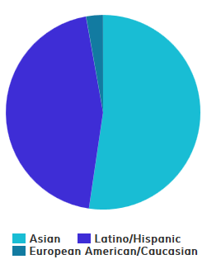
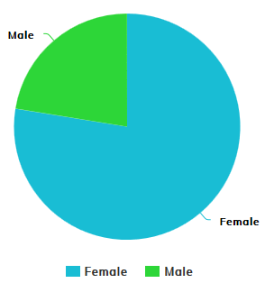
Results
A total of 122 teens were trained:
Majority were female (78%); Asian (52%) and Latino (45%).
Significant increase in Confidence, Knowledge and Behavior:
Increase in knowledge of My Plate (Z=-2.828); (p< 0.005).
Increase in knowledge of sugar content in drinks (Z=-2.530; p< 0.011).
Increase in fruit and vegetable consumption (Z=-2.138; p<0.033).

Slide 14
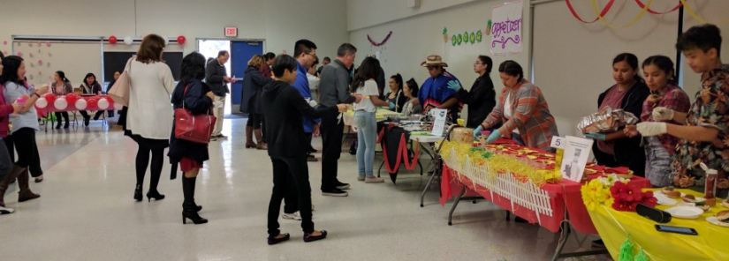
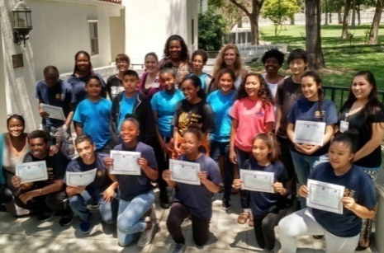
Outcomes
Our findings demonstrate a significant increase in knowledge, healthy behaviors and confidence among teens trained.
The TNC program engages youth as leaders and advocates to provide input on the needs of the community and spark behavior and built-environment change using a youth empowerment approach. They are trained to conduct health projects that promote youth involvement in civic discussions, including the use of Photovoice, a community assessment tool using photos from the communities' perspective.
Youth are empowered and committed to pursue higher education and future career opportunities in public health and community engagement.
Youth developed leadership skills and increased their self-confidence in public speaking.
Community health promoter (CHP) programs, especially when youth driven can be a force for increasing individual-level healthy behaviors and creating healthy environments that promote healthy practices.
Notes:
Mention that the kids are active on DART and the Mayors Youth Council.

Slide 15
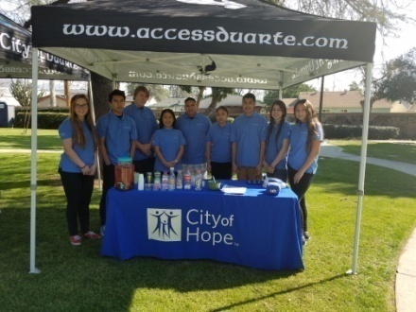
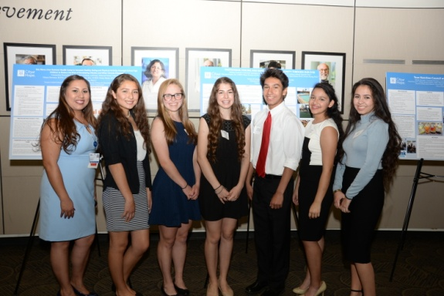
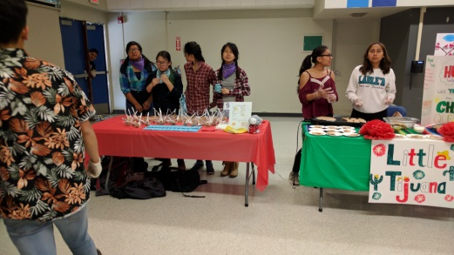
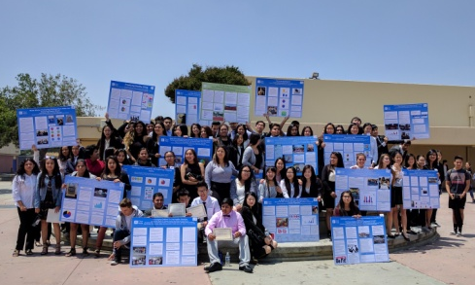
Testimonials
“I was able to achieve my goals during the training. Especially drinking more water, no sugary drinks. I take a water bottle everywhere I go now.”—Emily D.
“Due to the training, I now consume more fruits & vegetables, I exercise more than before, and I now pay more attention to nutritional values in food.”—Cassandra G.
“I was able to teach the kids at the health camp about eating healthy.” —Marisol A.
“I think the TNC has taught us many good things that we could use for the rest of our lives. The PhotoVoice project helped me and other people have a voice. I also felt we had a big role in our community when we got invited to go to the meeting and when they said they would remodel the park; made me feel like I had a big part in that.” –Alfredo A.
“I have been able to exercise more each week and have in fact educated my family about nutrition.” –Cynthia S.

Slide 16
Notes:
Poll Title: Have you ever used photovoice? https://www.polleverywhere.com/multiple_choice_polls/hDPmIKFRykLm8VR

Slide 17
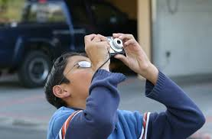
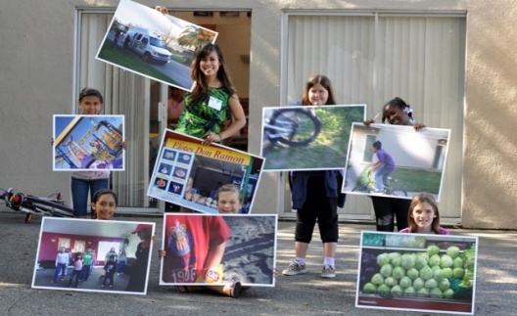
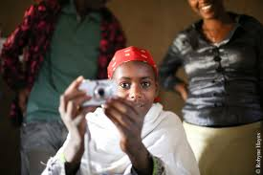
What is Photovoice?
Photovoice is a type of participatory action research in which people—usually those with little power—use photographs and/or video to picture their environment and experiences and to express their thoughts about them.
Photovoice is a process in which people use images to capture aspects of their environment and experiences and share them with others. The pictures can then be used, usually with captions composed by the photographers, to bring the realities of the photographers’ lives home to the public and policy makers and to spur change. It is an effective tool where people can capture and share their own visual interpretations of positive or negative health impacts in their community.

Slide 18
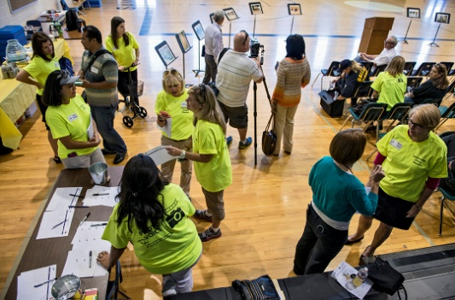
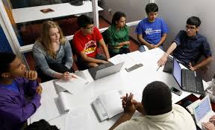
Photovoice Goals
Photovoice has three main goals:
To help those who are often unheard gain a voice, enabling them to record and reflect on their experiences and their communities’ conditions, both positive and negative.
To encourage critical consciousness. Through choosing, discussing, and reflecting on the subjects of their photographs, the photographers can come to a clearer understanding of their circumstances and the economic, social, psychological, and political forces that shape them.
To bring about change that will improve conditions and enhance lives by reaching and influencing policy makers.
Notes:
To provide a voice for those who do not have one
To reach and influence policy makers
To enable people to record and reflect their community’s strengths and concerns
To promote critical dialogue and knowledge about important issues through group discussions of photographs

Slide 19
What is the goal of Photovoice?
To empower you to become actively involved with community change efforts around your community.
To bring awareness and inform policy makers about health in your community from YOUR perspective.
Photovoice is a way for you to explore and communicate what you think and feel about health in your community
You’ll then be able to tell people in your community what you’ve come up with and if you think there are any ways to change things.

Slide 20
Why use Photovoice?
Rewards of taking photographs are immediate
Taking photographs or videos of familiar scenes and people can change participants perceptions about their social and physical environment
Basic photography is easy to learn and accessible to almost everyone
“A picture is worth a thousand words”

Slide 21
Why is it important?
When we talk about health, who are we talking about?
Who knows the most about this issue?
Who should be involved in efforts to address this? (Hint ‐ you are the experts.)

Slide 22
Notes:
Poll Title: Does your current work focus on affecting policy or system change? https://www.polleverywhere.com/multiple_choice_polls/qK5QN1BYpY53sMI

Slide 26
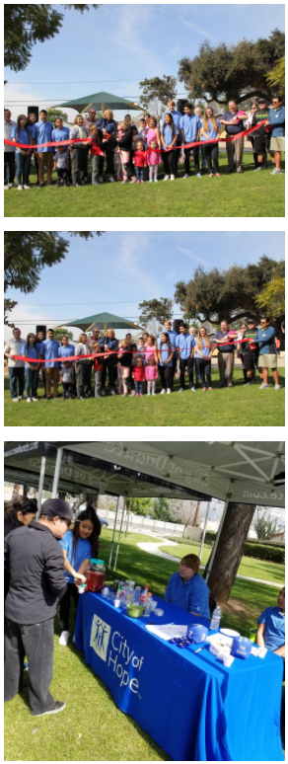
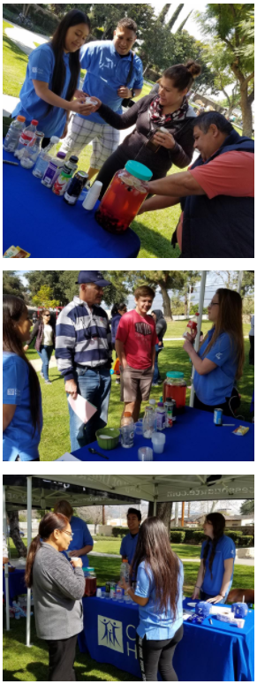
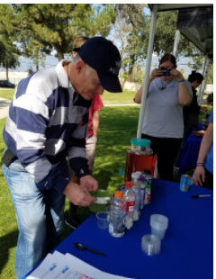
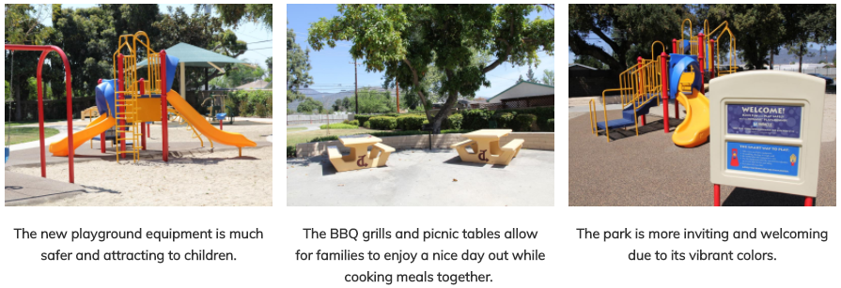
"We presented our Photovoice findings at the City Council and Healthy Cities Collaborative (HCC) meeting—a committee of local organizations and City policy makers interested in local health issues. The City of Duarte Parks and Recreation Director stated that the department would remodel Aloysia Park, which is worn down and unwelcoming with little light as a result of our Photovoice project. The park will now have a new playground replacing the old metal slide and swings and will have an outdoor fitness area for the community to exercise free of charge."
-Teen Nutrition Council

Slide 27
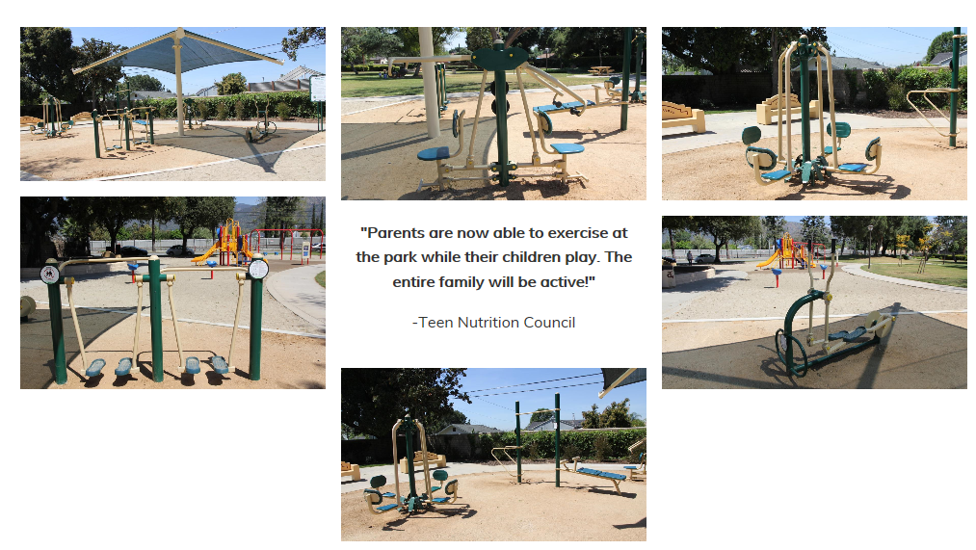
Outdoor Fitness Area

Slide 28
Photovoice, YPAR & Advocacy Resources
Community ToolBox: What is PhotoVoice http://ctb.ku.edu/en/table-of-contents/assessment/assessing-community-needs-and-resources/photovoice/main
YPAR hub at UC Berkeley - http://yparhub.berkeley.edu/
Institute for Community Research - https://icrweb.org/
Public Science Project - http://publicscienceproject.org/readings_resources/

Slide 29
Photovoice Project
Rules:
Post 5 pictures to Instagram of positive or negative health impacts in your community (see examples).
Tag the your hospital/organization in your photos.
In your captions, describe how your pictures impact the health of your community. Tell us where the photos were taken and include hashtags (e.g. #HealthyTeensSGV)

Slide 30
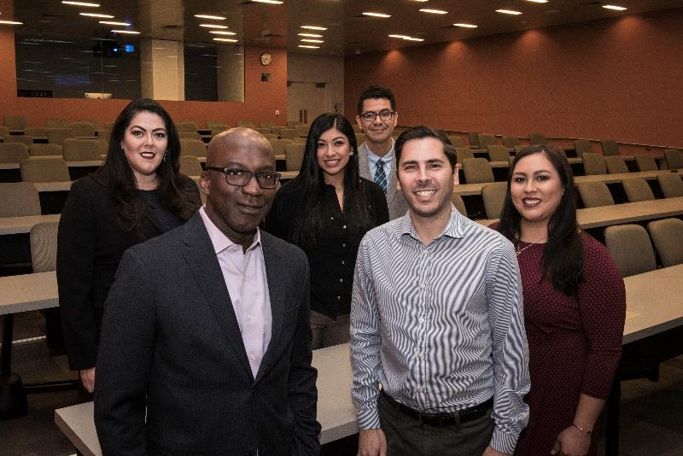
Questions?
Thank you!
CCARE Staff:
Dr. Rick Kittles, Director
Alejandro Fernandez, CRC
Marisela Huerta, Comm Int.
Katty Nerio, CRA I
Dr. Noe Chavez, Post Doc
Email: maserrano@coh.org

