Slide 1
Motivational Interviewing:
Virtually

Slide 2
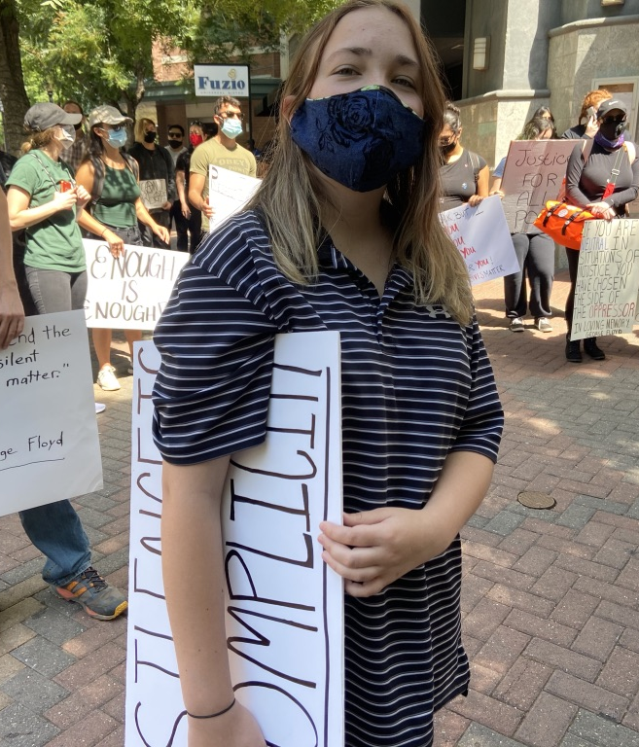

Slide 3
Notes:
Poll here:
What best describes your experience with MI?
I've heard of it, I'm not sure I know too much about it though
I've had some training in MI, and I sometimes use the techniques at home or at work
I've had quite a bit of training in it, and use it pretty consistently either at home or work
I have tons of experience with MI, and have even trained others in it. It is fairly ingrained for me!

Slide 4
05
01
Identification
Pre-Contemplation
Stages of Change
04
02
Action
Contemplation
03
Preparation
Notes:
This is a great slide to ask for participant input. You can ask who might want to define these (start with pre-contemplation and work clock wise. This is usually a chance to practice skillful reflective listening and also how to ‘correct’ without correcting, because often people wrongly define pre-contemplation as ’thinking about it’ or ‘ambivalence’ which is contemplation.
It is important here that as a trainer you feel very competent and confident about your own understanding of each stage of change, so you can give examples of what happens during each stage. It is also very useful to share examples from your own life, or an example from one of your patients (no names of course).
Here are some basic explanations:.
Pre-contemplation: Do not think it is a problem. No thought about changing. Sometimes called ‘denial’
Contemplation: also called ‘ambivalence’. Considering change; one step forward 1 step back, etc.
Preparation: no change yet, however the decision has been made, and preparations are happening, such as telling people (that the diet will start in 2 weeks, that the quit date for cigarettes is next month, etc.), buying supplies, looking for apartments (in the case of leaving a relationship, etc.). This is a good place to use an example from your own life or one of your patients.
Action: self explanatory
Identification: so identified with the change, relapse is very unlikely. It is important to give an example here.
You can add that relapse can happen after action, and often does for any behavior change.

Slide 5
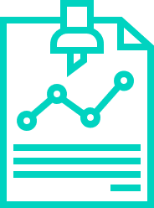
Over 90 Clinical Trials (MARMITE)
30 years of research on the effectiveness of MI
Notes:
This is where you want to hit it out of the park in terms of ensuring that everyone knows, unequivocally, that the evidence base for MI is solid. Depending on your participant group, some respond stronger to the research case than others, so you can judge by the audience how much time to spend on this slide (or if you want to add a few slides of your own, highlighting research from the bibliography that matches your organization’s mission or patients best). The important thing to convey on this slide is that the research base is enormous, and that MI is an evidenced based practice, and has been for about 20 years. I also think it can be useful to linger on the last 2 sentences here, that MI has been shown to have an impact on our own job satisfaction, it is a way to show your care not just for patients, for the employees in the room as well.
Just a reminder that ‘MARMITE’ is a meta analysis of MI done in 2011, showing evidence for MI effectiveness in a variety of settings, for a variety of behavior changes. This is not the only research (the whole bibliography is MI research) it is just a meta analysis, so easy to read if you’d like to review, and easy for others if you have someone in the audience that would like to read it.

Slide 6
Empathy
is Healing
Judgment, Stigma & Bias are Harmful

Slide 7
Empathy
Autonomy
Relationship
Respect
Principles
Notes:
This slide explains, in brief, the main principles. You can say that we are focused primarily on the first 2 bullets in ‘MI part 1’.
Express Empathy: This is THE primary principle of MI, the spirit of MI, the principle that all other principles are based on, and that all techniques are based on. This isn’t about feeling empathy, it is about effectively conveying empathy, which takes a lot of practice (a lifetime of practice!)
Autonomy: This means the ‘hero’ is the story is the patient, (or our family member), we are not the ‘hero’ in the story who saves anyone, our job is to support, empower and help activate patients heroic efforts for themselves.
Relationship: This means that no correcting, imposing, arguing, or ‘righting’ patients (or others) will ever be effective, and in fact can be harmful; we instead use the relationship to allow for the person to share about themselves and their own concerns and motivations.
Respect: This is similar to ‘unconditional positive regard’, meaning, MI asks us to remain in the place of always respecting the other persons own wisdom and their own path.

Slide 8
In person
On video
On the
Telephone
MI WORKS:
Notes:
To speak to MI's versatility, in that it works in all three of these modes of communication. This is a good time to mention, if you haven't already, that MI is just a skillful way of communicating, and we probably already use it with our family, friends, and our clients/patients. Anything we learn here today, in terms of how to enhance/strengthen those skills we can use in our personal life too.
You can note that on each strategy/technique slide, there are icons to show where it is applicable (all are applicable to all, except non-verbal empathy, which we don't/can't use on the phone)

Slide 9
Why is it so hard?
Notes:
We can talk about families, schools, communities….almost all of us have had conditioning to try and get people to do things in this way….

Slide 10
‘If you keep getting grades like this, you’ll never get into a good college’
‘Next time I catch you with pot, you will be grounded for months’
‘I’m really disappointed in you. I thought you were better than that’
FEAR
PUNISHMENT
SHAME
Notes:
This is a great one to ask participants for input. When they think about their childhood, can they identify examples of fear, shame or punishment, how their parents might have tried to get them to do, or not do things..you might share a simple story yourself to start the group off.

Slide 11
01 Negative judgments or Implicit Bias
02 Mirror neurons aren't functioning
03 Tired, stressed, fearful, or angry

Slide 12
Principle MI Strategies
Open-Ended Questions
Notes:
Ask participants to define open ended questions (can’t answer yes or no). Expand the definition to include any one word or one phrase answer, and give examples ‘when did that happen?” ‘where did you go?’ ‘who went with you?’
This is a slide to share research. Looking through the bibliography at some of the open ended question research is useful. Here are a few highlights:
The Institute of Medicine called open ended questions the ‘gold standard’ of communication over 15 years ago, and since then there has only been more research to support this.
Diagnostic accuracy is related to how many open ended questions clinicians (physicians and BH clinicians) ask. Inaccurate diagnosis is related to the number of closed questions
asked.
Open ended questions effectively convey empathy; closed questions do not, they convey an agenda.

Slide 13
Which medications are you taking?
Are you checking your blood sugars?
Do you want to quit drinking?
Notes:
In this slide, you can ask participants to change these questions into open ended questions.
This is where you can talk about not starting open ended questions with ‘Why’; and instead use the stems ‘What’, ‘How’ and ‘Tell me more about. If you ask participant the reason for avoiding staring questions with 'why' they will almost explain it for you.

Slide 14
What are your thoughts about starting this medicine?
How are you doing with checking your blood sugars?
Tell me more about your feelings about drinking
WHY?
Notes:
In this slide, you can ask participants to change these questions into open ended questions.
This is where you can share about not starting open ended questions with ‘Why’; and instead use the stems ‘What’, ‘How’ and ‘Tell me more about

Slide 15
Demonstration
Open-Ended Questions
Notes:
Ask participants to define open ended questions (can’t answer yes or no). Expand the definition to include any one word or one phrase answer, and give examples ‘when did that happen?” ‘where did you go?’ ‘who went with you?’
This is a slide to share research. Looking through the bibliography at some of the open ended question research is useful. Here are a few highlights:
The Institute of Medicine called open ended questions the ‘gold standard’ of communication over 15 years ago, and since then there has only been more research to support this.
Diagnostic accuracy is related to how many open ended questions clinicians (physicians and BH clinicians) ask. Inaccurate diagnosis is related to the number of closed questions
asked.
Open ended questions effectively convey empathy; closed questions do not, they convey an agenda.

Slide 16
Advice

Slide 17
Open Ended Questions
Practice
Step 1
Step 2
Step 3
Pick something real to practice with:
Ask your practice partner about what is sustaining them during this time
Switch
Groups of 3
Notes:
For Video Workshops: If you have break out rooms, use them here. If not, skip.
Set up the exercise. The basic directions are:
Triads are preferred. Keep the same triad throughout the workshop(s)
Give roles: 1. Person practicing 2. Person being practice on and 3. Observer.
Let the groups know to avoid any questions or advice. They are only practicing empathy techniques talked about previously.
The person being practiced on thinks of something they are willing to share, that they are having feelings about. They can use what they did before, in the previous exercise, or they can use something new.
The person practicing, asks at least 2 open ended questions (1, then let the person talk, then another)
The observer names whether a question is open or closed, after the person practicing asks. If it is ‘closed’ the practitioner stops and tries again..
Switch.
When the group comes back from breakouts, ask one question and let 1 or 2 people share 'what was surprising?' 'How was that for you when you were reflecting?' 'How was it for you when you were being reflected?' are examples.

Slide 18
Principle MI Strategies
Reflective Listening
Notes:
Ask participants to define open ended questions (can’t answer yes or no). Expand the definition to include any one word or one phrase answer, and give examples ‘when did that happen?” ‘where did you go?’ ‘who went with you?’
This is a slide to share research. Looking through the bibliography at some of the open ended question research is useful. Here are a few highlights:
The Institute of Medicine called open ended questions the ‘gold standard’ of communication over 15 years ago, and since then there has only been more research to support this.
Diagnostic accuracy is related to how many open ended questions clinicians (physicians and BH clinicians) ask. Inaccurate diagnosis is related to the number of closed questions
asked.
Open ended questions effectively convey empathy; closed questions do not, they convey an agenda.

Slide 19
01 Summary
02 Exact Words
03 Double Sided
Notes:
Define these 3 types of reflective listening.
Giving examples of these three makes them concrete.
Basic definitions:
Summarizing is when you respond to what has been said with a general summary: ‘It sounds like you have had such poor experiences with our healthcare system’ or ‘you’ve had so many losses recently’
Exact words means selecting the high impact words that the other person used: patient: I just feel like I can’t take it any more, my head feels like it is in a vice’ practitioner: ‘like it is in a vice’.
Double sided reflection: capturing both sides of ambivalence ‘I hear you saying you want your old body back, and I also hear that you feel like the dieting and exercise was punishing back then’
Reflective listening, more than most MI techniques, elicits push back from participants. People often share about when others have done it with them and it felt forced, or manipulative; often people share that they’ve done it to others, and been chastised ‘didn’t I just say that?!’.
The best response to this is to, well, use reflective listening and just repeat back, so they know they are heard. We can also reinforce that reflective listening, like all of these techniques, is highly skilled, and takes a lot of practice to be proficient at it, and we are never perfect!

Slide 20
Demonstration:
Reflective Listening
Notes:
Facilitators demonstrate reflective listening. It is helpful to demonstrate 3 times; exact words, summary and double sided reflection, so have your partner share something they are ambivalent about (wanting to exercise, not having time, for example….something real)
Set up the exercise:

Slide 21
Reflective Listening Practice
Practice
Step 1
Step 2
Step 3
Pick something real to practice with:
Practice Partner: talk about something you are worried about (1 min)
Practicer: Reflective Listening
Switch
Groups of 3
Notes:
For Video Workshops: If you have break out rooms, use them here. If not, skip.
Set up the exercise. The basic directions are:
Triads are preferred. Keep the same triad throughout the workshop(s)
Give roles: 1. Person practicing 2. Person being practice on and 3. Observer.
Let the groups know to avoid any questions or advice. They are only practicing empathy techniques talked about previously.
The person being practiced on thinks of something they are willing to share, that they are having feelings about. They can use what they did before, in the previous exercise, or they can use something new.
The person practicing, asks at least 2 open ended questions (1, then let the person talk, then another)
The observer names whether a question is open or closed, after the person practicing asks. If it is ‘closed’ the practitioner stops and tries again..
Switch.
When the group comes back from breakouts, ask one question and let 1 or 2 people share 'what was surprising?' 'How was that for you when you were reflecting?' 'How was it for you when you were being reflected?' are examples.

Slide 22
Notes:
Q and A

Slide 23
What is one thing would you like to practice this week?

Slide 24
Notes:
CCI to add link to resource page

Slide 25
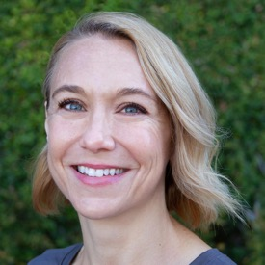
For related resources, or to reach me:
ELIZABETH MORRISON
LCSW, MAC
elizabeth@emorrisonconsulting.com
www.emorrisonconsulting.com
www.rsourced.com
Notes:
Shannon, UCLA, thank you; story about the title

