Slide 1

Medication Assisted Treatment, Opioid Use Disorder and Stigma
Providing Compassionate care
Grace Katie Bell MSN RN CARN PHN

Slide 2
Chapa-De Medication Assisted Treatment –one program, two sites
Our Team
  Annie Mascorro – RN Case Manager Auburn
  Katie Bell - RN Case Manager Grass Valley
  Holly Castro CAADC I – Substance Use Counselor Auburn
  Donita King – LMFT MAT Grass Valley
  John Bachman PhD –
    Interim Behavioral Health Director/MAT team supervisor
  Alinea Stevens MD – Auburn - Medical Dir.
    MAT Lead Provider
  Michael Quion MD – Grass Valley
  Dr. Julie Garchow MD – Auburn
  Sarah Bland FNP-C - Grass Valley

Slide 3

Our Program
RN Case manager model of MAT care
  Evidence based care
Focus on stabilization and whole person care
Harm-reduction and abstinent directed
Refill/Stabilization Group every week
Phased program
  Phase 1 – weekly groups, UDS and 7 day suboxone scripts, BH intake, outside treatment commitments
  Phase 2 – progress to 14 day Rx, group visits and UDS
  Phase 3 – progress to monthly visits, UDS and Rx refills

Slide 4
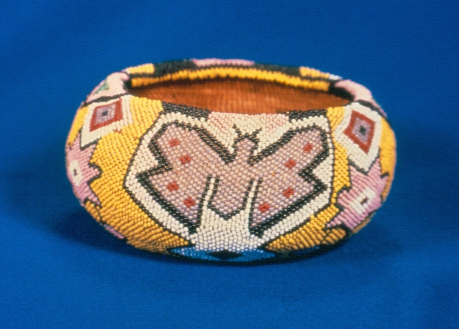
Pathway of Care
Trauma-informed care is essential with opioid use disorder
Education and Support
Level of Care per ASAM criteria
Case Management – refers based on LOC
  Referrals to outside Recovery Providers
  Referrals to community resources
Clear expectations
Phases of Care
Refill/Stabilization Groups

Slide 5
The Opioid Epidemic
Key Factors
Promotion of opioid pain management medications with inadequate research and slick, convincing marketing.
The VA and the Joint Commission developed and promoted assessing pain as the The 5th vital sign.
Patient Satisfaction Surveys focusing on pain management designed and promoted by Pharmaceutical companies.
Oxycontin - 1996 quickly became drug of abuse. Oxycodone – offers more euphoria than hydrocodone
Unethical prescribing and distribution
Powerful heroin distribution system to all parts of the country.
Multiple economic factors such as 2008 Recession, increased poverty, Iraq and Afghanistan wars.

Slide 6
Opioid Dependence + Behaviors = Opioid Use Disorder
Opioid Dependence is Physiologic – tolerance causes need to increase quantity to sustain effect; withdrawal symptoms when opioid is stopped.
Addictive Behaviors involve misuse such as taking more than prescribed or continued, compulsive use in the face of increasing consequences to health and wellness, diversion and relapse driven by craving and triggers.

Slide 7

Addiction or Substance Use Disorder?
Addiction is a chronic, progressive, relapsing disease. We use this term in Medicine – American Society of Addiction Medicine, Addictions RN, Addictionologist.
Substance Use Disorder – in Behavioral Health ( DSM-5) measured on a continuum of mild to moderate to severe. Opioid Use Disorder, Stimulant Use Disorder, Alcohol Use Disorder, etc.

Slide 8

A Guide to Acronyms and Terms
MAT – Medication-Assisted Treatment or Medications for Opioid Use Disorder (MOUD)
OUD – Opioid Use Disorder
Stigma – barrier to care communicated by language, judgmental attitude and because of this judgment, decrease in quality of care.
Diversion – trading, sharing, stealing, selling, buying illegal or prescribed controlled medications and substances.
Misuse – replaces the word abuse. Taking more than prescribed, using non-prescribed opioids including IV heroin.

Slide 9
Common terms
Harm-reduction – The defining features are the focus on the prevention of harm, rather than on the prevention of drug use itself, and the focus on people who continue to use drugs. Ex. Needle exchange, Opioid Replacement Therapy.
Abstinence – directed – SUD treatment which is focused on abstinence from all drugs and alcohol. “Clean and Sober”. Does not include tobacco or caffeine.
Level of Care (LOC) – using American Society of Addiction Medicine criteria for assessing whole person needs and best LOC for stabilization.

Slide 10
Stigma – in our thinking, attitude and our language
Stigma is shaped by our thinking – a bias and perception that substance users are “bad” and immoral rather than ill with a chronic condition requiring care and treatment. Often there is more than one chronic condition such as mental health disorders which also require care.
Stigma is communicated by tone, interpersonal attitude, body language.
Stigma is communicated by words.
Stigma becomes internalized by the person seeking help. The person views themselves as bad, as dirty, as weak which fuels the shame of stigma.

Slide 11
Stigmatizing language no longer used
“Abuse” as in Substance Abuse. Was identified as the only diagnosis which had the word abuse. “Misuse” or “Use”.
“Addict” – rather, person with substance use disorder or people who inject drugs or opioid users. Still used in 12 Step culture as a part of the recovery process.
“Drug-seeking” – can be re-framed as “relief-seeking”. Focus on the person rather than the behavior.
“Nodding Out” – a street term that is used to describe sedation caused by too many opioids or combining opioids with other sedating drugs.

Slide 12

Stigma is a secondary injury of substance use and can require treatment

Slide 13
The Stigma Injury – how to treat
Begin with acknowledgement of the injury caused by stigma
  Symptoms can be fear of Emergency Departments, distrust of medical providers; feelings of shame and dishonesty.
  If not treated, the person internalizes the shame and low-self worth caused by stigma
  OFFER HIGH DOSES OF:
Dignity
Empathy/ Compassion
Kindness
Respect
Listening

Slide 14

Urine Drug Screens - Labs
In medicine, we do not refer to lab results as “clean” or “dirty”, we use medical language at all times to support the dignity of our patients.
We say positive or negative. Consistent or Inconsistent.

Slide 15
The Human Suffering
Craving
“We need three things to survive (besides oxygen): food, water and dopamine. If you deprive study subjects of water for three days, then put them in a functional MRI and place water on their lips, the relative size of the craving is like a baseball. Do the same with food, and it is like a basketball. …Then, take someone with an addiction to opioids, up to one year after their last use, and talk about OxyContin while they are in a functional MRI, and the relative size of that craving is the size of a baseball field.” (Corey Waller MD, 2016)

Slide 16



Craving

Slide 17
Human Suffering
Opioid Withdrawal
11 primary symptoms - Clinical Opiate Withdrawal Scale (COWS)
  Elevated heart rate
  Pupil dilation
  Hot and Cold Sweats
  Intense over-all body aches, especially in back and legs
  Runny nose and tearing eyes
  Intense intestinal distress – cramping and diarrhea
  Severe anxiety and agitation
  Severe restlessness
  Tremors
  Yawning
  Gooseflesh

Slide 18
Human Suffering
Losses
Overdose deaths – 114 every day
Orphaned children
Grandparents raising families
Babies born with opioid dependence
Children in Foster Care
Overwhelmed agencies such as Law Enforcement, CPS and Emergency Services
Heart broken families and communities
Incarceration
Felonies
Medical challenges – HCV, HIV, Endocarditis, abscesses and cellulitis

Slide 19
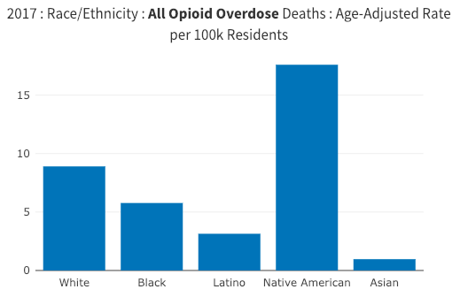
Consider the injustice of this epidemic

Slide 20
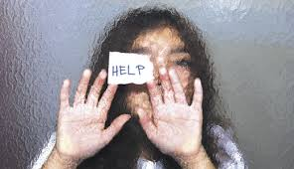

Slide 21

The Solution – Access to care
Addiction Treatment Starts Here
To increase access to care – Open doors to treating Opioid Use Disorder
  Develop a Medication-Assisted Treatment program
  Community Outreach and Education
  No Wrong Door – have an effective referral system
  Keep barriers to a minimum

Slide 22
The Solution – Medications of MAT
Buprenorphine - Suboxone, Sublocade – partial agonist opioid, high affinity for receptors, low activating, long-acting 37 hour half-life. No Cravings, No withdrawal, No euphoria. Normalizes the brain. Combined with naloxone is brand name Suboxone. Taken through skin – sublingual or transdermal. Also Subcutaneous injectable and implants.
Naloxone – Narcan – Opioid antagonist. Opioid overdose reversal treatment.
Naltrexone – monthly injection of long-acting opioid antagonist. Vivitrol. Blocks effects of opioids. Minimal relief of opioid cravings but effectively saves lives. This medication useful treating OUD with co-occurring Alcohol Use Disorder.

Slide 23
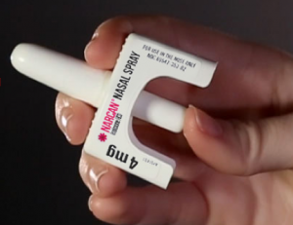
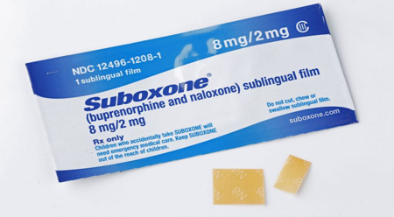
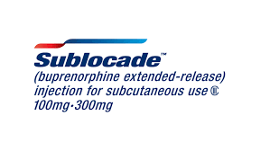
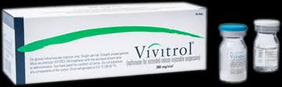
Suboxone, Narcan, Vivitrol

Slide 24



The Solution: Recovery and Wellness
Culture and Tradition
White Bison /Red Road to Wellbriety
  Restoration of wellness
  12 Step support
    Healers and Artists
    Culture and Identity
    Behavioral Health
    Life Directions
    Restored Relationships

Slide 25
What about Pain and Opioids?
Patients must be carefully assessed for co-morbidity and safety. When a change in medication is recommended, patient will need additional support, monitoring and choices along the way. This often requires more frequent visits. When managing these changes, go slowly, partner with and reassure patient: use the phrase “safely and comfortably”.
Consider Buprenorphine for Pain Program

Slide 26
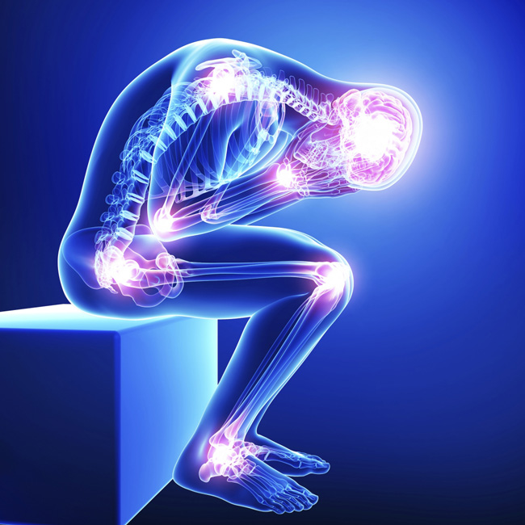
Assessing Pain Patients
Consider:
Is pain med regimen safe?
Is pain well-managed?
  Opioid Induced Hyperalgesia?
  Buprenorphine for Pain Management?
Is there a co-occurring Opioid Use Disorder? Mild – Moderate - Severe
Is there co-occurring substance use disorders? Increased alcohol use to manage pain as opioids decreased?
Re-evaluate benzodiazepine Rx – Generalized Anxiety Disorder tied to low-grade opioid withdrawal acquired from long term short-acting opioid therapy for pain.

Slide 27
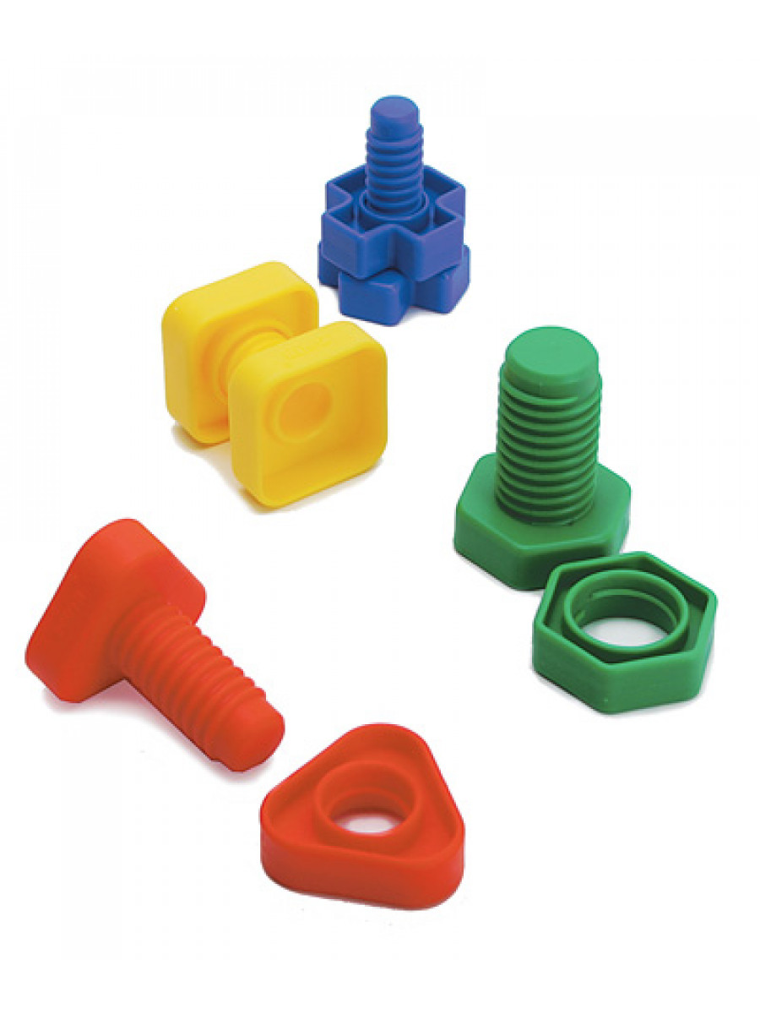
Building a Medication-Assisted Treatment Program in a busy Primary Care Setting
Waivered providers
Nursing support
BH therapists
Substance Use Counselors
Policies & Procedures
Treatment Agreement
Sustainability – billing and coding
Nuts & Bolts
  EHR templates
  Provider schedules
  Patient handouts/materials

Slide 28

Pathway of Care our OUD patients
  Focus on stabilization with medication, monitoring and recovery tools
Screening and referral
Importance of assessment
Begin with medical stabilization
Starting Buprenorphine (induction)
Right dose of medication
Hand off to Behavioral Health and SUD team
Treatment Agreement with Treatment Plan
Education and Support

Slide 29
Phases of Care
Phase 1
Harm Reduction and Abstinence-Directed
Weekly MAT group ( also known as refill/stabilization groups)
7 day suboxone Rx ( with refills, if appropriate and for clinic convenience
Weekly Point of Care Urine Drug Screens
Behavioral Health Biopsychosocial assessment with appropriate referrals for therapy and psychiatry within 30 days. Patients with immediate needs for continued medications and referral to psychiatry will be identified in Nursing Assessment And Medical Admission appointment.
Notes:
enter for Substance Abuse Treatment. Medication-Assisted Treatment for Opioid Addiction in Opioid Treatment Programs. Rockville (MD): Substance Abuse and Mental Health Services Administration (US); 2005. (Treatment Improvement Protocol (TIP) Series, No. 43.) Chapter 7. Phases of Treatment. Available from: https://www.ncbi.nlm.nih.gov/books/NBK64172/
Rationale for Phased Treatment Approach and Duration https://www.ncbi.nlm.nih.gov/books/NBK64172/#A83029

Slide 30
Phases of Care
Phase 2
Patient-centered decision made by the MAT Team
Patient has adhered to all requirements of their Phase 1 Treatment Plan
Meet with patient to update Treatment Agreement and Phase 2 expectations
14 day Suboxone Rx
14 day Urine Drug Screen
Bi-weekly attendance at MAT Refill/Stabilization Group

Slide 31
Phases of Care
Phase 3
30 day Rx ( or 28 day to keep pick-up days consistent throughout Phases)
One required Counseling visit – individual or group
Monthly UDS
MD visit every 90 days minimally, some patients prefer monthly visits
If relapse then increase care, patient returns to Phase 1 or Phase 2 per MAT team decision for more care and stabilization.

Slide 32
