Slide 1
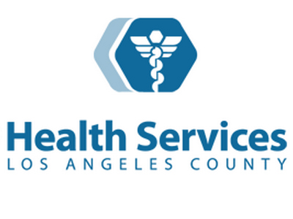
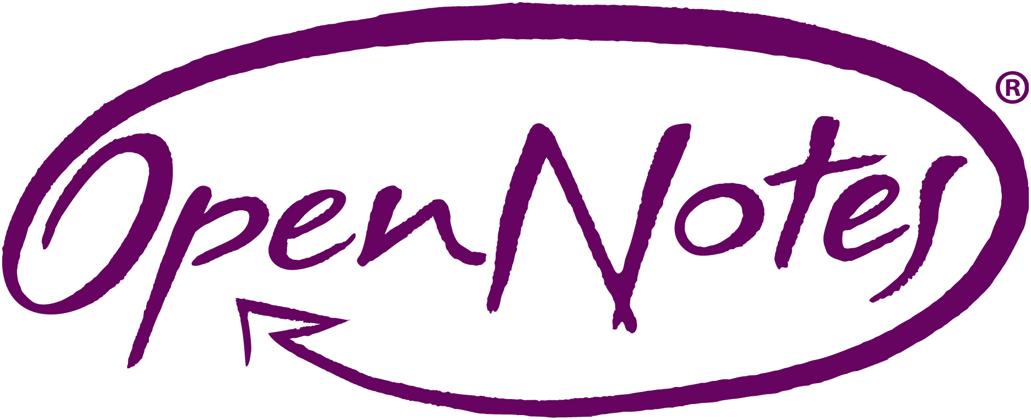
at
Last update: 4/24/18

Slide 2
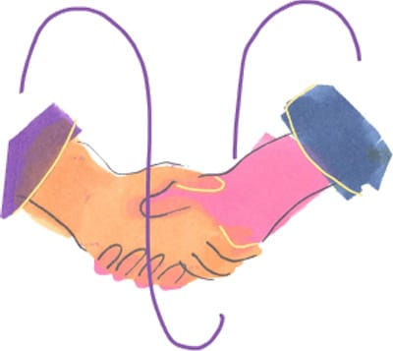
About OpenNotes
OpenNotes is a national movement dedicated to making health care more open and transparent by encouraging doctors, nurses, therapists, and others to share their visit notes with patients.
Began with a three-institution study in 2010, involving 105 primary care physicians and 20,000 of their patients.
Today more than 23 million U.S. patients have access to their visit notes through a secure, patient portal.
Notes:
----- Meeting Notes (9/23/15 14:09) -----
20 000 INVITED
ONE YEAR
NOW LOOK!!!!

Slide 3
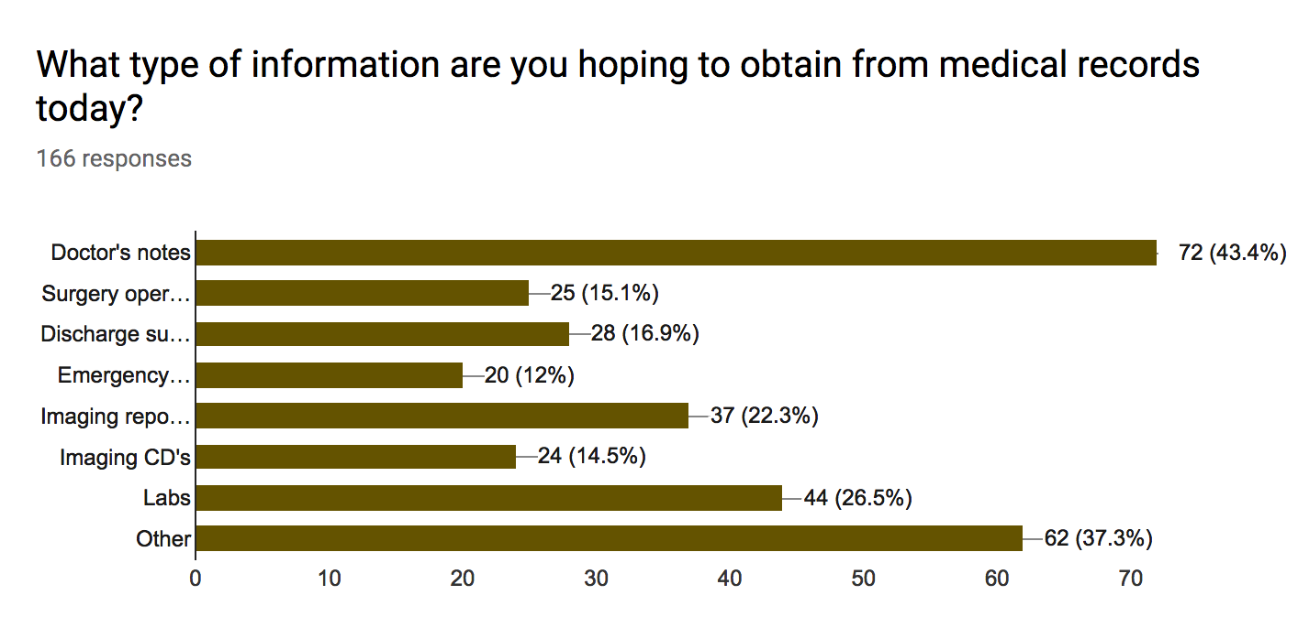
What data are our patients asking for? (DHS-wide Medical Records survey)
* Multiple responses were accepted

Slide 4
Why OpenNotes at DHS?
It is the right thing to do for our patients.
Patients feel more in control of their health and increased trust with their providers.
OpenNotes promotes patient centered care and patient engagement in their medical care.

Slide 5
DHS Logistics for OpenNotes

Slide 6
When Will Notes be Shared at DHS?
Notes written on or after release date (January 16th, 2018) will be shared with patients on the MyWellness patient portal.
Older notes (prior to release date) will not be shared.

Slide 7
When will the note post?
Notes will be posted after an 72 hours after the note has been signed in the chart.

Slide 8
Does OpenNotes = Open Chart?
No!
The purpose of sharing notes is for patients to better engage in the plan of care with their medical providers using key notes.
Reminder: Imaging notes are already being shared as of 3/5/2017.

Slide 9
Which Notes are Currently Being Shared
Inpatient: History and Physicals, Discharge Summaries, Specialty Consultations
Note: Please use the “consultation” note type for an initial consultation
Progress Notes will not be displayed (these can be wordy and difficult to follow)
Emergency Room: ED Provider Notes, UC Provider Notes
Outpatient: Specialty clinic notes

Slide 10
Which Primary Care Notes will be shared?
Adult Primary Care Outpt Provider Note
Disease Management Outpt Provider Note
Geriatric Medicine Outpt Nursing Note
HIV Primary Care Outpt Provider Note
Outpatient Clinic Generic Provider Note
Pediatrics Primary Outpt Provider Note
Not HUB notes

Slide 11
What will not be displayed at this time?
Behavioral Health/Mental Health notes
Parents will have not have access to adolescent notes
Pediatric HUB notes – forensic, foster care notes
Social Work notes – these can contain sensitive information
Phone messages and clinic communication – this is often casual, not relevant to care plan
Nursing notes

Slide 12
What about Adolescents?
At this time, MyWellness does not have adequate privacy protections for adolescents per California state law.
We are in the process of closing the adolescent access to MyWellness (age 12 – 18).
Cerner is currently working on this – anticipate this will be closed within 1 month.
At this time adolescents and parent proxies can only see appointments.
We have applied filters to the current accounts – notes, labs, radiology are not viewable.

Slide 13
What if there is a note I do not feel comfortable sharing with the patient?
Use “Sensitive” Note Type when writing this note.
May be relevant if you suspect physical abuse, substance abuse, some mental health concerns.
Powerchart: “Sensitive Note”
FirstNet: “ED Note-Provider (Sensitive)” “UC Note-Provider (Sensitive)”
This note is used rarely in health systems with OpenNotes (<1%).
Note: HIPAA allows patients to access these notes through the paper medical records process.

Slide 14
What will the patient see?

Slide 15
How should I modify my documentation to make more sense to my patients?
Do
Explain to patients what they may expect to see in notes
Expect patients to read, download and share your notes-write accordingly
Use situational wording to focus discussion on the problem at hand
Use plain language for planning, less jargon and abbreviations
Incorporate lab or study results
Include educational materials
Soften certain language:
Poor historian=patient could not recall
Patient denies=patient did not report
Noncompliant=patient chooses not to………
Don’t
Oversimplify notes
Omit sensitive issues such as obesity, substance abuse, mental health, suspicions of life threatening illness, etc.
Use pejoratives/judgmental terms e.g., fat, angry, resistant
Include jargon or abbreviations such as SOB (easily misinterpreted) or BID (not easily understood)

Slide 16
Additional Tips – Also see OpenNotes Sharepoint for Complete List of Tips
“I want you to look at my notes and make sure we are both on the same page.”
“Reading your notes may remind you about what we discussed when you get home. You can also share it with your family or caregivers if you would like.”
Minimize abbreviations. Edit your dot phrase templates to spell out phrases.
What would you think if you saw “F/U SOB” on an Assessment/Plan?
Obese patients. Review their body mass index and the definitions for overweight, obese, and morbidly obese with patients so that they understand why these terms are in the chart.

Slide 17
What if patient’s request corrections?
Patients do find errors in providers notes.
DHS already has a policy in place for amending notes – Policy 361.18. Please review this policy which is on the OpenNotes sharepoint.
Additional examples:
“Thanks for pointing out that I wrote ‘right knee’ rather than ‘left knee’; I’ll be sure to note the correction in your chart.”
“I understand you want your history of cocaine use removed from the medical record, but this information has important implications for your blood pressure and chest pain.”
“I’m sorry you disagree with my assessment that alcohol contributed to your fall. While I can’t change my medical opinion, if you’d like I can add that you disagree with it.”

Slide 18
Who is sharing notes in Los Angeles and in public hospitals?
Los Angeles
VA
UCLA - Neurology
Cedars Sinai – Primary Care
Kaiser Permanente - South Bay, Santa Monica, Woodland Hills, Fontana
Adventist Health
Providence Health
Memorial Care
Public Hospitals
Monterey County, CA
Harborview Medical Center, Seattle, WA
Billings Clinics, WY
Multiple Academic Hospitals with Public Hospital facilities
Cook County, Chicago, IL – planning phases

Slide 19
What is the data behind OpenNotes?

Slide 20
Initial OpenNotes Study Findings
Three out of four patients reported:
taking better care of themselves;
understanding their health and medical conditions better;
feeling more in control of their health and health care;
being better prepared for visits;
and doing better with taking their medications as prescribed.
Delbanco, Walker, et al, Annals of Internal Medicine
Notes:
----- Meeting Notes (9/22/15 12:18) -----
20 000 PATIENTS
----- Meeting Notes (9/23/15 14:09) -----
ONE DIAGNOSIS AND SIX PATIENTS IN 10 MINUTES!
SHOW YOU THE IMPACT OF FULLY TRANSPARENT NOTES INCLUDING THE DOC
MR A DIAGNOSIS? TREATMENT?
----- Meeting Notes (9/23/15 14:38) -----
TELL THE STORY. 40 YRS MR A
CIGS BEER
FAMILY
WONT WRITE DOWN UNLESS YOU THINK....

Slide 21
Caregivers Benefit as Much as Patients
88% of patients and 86% of caregivers had better formulated questions for the doctor.
86% of patients and 82% of caregivers had more productive discussions about the patient’s care.
94% of patients and their caregivers said they had a better understanding of patient health conditions, better remembered the patient’s care plan, and felt more in control of care.
71% of both patient and caregivers reported patients taking medications as prescribed more often.
Wolff, et al. JAMIA
Notes:
----- Meeting Notes (9/22/15 12:18) -----
20 000 PATIENTS
----- Meeting Notes (9/23/15 14:09) -----
ONE DIAGNOSIS AND SIX PATIENTS IN 10 MINUTES!
SHOW YOU THE IMPACT OF FULLY TRANSPARENT NOTES INCLUDING THE DOC
MR A DIAGNOSIS? TREATMENT?
----- Meeting Notes (9/23/15 14:38) -----
TELL THE STORY. 40 YRS MR A
CIGS BEER
FAMILY
WONT WRITE DOWN UNLESS YOU THINK....

Slide 22
Engaging Vulnerable Patients
New research challenges common assumptions about who benefits from electronic health information.
The majority of non-Caucasian patients and those with less formal education and/or poorer health ascribe high importance to reading notes.
Good opportunity for family member “proxies” as well
Vulnerable patients may find OpenNotes particularly valuable to understand and engage in their care.
OpenNotes may be used to engage patients who have been historically more challenging to reach.
Patients’ use of notes may be leveraged to improve safety and shared-decision making for all patients.
Gerard, et al, OpenNotes Safety Initiative

Slide 23
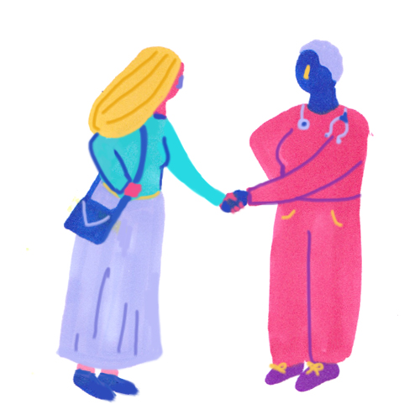
The Bottom Line for Patients
Patients want access to their visit notes, and 4 out of 5 say that the availability of OpenNotes would impact their choice of provider.
“[The note] helps me feel that my [doctor] and I are partners
in promoting my health.” – a patient
“We are grateful to receive “notes” to be able to review the
visit and procedures (if any) performed. Especially helpful
for older patients who may have hearing and/or some cognitive (or) memory loss.” – a patient
Notes:
23

Slide 24
What We’re Learning from Clinicians
Many expect a change to workflow, but those concerns do not bear out. In the initial study and over time, very few clinicians report any impact on workflow, with only 3% reporting longer visits or more questions.
Clinicians have concerns that patients will worry or be confused by notes, but this rarely happens. Patients are more likely to report gratitude for having access to their notes and greater satisfaction with their care.
Clinicians report little change in the way they write notes, and those who do, remark that the changes are minor and doable, such as using less jargon and spelling out abbreviations and acronyms, and that the changes make their notes better.
Notes:
Clini

Slide 25
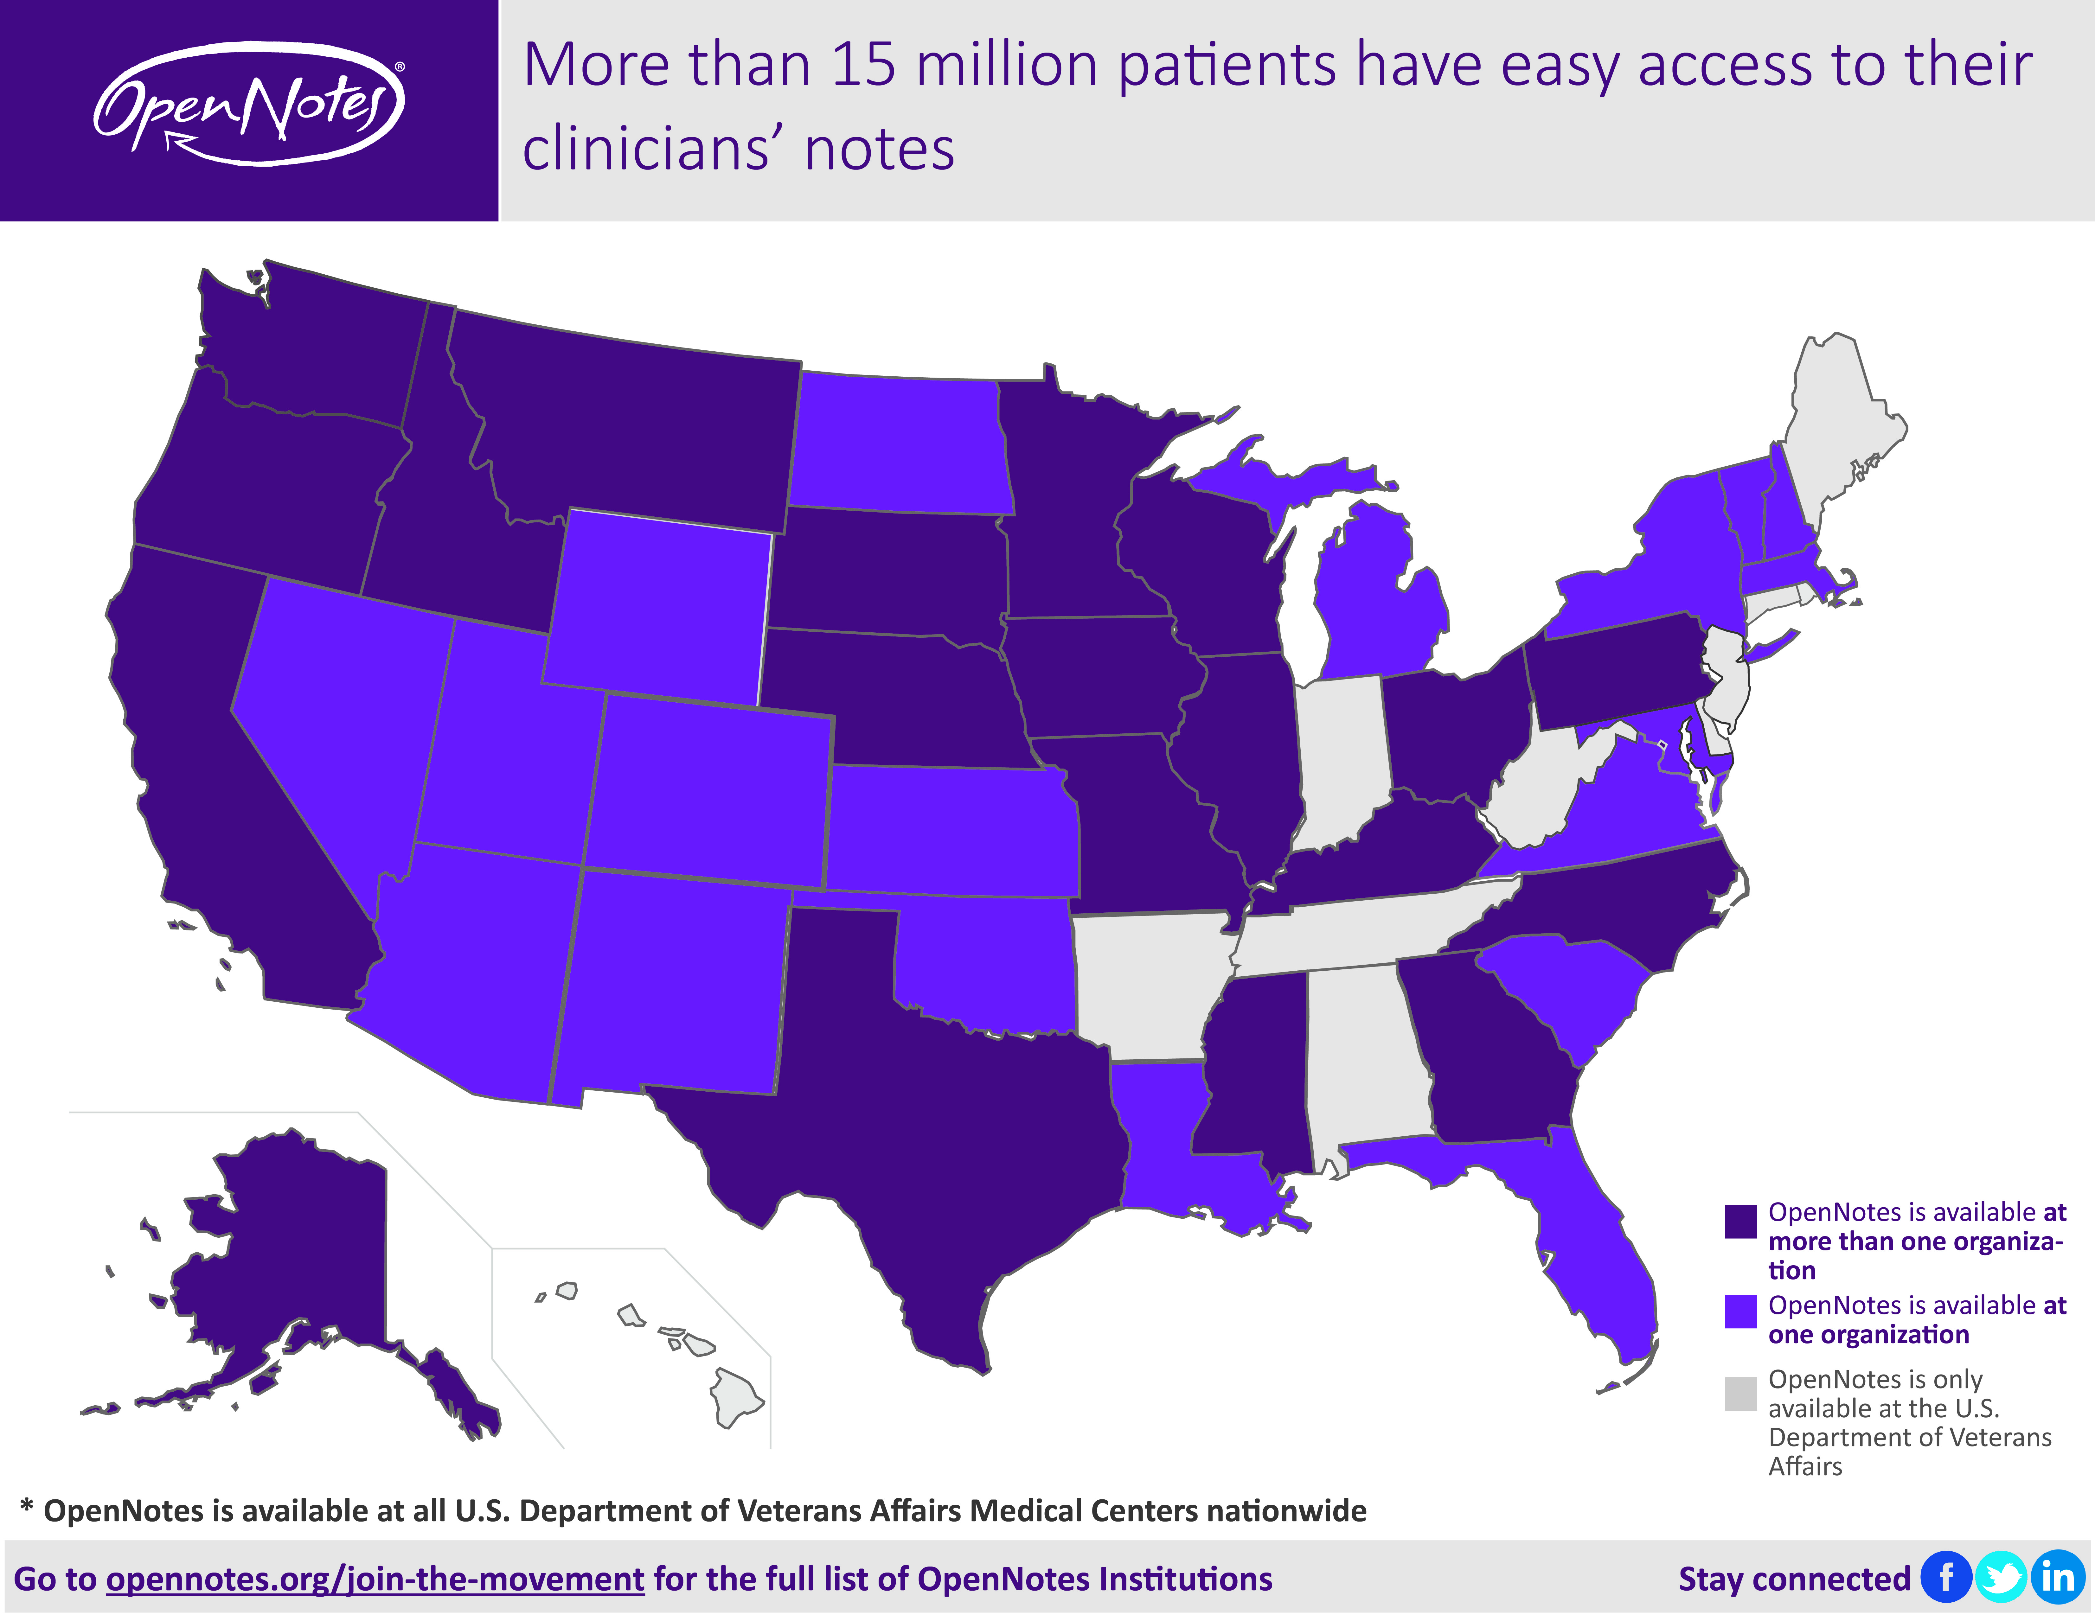
Notes:
Now 20+ million

Slide 26
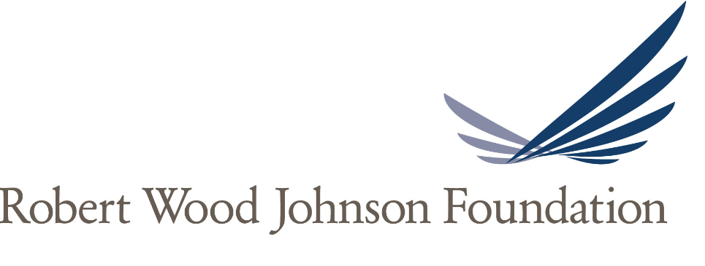
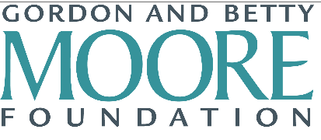
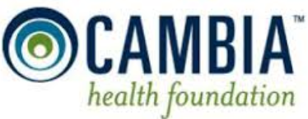
Thank You from OpenNotes!
Please visit the OpenNotes website for more information,
including research, videos, FAQs and toolkits.
www.opennotes.org
OpenNotes is supported by a combined grant from four leading foundations.
Notes:
----- Meeting Notes (9/23/15 14:09) -----
20 000 INVITED
ONE YEAR
NOW LOOK!!!!

