Slide 1



All hands on deck
For mywellness
Increasing Patient Portal Enrollment & Engagement

Slide 2
Objectives
All hands on deck for mywellness
Verbalize Purpose of Patient Portal Initiative
Understand Opt Out Strategy
  Invite all new and return patients at registration!
Demonstrate
  How to generate email invitation at registration
  How to generate email invitation using nursing workflow
View patient portal from patient’s perspective
Introduce Patient Portal Enrollment Station
Notes:
Ivania
Low income pt., lives several hours away, 3 children
Wants view lab results, ease anxiety about state of her health
Takes day off work, travels several hrs. brought children to clinic only to be told she has to drag her children to a different building to go to medical records, pay fee…when she could have just been offered PP enrollment over the phone/in clinic and viewed lab results at home

Slide 3
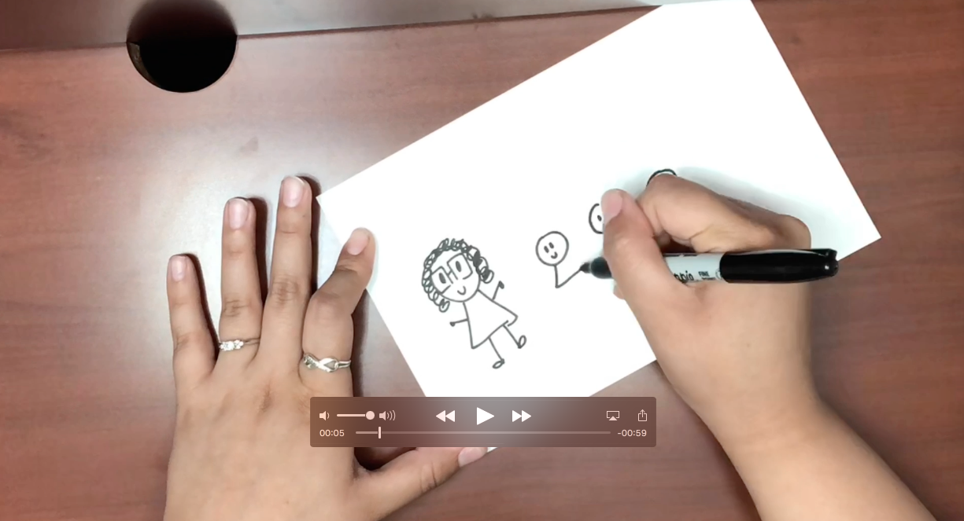
Introduction
All hands on deck for mywellness
Mrs. Garcia https://youtu.be/kIWZFRMtPD8
Notes:
Ivania
Low income pt., lives several hours away, 3 children
Wants view lab results, ease anxiety about state of her health
Takes day off work, travels several hrs. brought children to clinic only to be told she has to drag her children to a different building to go to medical records, pay fee…when she could have just been offered PP enrollment over the phone/in clinic and viewed lab results at home

Slide 4
All hands on deck for mywellNess
LAC+USC PRIMARY CARE ADULT WEST MYWELLNESS PORTAL ENROLLMENT PATIENTS CHECKED OUT BY MONTH
Notes:
. So we have some work to do…

Slide 5
LAC+USC PRIMARY CARE ADULT WEST MYWELLNESS PORTAL ENROLLMENT OVER TIME
All hands on deck for mywellness

Slide 6
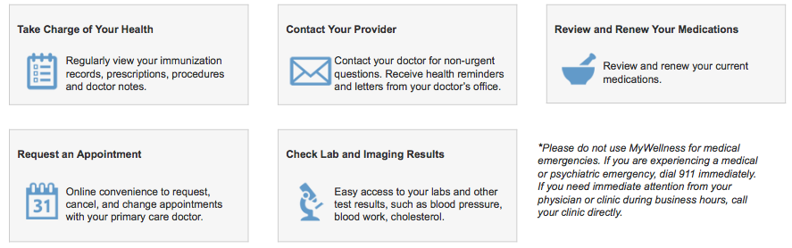
Introduction
All hands on deck for mywellness
  Patient Portal- Helps Patients Manage Care Remotely from Home
Notes:
Ivania

Slide 7
Purpose of Initiative
All hands on deck for mywellness
Increase Patient Portal Enrollment Rate
Increase Patient Engagement
Notes:
Toni
Pt no longer has to drive all the way here, wait on phpone, ask for refill then have to wiat several days to have requests processed
Improve meaningful patient access to primary care services
Increase care teams’ ability to communicate and engage with defined populations
Start (Jan.): 1.53% total enrollment rate (26/1700)

Slide 8
Why Should I Care?
All hands on deck for mywellness
Improves pt. access to care team
Improves care team access to patients
Improve patient engagement, awareness and management of health conditions
Help with outreach initiatives!
Improve efficiency around phone calls, refills, questions about results
Reduce incoming calls and walk-in requests!
Notes:
Toni
Pt no longer has to drive all the way here, wait on phpone, ask for refill then have to wiat several days to have requests processed
Improve meaningful patient access to primary care services
Increase care teams’ ability to communicate and engage with defined populations
Start (Jan.): 1.53% total enrollment rate (26/1700)

Slide 9

All hands on deck for mywellness
Q1: What is the purpose of the patient portal initiative?
    Increase Patient Portal Enrollment Rate
    Increase Patient Engagement

Slide 10
Goal
All hands on deck for mywellness
Increase patient portal enrollment from 2.88% to 5% by June 30, 2018

Slide 11
Mywellness portal enrollment rate
All hands on deck for mywellness
EMPANELED PATIENTS
Notes:
Ivania
We are now beginning to see a decline in enrollment within our clinic. 3.66% of all patients that checked out enrolled into the MyWellness Portal in September. So we have some work to do…

Slide 12
Initiatives to Increase Enrollment Rate
All hands on deck for mywellness
Opt Out Strategy
  Generate email invitation for all patients at registration!
Integrate enrollment into provider and nursing workflow
  CMAs
  PCPs
  RNs
  Everyone- customer service recovery tool
MyWellness portal enrollment station
Notes:
Toni
Oppt out strategy- not giving patients a choice

Slide 13
All hands on deck for mywellness
Opt Out Strategy

Slide 14
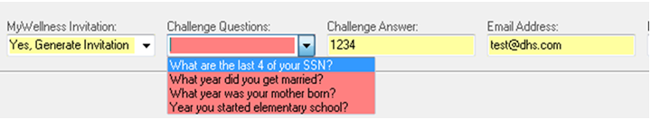
OPT OUT STRATEGY
All hands on deck for mywellness
Generate email invitation for all patients at registration
If patient interested and has email address or desires to use a proxy email address:
  Flip MyWellness Invitation indicator to “Yes, Generate Invitation”
  Read 4 challenge questions and have patient choose one (recommend using last 4 digits of SSN)
  Type in 4-digit answer
  Enter patient’s E-mail Address- confirm, by reading the email address back to patient!
  Press “Complete”
Notes:
Jessica

Slide 15
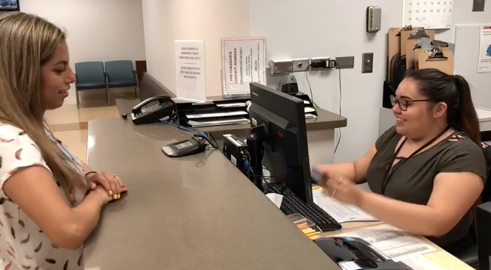
OPT OUT STRATEGY
All hands on deck for mywellness
https://youtu.be/NxMPa6cVisc
Notes:
IVANIA
Now describe 3 or 4 parts of the solution and feedback from testing it
Opt Out Strategy
Here is how we use the opt out strategy in clinic. Please pay close attention, because all staff working at the front desk will be asked to implement the opt out strategy.

Slide 16
OPT OUT STRATEGY
Generate Email Invitation at Registration
All hands on deck for mywellness
DEMO
Notes:
Jessica

Slide 17
Q2 : What is the Opt Out Strategy?
All hands on deck for mywellness
Generating email invitation for all patients at registration!
Notes:
Jessica

Slide 18
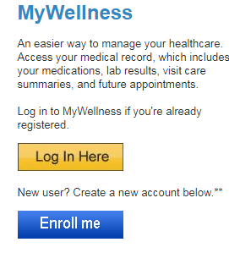
Sample Script
All hands on deck for mywellness
After verifying demographics during registration/scheduling ask patients
  “May I have your email address? If it is easier for you, you can write it down.”
2. If no, patient states no email address
  “Do you have a family member or friend who helps you manage your healthcare information? I can set them up as a “proxy” for your MyWellness account. A proxy is an authorized user that has permission to access your account. They will have full access to help you manage your health information and your medical record.”
3. If No, states no email address and declines proxy:
  “You can create an email account for yourself and go to this website: http://dhs.lacounty.gov/wps/portal/dhs/mywellness/ enroll using
  medical record number and social security number”
Notes:
Jessica

Slide 19
Sample Script
All hands on deck for mywellness
4. If Yes:
  “I’m sending you an invitation to sign up online in order to access your medical record, including your provider’s notes and all of your results. You can find the invitation in your email folder. Make sure you check your Spam folder in case you don’t see it.”
  “When you access your email invitation, click on the link provided. You’ll me asked for the answer to a challenge question. This will be the last four digits of your social security number.”
  Use standardized challenge answer, last 4 digits of SSN, to generate invitation.
Notes:
Jessica

Slide 20
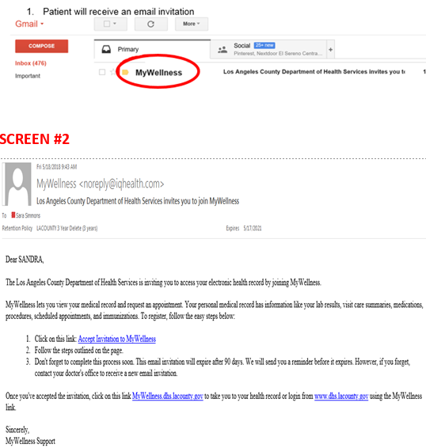
What do patients see at home?
All hands on deck for mywellness
Patient will receive an email invitation
Click on link to accept invitation
Notes:
Jessica

Slide 21
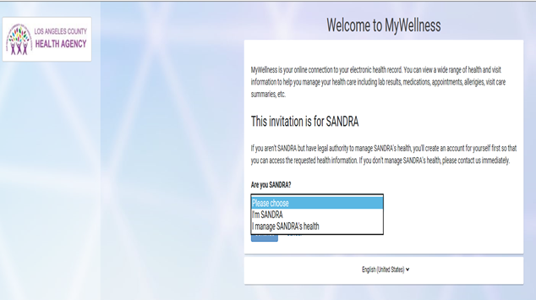
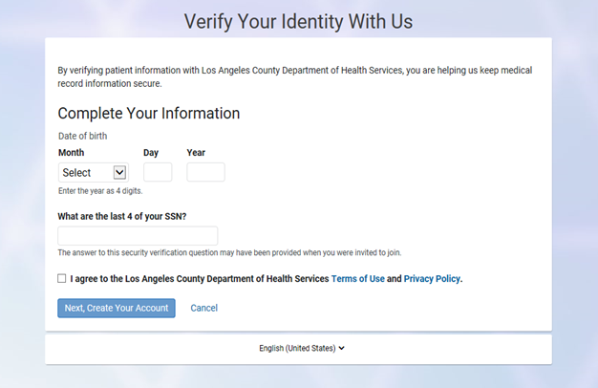
What do patients see at home?
All hands on deck for mywellness
3. Create Account
Notes:
Jessica

Slide 22
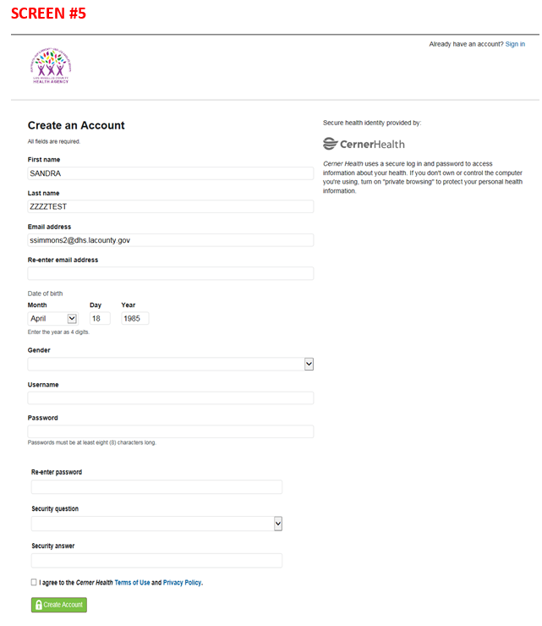
What do patients see at home?
All hands on deck for mywellness
Notes:
Jessica

Slide 23
All hands on deck
For mywellness
Nursing Workflow Demo

Slide 24
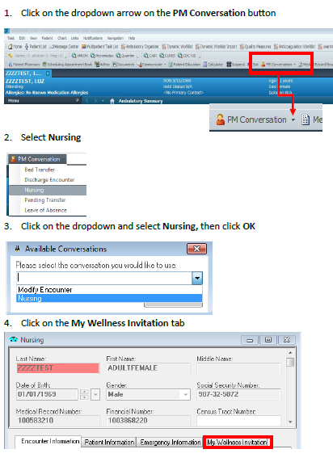
Nursing Workflow
All hands on deck for mywellness
Notes:
Jessica

Slide 25
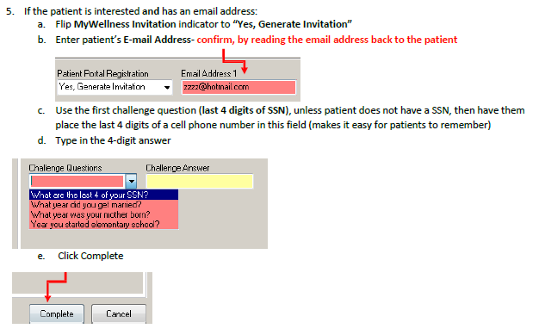
Nursing Workflow
All hands on deck for mywellness
Notes:
Jessica

Slide 26
What do patients see at home?
All hands on deck for mywellness
Notes:
Jessica

Slide 27
Initiatives to Increase Enrollment Rate
All hands on deck for mywellness
Everyone can invite patients as customer service recovery tool
  Missed appointments
  View lab results
  Medication refill requests
Notes:
Toni
Oppt out strategy- not giving patients a choice

Slide 28
Nursing Workflow
All hands on deck for mywellness
Q2 : How does an RN/CMA generate email invitation for patients? Demonstrate.
Notes:
Ivania

Slide 29
All hands on deck
For mywellness
Patient Portal Demo-
Patient’s Perspective

Slide 30
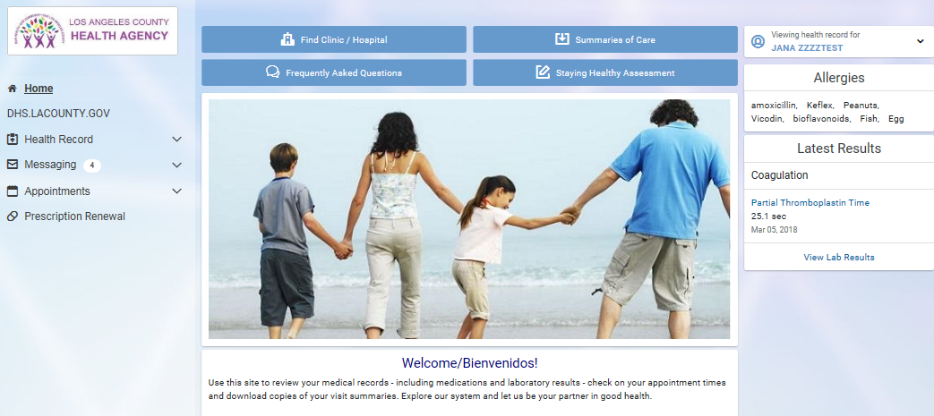
MyWellness Portal
All hands on deck for mywellness
Test Patient
Username: testjana
Password: cerner2016
Notes:
Ivania

Slide 31
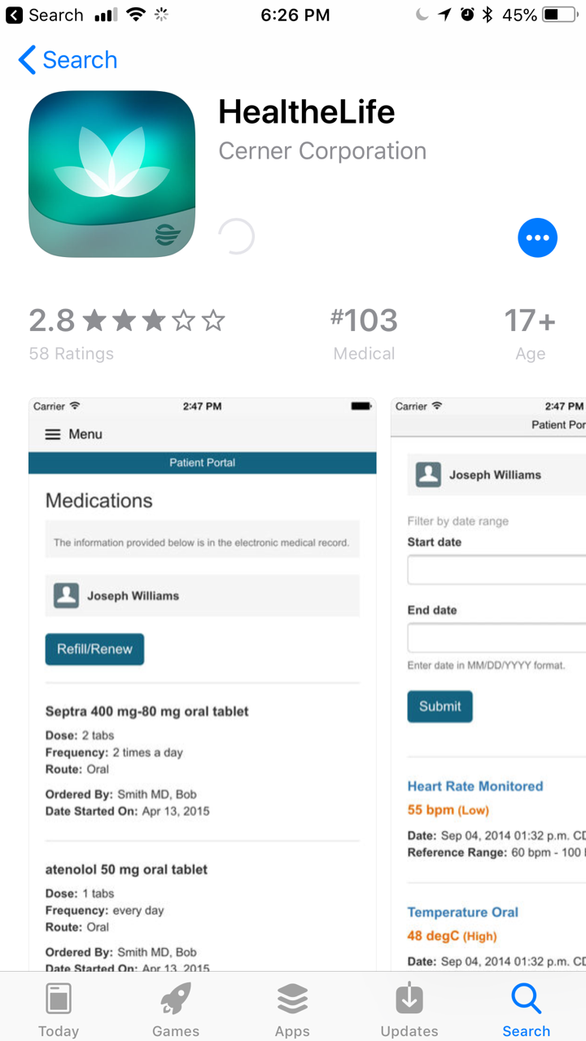
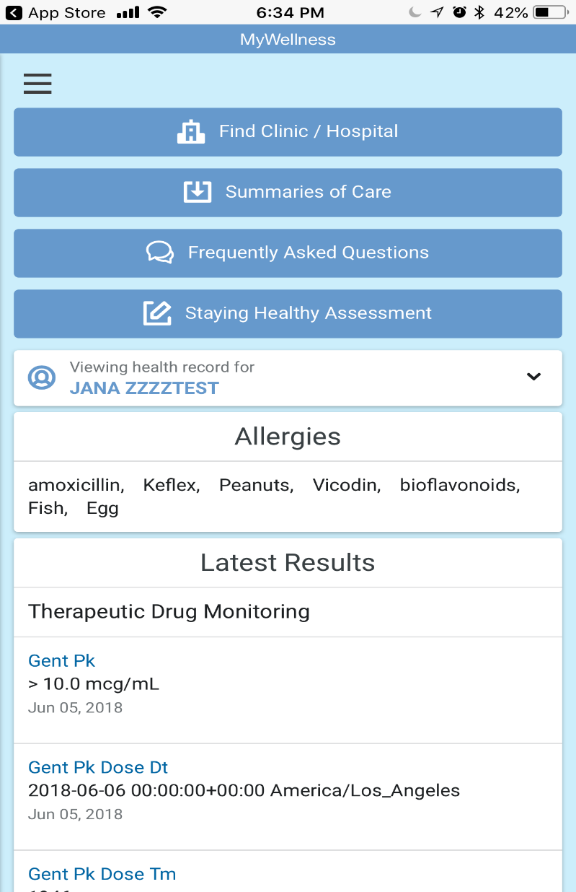
MyWellness Portal Application-HealtheLife
All hands on deck for mywellness
Notes:
Ivania

Slide 32
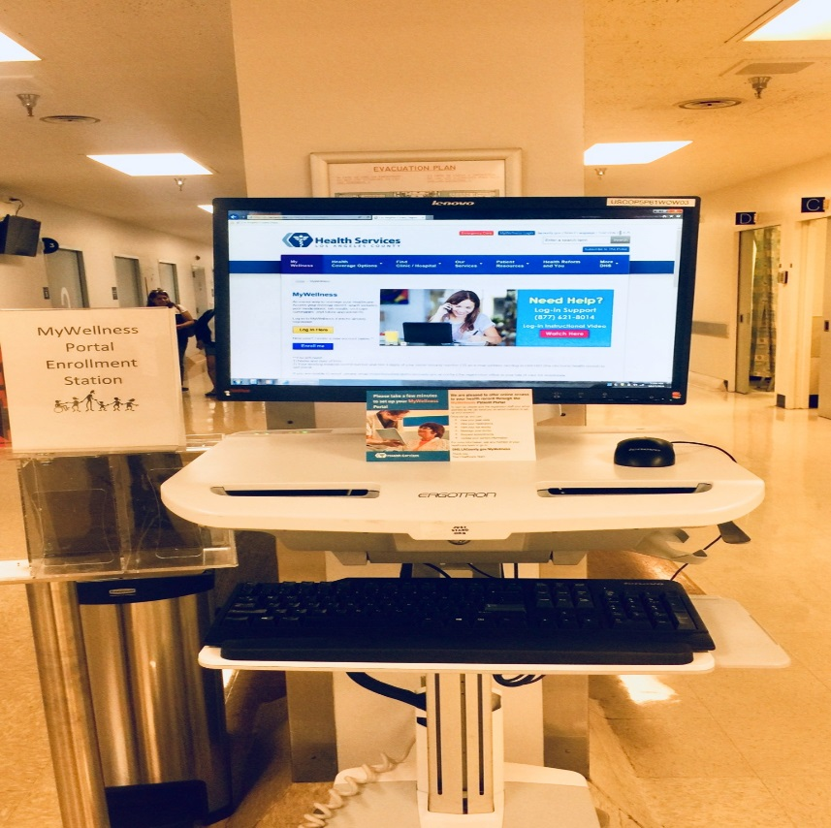
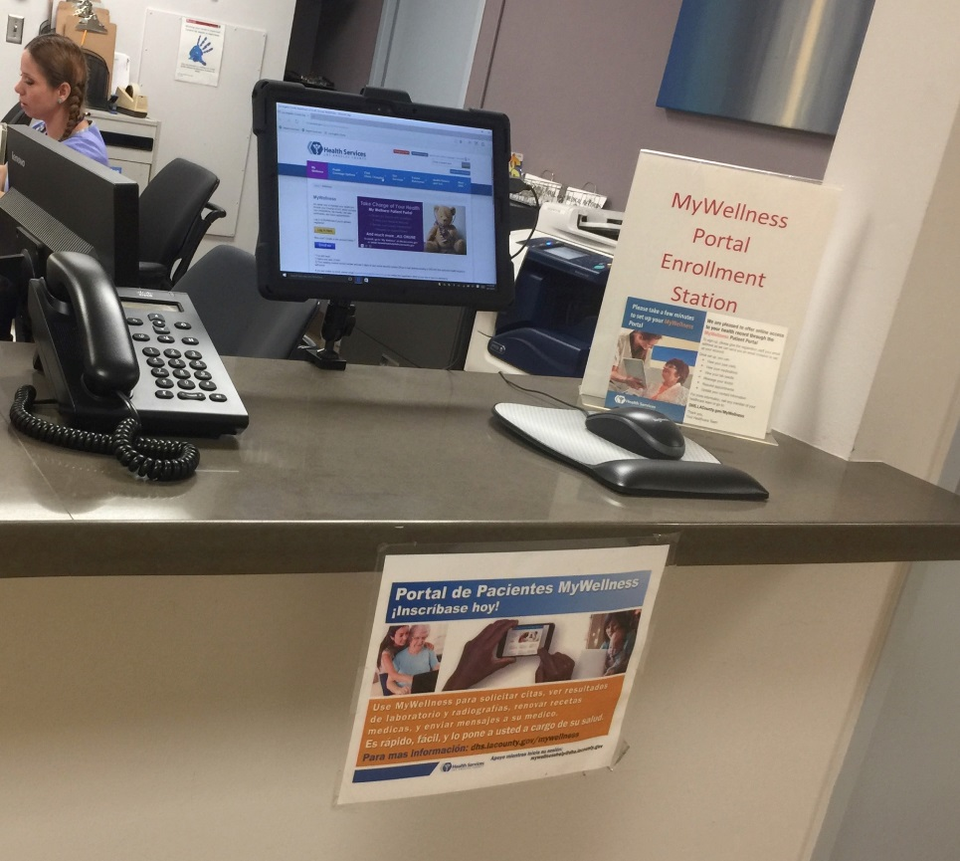
Patient Portal Enrollment Station
All hands on deck for mywellness
Increasing Patient Portal Enrollment and Engagement
Notes:
Jessica

Slide 33
Q&As
All hands on deck for mywellness
Q: Can adult use a “proxy” ( designate another adult to be able to login to their MyWellness account for them?
  A: Yes.
2. Q: Can providers and their nurses invite patients to join MyWellness portal as part of their workflow?
  A: Yes!
3. Q: Which labs are not viewable?
  HIV, STD, Hepatitis, pathology
4. Q: Which Imaging Results are Viewable?
  All radiology results
5. How long will it take for radiology results to be viewable?
  A: 72 hours
Notes:
Jessica

Slide 34
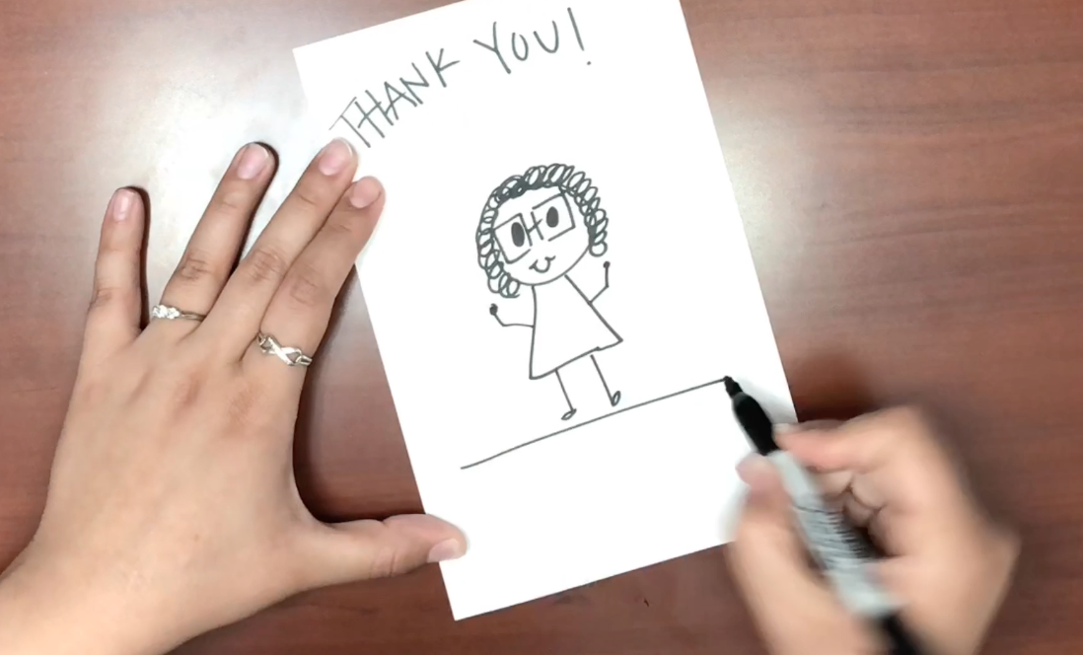
Let’s work together to enroll patients in MyWellness Portal! https://youtu.be/LWBqMnZ5Mmc
All hands on deck for mywellness
Notes:
Ivania

