Slide 1
The Hub Innovation Program Evaluation Plan
Draft for Discussion
January 8 2019

Slide 2
Overview of document
The Hub Innovation Program and Theory of Change drives the evaluation plan and focus. The core belief is that a combination of strategies and programming for Hub organizations, will lead to Hub activity and output, which will lead to greater awareness and capability to adopt new technologies, and to sharing of insights with others to meet the overall goal of improved patient health and experience. The evaluation plan is designed to test this thinking and identify opportunities for improvements to the Hubs program.
The Evaluation plan is designed to meet the needs of Hub organizations, CCI and CHCF and aims to place a very modest burden on the Hubs organizations.
The plan includes preparation (interviews/data analysis) prior to a survey to be completed by each Hub organization, followed up by 1-1 interviews with Hub organization leaders, with a review of findings and brainstorming on program improvements at the San Mateo May meeting. We anticipate time from Hubs will be approximately 2 hours over 6 months, outside of regular meetings such as the San Mateo meeting and in regular calls (as desired).
The ask of the Hub Organizations for January:
Please review the theory of change and overall plan, and provide feedback during the regular Hubs call January 25 2019
Identify 1 person to be the point of contact for this evaluation, who will respond to the survey, and be interviewed (organizations can provide several survey responses if desired, and/or provide several people to be on the single interview)

Slide 3
Hubs Innovation Program Theory of Change Ultimate Goal: Improve safety net patient health and experience by expanding SNP capacity to serve patients Hub Program Goal: Accelerate underserved populations’ access to high-value care by cultivating SNPO’s ability and motivation to assess and adopt new technologies
The Hub Innovation Program is based on a theory of change that selecting the right Hub organizations, providing them optimal programming and network tools will enable better and faster technology adoption at Hub organizations and in the wider safety net
Draft for discussion
Hub Program
Strategy & Activities
Select and resource specific organizations to vet, test, implement, and share findings on technologies
Support Hubs with programming with grants for Hub organizations to:
Create dissemination tools such as case studies and webinars
Attend trainings, site visits, conferences to create awareness of and skills for innovation
Connect Hubs teams with advisors and programs such as the Innovation Catalyst
Access and a guide to the wider innovation system
Create and enable a network to share findings with other Hubs and the wider SN health system
4. Track and catalogue SNPO’s long-term progress in exploring, testing, adopting and spreading solutions enterprise wide
Direct Outputs from Hub Organizations
Active participation in the Hub programming
Activity in their own organization on defining needs, vetting, assessing, piloting and adopting technologies
Active engagement with spreading insights into their organizations.
Sharing insights on tech assessment, adoption, and use of Hub programming tools with wider safety net system
Impact on Hub Organizations and on the wider SN health system
Immediate:
Faster pace of awareness, experimentation of high potential technologies across Hub organizations
Greater adoption of technologies
Increase in skills and motivation to define the problem, assess need for technology, determine buy vs build, and then vet, pilot and adopt technologies
Longer term:
Improved patient health and experience
Additional SNPO capacity to provide care
Cost efficiencies for SNPOs

Slide 4
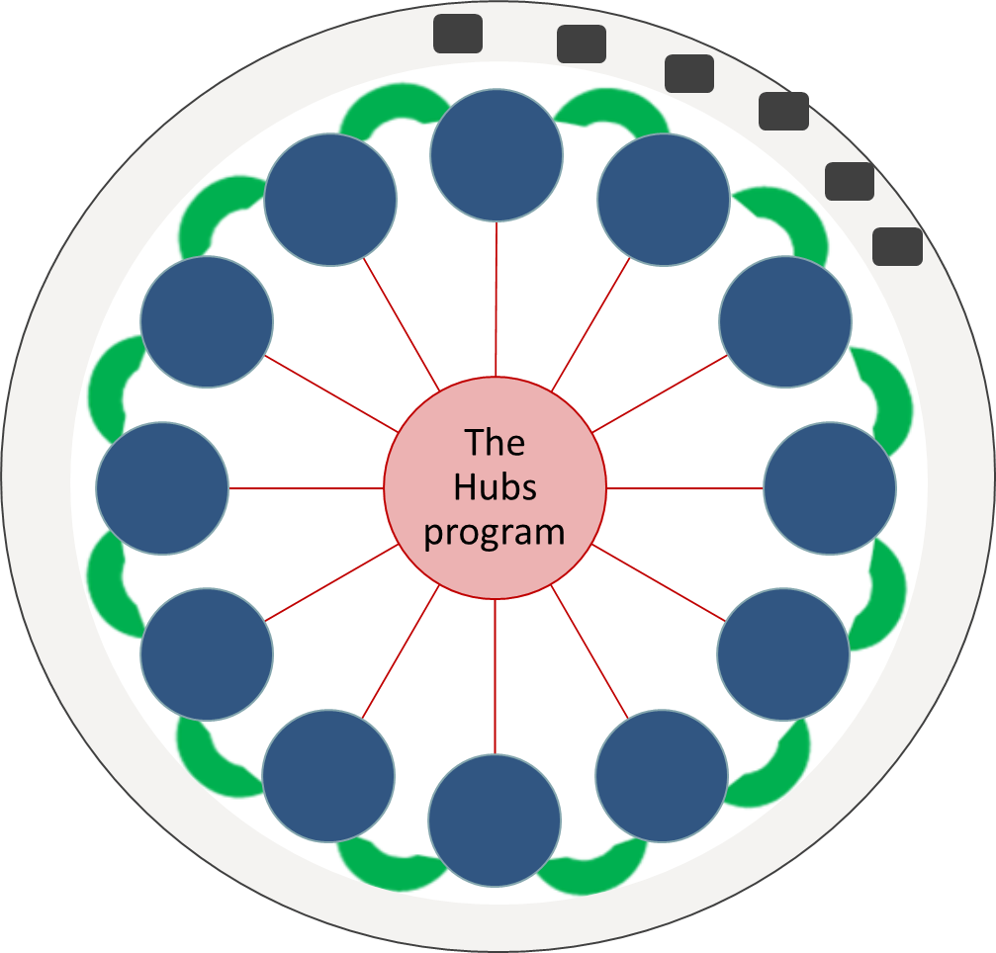
Expanding on Column 1 of the Theory of Change The Hub Program is a combination of selected Hub organizations, programming delivered to Hub organizations, Hub-Hub engagement and Hub-wider safety net to spread insights to the wider safety net with a communication catalog
Hub Organizations
12 selected organizations that receive and engage through programming
Hub Programming
Combination of grants, tools, visits, webinars, training, advisors for Hub Organizations
Hub Network engagement
Tools and space to enable sharing of insights within a Hub organization, Hub-Hub and Hub to wider safety net
Communication catalog
Hub Org’n
Hubs Progra-mming
Hub-Hub engagement
Engage-ment with Wider SN innovation ecosystem

Slide 5
The Goals of the Evaluation are to understand the validity of the theory of change: the impact of the overall program at the Hub organizations, the “spread” of insights to the wider safety net and generate recommendations for program improvement
Goals
Evaluate impact of the program (as a whole and specific components) at the Hub organizations on their ability and capacity to adopt technologies
Evaluate the components of the program: Hub organizations, Hub programming, Use of Network Strategy, Communication Catalog
Understand the Hubs organizations’ engagement with the wider-safety net on sharing learnings to understand if and how information and insights are shared from the Hub organizations to the wider safety net and identify ways to improve this spread
Generate and prioritize ideas for improvements for the Hubs program (current program and future iterations)
Other Goals
Gain insights on how to evaluate capacity building for other CHCF programs
However, it’s not about duplicating the CCI data on program tracking e.g., which and the number of technologies vetted or use of programming
© The Scott Group 2019

Slide 6
The evaluation will focus on the impact of the Hub program on Hub organizations and the spread of insights from the Hub organizations to the wider safety net
Impact at Hub organizations
1. What is the impact of the Hubs Program at Hubs organizations?
2. Which Hub organizations experienced greater impact from the Hub program and why?
3. Which components of the Hub programming are working well or not working well for the Hub organizations?
Draft for discussion
6. What are the recommended improvements to the Hub Program to increase impact at the Hub Organizations and to further enable spread?
Extent of “spread”
4. How and to what extent are Hub organizations engaging and sharing learnings with the broader safety net sector?
5. Which components of the Hub program most enable “spread” to the wider Safety Net?

Slide 7
The Evaluation will use qualitative and quantitative data to generate insights including a tailored survey, 1-1 interviews, group engagement and polling
Draft for discussion
Key tasks: Mine CCI data; initial Hub organization and CCI interviews (to shape survey), create/deploy tailored survey to the Hubs organizations; interview remaining Hub leads; segment Hubs; engage group at Hubs meeting (interim findings and polling for improvements); interview dropped Hub participants; online focus group TBD
Activities:
Analyze Hub use of the program activities (leverage CCI and CCHE data) Create interview guide; Conduct 3-4 interviews with Hub organizations and CCI to inform the project plan and survey design
Create survey tool; test tool deploy mid February
Survey analysis
Interview remaining 8 Hub organizations 1-1, and other CCI staff
Engage group
Conduct Segmentation Analysis
Create “dropped” interview guide; Interview 3 participants from dropped Hub organizations
Synthesize findings, share interim findings at Hubs event
San Mateo; Poll group at event for improvements
Create final report and host
workshop on Findings
Jan
Feb
March
April
May
June

Slide 8
Approximate time investment for the Hub organizations, CCI and CHCF
The Hub Organizations
CCI
CHCF
One 1-1 interview with each lead in the Hub organization (30-60 min)
Survey response (likely 30 min max for 1 survey) February 2018
Short (15-30 min or less) engagement on some of the regularly scheduled Hub calls
~60-90 minutes of engagement at the San Mateo meeting on findings and polling on program and “spread” improvements
Provide data from the CCI evaluation and the Hubs engagement; help guide the analysis to ensure relevance to the data interpretation
Engage twice a month on hypotheses, findings, data, survey tool design, interview guide protocol and on the time/format for the San Mateo meeting engagement
2-3 CCI Staff interviews
Total time ~4-5 hours per month (including initial and final workshops)
Engage twice a month on the evaluation plan, tools, findings, or as desired (limit of 3 rounds of edits for evaluation tools)
Participate in the optional advisor calls, as desired
Participation in the San Mateo workshop TBD by CHCF

