Slide 1
Path Ahead
May, 2018

Slide 2
Overview
Upstream Health Innovations (UHI) launched in April 2015, with the support of a $2.5M Community Health Grant from United Health Foundation
UHI employs ethnographic research and human-centered design to develop approaches to community health with a focus on: Patient Care, Engagement, and Social Determinants of Health
UHI develops innovations that address barriers to healthcare access among patients and community members with complex socioeconomic and health issues by shifting the focus to upstream opportunities
UHI seeks to nurture personal capacity and engage community partners to co-create a new model of health that enables people to achieve personal well-being

Slide 3
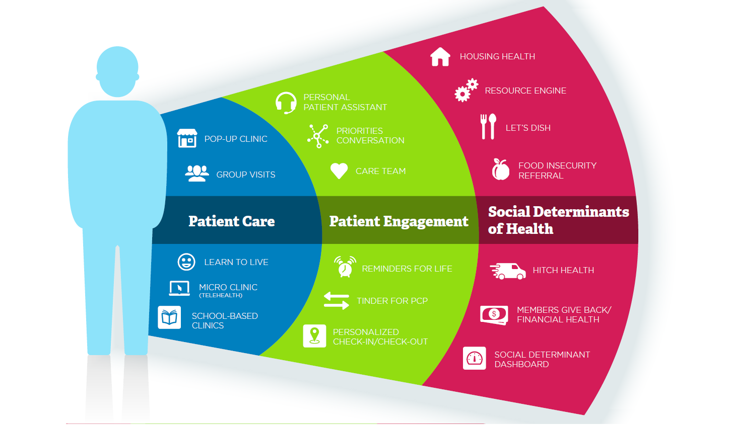
Active Portfolio

Slide 4
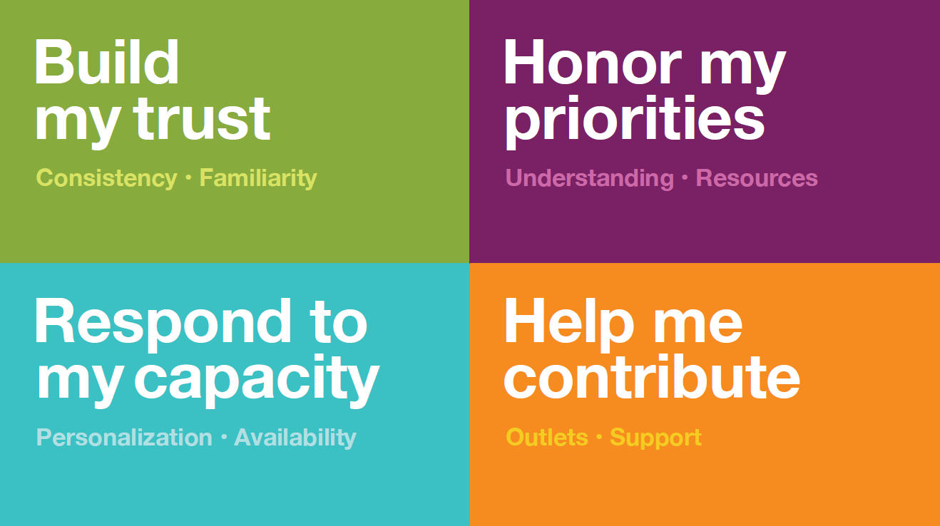
Ethnographic Learnings

Slide 5
Path Ahead
“This is exactly what I need now. Now I have done my mental health program, and I don’t have to focus on that – not have that be the biggest concern in my life. Now I feel ready to expand. I need to get beyond being mentally ill. I need to get back into the community.”
- S., now volunteering
Vocational rehab program that teaches job seeking and financial health skills.
Supports clients to secure meaningful employment or volunteer roles while fulfilling a sense of “giving back”, as well as, self-confidence.
“Without Members Give Back, I probably would never have thought to go get a job. I would feel like I wasn’t capable of it, ‘My resume sucks, I have a big gap in work, no one would want to hire me.’
I didn’t feel capable of having a job. But talking about having accommodations and different types of jobs, it opened my eyes more. If I’m having a bad day, it motivates me to stay in group, because I know that I have Members Give Back that afternoon. I always feel so much better.
- M., now employed part-time
Notes:
6 of 9 have paid positions
5 of 9 have volunteer positions (2 overlap)
Cost of program $1400 per patient less than an ED visit.
Pre: 9 ED visits
Post through Nov: 0
Pre number of Medications: 243
Post through Nov: 108
The program is composed of a 10-week series of group and 1:1 sessions, followed by ongoing support for up to 6 months. Clients complete the program with an updated resume, cover letter, thank you note, and interview preparation, as well as increased familiarity with additional financial and work-related skills.
The program contributes to a client’s rehabilitation treatment plan by helping them reintegrate into daily life through a structured role. This aligns with the goals of HCMC’s rehab programs, and meets an often unfilled need for employment services.
An initial prototype was tested with a cohort of 9 current clients or recent graduates of the Day Treatment Program, specifically the mood and personality disorder track. To date, 7 out of 9 Members have successfully entered or are about to enter an employment or volunteer opportunity. Collection of post-assessments are in progress.

Slide 6
Prototyping Team
Our cross-disciplinary team tested elements of Path Ahead through visual and behavioral prototyping.
Cohort
Core Team
Advisors & Supporters
Day Treatment Program leadership
Volunteer Services manager
Psychiatry Manager
Chief of Psychology
Psychology Manager
Lifetrack supervisors
Upstream Health team
Occupational Therapist, serving as the Link
2 employment specialists from Lifetrack
Branch Manager of U.S. Bank
Coordinator
Designer
9 people, all current or recent clients of Day Treatment, specifically those in the mood and personality disorder track

Slide 7
Prototyping Process
Beginning in late 2015, the prototyping team developed and tested this concept:
Dec
Jan
Feb
March
April
May
June
Prototype planning
Create & test enrollment process
Gather & develop curriculum
Guide group & 1:1 sessions
Continue Support

Slide 8
Phases and Components

Slide 9
Phases & Components
Program Phases
Enroll Cohort
Identify & engage 10-12 clients who will form a diverse, balanced, and supportive cohort.
Guide as Group and 1:1
Provide structured content about work and finance-related topics as well individualized support and accountability to work toward employment or volunteering goals
Continue Support
Provide a person to turn to and ongoing accountability for persisting in work or volunteer engagements or seeking.
Program Components
Link
Facilitator + Expert network
Criteria and Protocol for Enrollment
Curriculum
Spaces for Group Sessions and 1:1’s

Slide 10
Enroll Cohort: Tested
In this prototype, the OT department liaison led the selection and enrollment process which included:
Criteria
Engagement
Assessments
Criteria for Enrollment
• Current or recent client of Day Treatment program
- If current: entering the fourth month or later
- If recent: graduated within the past few months and still connected through the S1 clinic
• 80-100% attendance in Day Treatment
• Infrequently exhibits therapy interfering behaviors
• Has indicated interest in employment or volunteering
• Observation of high engagement in treatment
• Provider agreement that participation will align with treatment priorities
High-functioning
Has completed Occupational Self Assessment
Focus for this cohort
• Mood and personality disorder track
Potential members were asked to provide feedback on a draft schedule of topics & a program expectations document
Financial Health Assessment
WHOQOL-BREF
SF-36
Occupational Self Assessment (completed previously)

Slide 11
Enroll Cohort Learnings
Insights
Design Direction
Asking for client feedback on session topics during the enrollment process fosters engagement and the feeling of customization
Potential cohort members had recommendations for who else should be in the group – their buddies or people they thought would be helped.
Intentionally building a diverse but balanced cohort insured a comfortable dynamic – people feeling like it was “for them.”
Design curriculum to be standard but slightly adjustable toward common needs. Share program objectives & milestones to prompt discussion and engagement.
Be open to this coming up by having a target range for number of participants rather than one target number. Set clear expectations for selection criteria.
Leverage the Link’s knowledge of Members and intuition about group dynamics to create balance (age, race, personality, employment/volunteer interest)
“It felt good that we were all in the same situation. No one there was better than anyone else.”
- H.

Slide 12
Guide (as Group): Tested
We tested a group structure & prototype curriculum related to role-seeking, workplace skills, and financial knowledge.
Timing
Content
Format
Group sessions were held every Tuesday from 11:45am-1:00pm (lunch was served first and the content began at noon)
11 group sessions were conducted
Each session covered 1-3 topics
Financial topics were interspersed with those related to employment or volunteering, though they didn’t begin until week four
Content was delivered in the form of slide lectures, interactive small group or pair activities, and printed materials (compiled in a binder.)

Slide 13
Guide as Group Learnings
Insights
Design Direction
“It’s always helpful to have a group because you don’t have all the ideas yourself – you exchange ideas with someone in a similar situation.”
The cohort expects information and advice to be very tailored to their specific contexts (e.g. mental health, level of income, type of roles they’re seeking)
Sessions have seemed like they went by quickly and content was rushed, losing time for questions and sharing.
The cohort was most engaged when they were discussing their personal experiences and getting individualized feedback.
Be transparent about the focus of the cohort from the beginning. Allow at least two weeks for Link & Facilitator to collaborate on curriculum adjustments prior to each cohort. Engage guest experts specific to cohort’s key needs.
Design curriculum in realistic 30-minute modules that can be clustered or unclustered to respond to context space/time needs.
Structure each session to allow and support sharing of past and current successes and challenges.
- A.

Slide 14
Guide (as 1:1): Tested
Two facilitators (both employment specialists) led consistent 1:1 sessions, responding to each person’s specific needs. Individual sessions with the bank manager were also available by appointment.
Timing
Content
Format
1:1 sessions were held every Thursday between 12pm-3pm.
Members could sign up for a time window after group that week, or keep a consistent time.
Sessions ranged from 30-60 minutes, depending on the Member and work being focused on
Facilitators gathered specific information or materials that related to the Members interests, concerns, and goals.
Types of individualized content included: job postings, event announcements, & research about housing benefit regulations
1:1 sessions were primarily driven by the Member’s questions and needs for support. Such as: reviewing material that was presented in group, checking in on job/volunteer search tasks, filling out an application together, the Member placing a phone call to a potential employer & reviewing resume and cover letter drafts

Slide 15
Guide (as 1:1)Learnings
Insights
Design Direction
Each person needed a different kind of support and at different times. Though working on similar goals, they were all on different paths – some finishing a resume in one meeting, others taking several.
Some clients had specific concerns that weren’t shared by other group members but were especially important to them (e.g. expungement, housing income regulations)
1:1 time was most impactful when it was used to do, not just discuss.
Allow 1:1 sessions to be flexible to client need, but identify milestones so they also stay on track as a group. Consider offering prep 1:1s prior to the regular schedule beginning, for clients who may need more support to reach milestones.
• Identify experts who can support clients 1:1 on specialized topics. Consider scheduling these sessions in addition to or as part of a regular 1:1. Referrals to community events or organizations could also be provided. (e.g. An event on job seeking with a criminal record.)
Set the expectation that each session includes a “do.” Consider connecting this to milestones or stretch opportunities.
“It’s a good model to have 1:1s and really talk to someone – about your history and what will work best for you. It’s really individualized. I don’t think the program would work half as well without the 1:1s.”
- S.

Slide 16
Continue Support
“Staying in touch helps you keep on track. You know you’re going to be talking to that person again. If not, you could say “Oh, I’ll do it next week” and it drifts away. Having that connection beyond is motivating and supportive for me. “
Insights
Design Direction
Many clients have indicated a desire to keep in touch with their 1:1 facilitator, some even setting up a schedule for future check ins.
Clients indicate that support likely won’t be needed once they feel settled in a job or volunteer role
There’s a desire to feel like the communication channel is still open, just in case.
Formalize this offering. Consider offering different levels of continued support (e.g. “I’ll call you once a month,” “you email me if you have questions,” or “we’ll meet for 3 more weeks”)
Offer a tapering off of regular contact, once a position is secured
Communicate about the end of the group & 1:1 sessions as a transition rather than an end to the relationships they’ve formed.
- S.

Slide 17
“This is exactly what I need now. Now I have done my mental health program, and I don’t have to focus on that – not have that be the biggest concern in my life. Now I feel ready to expand. I need to get beyond being mentally ill. I need to get back into the community.”
- S., now volunteering

Slide 18
Curriculum Design and Principles

Slide 19
Curriculum: Design Principles
• Make everything feel like it was made for me
The examples relate to issues the cohort may face, the photos show people who look like them doing things they might do, the roles discussed are the actual types they are considering, the topics align with their biggest concerns and interests
“The best thing was doing role playing, like in the interviewing. We weren’t just being lectured all the time. It allowed us to be doing things, play it out with the partners, practice.”
• Lead with personal experience
Illustrate the content with real life examples (from the Facilitator, Link, or other known staff,) and prompt the cohort to share their own
• Prioritize group interaction and sharing
Leverage the group to support and learn from each other by fostering structured and unstructured interactions in each session
• “Show” as much as possible
- J.
Use videos of example interview questions, click through a tour of an online resource, pass around actual thank you note examples

Slide 20
Curriculum: Schedule
The curriculum will be made of 30-minute, combinable modules and will include one group and one 1:1 session per week.
My first two 1:1s were 30 minutes, but when we started on my resume I was like “this isn’t going to work.” We switched to an hour instead. We got my resume finished and went back to 30 minute sessions. An hour is too much all the time.
Group sessions may cover two or three modules (1-1.5 hours) while 1:1 sessions will only include one or two (.5-1 hour) depending on the Member’s needs
A default schedule will serve as a starting point, but some elements may be adjusted by the Link & Facilitator during the enrollment phase (incorporating cohort needs and contexts)
The default schedule will include at least one flex group session, which remains available for addressing a need that arises during the program (e.g. an additional expert guest, going into more depth on a certain topic, more time for group updates, etc.)
Group sessions will be scheduled at a consistent time each week. The Facilitator will hold a consistent block of time for 1:1 sessions, but clients may shift their times within that window.
- M.

Slide 21
Curriculum: Session Structure
Both group and 1:1 sessions will maintain a consistent structure each week, across different topics and activities.
Check in – share 1 learning or accomplishment
Share out homework (hold clients accountable for completing)
Facilitator or expert presents content (in group this may be a video or slides, in 1:1 this may be a resource or prompting idea)
Discussion of personal experience related to content + questions
Activity which prompts applying the material just discussed (in dyads or small groups)
Introduce next session’s topic & assign homework
Check out - set a personal goal to work toward between sessions
Facilitator emails session materials, homework assignment, and prep materials for next session to cohort

Slide 22
Curriculum: Topics & Cohort Feedback
Group Sessions: Tested
Week 1 - Introduction & Work Interest Assessment
Week 2 - Overview of the Job Market
Week 3 - Common Steps in Finding a Job
Week 4 - Making and Following a Personal Budget
Week 5 - Resumes & Cover letters
Week 6 - Strategies for Successful Interviewing
The Assessment can be done as homework prior to the session and discussed here
Content shared about disclosure, accommodations, and how income effects benefits were most valuable. Cohort wanted more and more detailed info here – break into separate sessions and consider identifying an expert.
This material was very high level, and it can be condensed and combined with week 1
“Organizing your finances is fine, but I would say it’s a little far ahead. It’s a good thing to know, but some people just don’t even have any money so what’s the use of it.”
Consider moving much of financial content to 1:1 sessions to tailor to each person’s situation & level of knowledge
Members highlighted these as important topics, but wanted more time to actually write them. Consider moving this earlier in the sequence.
This content was well received but way too much to cover for 1 session – Break into at least two.

Slide 23
Curriculum: Topics & Cohort Feedback (cont.)
Week 7 - Interview Questions + Thank You Notes
Week 8 - Positive Attitude & Handling Stress
Week 9 - Loans & Credit Records
Week 10 - Keeping your Money & Identity Safe + Communication & Advocacy in the Workplace
Week 11 - Share & Celebrate Progress
“If I have to write a thank you letter tomorrow, I’m in the same place I was: I don’t know how to do it. We should do it and have to bring it to the 1:1.”
“The best thing was doing the interview role playing. “
“Discussing stressful work situations increases anxiety “
Provide a set of tools and offer time to try them out
“What is really boring to me and makes me want to rip my hair out is about the finances, the loans and things.”
Make financial content very interactive & as tailored as possible
Helpful to have additional time for discussion disclosure, but still need an expert voice here
Time to share and celebrate. Group shared what their next steps will be. Members could sign up for future 1:1 sessions

Slide 24
Cohort Progress and Reflections

Slide 25
Cohort Progress
At the close of the Guide phase, 8 out of 9 Members have successfully entered an employment or volunteer opportunity.
“I had been thinking about volunteer work probably for the last nine months. I just never jumped in. It all seemed so vague for me. Path Ahead helped me really look : Where do you want to use your talents? What will be most enjoyable for you? I started last week volunteering for the May Day parade. It was just fun! ”
- Snowboarding coach - Theatre volunteer - HCMC front desk - Century Plaza volunteer - Hospice volunteer - Public speaking volunteer
- RESOURCE, Inc. volunteer
- North Minneapolis elementary school tutor
* The 9th Member obtained her CNA license but needed to leave the state to help with childcare.
- S.
Notes:
Updated on 7/20/2016

Slide 26
Cohort Reflections
Path Ahead eases the transition back to daily life.
“We have group therapy in the treatment program, but it’s not specifically job oriented. That’s the next transition that someone would make coming out of a program. It’s a major anxiety. The group let’s people talk about those anxieties. “
"Being in the program for 6 months or so, and when the time is up, it’s up and you have nothing else to do. It made me feel kind of nervous at first. Path Ahead gave me something else to do other than staying home and doing nothing.”
-A.
- H.

Slide 27
Cohort Reflections
Path Ahead increases confidence.
“It was a little scary at first – not knowing whether or not you’re going to get a call back. I was afraid that my employment gap has been so long. I didn’t think that people would respond. But now I’ve gotten a little bit of confidence. It’s great that I have the materials to send out now.”
I think the biggest thing is confidence. It gives me hope that eventually I’ll get a job again and work. I’ll be confident enough to go into a job interview. It helped hearing everyone’s stories – knowing you’re not the only one in this kind of situation, knowing you’re not alone.
- C.
-J.

Slide 28
Cohort Reflections
Path Ahead supports individual action.
“Clare helped me fill out applications for volunteering – it made such a difference. It would have taken me months, if I ever did it at all. I would have dragged my feet, which I’ve been doing in the past. There were times when we worked 1:1 that it was really uplifting, really positive, inspirational, really spurred me on.”
“Tou was trying to get me to call the YMCA and check on my application. I was so nervous, and I was like ‘Tou, I can’t do this, no way man.’ But I did it, and he gave me a high five! The next week I came in and he had me call another place, and I did it. Without Tou there I never would have called this number and asked for HR, I was so nervous.”
- S.
-M.

Slide 29
“My overall recovery goal was to find hope, but I didn’t know how to do that. But going to Path Ahead I’ve found a glimpse of hope – that I can get a job, that I can work and live a normal lifestyle. ”
-.

Slide 30
What’s Next
Financial Self-Sustaining model developed
Finalizing and Packaging Path Ahead curriculum based on all of the feedback
Distributing to America’s Essential Hospitals*
Second class starting in mid May at Hennepin Healthcare
Submitted a paper: Using human-centered design to co-create meaningful employment and volunteer opportunities with people in rehabilitation programs
*Please email Susan Jepson or Amber Courtney to receive the curriculum. It will be complete by June 15, 2018.
Susan Jepson: susan.jepson@hcmed.org
Amber Courtney: amber.courtney@hcmed.org

Slide 31
Discussion

