Slide 1
Pathways to Health
Community Led Solutions to Public Injecting
Lessons Learned from the Safer Inside Initiative
May 3, 2018

Slide 2
Workshop Overview
Explore
  Impact of the opioid epidemic on health and well-being in the Tenderloin
  Creating effective partnerships between health care and community to address complex issues
  Role of hospital systems can play in advancing community solutions to population health challenges
Notes:
between health care, community based organizations and other stakeholders
Role of engagement and trust in creating the conditions for behavior, policy and systems change

Slide 3
Who are we and what is Safer Inside?
  Safer Inside is a neighborhood based, community-driven initiative for a healthier Tenderloin.
  Safer Inside partners actively support supervised injection services as an evidence based response to the public health crisis of substance use in the neighborhood.
Notes:
Partnership of community stakeholders who came together to address the issue of public injecting and improper needle disposal in the Tenderloin
Coalesced around a set of recommendations that included the opening of safe injection services in ttheTenderoin

Slide 4
What are the goals of Safer Inside?
  Reduce environmental trauma from public injecting
  Reduce the incidence of improperly disposed drug paraphernalia in the neighborhood
  Improve individual drug user health
  Improve the health of the Tenderloin community

Slide 5
Safer Inside:
The human face of injection drug use and addiction in the Tenderloin – stories from the field
Terry Morris – San Francisco AIDS Foundation
Notes:
TERRY MORRIS

Slide 6
2016 survey among 200 Tenderloin + South of Market people who inject drugs found
  84% injected drugs outside in public
  43% did not have stable housing
  68% with housing instability reported sharing syringes (a marker for HIV and hepatitis transmission)
  90% indicated they would use Safe Injection Services
Notes:
TERRY MORRIS

Slide 7
Safer Inside:
Safe Injection Services from a harm reduction lens
Paul Harkin - Glide

Slide 8
Client Directed Harm Reduction
  Includes a spectrum of health, social service and substance use programs and interventions
  Includes prevention, treatment and health care
  Does not judge the person or their use of injection drugs
  Accepts the client as is and recognizes that the client may not be ready to stop using injection drugs
  Focuses on small, incremental steps in a person’s recovery
Notes:
PAUL HARKIN

Slide 9
Harm Reduction Programs
  Use proven, evidenced based interventions that help PWID change unsafe behaviors. These include:
    Syringe exchange
    Opioid agonist therapy OAT (e.g., Methadone and Buprenorphine)
    Naloxone training and distribution
    Client centered counseling

Slide 10
Safer Inside:
Substance use and treatment options from a medical perspective
Dr. Paula Lum – UCSF

Slide 11
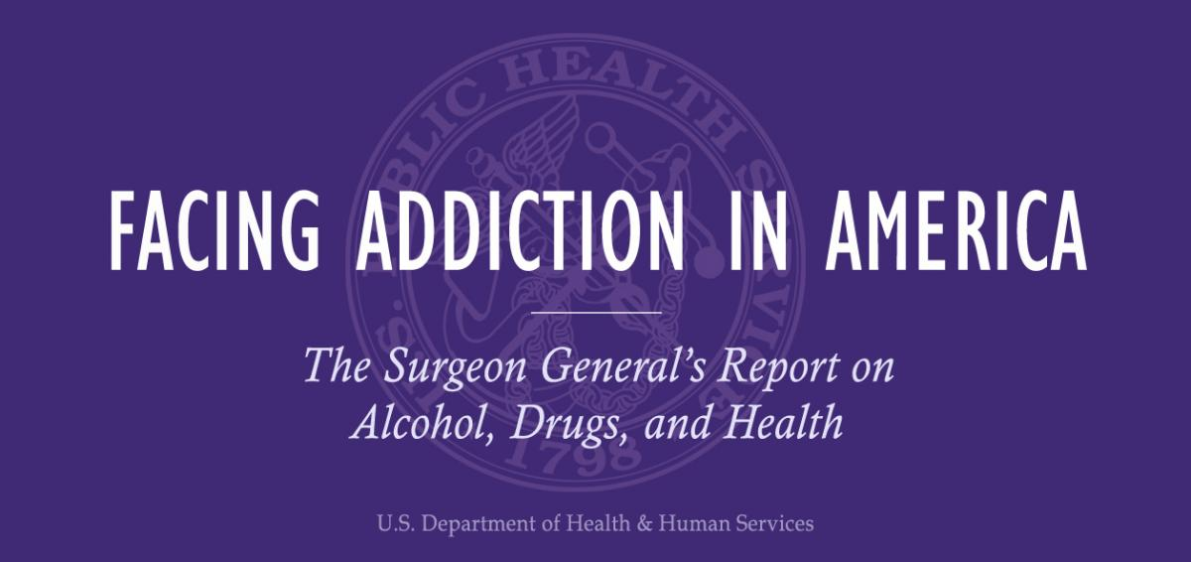

Vivek H. Murthy, M.D., M.B.A
Office of the Surgeon General,
Washington, DC: November 2016.
Notes:
Nov 2016 Surgeon General report on addiction as a chronic health condition – what does an opioid addiction look like and why do we not treat it as we do other chronic conditions?

Slide 12
Substance Use Disorders
  Few other medical conditions are surrounded by as much shame and misunderstanding.
  Historically treated as symptoms of moral weakness or a willful rejection of societal norms, and addressed primarily through the criminal justice system.
  Not given the same level of attention by our health care system as other health concerns that affect similar numbers of people.
Notes:
PAULA LUM
https://addiction.surgeongeneral.gov/executive-summary
Most Americans know someone with a substance use disorder, and many know someone who has lost or nearly lost a family member as a consequence of substance misuse. Yet, at the same time, few other medical conditions are surrounded by as much shame and misunderstanding as substance use disorders. Historically, our society has treated addiction and misuse of alcohol and drugs as symptoms of moral weakness or as a willful rejection of societal norms, and these problems have been addressed primarily through the criminal justice system. Our health care system has not given the same level of attention to substance use disorders as it has to other health concerns that affect similar numbers of people. Substance use disorder treatment in the United States remains largely segregated from the rest of health care and serves only a fraction of those in need of treatment. Only about 10 percent of people with a substance use disorder receive any type of specialty treatment.¹ Further, over 40 percent of people with a substance use disorder also have a mental health condition, yet fewer than half (48.0 percent) receive treatment for either disorder.
Although the mechanisms may be different, addiction has many features in common with disorders such as diabetes, asthma, and hypertension. All of these disorders are chronic, subject to relapse, and influenced by genetic, developmental, behavioral, social, and environmental factors. In all of these disorders, affected individuals may have difficulty in complying with the prescribed treatment.4

Slide 13
Like Diabetes, Asthma, Hypertension
  Chronic
  Subject to relapse
  Influenced by genetic, developmental, behavioral, social, and environmental factors
  Affected individuals may have difficulty in complying with the prescribed treatment
Notes:
PAULA LUM
Although the mechanisms may be different, addiction has many features in common with disorders such as diabetes, asthma, and hypertension. All of these disorders are chronic, subject to relapse, and influenced by genetic, developmental, behavioral, social, and environmental factors. In all of these disorders, affected individuals may have difficulty in complying with the prescribed treatment.4
• Well-supported scientific evidence shows that addiction to alcohol or drugs is a chronic brain disease that has potential for recurrence and recovery.
• Well-supported evidence suggests that the addiction process involves a three-stage cycle: binge/ intoxication, withdrawal/negative affect, and preoccupation/anticipation. This cycle becomes more severe as a person continues substance use and as it produces dramatic changes in brain function that reduce a person’s ability to control his or her substance use.
• Well-supported scientific evidence shows that disruptions in three areas of the brain are particularly important in the onset, development, and maintenance of substance use disorders: the basal ganglia, the extended amygdala, and the prefrontal cortex. These disruptions: (1) enable substance-associated cues to trigger substance seeking (i.e., they increase incentive salience); (2) reduce sensitivity of brain systems involved in the experience of pleasure or reward, and heighten activation of brain stress systems; and (3) reduce functioning of brain executive control systems, which are involved in the ability to make decisions and regulate one’s actions, emotions, and impulses.
• Supported scientific evidence shows that these changes in the brain persist long after substance use stops. It is not yet known how much these changes may be reversed or how long that process may take.
• Well-supported scientific evidence shows that adolescence is a critical “at-risk period” for substance use and addiction. All addictive drugs, including alcohol and marijuana, have especially harmful effects on the adolescent brain, which is still undergoing significant development.

Slide 14
Addiction
  A brain disease that has potential for recurrence and recovery
  3-stage cycle: binge/ intoxication, withdrawal/negative affect, preoccupation/anticipation
  3 brain areas disrupted: basal ganglia, amygdala, prefrontal cortex
Notes:
PAULA LUM
Well-supported scientific evidence shows that addiction to alcohol or drugs is a chronic brain disease that has potential for recurrence and recovery.
• Well-supported evidence suggests that the addiction process involves a three-stage cycle: binge/ intoxication, withdrawal/negative affect, and preoccupation/anticipation. This cycle becomes more severe as a person continues substance use and as it produces dramatic changes in brain function that reduce a person’s ability to control his or her substance use.
• Well-supported scientific evidence shows that disruptions in three areas of the brain are particularly important in the onset, development, and maintenance of substance use disorders: the basal ganglia, the extended amygdala, and the prefrontal cortex. These disruptions: (1) enable substance-associated cues to trigger substance seeking (i.e., they increase incentive salience); (2) reduce sensitivity of brain systems involved in the experience of pleasure or reward, and heighten activation of brain stress systems; and (3) reduce functioning of brain executive control systems, which are involved in the ability to make decisions and regulate one’s actions, emotions, and impulses.
• Supported scientific evidence shows that these changes in the brain persist long after substance use stops. It is not yet known how much these changes may be reversed or how long that process may take.
• Well-supported scientific evidence shows that adolescence is a critical “at-risk period” for substance use and addiction. All addictive drugs, including alcohol and marijuana, have especially harmful effects on the adolescent brain, which is still undergoing significant development.

Slide 15
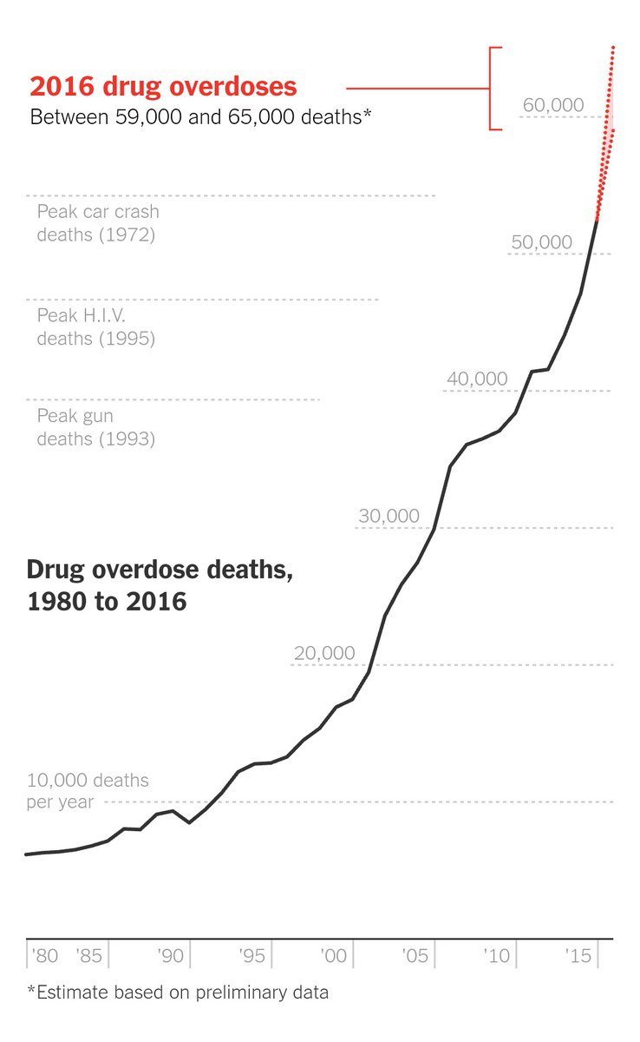
Major Public Health Challenge
  Over 27 million people in the U.S. reported current use of illicit drugs or misuse of prescription drugs in 2015
  Nearly 20.5 million have a substance use disorder (SUD)
  Only about 10% receive any type of specialty treatment
  60,000 drug overdose deaths in 2016 and climbing
Notes:
PAULA LUM
What kind of health complications do PWID face? How are these exacerbated in the Tenderloin?
In 2015, over 27 million people in the United States reported current use of illicit drugs or misuse of prescription drugs, and over 66 million people (nearly a quarter of the adult and adolescent population) reported binge^{i}drinking in the past month.¹ Alcohol and drug misuse and related disorders are major public health challenges that are taking an enormous toll on individuals, families, and society. Neighborhoods and communities as a whole are also suffering as a result of alcohol- and drug-related crime and violence, abuse and neglect of children, and the increased costs of health care associated with substance misuse. It is estimated that the yearly economic impact of substance misuse is $249 billion for alcohol misuse and $193 billion for illicit drug use.^{2,3}

Slide 16


Injecting Drugs Can Ruin a Heart. How Many Second Chances Should a User Get?
A life-threatening heart infection afflicts a growing number of people who inject opioids or meth. Costly surgery can fix it, but the addiction often goes unaddressed.
https://www.nytimes.com/2018/04/29/health/drugs-opioids-addiction-heart-endocarditis.html

Slide 17
9 Interventions Proven to Reduce HIV Transmission in PWID
  When delivered at scale, first 4 can contain/reverse upward trend of HIV epidemics among PWID:
  Opioid agonist therapy (OAT) and other evidence-based drug treatment
  HIV testing and counseling
  Antiretroviral therapy (ART)
  Needle and syringe programs (NSPs)
  Prevention and treatment of sexually transmitted infections
  Condom programs for PWID and their sexual partners
  Targeted information, education and communication (IEC) for PWID and their sexual partners
  Prevention, vaccination, diagnosis and treatment for viral hepatitis
  Prevention, diagnosis and treatment of tuberculosis
Notes:
PAULA LUM
Source: WHO/ UNODC/UNAIDS Technical Guide
The WHO/ UNODC/UNAIDS Technical Guide to reduce HIV infection among people who inject drugs (PWID) sets out nine interventions proven effective in reducing HIV transmission among this population. Universal access to the comprehensive package of nine interventions is a priority. Of these nine, the first four have been identified as the most effective in reducing the spread of HIV: when delivered at scale the four can contain and reverse the upward trend of HIV epidemics among PWID. The nine interventions are:
Needle and syringe programmes (NSPs)
Opioid substitution therapy (OST) and other evidence based drug dependence treatment
HIV testing and counselling (HTC)
Antiretroviral therapy (ART)
Prevention and treatment of sexually transmitted infections (STIs)
Condom programmes for people who inject drugs and their sexual partners
Targeted information, education and communication (IEC) for people who inject drugs and their sexual partners
Prevention, vaccination, diagnosis and treatment for viral hepatitis
Prevention, diagnosis and treatment of tuberculosis (TB)

Slide 18
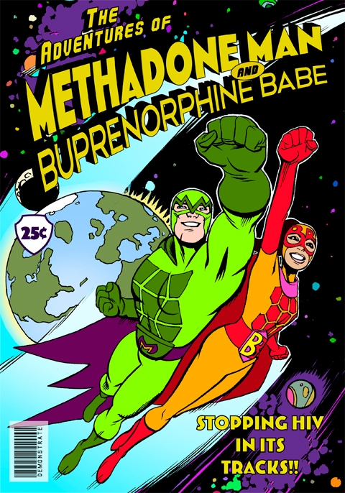
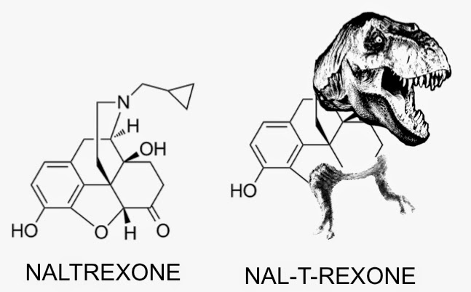
Treatment for Opioid Use Disorder
Opioid agonists e.g. methadone
Opioid partial agonists e.g. buprenorphine
Opioid antagonists
Notes:
PAULA LUM
The other effective response to opioid analgesic use or heroin use disorders is medication assisted treatment.
The come in 3 forms:….READ

Slide 19
Addiction Treatment Gap
    Inability to access or afford care
    Lack of screening for unhealthy substance use in general health care settings
    Not a problem, not ready
    Fear of shame and discrimination
    Stigma and discrimination
Notes:
PAULA LUM
https://addiction.surgeongeneral.gov/sites/default/files/executive-summary.pdf
What role does stigma and judgement play in a person’s ability to access a pathway to health What does success look like from your perspective?
Many factors contribute to this “treatment gap,” including the inability to access or afford care, fear of shame and discrimination, and lack of screening for substance misuse and substance use disorders in general health care settings. Further, about 40 percent of individuals who know they have an alcohol or drug problem are not ready to stop using, and many others simply feel they do not have a problem or a need for treatment1 —which may partly be a consequence of the neurobiological changes that profoundly affect the judgment, motivation, and priorities of a person with a substance use disorder.

Slide 20

Notes:
PAULA LUM
We need UPSTREAM strategies to deliver treatment to persons not engaged in care

Slide 21
Safer Inside:
Safe Injection Services from a research and public policy lens
Laura Thomas - Drug Policy Alliance

Slide 22
Safe Injection Services
    Safe injection services provide a safe, hygienic space for a person to inject their own drugs, under clinical supervision, in a facility where they can be linked to programs and services
    Safe injection services prevent fatal overdoses
    >100 safe injection sites in 10 countries in 66 cities across the globe – 0 overdose deaths
    At Insite, >30% of clients enter substance use treatment

Slide 23
Safe Injection Services
    Promote safer drug injection practices + healthy behaviors
    Attract hard to reach populations
    Reduce morbidity and mortality
    Reduce public drug injection
    Reduce discarded syringes and drug paraphernalia
    Improve public spaces in areas surrounding urban drug markets

Slide 24
Advocacy + Aligning for results
  Safer Inside has informed the SF city-wide and State efforts to address the opioid crisis with expertise, recommendations and data
Board of Supervisors City-Wide Task Force
  Diverse public and private stakeholder representation, including many voices from the Tenderloin Taskforce
  Report and Recommendations released Sept. 2017 - BOS hearing
  SF Health Commission endorsed the Taskforce recommendations early 2018
Statewide Legislation AB 186
  Advocacy efforts in Sacramento
  AB186 passed both Assembly and Senate Health and Public Safety Committees – fell short in Senate by 2 votes in 2017. On hold through 2018
City-Wide Coalition
  Supporting Yes to SCS - Supervised Consumption Services

Slide 25
Safe Injection Services: Ongoing Challenges
Legal barriers to providing Safe Injection Services – local / State / Federal
Service Providers – organizations who serve PWID securing internal approvals to expand existing services to include Safe Injection Services
Locations – expansion of existing services / new sites?
Funding – DPH or public/private partnerships or both?
Community Education - substance use disorders and the benefits of Safe Injection Services

Slide 26
Safer Inside: How did it evolve?
Defining goals
Building Trust
Action
Advocacy and Outreach

Slide 27

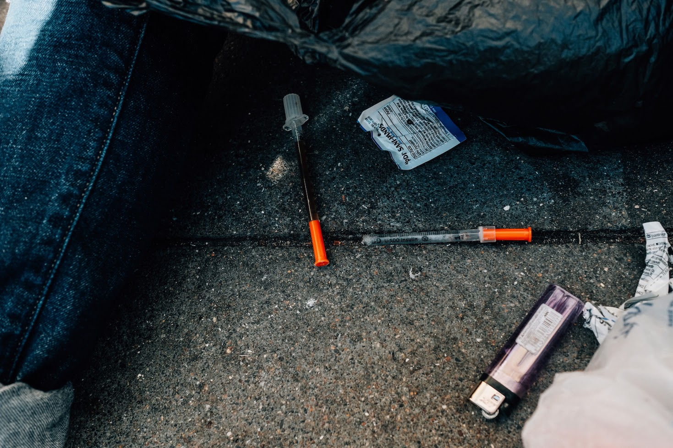
Safer Inside: Community Process
What is toxic ?
Notes:
In 2015, TLHIP convened local stakeholders to explore community concerns about environmental trauma and persistent traumatic stress arising from public injection drug use and improperly discarded syringes in the Tenderloin
Tensions ran high between leading needle exchange service providers and children and family serving organizations, as the prevalence of discarded needles in the Tenderloin were seen as an unintended negative consequence of a nationally recognized syringe access program revered by the harm reduction community
TLHIP stepped in to lead a multi-sector response to this community need
Question of toxicity depended on the lens
On the one hand were community members who felt that discarded needles and public injecting were causing an environmental trauma on the community and contributing to ACE’s (adverse childhood experiences) amongst children that would contribute to long term mental health challenges
On the other were members of the community who felt that the stigma and rejection shown to PWID who were suffering from addiction was discriminatory and amounted to a toxic response to human suffering
n

Slide 28
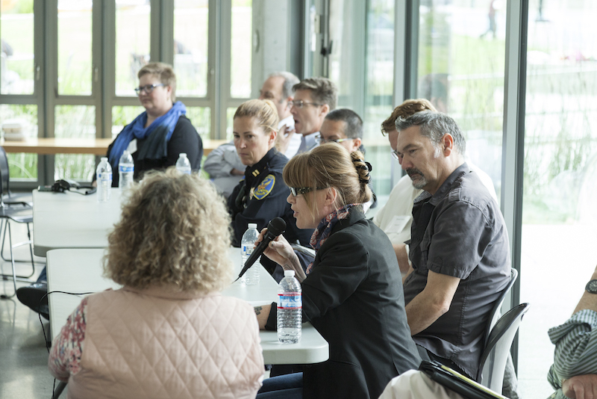
Safer Inside:
Building Trust through sustained dialogue
Notes:
In 2014, Golden Gate neighbors first met with harm reduction service providers to address concerns about environmental trauma and persistent traumatic stress arising from public injection drug use and improperly discarded syringes.
TLHIP encouraged more voices to join the conversation, including addiction experts and researchers, neighborhood organizations serving the local drug user population, Department of Public Health and other city agencies, business stakeholders, CBO’s, philanthropy and others
Despite knowing the importance of having lived experience at the table, it took until the fall of 2016 to include the voice of people who use drugs directly in the conversation
Over more than two years, through sustained dialogue and reflection, the Safer Inside taskforce moved from reacting to a community and environmental health crisis to a more nuanced understanding of the consequences of public injection drug use for both individual drug users and the community at large.

Slide 29
SIF Timeline
2014 -2018
Tenderloin Community Conversations
Insite Vancouver
Safer Inside Recommendations
3 day Summit
Health Commission Meeting
Surgeon Generals Report
2016
AB186
Education and Outreach
Supervisor Breed Task Force
BOS + Health Commission Hearings
Organizational Readiness Assessment
2017
Health Commission Resolution
SIF
City Attorney
Counting the votes for AB186
Demonstration Project, Education and Outreach
2018
Notes:
2014 – 2015 Community Conversations
2016
April – Vancouver
Summer – Safer Inside Recommendations
August - Opioid and Addiction Summit
September – Health Commission Meeting in community
November – Surgeon Generals Report on Addiction
2017
Susan Eggman introduced AB186 to create a legal pathway to opening safe injection facilities with medical supervision
Spring and Summer – passed through House and Senate Committees
April – Sup Breed charged DPH with convening a Safe Injection Taskforce to make recommendations for operating SIF in SF
September – Task Force Report and Recommendations
October – BOS Hearing
November – Health Commission hearing
2018
Health Commission endorsed SIF TAsk Force Report and Recommendations

Slide 30
Participating Organizations and Agencies
Organizations | Advisory Participants
Dataway Systems DeMarillac Academy | People who use Injection Drugs Homeless Youth Alliance
Drug Policy Alliance Episcopal Community Services | Mayor’s Office of Economic and Workforce Development RTI, San Francisco
Glide Gubbio Project Healthright 360 | San Francisco Dept. of Public Health San Francisco Dept. of Public Works San Francisco Drug Users Union
Hospitality House St. Anthony Foundation | San Francisco Planning Dept. San Francisco Police Dept.
Saint Francis Foundation Saint Francis Memorial Hospital San Francisco AIDS Foundation | San Francisco District Attorney’s Office
Tenderloin Neighborhood Development Corporation Urban Survivors Union | University of California San Francisco

Slide 31
Safer Inside: Outcomes
Adopted a 4 Pillars Approach – Prevention, Harm Reduction, Treatment and Recovery, Law Enforcement
Involved community members from each Pillar
Identified 7 Priority Recommendations, including SIS
Created a Harm Reduction Action Plan
Hosted outreach meetings to educate/build public will
Developed Operational Plans for SIF
Actively participated in the SF city-wide Taskforce

Slide 32
Safer Inside:
The importance of including the voice of lived experience
Notes:
TERRY MORRIS

Slide 33
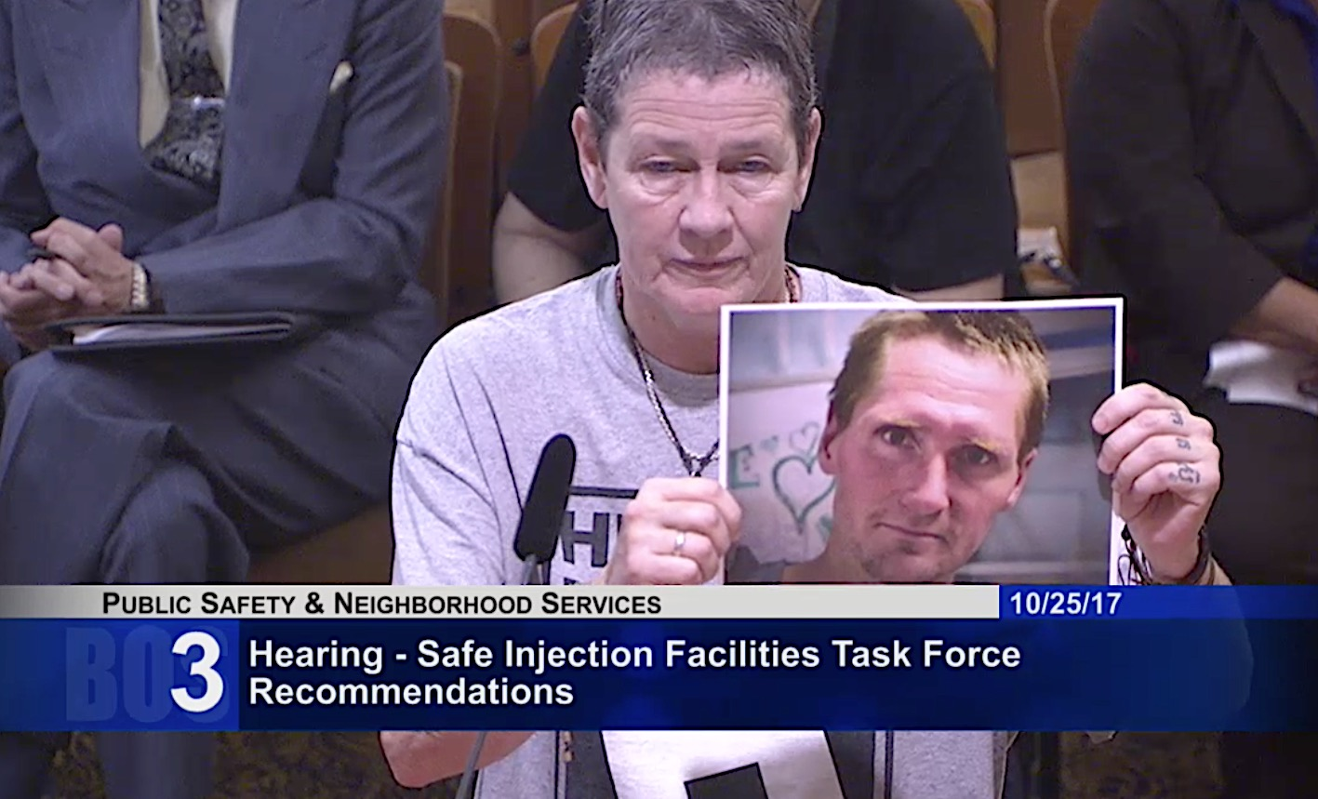
“You don’t want to see me use drugs, and I don’t want you to see me use drugs. A SIF will meet both our needs” - Seven
Notes:
Despite knowing the importance of having lived experience at the table, it took until the fall of 2016 to include the voice of people who use drugs directly in the conversation
Made space at the table for active drug users – invites into the conversations, especially as they related to the operating plans
Saw the power of these voices in the public advocacy efforts

Slide 34
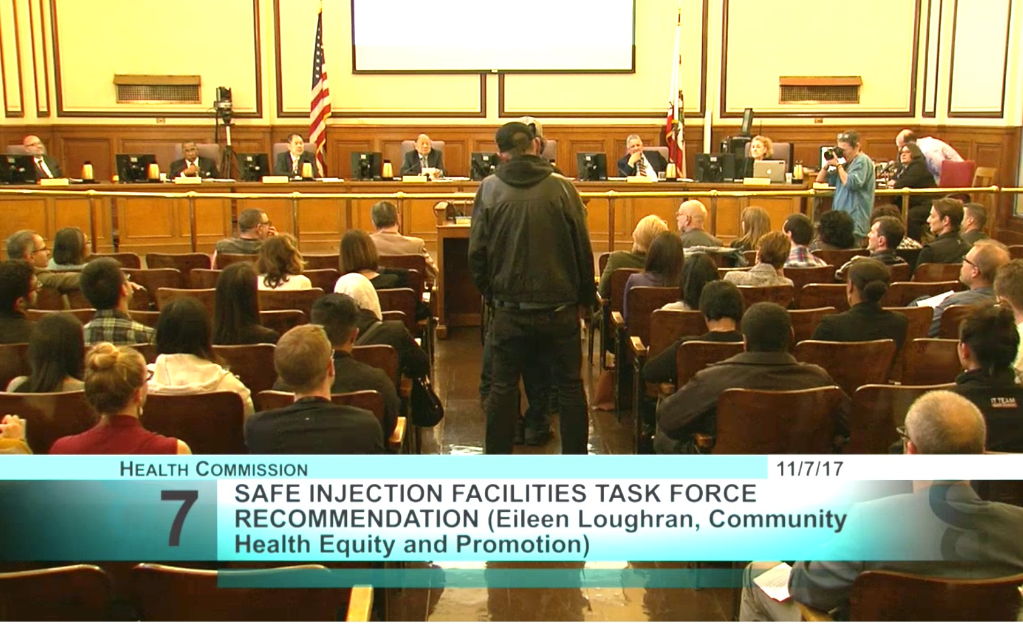
San Francisco Health Commission Hearing
November 7, 2017

Slide 35
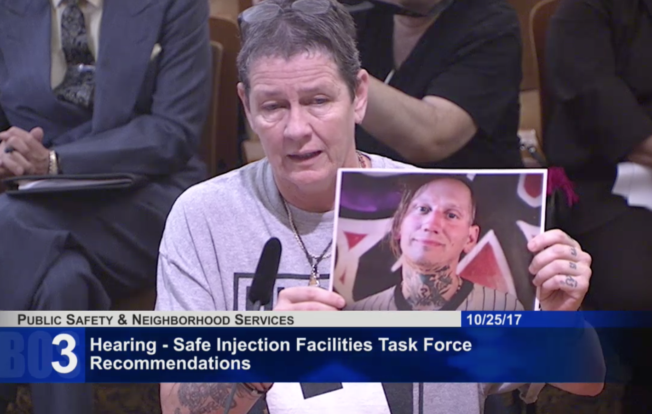
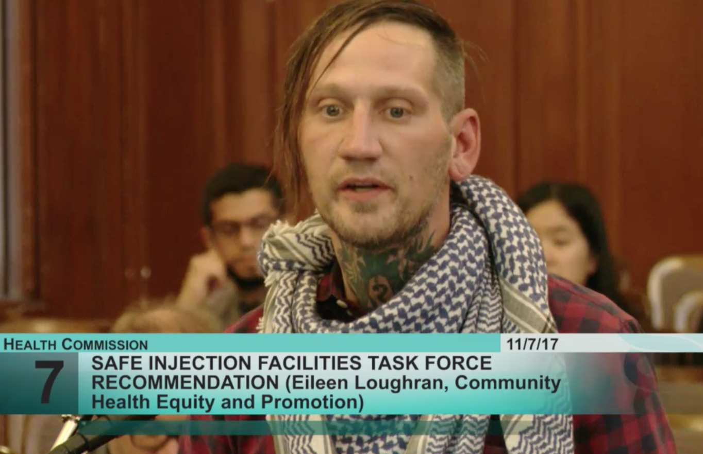
“I don’t want to use drugs in public,
especially in front of children” - Kyle
Board of Supervisors Committee Hearing October 25, 2017
San Francisco Health Commission Hearing – Nov 7, 2017

Slide 36
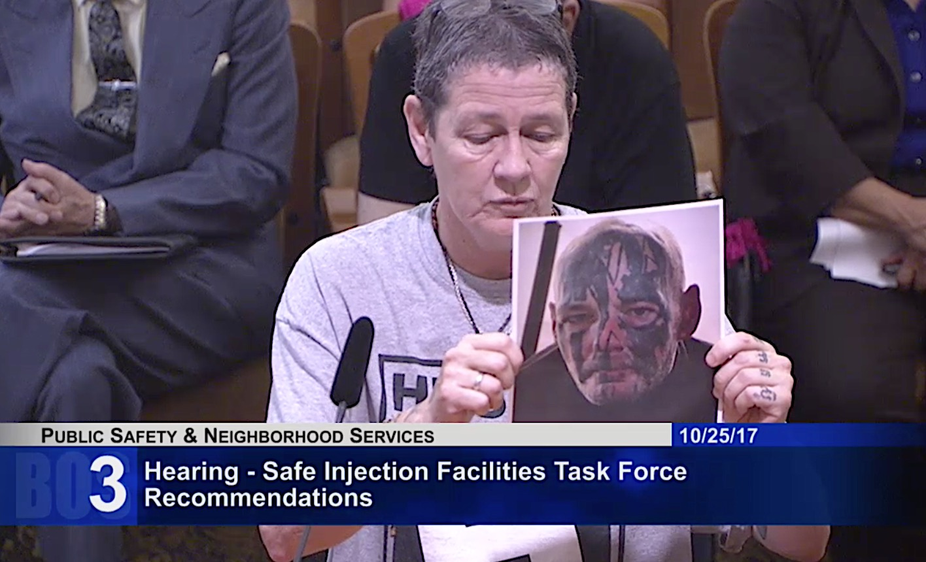
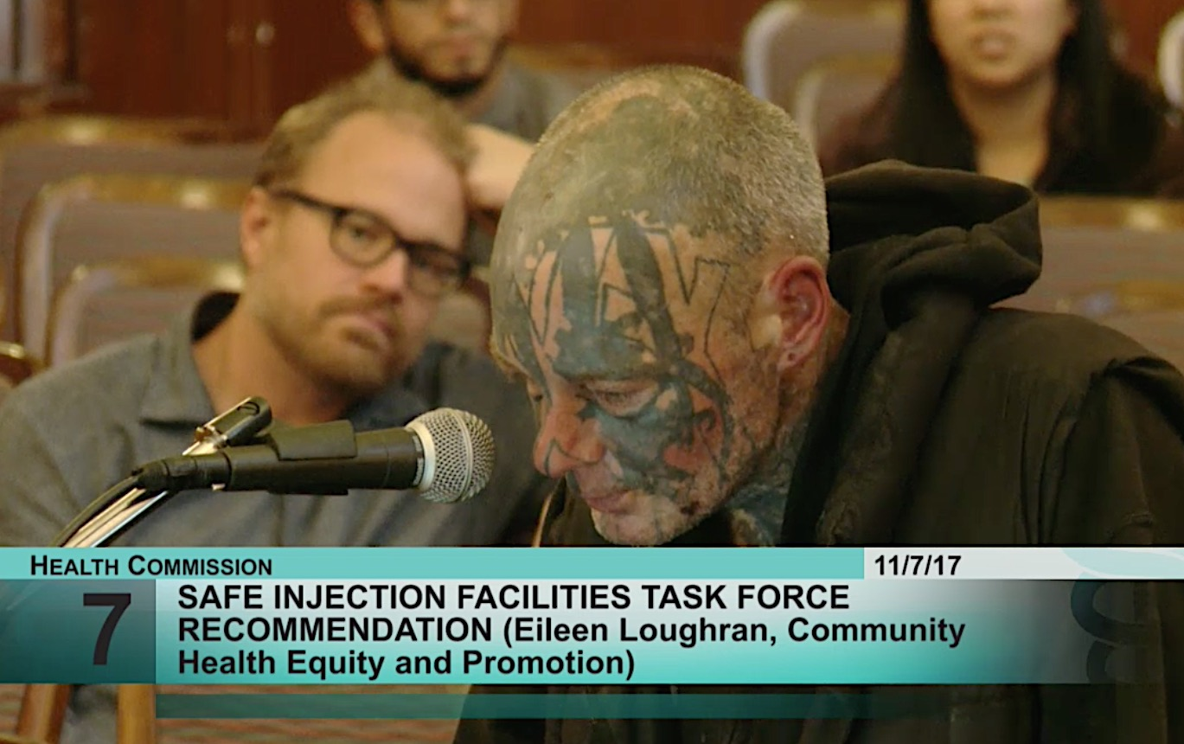
“I don’t want to die of an overdose alone”
- Johnny
Board of Supervisors Committee Hearing October 25, 2017
San Francisco Health Commission Hearing – Nov 7, 2017

Slide 37
What is the Tenderloin Health Improvement Partnership (TLHIP) ?
TLHIP is a multi-sector collective impact partnership committed to improving health and well-being in the Tenderloin by aligning priorities, resources and activities to create pathways to health for residents.
SFF
SFMH
Notes:
Partnership is led jointly by Saint Francis Foundation and SFMH

Slide 38

Why Saint Francis?
Twin Missions in Action
SFF
SFMH
TLHIP represents the Foundation + Hospital’s twin missions in action providing compassionate care and partnering with the community to improve quality of life for the poor and disenfranchised.
Notes:
SFFMH community hospital in down town SF

Slide 39





TLHIP Pathways to Community Health
Resident Health
Active, Vibrant, Safe, + Clean Shared Spaces
Behavioral Health + Mental Health
Economic Opportunity + Affordable Retail
Housing Access
Notes:
+ Safety, Community Connections, Opportunities for Health Choices
+ Community Engagement and Neighborhood Voice: Listen to and work with residents to strengthen community connection
+ Equity: Race/ethnicity, gender, sexual orientation, primary language, action zone, justice-involved, physical/mental abilities, income, legal status, trauma exposure
Context for the goals is our Pathways to Health strategy ching continuum toward population level goals
TLHIP Pathways to Health
Active, Vibrant, Safe + Clean Shared Spaces
Safe, clean neighborhood
Positively activated shared community spaces
4Corner Friday is an example of a strategy to address safety in the neighborhood
Behavioral Health & Mental Health
Resilient , supportive community free of trauma
Strong community identity + sense of purpose
Residents behavioral, addiction and mental health are supported
Resident Health
Healthcare is accessible + coordinated amongst providers
Healthy food + opportunities for physical activity are available + accessible to residents
Residents prevent +manage chronic conditions outside SFMH
Economic Opportunity & Affordable Retail
Local businesses serve residents of all incomes
Living wage jobs + career growth are available + accessible
Housing Access
The neighborhood is diverse and has a range of income levels
Safe, permanently affordable housing is available + accessible to no, low + middle income residents
Public Realm: TLCBD
Something we have supported and more recently the re-emergence/stabilization
Safe Passage is now a program of TLCBD again
Turk and Hyde Mini Park
Tenderloin Wellness Trail
Community Trauma: Supervised Injection Services
Partner with Community for Healthier Tenderloin.
Stepped into a new world engaging active users which has been a learning for everyone and has shaped the work we’re doing.
Community Outreach we’ve conducted about 40-50 reaching hundreds of people to talk about Safe Injection Services.
Developed template for Operational Plan so people can have idea for what that could look like
Participated in the Breed’s SF Safe Injection Taskforce
Did the Urban Solutions Summit last fall.
Linkages to Social Services and Health Services: Navigator + AOD Counselor

Slide 40

Institute for Healthcare Improvement: SCALE
18 Communities across the country working to:
Make meaningful and measurable improvement on health and health equity (Community Priority Areas)
Transform how their community addresses health, wellbeing and equity (Community Transformation)
Spread this work to other communities (Scale-Up)
www.100mlives.org
Notes:
Spreading Community Accelerators through Learning and Evaluation
Improvement Science, Small Tests of Change, Scaling what works, Failing Forward, Authentic Engagement and Inclusion with Lived Experience
From a “sick care system” to a “health and wellbeing system”
Take our work on equity from “doing good” to a recognition that we are interconnected and cannot afford the price of poverty and inequity in terms of health and life outcomes or cost
From people and communities of poverty to people and communities of trapped and untapped potential
From pathology to vision – change is possible
From scarcity to abundance

Slide 41
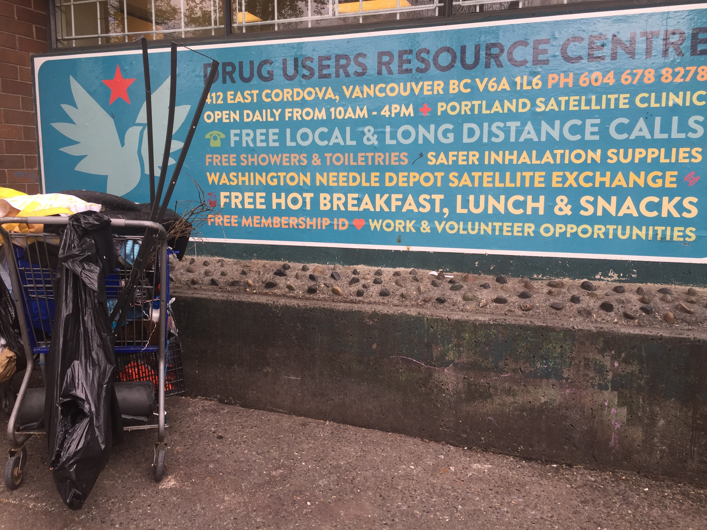
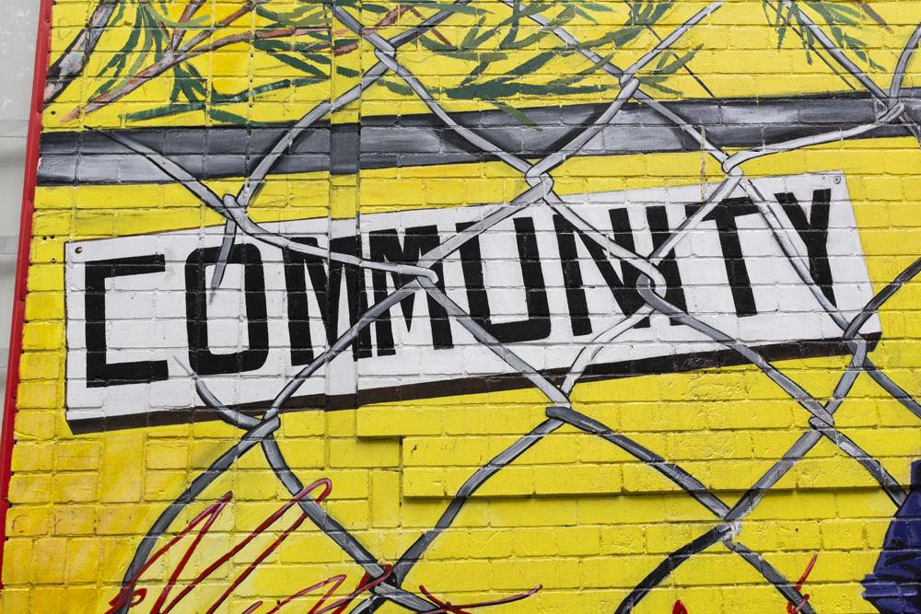
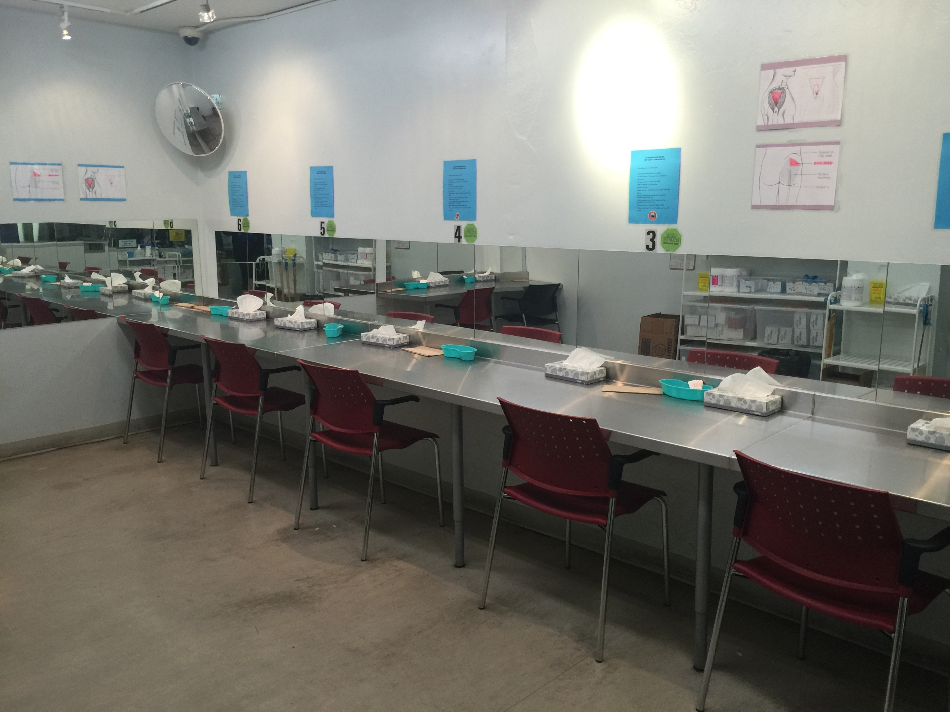
Safe Injection Services
Drug User Resource Center
Access to Treatment + Recovery
Expand Behavioral
Health Services
Research + Evaluation
Notes:
Looking ahead

Slide 42



Improve Neighborhood
Safety
Coordinated Law Enforcement Practices
Expanded LEAD Program
Block Group Community Organizing
Develop a Tenderloin Community Plan

Slide 43
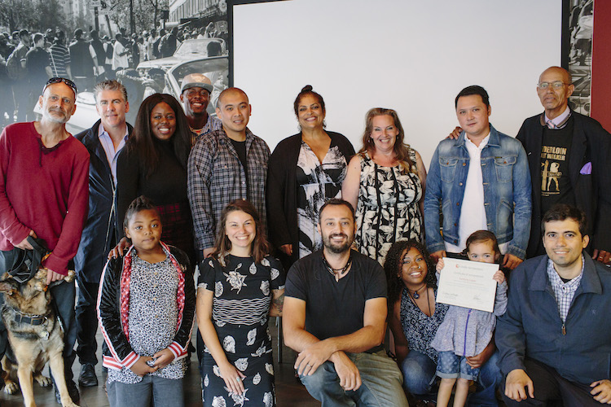


Expand Economic
Opportunities for
Residents
Code Tenderloin
Block by Block
Downtown Streets Team
Wellness Trail Map
Build
Employment Pipeline

Slide 44
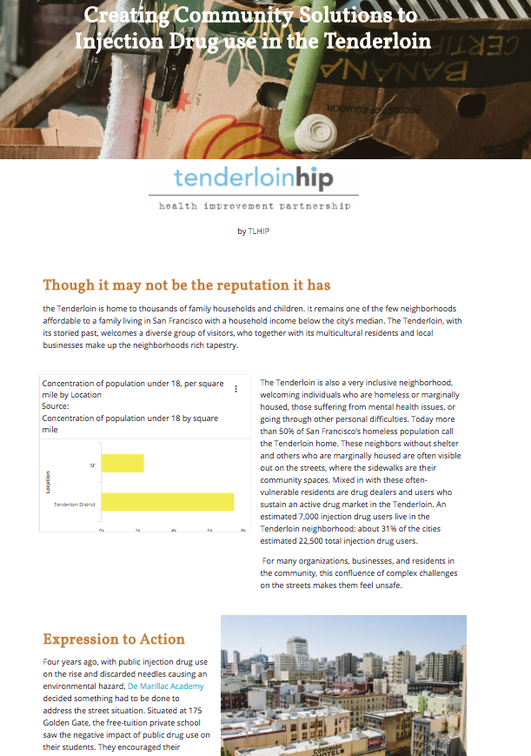
Visit http://www.saintfrancisfoundation.org/tenderloinhip
for more stories

Slide 45

saintfrancisfoundation.org/tenderloinhip

