Slide 1
Impact of Moving Towards Centralized Technology Solutions

Slide 2
Maze of Individualized Solutions
Health Centers
EHR: EPIC
EHR: OCHIN EPIC
Hospitals
Case Management Tool: CHR
Case Management Tool: Welkin
Resource Directory: Purple Binder
Health Plans
Text Tool: Well Text
Consortia
Text Tool: Care Message
Resource Directory: Aunt Bertha

Slide 3
E-Referral Platforms
Community Health Center Network
Alameda Health System
Rubicon
Rubicon EPIC
OCHIN EPIC
EPIC
E-referral/E-consult

Slide 4
Challenges of a Centralized Solution
Local Solution 1
Local Solution 2
Local Solution 3
Single Centralized Solution
What happens to local solutions 1, 2, and 3?

Slide 5
Big Questions
What does it mean to develop a unique, centralized solution, and how can we do so without losing the values and experiences of existing solutions?
How are larger systems aware of the smaller, individual systems’ solutions that already exist?
How do you achieve alignment in goals while supporting localized solutions?
Do you lose the local solutions to become part of the larger system? In doing so, do you negatively impact, quality outcomes for patients, employee moral and innovation?

Slide 6
Panel Management and Turning Patients into Active Members

Slide 7
Current Members without PCP Visit within 365 days

Slide 8
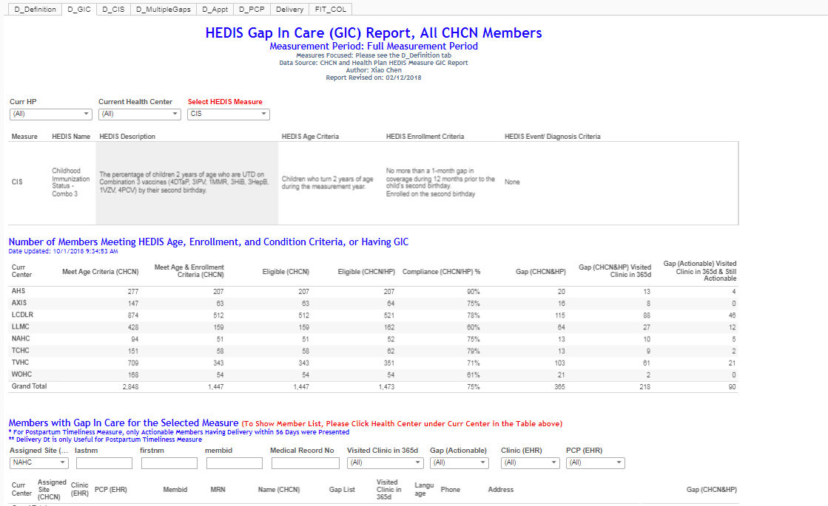
Incorporating PCPs with HEDIS GIC and IP summary notifications

Slide 9
Inpatient Admissions within 7 Days

