Slide 1


CCI-PHASE
Motivational
Interviewing
Community of Practice
Notes:
Make sure to put your names on this instead of mine, and take my logo off ☺
Setting up the tone:
The most important task before beginning is to engage the participants. Only engaged learners are open to information, and only engaged learners will change behavior as a result of information. Remember that we are modeling exactly what we want participants to do with patients, so the task before beginning is to make a genuine connection to the participants (even if you already know them) and also connect them to the material at hand.
Introducing yourself: First, introduce yourself if participants don’t know you. You want to connect to them, regardless of how well you know them, so sharing some personal information is important.
It is also usually important to qualify your own personal and professional connection with MI. What is it about MI that matters to you? How did you become acquainted with it? What
The group introducing themselves: It is important for everyone to introduce themselves, because feeling connected to you, the material, and each other will determine the success of the training. It is important to budget time for introductions, and to demonstrate listening skills when it is occurring (eye contact, mirroring, walking close to those who are talking, reflective listening, etc.). Depending on how large the group is, you might have to do just names/jobs, if it is a smaller group, you could ask them also to talk about something else, like what their experience is with MI, or what they hope to get from today’s workshop. If everyone knows each other, you can skip names and possibly jobs, and just ask for their experience with MI, or hopes for the workshop.
Just a reminder, if you don’t know everyone, this is the time you want to use your memory skills to memorize everyone’s name, so you can use it in the workshop.

Slide 2
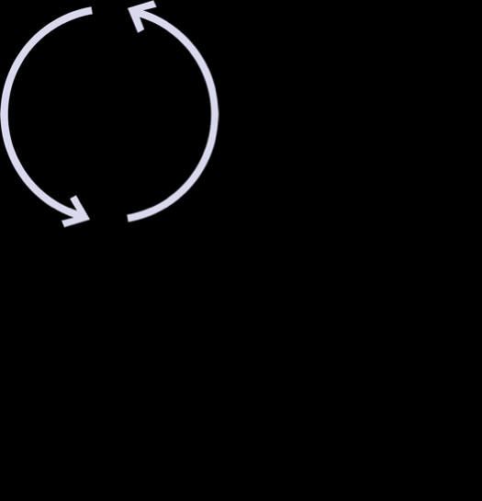
05
01
Identification
Pre-Contemplation
Stages of Change
04
02
Action
Contemplation
03
Preparation
Notes:
This is a great slide to ask for participant input. You can ask who might want to define these (start with pre-contemplation and work clock wise. This is usually a chance to practice skillful reflective listening and also how to ‘correct’ without correcting, because often people wrongly define pre-contemplation as ’thinking about it’ or ‘ambivalence’ which is contemplation.
It is important here that as a trainer you feel very competent and confident about your own understanding of each stage of change, so you can give examples of what happens during each stage. It is also very useful to share examples from your own life, or an example from one of your patients (no names of course).
Here are some basic explanations:.
Pre-contemplation: Do not think it is a problem. No thought about changing. Sometimes called ‘denial’
Contemplation: also called ‘ambivalence’. Considering change; one step forward 1 step back, etc.
Preparation: no change yet, however the decision has been made, and preparations are happening, such as telling people (that the diet will start in 2 weeks, that the quit date for cigarettes is next month, etc.), buying supplies, looking for apartments (in the case of leaving a relationship, etc.). This is a good place to use an example from your own life or one of your patients.
Action: self explanatory
Identification: so identified with the change, relapse is very unlikely. It is important to give an example here.
You can add that relapse can happen after action, and often does for any behavior change.

Slide 3
MI assumes we don’t need to ‘get’ motivation from someone outside of us. Instead, another can help us elevate and amplify our own intrinsic motivation.
Notes:
This is the spirit of MI; it assumes we are all equal, and is not hierarchical (even with children)….however it feels most natural for you to talk about this, it is important to convey it is a different way of thinking about motivation, than most of us have seen in traditional health care.

Slide 4

1.
Empathic Presence
2.
Skillful listening
3.
Eliciting of thoughts, feelings, values, goals and motivations

Slide 5

Why is it so hard?
Most of us
have been
raised with
(good) people
trying to get
us to do
things through
fear, shame or anger…
Notes:
We can talk about families, schools, communities….almost all of us have had conditioning to try and get people to do things in this way….

Slide 6
‘If you keep getting grades like this, you’ll never get into a good college’
‘Next time I catch you with pot, you will be grounded for months’
‘I’m really disappointed in you. I thought you were better than that’
FEAR
PUNISHMENT
SHAME
Notes:
This is a great one to ask participants for input. When they think about their childhood, can they identify examples of fear, shame or punishment, how their parents might have tried to get them to do, or not do things..you might share a simple story yourself to start the group off.

Slide 7

Empathy
Autonomy
Relationship
Respect
Principles
Notes:
This slide explains, in brief, the main principles. You can say that we are focused primarily on the first 2 bullets in ‘MI part 1’.
Express Empathy: This is THE primary principle of MI, the spirit of MI, the principle that all other principles are based on, and that all techniques are based on. This isn’t about feeling empathy, it is about effectively conveying empathy, which takes a lot of practice (a lifetime of practice!)
Autonomy: This means the ‘hero’ is the story is the patient, (or our family member), we are not the ‘hero’ in the story who saves anyone, our job is to support, empower and help activate patients heroic efforts for themselves.
Relationship: This means that no correcting, imposing, arguing, or ‘righting’ patients (or others) will ever be effective, and in fact can be harmful; we instead use the relationship to allow for the person to share about themselves and their own concerns and motivations.
Respect: This is similar to ‘unconditional positive regard’, meaning, MI asks us to remain in the place of always respecting the other persons own wisdom and their own path.

Slide 8



In person
On video
On the
Telephone
MI WORKS:
Notes:
To speak to MI's versatility, in that it works in all three of these modes of communication. This is a good time to mention, if you haven't already, that MI is just a skillful way of communicating, and we probably already use it with our family, friends, and our clients/patients. Anything we learn here today, in terms of how to enhance/strengthen those skills we can use in our personal life too.
You can note that on each strategy/technique slide, there are icons to show where it is applicable (all are applicable to all, except non-verbal empathy, which we don't/can't use on the phone)

Slide 9




Principle MI Strategies
Open-Ended Questions
Notes:
Ask participants to define open ended questions (can’t answer yes or no). Expand the definition to include any one word or one phrase answer, and give examples ‘when did that happen?” ‘where did you go?’ ‘who went with you?’
This is a slide to share research. Looking through the bibliography at some of the open ended question research is useful. Here are a few highlights:
The Institute of Medicine called open ended questions the ‘gold standard’ of communication over 15 years ago, and since then there has only been more research to support this.
Diagnostic accuracy is related to how many open ended questions clinicians (physicians and BH clinicians) ask. Inaccurate diagnosis is related to the number of closed questions
asked.
Open ended questions effectively convey empathy; closed questions do not, they convey an agenda.

Slide 10
Sure Chat, Chat, Chat…
Tell me more about ‘not worrying’ about your blood pressure?
Notes:
Example of open ended (and 'guided' in that it is very specific) This is a good example since often people worry that open ended questions will take too long, that it will encourage someone to talk too much. We can ask open ended questions that are very specific, just by saying 'tell me more about X'

Slide 11
Closed Questions
Notes:
Ask participants to define open ended questions (can’t answer yes or no). Expand the definition to include any one word or one phrase answer, and give examples ‘when did that happen?” ‘where did you go?’ ‘who went with you?’
This is a slide to share research. Looking through the bibliography at some of the open ended question research is useful. Here are a few highlights:
The Institute of Medicine called open ended questions the ‘gold standard’ of communication over 15 years ago, and since then there has only been more research to support this.
Diagnostic accuracy is related to how many open ended questions clinicians (physicians and BH clinicians) ask. Inaccurate diagnosis is related to the number of closed questions
asked.
Open ended questions effectively convey empathy; closed questions do not, they convey an agenda.

Slide 12
No
Do you use want to quit smoking?
Notes:
We can share here that the difficulty with the 'do you want to quit X' questions is that they are closed, and also that they indicate it is a yes/no answer, when we know the great majority of us are ambivalent about these behaviors- it is both yes AND no.
Closed questions also include:
Have you thought of doing…..
Do you think you could/should….
Which sort of masquerade a bit as open; those questions tend to increase psychological resistance, as people feel we are pushing them to do something.

Slide 13
Narrow Questions
Notes:
Ask participants to define open ended questions (can’t answer yes or no). Expand the definition to include any one word or one phrase answer, and give examples ‘when did that happen?” ‘where did you go?’ ‘who went with you?’
This is a slide to share research. Looking through the bibliography at some of the open ended question research is useful. Here are a few highlights:
The Institute of Medicine called open ended questions the ‘gold standard’ of communication over 15 years ago, and since then there has only been more research to support this.
Diagnostic accuracy is related to how many open ended questions clinicians (physicians and BH clinicians) ask. Inaccurate diagnosis is related to the number of closed questions
asked.
Open ended questions effectively convey empathy; closed questions do not, they convey an agenda.

Slide 14
4 months
How long since you took your medication?

Slide 15
Stems:
Tell me more (about)….
How (did you/are you)….
What (are your/do you)...
Why…?

Slide 16
Which medications are you taking?
Are you checking your blood sugars?
Do you want to quit drinking?
Notes:
In this slide, you can ask participants to change these questions into open ended questions.
This is where you can talk about not starting open ended questions with ‘Why’; and instead use the stems ‘What’, ‘How’ and ‘Tell me more about. If you ask participant the reason for avoiding staring questions with 'why' they will almost explain it for you.

Slide 17
What are your thoughts about starting this medicine?
How are you doing with checking your blood sugars?
Tell me more about your feelings about drinking
Notes:
In this slide, you can ask participants to change these questions into open ended questions.
This is where you can share about not starting open ended questions with ‘Why’; and instead use the stems ‘What’, ‘How’ and ‘Tell me more about

Slide 18

Demonstration:
Open Ended Questions
Notes:
Video Workshops: If you have a co-facilitator, you can practice via video in front of the group. If you are alone, and have a close friend/colleague in the workshop, you can ask them if you can practice asking open ended questions to them. If not, you can skip.
In person: Facilitators demonstrate. Open ended questions are hard, so if you make a mistake during the demonstration, and ask a closed or narrow question, you can just normalize how hard it is and try again to do an open question. Remember to use something real, no role playing ☺

Slide 19
Open Ended Questions Practice!
Step 1
Step 2
Step 3
Practicer: ask partner an open- ended question about their work
partner: IRL answer
Practicer: ask another open-ended question in follow up
Switch
Groups of 3
Notes:
For Video Workshops: If you have break out rooms, use them here. If not, skip.
Set up the exercise. The basic directions are:
Triads are preferred. Keep the same triad throughout the workshop(s)
Give roles: 1. Person practicing 2. Person being practice on and 3. Observer.
Let the groups know to avoid any questions or advice. They are only practicing empathy techniques talked about previously.
The person being practiced on thinks of something they are willing to share, that they are having feelings about. They can use what they did before, in the previous exercise, or they can use something new.
The person practicing, asks at least 2 open ended questions (1, then let the person talk, then another)
The observer names whether a question is open or closed, after the person practicing asks. If it is ‘closed’ the practitioner stops and tries again..
Switch.
When the group comes back from breakouts, ask one question and let 1 or 2 people share 'what was surprising?' 'How was that for you when you were reflecting?' 'How was it for you when you were being reflected?' are examples.

Slide 20

Principle MI Strategies:
Reflective Listening

Slide 21
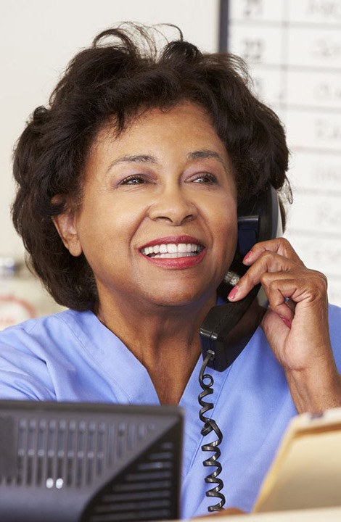
Reflective Listening is Vital
on the phone
Notes:
Ask participants what they think about this, they likely will articulate the reasons for you. Generally: we lose all non-verbals on the phone- this makes the verbal MI skills much more important. Reflective listening is what we do when we normally nod, say 'mmmm', make eye contact, and otherwise indicate that we understand what someone is saying to us.
On the phone, not only do those talking worry about the phone line cutting out if we are silent too long, they also worry if we are judging, not understanding, spacing out, or otherwise not 'with' them, making reflective listening one of our most important phone strategies

Slide 22
Types of
Reflective Listening

Slide 23

01
Summary
Selected exact words
02
03
Double-sided reflection
Notes:
Define these 3 types of reflective listening.
Giving examples of these three makes them concrete.
Basic definitions:
Summarizing is when you respond to what has been said with a general summary: ‘It sounds like you have had such poor experiences with our healthcare system’ or ‘you’ve had so many losses recently’
Exact words means selecting the high impact words that the other person used: patient: I just feel like I can’t take it any more, my head feels like it is in a vice’ practitioner: ‘like it is in a vice’.
Double sided reflection: capturing both sides of ambivalence ‘I hear you saying you want your old body back, and I also hear that you feel like the dieting and exercise was punishing back then’
Reflective listening, more than most MI techniques, elicits push back from participants. People often share about when others have done it with them and it felt forced, or manipulative; often people share that they’ve done it to others, and been chastised ‘didn’t I just say that?!’.
The best response to this is to, well, use reflective listening and just repeat back, so they know they are heard. We can also reinforce that reflective listening, like all of these techniques, is highly skilled, and takes a lot of practice to be proficient at it, and we are never perfect!

Slide 24

Demonstration:
Reflective Listening
Notes:
Facilitators demonstrate reflective listening. It is helpful to demonstrate 3 times; exact words, summary and double sided reflection, so have your partner share something they are ambivalent about (wanting to exercise, not having time, for example….something real)
Set up the exercise:

Slide 25
Reflective Listening Practice
Practice
Practice
Practice
Groups of 3
Partner: Share something real you are worried about
Practicer: Reflective Listening
Switch
Notes:
Video workshop: Use break out rooms if possible; if not, skip
One last practice session, using all three.
Triads are preferred. Keep the same triad.
Give roles: 1. Person practicing 2. Person being practice on and 3. Observer.
Let the groups know to avoid any questions or advice. Add to avoid any cheerleading. They are only practicing empathy techniques, open ended questions and reflective listening.
The person being practiced on thinks of something they are willing to share, that they are having feelings about. They can use what they did before, in the previous exercise, and build on it, or they can use something new.
The person practicing, uses the skills from these three techniques.
The observer names what type of techniques were used.
Switch.
Use your phone to time exercises; 2 minutes for each person, and each person should go, so 6 minutes for the exercise.
When everyone has gone, pull the group back together, and ask a general question to process, like ‘how was that’? Or ‘who would like to share their experience with practicing?’ and let 1-3 people share.

Slide 26


MI Facilitator Resources:
Updated MI slide decks
Tips for facilitating practice episodes
Sample evaluations
Options for breaking up workshops
Guidelines for creating MI congruent workshop environments
CCI MI CoP webpage or www.rsourced.com
Notes:
This slide is left blank for an ending slide; depending on the participant group, how well you know them, when the follow up part 2 might be, etc, you can use this to encourage people to set one goal for practicing before next time, you can say thank you for the time, you can elicit questions or thoughts, you can share links to resources, etc.

