Slide 1
CCI-PHASE MI CoP
July 14, 2020
Notes:
Make sure to put your names on this instead of mine, and take my logo off ☺
Setting up the tone:
The most important task before beginning is to engage the participants. Only engaged learners are open to information, and only engaged learners will change behavior as a result of information. Remember that we are modeling exactly what we want participants to do with patients, so the task before beginning is to make a genuine connection to the participants (even if you already know them) and also connect them to the material at hand.
Introducing yourself: First, introduce yourself if participants don’t know you. You want to connect to them, regardless of how well you know them, so sharing some personal information is important.
It is also usually important to qualify your own personal and professional connection with MI. What is it about MI that matters to you? How did you become acquainted with it? What
The group introducing themselves: It is important for everyone to introduce themselves, because feeling connected to you, the material, and each other will determine the success of the training. It is important to budget time for introductions, and to demonstrate listening skills when it is occurring (eye contact, mirroring, walking close to those who are talking, reflective listening, etc.). Depending on how large the group is, you might have to do just names/jobs, if it is a smaller group, you could ask them also to talk about something else, like what their experience is with MI, or what they hope to get from today’s workshop. If everyone knows each other, you can skip names and possibly jobs, and just ask for their experience with MI, or hopes for the workshop.
Just a reminder, if you don’t know everyone, this is the time you want to use your memory skills to memorize everyone’s name, so you can use it in the workshop.

Slide 3
MI Foundational
Skills:
Normalizing & Affirming
Practitioner

Slide 4
Verbalizing EMPATHY
01
Affirming Strengths
02
Acknowledging Feelings
03
Normalizing
04
Stating Non- Judgment
Notes:
This is where you define each of these things. It is necessary to have examples for each for participants to understand what they really mean, so if having some examples in your pocket is important.
Affirm: noticing and articulating someone's strengths. Often starts with ‘I’m impressed with your…’ ‘I’m inspired by your....’,’ I appreciate your....’ (in giving examples, need to finish the sentence)
Acknowledgement: this is acknowledgment of feeling, whetther someone said it or just ‘showed’ it. ‘I hear you are feeling......’ or ‘that sounds really tough’
Normalizing: Letting someone know they are normal ‘Anyone would feel that way’ ‘I’d feel the same’ ‘relapse is so common with this disease’ ‘most of us struggle with our weight...’
Non-judgment: All of the above demonstrate non-judgement, this is a technique where we directly say it ‘I’m not judgeing you’ ‘i don’t have judgments about that, I just wanted to reassure you’

Slide 5
Normalizing
Normalizing conveys that an experience is not uncommon or unacceptable
"we all seem to….."
"It is so common…"
"it is normal to feel…."
"I'd feel the same way…"

Slide 6
Affirm Strengths
Affirming is noticing and amplifying a person’s strengths
I'm so impressed by….
I'm inspired by….
I can hear how much:
effort you've made
you love your son
you value your health

Slide 7
Normalizing and Affirming Practice
Step 1
Step 2
Step 3
Pick something real to practice with
Switch
Groups of 2
Notes:
In person: Triads are preferred. Avoid ’counting off’, it causes movement and commotion, and we want people just practicing with those next to them, as they usually are more comfortable with those they sat by.
Video workshop: Use break out rooms if possible; if not, skip
Give roles: 1. Person practicing 2. Person being practice on and 3. Observer.
Let the groups know to avoid any questions or advice. They are only practicing empathy techniques talked about previously.
The person being practiced on thinks of something they are willing to share, that they are having feelings about. They can use what they did before, in the previous exercise, or they can use something new.
The person practicing, responds with non-verbal empathy, and then at least one empathy technique (normalizing, akcnowledgment, non-judgement, affirming).
The observer names the non verbal and the verbal empathy techniques used.

Slide 8
Creating Meaning Through Stories
Facilitation

Slide 9
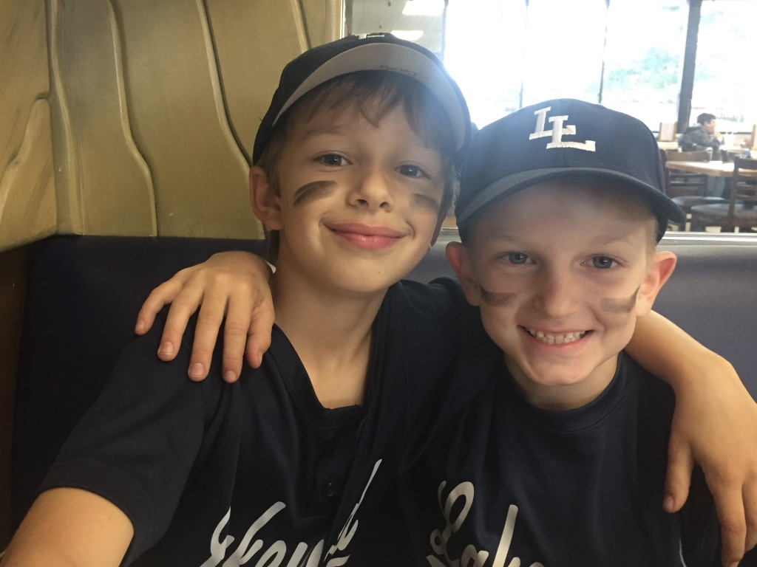

Slide 10
"Personal stories are the emotional glue that connects your audience to your message "
- Nancy Duarte

Slide 11
Types of Connecting Stories
Humor
Vulnerability
Commonality

Slide 12
The most effective stories tend to:
Be purposeful
Be under 2 minutes; many are just a few seconds
Not evoke affective empathy from participants
Be true, genuine, and match your spirit

Slide 14
Story Practice
Step 1
Step 2
Step 3
Set time
& share story
Feedback & Switch
Groups of 2
Notes:
In person: Triads are preferred. Avoid ’counting off’, it causes movement and commotion, and we want people just practicing with those next to them, as they usually are more comfortable with those they sat by.
Video workshop: Use break out rooms if possible; if not, skip
Give roles: 1. Person practicing 2. Person being practice on and 3. Observer.
Let the groups know to avoid any questions or advice. They are only practicing empathy techniques talked about previously.
The person being practiced on thinks of something they are willing to share, that they are having feelings about. They can use what they did before, in the previous exercise, or they can use something new.
The person practicing, responds with non-verbal empathy, and then at least one empathy technique (normalizing, akcnowledgment, non-judgement, affirming).
The observer names the non verbal and the verbal empathy techniques used.

Slide 15
Adding People to the CoP

Slide 16
Next Steps
Conduct at least one workshop before the next CoP
Let Sam and Elizabeth know if you would be willing to share your experiences at the next webinar
Call or email Sam and I if you'd like support or TA!

