Slide 1
County of Santa Cruz
Health Services Agency
Watsonville Health Center – ATSH Wave 2
Santa Cruz Health Center – ATSH Wave 1
Homeless Person Health Project – TAPC + ATSH Wave 1
Joey Crottogini, HPHP – Health Center Manager
Danny Contreras, SUDCC III – MAT Program Manager

Slide 2
Homeless Persons Health Project 115-A Coral St., Santa Cruz, CA 95060 831-454-2080; HPHPReferral@santacruzcounty.us
The mission of the Homeless Persons Health Project is to eliminate homelessness by providing comprehensive health care and housing for everyone.
Healthcare for the Homeless, Patient Centered Medical Home
Primary Care, integrated behavioral health, substance use disorder services including medication-assisted treatment & acupuncture

Slide 3
12 bed recuperative care center
On-site medication dispensary
Benefits advocacy and money management program
Permanent Supportive Housing Programs
Housing Navigation and Case Management
Outreach + Harm Reduction Services, Narcan distribution program
Project Connect – team for frequent users of the ER

Slide 4
Permanent Supportive Housing
HPHP currently supports 93 clients in permanent supportive housing
Current clients have been housed an average of 5.5 years
Total of 195 clients receive case management from HPHP staff
Working with Coordinated Entry System

Slide 5
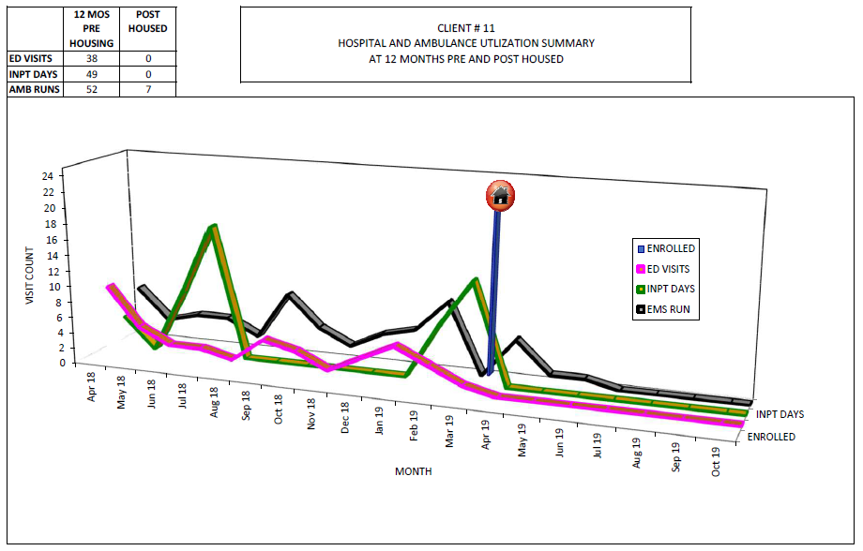
Housing Is Health

Slide 6
Building Policies & Procedures:
Clinic Administration sponsorship.
We created a MAT Committee to establish procedures. We began to meet every week, then every two weeks. We are now meeting once a month.
Consents, ROI’s, Treatment Agreements.

Slide 7
Building Policies & Procedures: That fit your clinic and can be sustained
Resources:
Boston Medical Clinic - Procedures
SAMHSA TIP 43 & 63
TAPC – Treating Addiction in the Primary Care safety net (https://www.careinnovations.org/programs/tapc/)
Trainings: Project Echo, hub and spoke trainings, ATSH through CCI.
Vanessa De La Cruz – Chief of Psychiatry Santa Cruz County
Dominique McDowell – Marin City Clinics
Katie Bell – Chapa de/ Indian Health
Cheryl Ho – Santa Clara Valley Medical Center / Homeless Clinic
Get a Coach – Natasha Pinto, Katie Bell, Shelly Verna
Don’t reinvent the wheel

Slide 8
MAT has transformed our clinics
Models and EBP used:
Harm Reduction
Motivational Interviewing
Integrated Behavioral Health
How has MAT changed our clinic:
MAT has helped us grow as a clinic in dealing with challenging patients.
Helped us improve all our Case Management services.
Helping us develop our EMR to better serve all our patients not just MAT.
Helped us better educate and train our staff so we can provide better patient centered care.
Staff have changed their heart and mind towards patients as it relates to stigma.

Slide 9
What Staff Do I need?
SUD counselors, Nurses, X-Waivered Providers, Medical Assistants
What skills and qualities am I looking for in staff?
MAT staff need leadership and advocacy skills. These positions will shift and change culture amongst your clinic.
You need individuals that can connect with people. People with lived experience and the education are a great asset, but people can be trained to provide these services.
Non-Judgmental, Not a 12 step demagogue; able to practice harm reduction.
The ability to work with any population.
Ability to be flexible, able to do outreach (streets, bridges, shelters, home visits, hospitals, etc.).
Can facilitate group regularly and well versed in delivery of different curricula.

Slide 10
What about prescribers or staff that don’t want to see these populations?
Train all staff in dealing with people as humans (registration, security, admin, volunteers, everyone).
Not every provider is going to want to deal with MAT, that’s ok.
Find your champions and build with them.
Have your MAT staff continually educate and inform staff and the community about services and needs of MAT patients.
Advocate for more MAT Providers –
ask about X waiver and MAT in interviews, ask about their thoughts on harm reduction.
block new providers’ schedule when they first start so they can complete their training and get their X waiver.
Build a sustainability plan – x number of new patients + x number of visits * no show rate * visit rate = revenue$.
Schedule accordingly – 40 minute NEW MAT, 20 minute follow ups, hold appt slots.
People will have a change of mind and heart, just need to be patience and have those educational conversations.

Slide 11
Addiction is not in itself the problem, but Rather attempt to solve the problem
Do you think there is a relationship between peoples Trauma, Hurt, Pain, and Addiction?
Roots nobody can see maybe nobody even knows about.
Perceived Pain, Sexual, Mental, Physical, and Emotional Abuse.
It takes a lot of work to wake up as a human being, its a lot easier to stay “asleep” then to wake up! – Gabor Mate

Slide 13
MAT Workflow
August 2016
2014 - 2016
2016
2016
2018
2019
1
X-waivered Prescriber who inherited MAT patients, no set program or support.
2016 SUD MH grant hired 1st Drug & Alcohol counselor
Started MAT group at HPHP
SSP shifts
Outreach
TAPC
Marin City Clinics
Natasha Pinto
Only HPHP and Emeline clinic providing MAT. No openings at Emeline to see our 1 prescriber. That prescriber was at HPHP once a week and had 2 openings a week.
Building Procedures and Implementing MAT at all clinics.
September 2017
Watsonville Health Center
5 prescribers get waivered but not offering services yet.
Started MAT group at WHC.
WHC starts offering MAT.
Hired 2nd Drug and Alcohol Counselor for WHC.
Hub and Spoke to hire 3 nurses and 3 SUD counselors.
Katie Bell train all our nurses.
Start SMA at HPHP and Emeline
21 X-Waivered Providers and other prescribers using Vivitrol.
1 MAT Program Manager.
6 SUD counselors.
3 Nurses.
Contingency Management Pilot at HPHP.
Hired 3 more Drug and Alcohol Counselors
HRSA SUD MH Grant - $ for Contingency Management $ Acupuncture
Acupuncture in all 3 clinics.
Addiction Treatment Starts Here Primary Care Wave 1 (HPHP and Emeline) and Wave 2 (WHC).
Harm Reduction + Narcan Trainings Occurring Regularly
Narcan Distribution expanding with outreach

Slide 14
MAT Case Management Visits By Year and Clinic

Slide 15
MAT Services
IBH (Therapy & Psychiatry)
Acupuncture
Contingency Management
Syringe Service Program
Yoga
Peer Mentors
Groups/SMA 1x1
Outreach in the streets

Slide 16
MAT Workflow
Labs Pre-Induction visit with Nurse
Group/1x1
SUDCM
MAT intake
Follow up Provider Visit
Follow up on induction with Nurse
Post- Initial visit with Nurse
Initial appointment with MAT provider (MD, Psych, PA, NP)
Continue Treatment determined by Tier

Slide 17
Program Requirements:
Complete intake and labs.
Attend groups and individual meetings determined by tier and treatment team.
Patients graduate from each tier by providing negative urine drug screens and adhering to your group and/or scheduled appointments with IBH/SUD counselor.
Relapse: If during treatment there is a relapse, patient will return to Tier 2 level of care and more support will be provided.
Appointments: It is very important that appointments are not missed. Encourage patients to call and reschedule ahead of time.
Drug test: Patients will be drug tested at every visit. We use point of care urine drug screens and send out to lab if needed.

Slide 18
Making A Transformation Groups
Seeking Safety
Acupuncture
Living In Balance
Best Life
Yoga
Peer Mentors
Psycho – Educational
Various Curriculums

Slide 19
Set up Your Tiers of Treatment for MAT in Primary Care
 | Prescription | Group/IBH
Tier 1 Induction (Days - 2 weeks) | Weekly | Weekly
Tier 2 Early Treatment (12 weeks) | Weekly | Weekly
Tier 3 Stabilization (12 weeks) | Every other week | Every other week
Tier 4 Maintenance (6 months to 1 year) | Once a month | Once a month
Tier 5 On going Maintenance | Once a month | Once a month
Induction
Stabilization
Maintenance

Slide 20
Making A Transformation groups
Day | Time | Location
Monday MAT group | 2-3 pm | WHC (atrium) Building A
Monday MAT group | 10-11 am | Emeline (SMA room #109)
Tuesday MAT group | 2-3 pm | HPHP (SMA)
Tuesday MAT group | 4-5 pm | Emeline (SMA) (room#109)
Wednesday MAT group | 6-7 pm | Emeline (room#109)
Wednesday Seeking Safety | 5-6 pm | WHC (atrium) Building A
Thursday Seeking Safety in Spanish | 5-6 pm | WHC (atrium) Building A
Friday MAT group | 11-12 pm | HPHP

Slide 21
What ATSH Quarterly Data Tells Us
97% of all patients prescribed buprenorphine/naltrexone adhered for 6 months
or
41% of patients prescribed bup/naltrexone adhered for 6 months
315 patients prescribed bup
41% of all patients with OUD prescribed bup/naltrexone
23% of patients screened for OUD of all patients seen last quarter
Or only 4%...
97% of patients had 1 follow up visit within 14 days of starting bup/naltrexone
99% of patients had 2 follow-up visits in 30 days of initial prescription
82% patients prescribed bup/naltrexone received urine toxicology test within 3 days of starting medication
Notes:
226/229 = 99% of patients had 2 follow-up visits in 30 days of initial prescription

Slide 22
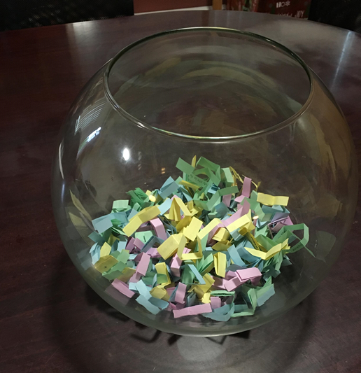
Contingency Management
“Simply stated, it involves providing tangible and concrete reinforcers or incentives to patients for evidence of objective behavior change.” (Petry, 2012)
https://www.careinnovations.org/resources/contingency-management-treatments-for-stimulant-and-other-substance-use-disorders-what-they-are-and-how-they-work/
We already use CM in our daily lives ( children, employees, pets, etc.)

Slide 23
Why Implement Outreach Teams?
Expand access to care – reach most isolated, difficult to reach populations.
Continuous engagement.
Preventative Medicine – prevent outbreaks, decrease ER use.
Low-cost to implement.

Slide 24
Outreach/ In-reach
Outreach Opportunities: | What we do:
Syringe Service Program | Our MAT staff and Peer Mentors work shifts in the Syringe Service Program to build rapport and be there to talk to patients about treatment and getting connected to other needed services. Every patient gets all the MAT staff work cell number when they leave.
Presentations / Trainings | Our staff conduct presentations to educate the community about MAT services, to educate about substance use disorder and stigma. Our staff also conduct presentations for our own county staff at all staff meetings and other departments.
Outreach to Homeless Encampments | SUD counselors and Public Health Nurses go out and do outreach together to check on people, teach them how to use Narcan, give them vaccines, refer them back to clinic, provide services right there in the field, we bring back packs with supplies, tents, water, granola bars, sleeping bags, socks, hygiene kits, etc.

Slide 25
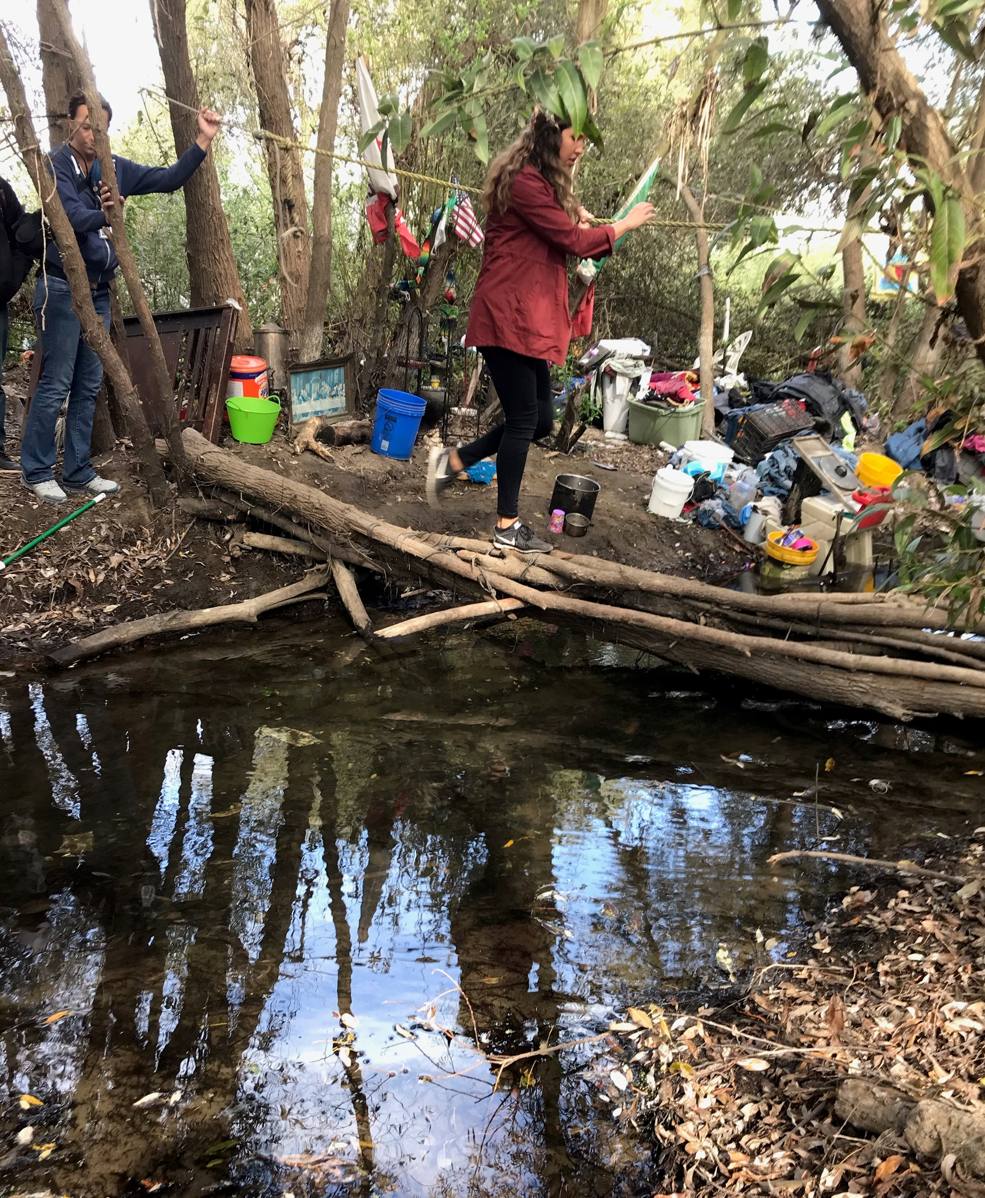
Effective Street Outreach
Street outreach staff receive regular training in evidence-based practices
Utilize harm reduction principles
Liaison to housing services
Coordinate with other agencies
Notes:
HOPES Team is one true MDT coordinating outreach efforts targeting individuals experiencing homelessness. The County of Santa Cruz hired the consultant firm Focus Strategies to assist community leadership and key stakeholders to evaluate, align, and improve the countywide response to homelessness. In one of their report, they found that while outreach does exist, it is not well coordinated between agencies, and recommended better coordination between other agencies to improve systematic response to homelessness that involves common goals, shared approach or protocols, understanding of geographic coverage, consistent data collection, and common outcomes. The Homeless Persons Health Project expects to take a leadership position in the efforts to coordinate outreach activities within the Health Services Agency, as well as throughout the community with other agencies involved.
Department of Housing & Urban Development, Department of Veteran Affairs, Department of Health & Human Services, and the National Alliance to End Family Homelessness produced several guidelines for effective outreach
Provide warm handoffs to coordinated entry or to shelter, housing, and service providers.

Slide 26
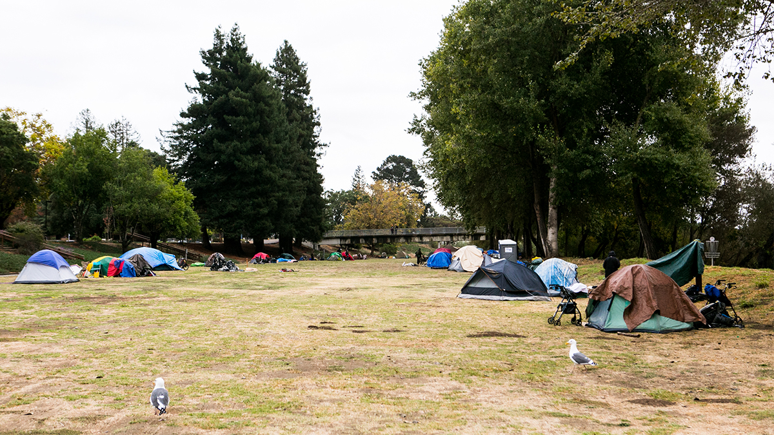
An Ecological Approach to Health Care – County of Santa Cruz Health Services Agency
Legal Assistance
Behavioral Health
Referrals
Primary Care
HIV/HCV Testing
MAT
HPHP Mobile Clinic – Street Medicine
Case Mgmt.
SSP
Shelter
Wound Care
Naloxone
IOP + Inpatient SUD Programs
Coordinated Entry/Permanent Supportive Housing
Food
Image from Santa Cruz Good Times

Slide 27
Santa Cruz County Health Services Agency Primary Care Clinics MAT Team
Homeless Person Health Project (HPHP)
Joey Crottogini, Health Center Manager at HPHP
Santa Cruz Health Center (EMELINE)
This could be you, MAT Nurse
Watsonville Health Center (WHC)
Angelica Torres, CADC- CAS, Bilingual SUD CM
Greg Goldfield, CADC- CAS, SUD CM
Marissa Torres, CADC II, Bilingual SUD CM
Adam Echols, RADT, SUD CM
Alejandro Monroy, CADC-CAS, Bilingual SUD CM
Andres Galvan, CADC II, SUDCC II, Bilingual SUD CM
Jasmine Marozick, MAT Nurse
Danny Contreras, SUDCC III – MAT Health Services Manager
Elvia Cohen, MAT Nurse

Slide 28
Questions & Answers:

