Slide 1
CCI Learning Collaborative for SUD Services
Gilmore Chung, MD
Anasa Matthews-Billignsly, MSW, MPH
Tobin Shelton, LCSW

Slide 2
Welcome!
Lunch & Introductions
Venice Family Clinic Overview
Chill with Gil—VFC MAT Provider Champion
Tour of Venice Family Clinic & Common Ground
SBIRT & Referrals
Scaling & Increasing Access
Closing & Final Questions

Slide 3
ICEBREAKER!

Slide 4
Venice Family Clinic Overview
Our Mission:
Venice Family Clinic's mission is to provide quality primary health care to people in need
Our Services:
Comprehensive primary health care & supportive services with 125,000+ visits in FY 2017-2018.
Eleven clinics, satellite, and school based clinics as well as shelter- and street-based outreach teams.

Slide 5
VFC Substance Use Services Overview
Medication-Assisted Treatment
13 X-Waivered providers & 18 Vivitrol providers
Psychosocial Services
Counseling
Therapy
Case management
Support groups
Common Ground Services
HIV prevention and treatment
Case management
Syringe access

Slide 6
SUD Services Roadmap
~800 unique patients served
in 2018
5
HRSA MAT
9
Extended hours for SEP
6
DHCS HSS
4
Acquisition
of CG
2
Behavioral health services offered
VFC pharmacy carries bupe on site
10
7
SAMHSA
3
SUMMIT study
1
VFC
founded
8
Shared medical
visits
1970’s
2012-2018

Slide 7
Your Turn!
What does your MAT team look like?
How many patients are you currently servicing?
Where do you want your program to be in 2 years?

Slide 8
Scaling & Improving Access to SUD Services
Screening
Quality Improvement, Data Quality, & Population Health
Shared Medical Visits
Organizational Culture
42 CFR Part 2
Multiple points of access

Slide 9
MAT Encounters: Buprenorphine
Notes:
On average, shared medical visits increase MAT encounters/access by 30% each month

Slide 10
Chill with Gil
Notes:
45 mins

Slide 11
Discussion Point 1: Inductions & Treatment
What is your conversation with patients around inductions and withdrawal management?
How do you choose between mono and combination tablets?
What’s your/the clinics process in monitoring pts with comorbidities and/or on benzo’s?

Slide 12
Discussion Point 2: Diversion
What's the conversation with patients who continue to say, “I lost my prescription”?
Do you have any experience with DEA audits?

Slide 13
Discussion Point 3: Supportive Services
What do your shared medical visits and support groups look like?
What is the structure of your interdisciplinary team?

Slide 16
Point of Access Workflow
Provider conducts BI/gives patient options for MAT and SUMMIT
Patient connected with behavioral health staff for additional services
Patient Screens Positive at visit
Behavioral Health On-Call
Patient Assessed for SUD services
SUMMIT Intake
Maintenance
MA screens patient with modified NIDA Quick Screen. Positive screens entered in Reason for Visit
Same day apt w/ LCSW to assess patient for further MH issues & refer to SUMMIT
Patient continues in treatment and follow-up as needed
At any time, a patient can opt-out of any one of these services

Slide 17
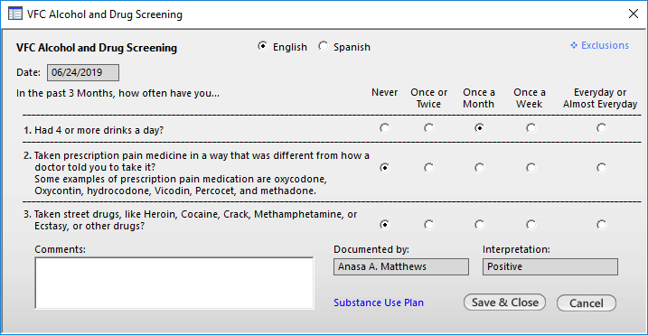
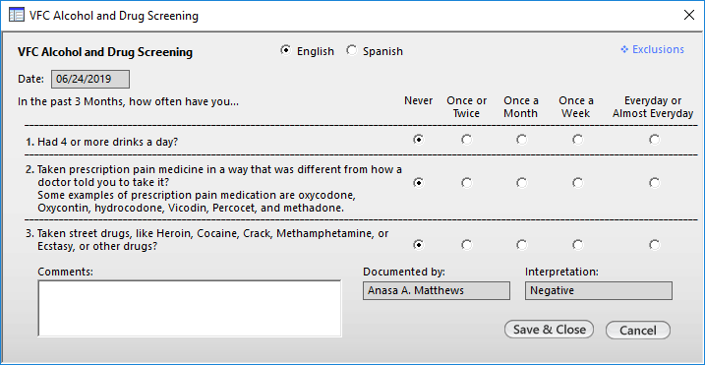
SBIRT
Screening

Slide 18
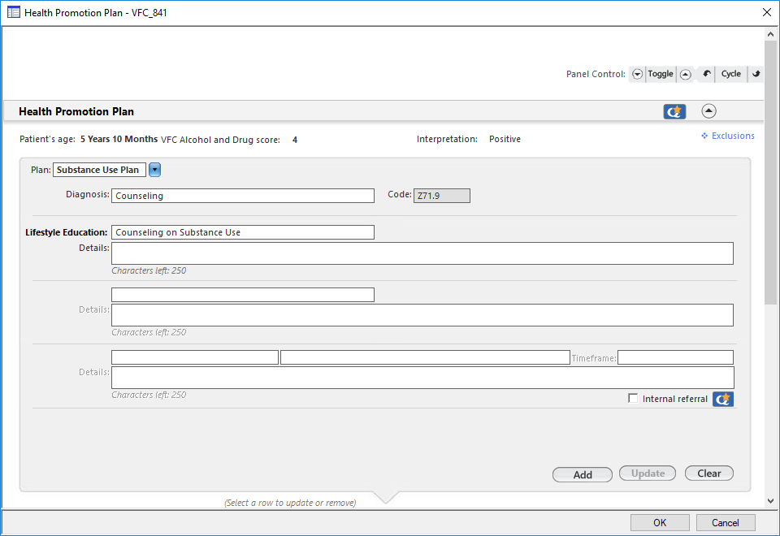
SBIRT
Brief Intervention

Slide 19
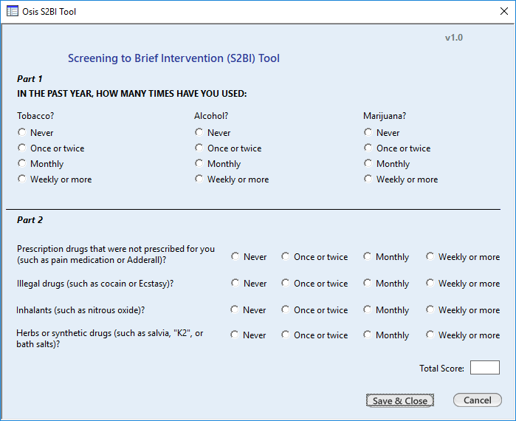
SBIRT for Adolescents

Slide 20
SBIRT
Referral to Treatment
Behavioral Health-on Call
SUMMIT
Higher levels of care

Slide 21
What does success look like at your organization?

Slide 22
Questions & Answers

Slide 23
Thank You ☺
Gilmore Chung, MD
gchung@mednet.ucla.edu
Anasa Matthews-Billingsly, MSW, MPH
amatthews@mednet.ucla.edu
Tobin Shelton, LCSW
Tdshelton@mednet.ucla.edu

