Slide 1
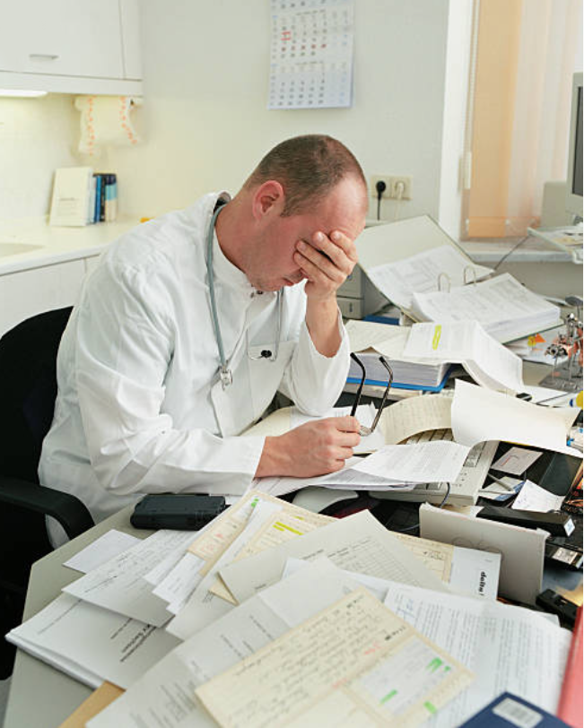
DRAFT
Scribing solutions for clinical documentation
August 2018

Slide 2
Scribing could slow physician burnout and improve efficiency
There is an increasing health care workforce shortage in California, due in large part to inability to retain clinicians. The Mayo Clinic reports 54% of doctors experience burnout; studies have found that physician burnout is driven by administrative burden¹ and clinical inefficiency
Problem
Solution
Physicians are spending half of their day on clinical documentation and administrative work
Multi-state time study: “physicians spent only 27% of day on direct clinical face-time with patients vs. 49% on EHR and desk work”
Physician engagement and satisfaction declines, leading to burnout
2017 Medscape survey of 14,000+ physicians: “too many bureaucratic tasks” is leading cause of burnout
Scribing technologies consistently report an average of ~50% savings on time spent on documentation, freeing up 2-3 hours per doctor each day
Physician satisfaction increases with a greater percentage of time spent with patients and smaller percentage spent on desk work → lowers burnout
Additional benefits can include:
Physicians able to see more patients in a day, increasing efficiency and revenues
Patient experience improves with higher physician engagement in interaction
Improved quality of data capture
¹Cited as the leading cause of physician burnout by Avia and NEJM (2016 Catalyst survey)

Slide 3
Landscape of scribing solutions
Current CHCF focus
In-person scribes
Remote scribes
AI scribes
Companies
N/A – clinic / health system hires and trains
Augmedix is the leader, utilizing Google Glass technology and remote scribes in CA and Asia
Suki (“Alexa for doctors”) is the most developed
Others: Saykara and Sopris Health
Pros
Real person in room – additional brain for review, translation, prompting, other tasks
No devices (ramp-up, patient comfort)
Can prompt / remind
Glass captures non-verbal communication (e.g., pointing to elbow)
Some bilingual ability
Scalable
No training or retention issues
Cons
Requires recruiting and training / ramp-up
Attrition
Long training period
High turnover
Product still improving
No prompting (planned for Q1 2019)
Cost
~$3500+/month
$2500-3200/month/doc
$15,000/year/doc
(=$1250/month/doc)
Users in CA
Shasta
Sutter, Dignity, small independent clinics
Plastic surgery (Bay Area), ophthalmology (LA)
EMRs
N/A
Any, but already working with 20+ EHRs, e.g., Epic, Cerner, Allscripts, NextGen, eClinicalWorks, Athena
Any, but already working with 10+ EHRs: Epic, Cerner, NextGen, Athena, Redox

Slide 4
Suki: At a Glance
Company overview
CEO / Founder, Punit Soni, and core leadership team have technology (Google, Salesforce, Oracle) and medical backgrounds (UCSF internal medicine, Stanford trauma surgery), as well as various start-up and other professional experience (e.g., McKinsey)
Backed by strong investors: Venrock, First Round Capital, Marc Benioff
First few pilots launched Fall 2017. Currently serving ~30 doctors across the US, ranging from family practice to cardiology to plastic surgery to a few large hospital systems. Expecting to be serving ~100 doctors by end of 2018
Customers most often use Suki to ease physician satisfaction / burnout issues, but many clinics / health systems also make a modest productivity ask (product easily pays for itself by seeing a few more patients a week)
Product overview
Suki is a software voice agent, activated on name command (voice agent can be turned off)
It can capture dictation, medical acronyms, pull up past patient history, structure a note, transcribe new information, etc. with 100% accuracy
Average demonstrated time savings of 58% per note (N = 2,200)
Suki is fully customized to each doctor, taking the last 100 notes the physician created and learning from them (“I did a physical exam and it was normal” → Suki can convert this into a description of what “normal” means)
Notes are created outside of the EMR and then pushed back in; maximizes time savings

Slide 5
Discussion Questions
Are documentation and physician satisfaction / burnout among the pain points for your clinic?
What are your reactions to AI scribing (Suki) as a potential solution for time spent on documentation?
Do you think this would increase physician satisfaction in your clinic?
How would you compare this to previous experience (if any) with scribing or other solutions to reduce administrative burden?
Do you have additional questions for the scribing companies? We can set up a direct introduction and demo with the company if there is interest

