Slide 1

Timely Access to Patient Services (TAPS)

Slide 2
Implementation Resources Toolkit Contents
TAPS Rationale and Framework
TAPS Model Overview
Implementation
  Training and protocol
  Evaluation and Performance Measurement

Slide 3

What is TAPS?
Timely Access to Patient Services
Current appointment options for patients who call the Nurse Advise Line:
  1) Try to schedule a clinic visit
  2) Refer to urgent care
  3) Refer to emergency room
NEW OPTION: TELEPHONE VISITS
Notes:
Talking points:
-The goal of TAPS is to improve patient access to primary care services through non-traditional and innovative ways of engaging patients in managing their health.
-Currently, there are only three options for patients who call the Nurse Advice Line. Option 1 is to try to book an appointment in our health centers which can take anywhere from 10 – 30 days. Options 2 and 3 are expensive alternatives that would be a financial burden on our patients. All these options are NOT patient-friendly.
-A new option that we are working on developing is to provide telephone visits for patients who can be seen in the time frame of between 2 hours to 2 weeks. Many of our current primary care visits do not require a physical exam therefore the patient do not need to be seen in person. Telephone visits is a way for these types of patients to receive the care that they need in the comfort of their homes and in between their busy work schedules.

Slide 4
Problem Areas
Long wait times for appointments
Inconvenient, unnecessary clinic visits
Limited same day appointments
Missed opportunities/High no show rates
Reduced capacity with staggered EHR roll-out

Slide 5
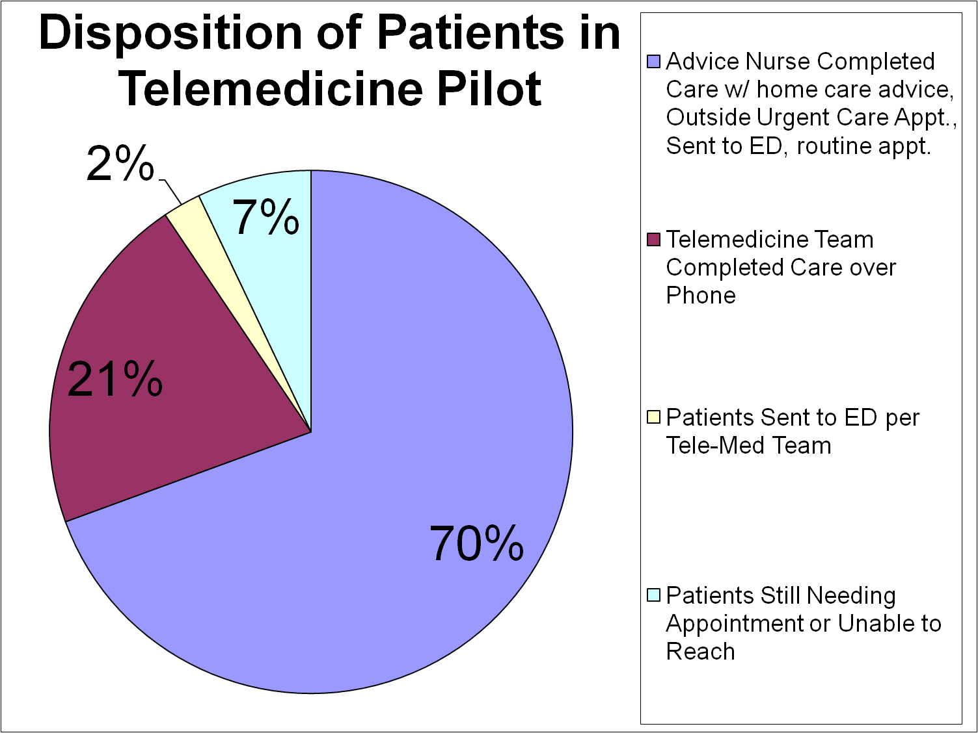
Contra Costa Telephone Consultation Clinic Model
Cost/year = $397,000
Savings/year = $934,000
Net Cost Saving/year = $537,000
Patient Satisfaction = Priceless
Notes:
Talking points:
-TAPS is modeled based off of the Contra Costa Telephone Consultation Clinic
-From the Telephone Care Clinic, Contra Costa had a net cost saving of over $500,000 per year and had high patient satisfactions scores.
-Of their pilot, 21% of patients were able to complete their care through telephone visits, which opens up those appointment times for patients who need the face-to-face visit.

Slide 6
New Process Model
Patient calls
Nurse Advice Line
ED/911
Primary Care Appt
Urgent Care Appt
NEW OPTION:
TAPS – Telephone Visits

Slide 7
Countermeasure to Problem Areas
Reduce long wait times for appointments
Eliminate inconvenient, unnecessary clinic visits
Increase same day appointments
Understand reasons for no shows and missed opportunities
Reduce the number of semi-urgent patients sent to Urgent Care
Notes:
Talking points:
- TAPS is a countermeasure for some of these problem areas that we are having. We can reduce our long wait times because we are eliminating inconvenient, unnecessary clinic visits.
-We can increase our same day appointments because we are now only seeing patients that need to be seen in person and additionally we can provide same day consultations through the telephone.
-Though TVs do not directly affect our missed opportunities and high no show rates, we can use some of the data we are collecting such as reasons for referrals and patient feedback from the patient satisfaction surveys to help us understand why our no show rates are high.
-With the roll-out of eCw for Urgent Care in April, TVs will help reduce the numbers of patients being sent to Urgent Care by ensuring that patients who are going to Urgent Care are those who really need the urgent care.

Slide 8
Benefits of TAPS
Prompt patient centered access to care
Establish the operational infrastructure that supports excellent patient care
Improve the health of our patient population
Re-allocate visit slots at the clinics and urgent care to patients who require an in-person visit
High patient and staff satisfaction rates demonstrated

Slide 9
Implementation

Slide 10
Implementation Steps
Secure inventory
  Network: devices, connectivity, security,
  Hardware: Space, desk, telephone, computers, printers, scanners, laptop
Develop workflows, protocols, and procedures
  eCW template, lab, radiology, read only X-rays
Training of RNs-Scripts
Recruit and train providers
Develop project measures, methods for tracking, and reporting structure

Slide 11
Workflow - Overview
Nurse Advice Line
Patient calls Nurse Advice Line (NAL)
Can patient be seen via telephone?
Follow up Patient Satisfaction Survey
YES
Patient is referred to Urgent Care or Clinic
Patient is referred to TAPS Provider
TAPS Provider
Patient’s needs are NOT met by telephone visit
TAPS Provider meets with patient via telephone
Patient’s needs are met by telephone visit
Notes:
NOTE: More detailed workflow is on slide 8
-The patient calls the NAL. The RN decides if the patient can be seen through a telephone visit. If not, then the patient is referred to Urgent Care or schedules an appointment in their designated health center.
-If the patient can be seen through a telephone visit, the RN refers the patient to a TAPS provider. The RN informs the patient of a time to expect the TAPS provider phone call.
-The TAPS provider calls the patient and carries out the visit like a face-to-face visit. The provider can order any tests or labs through the health center that the patient is assigned to and the patient can come in for the tests and labs. If after the telephone visit, the provider feels that a face-to-face visit is needed, the patient can schedule an appointment for a clinic visit.
-After the TV, the patient will receive a patient satisfaction survey phone call to get feedback on this process.

Slide 12

Staffing Positions and Recruitment
Telephone Advice Line Physician Lead
Telephone Advice Line Provider (NP or MD)

Slide 13
Provider Desired Qualifications
* See appendix for full job descriptions
Experienced provider, comfortable with “seeing” patients over the phone
Experience working in urgent care setting with patients with acute illness
Works well as part of a multi-disciplinary team, to prioritize and also work independently.
Sensitivity to and experience working with racially, ethnically, culturally and sexually diverse individuals.
Language skills

Slide 14
Training & Protocol
Implementation:

Slide 15
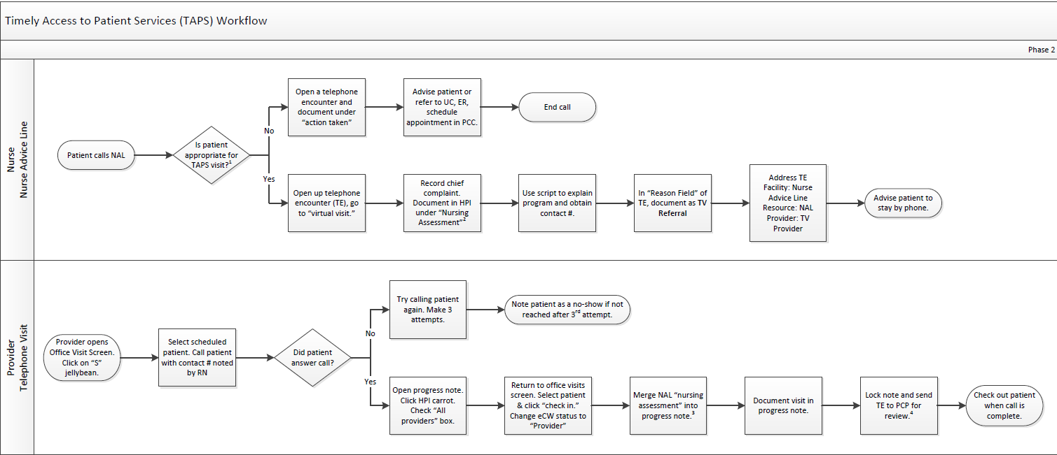
Workflow Diagram

Slide 16
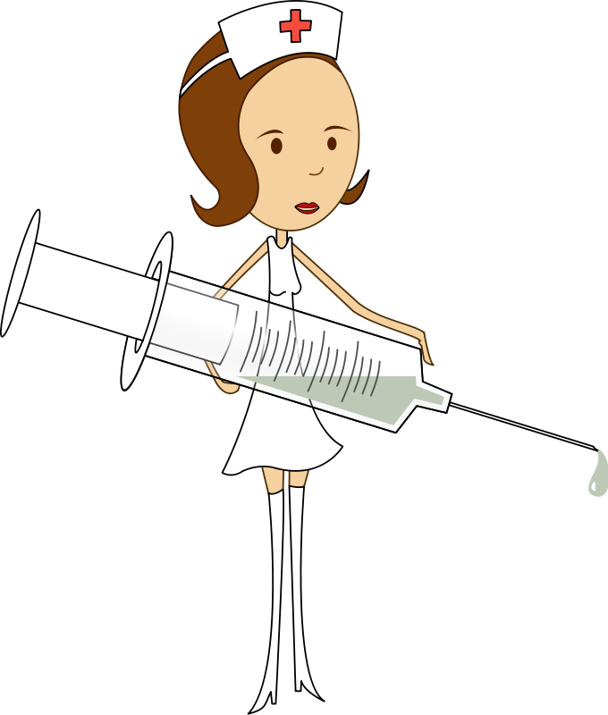
RN Role

Slide 17
TAPS will see all patients except:
  Any symptoms that needs 911/ED attention or requires a physical exam
  New patients
  Narcotic and routine medication refills
  Pregnant women or r/o pregnancy
  Mental health issues
  Dental issues
REFER ANY OTHER SYMPTOMS THAT FIT INTO A 12-72 HOUR DISPOSITION

Slide 18
RN Script
“The Nurse Advice Line currently allows the nurse to refer the patient to a provider telephone clinic. I will route my triage notes to the provider and you will get a call back within 2 hours. If you don’t hear from the provider after 2 hours, call back to the Nurse Advice Line.”

Slide 19
RN Nursing Assessment
Document RN notes in Nursing Assessment
  Click on blue HPI link
  Click on *Screening/Risk Assessments on left side column
  Scroll and select Nursing Assessment from list

Slide 20
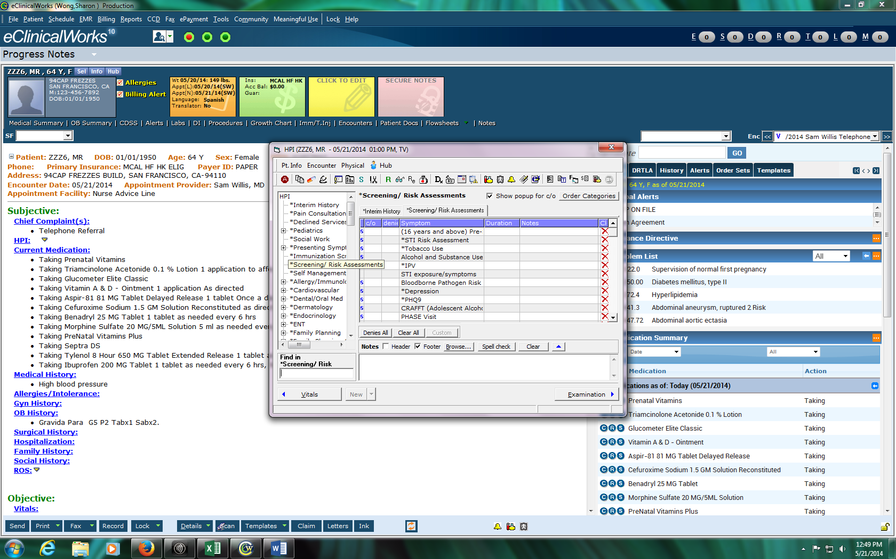
RN Nursing Assessment
1. Select “HPI”
2. Select
Screening/Risk Assessment

Slide 21
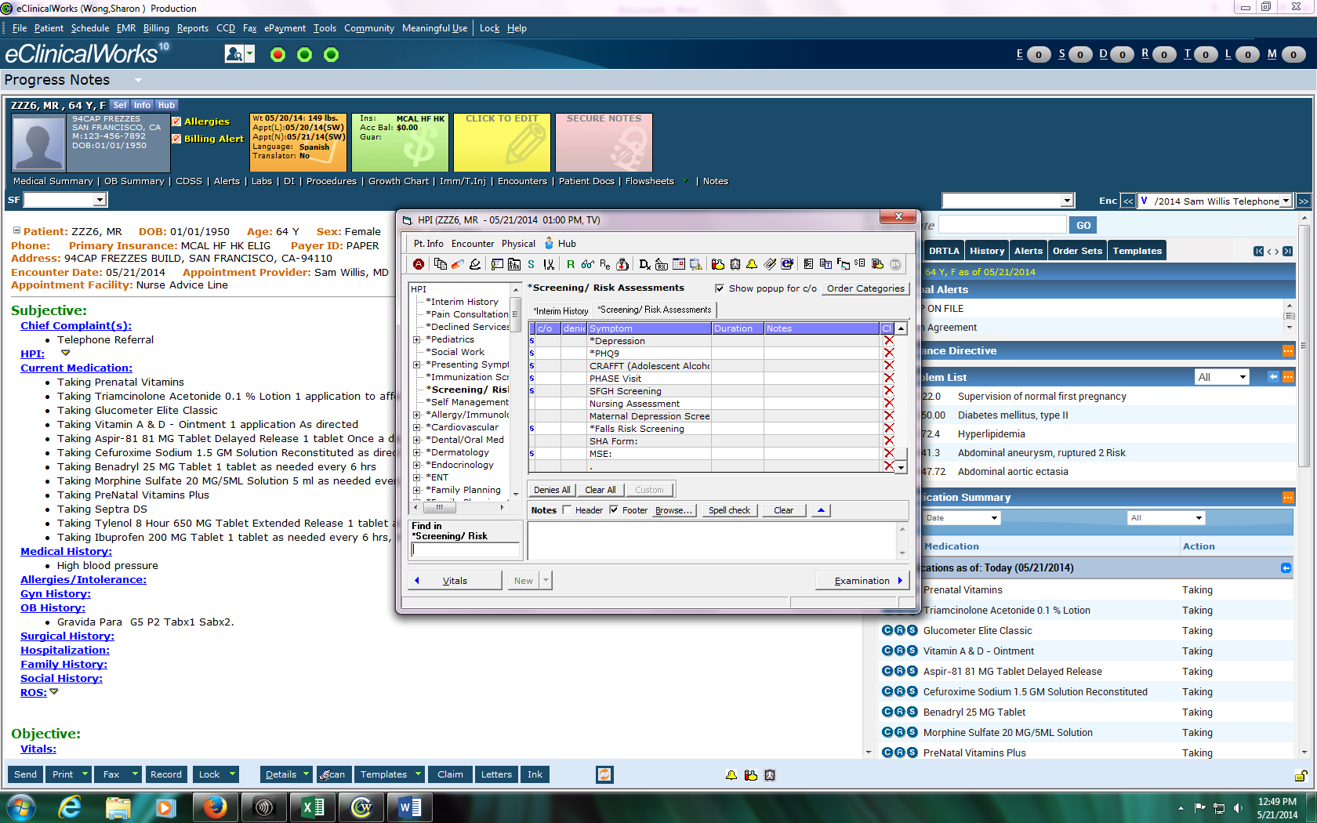
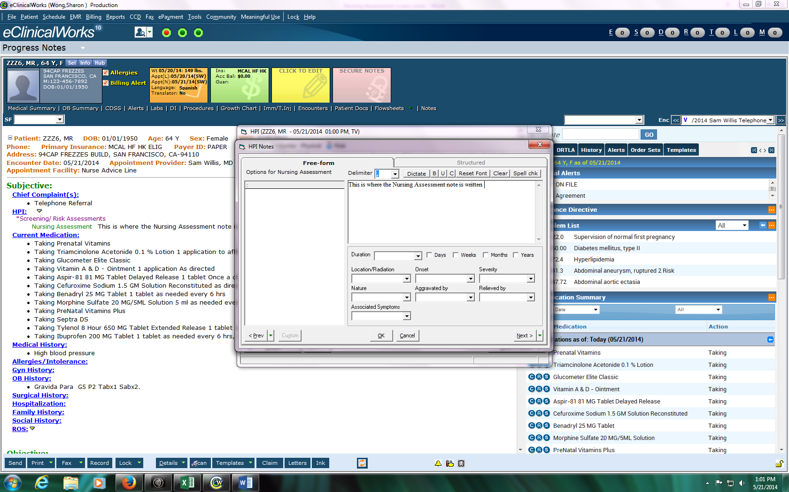
RN Nursing Assessment
3. Select
Nursing Assessment
4. RNs document notes here

Slide 22
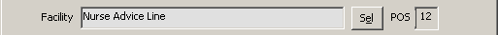
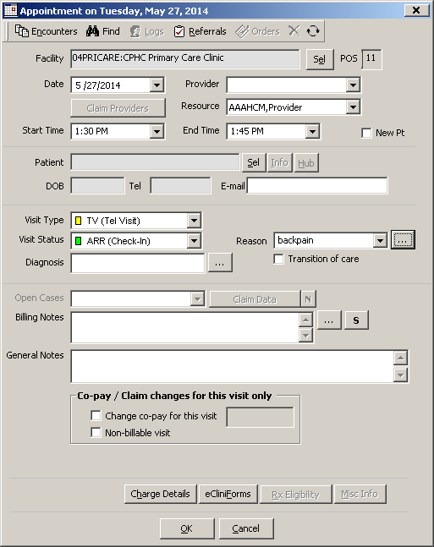
RN Scheduling into ECW
Facility: Nurse Advice Line
Resource: NAL
Provider: TAPS provider
Visit Type: TV (Tel Visit)
Visit Status: ARR
Note: Schedule directly into ECW, not LCR/Invision

Slide 23
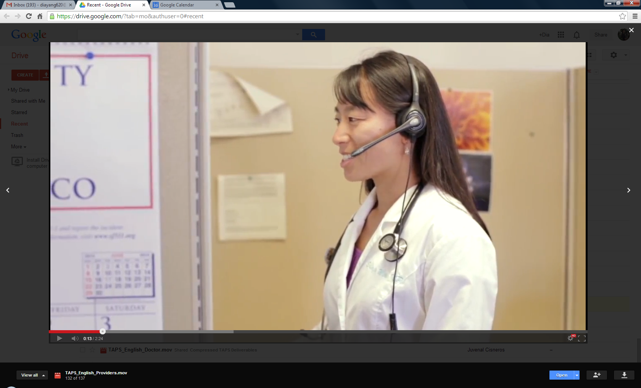
Provider Role

Slide 24
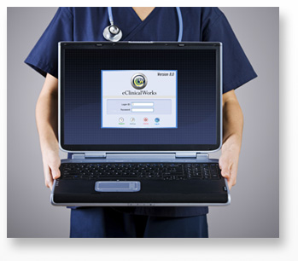
TAPS Provider
Call patient
Check-in/check-out patient
Merge Nursing Assessment
Lock note & send to PCP for co-signing/review

Slide 25
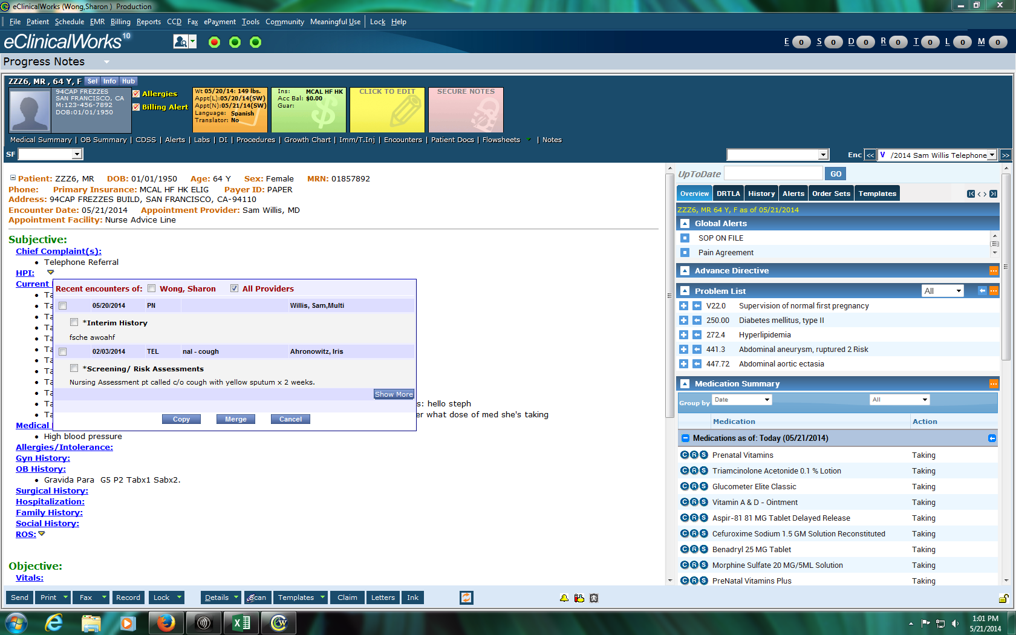
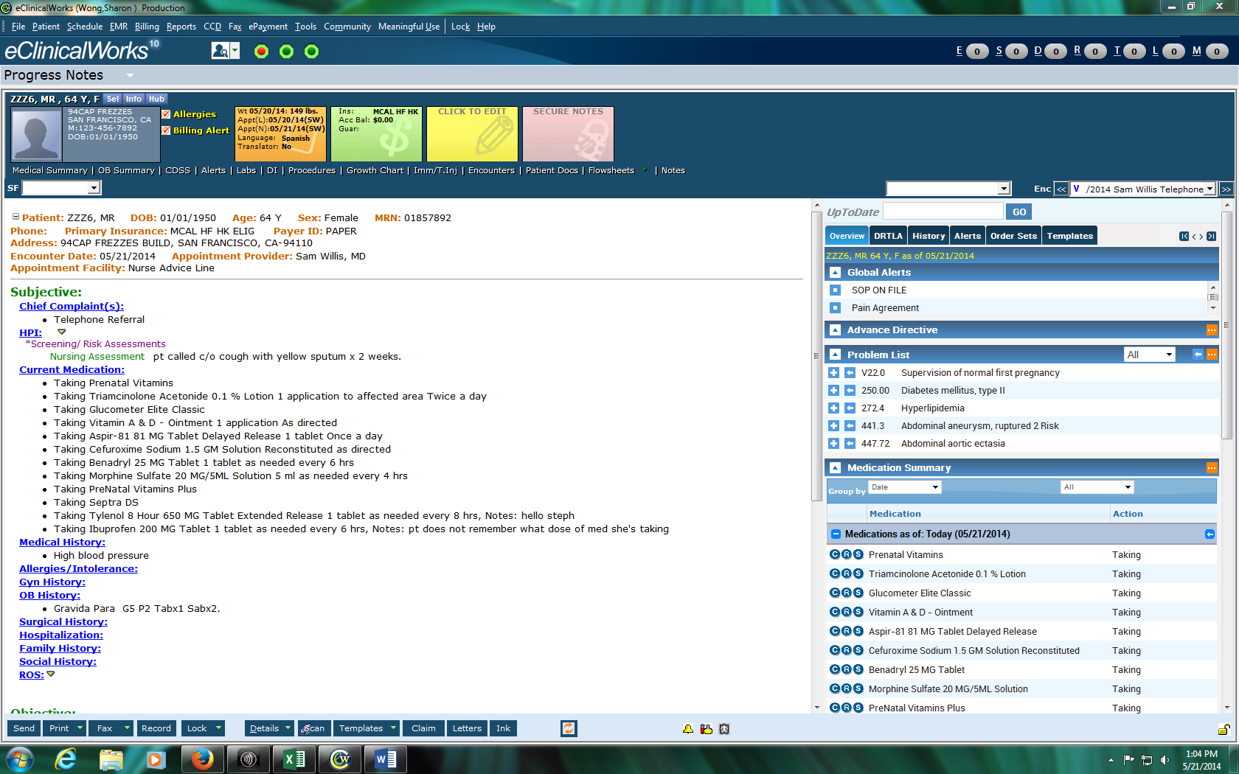
Merge Nursing Assessment
Click on yellow carrot
Check All Providers box
Check *Screening/Risk Assessment box
Click Merge
REMEMBER TO CHECK – OUT PATIENT AFTER VISIT
Notes:
After merging nursing assessment, continue with provider notes.

Slide 26
Patients needing Lab Orders/X-Rays
Patient referred to their medical home to get the test drawn
The TAPS provider forwards a Telephone Encounter to the triage RN at the medical home to notify them that the patient will be dropping in
X-ray requests are faxed directly to Radiology

Slide 27
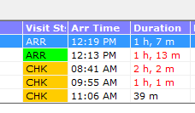
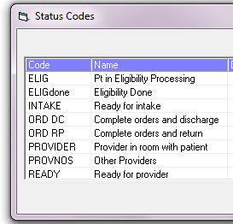
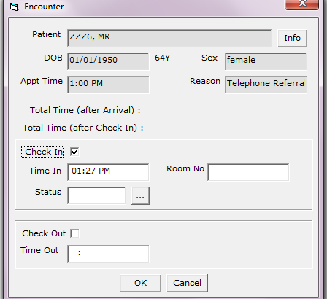
Check-in/Check-out
Check – in patient
Check – out patient
Visit status should change to “CHK”
Notes:
Make sure to reach patient first before checking in patient (open up progress note to see patient’s phone number, call patient)

Slide 28
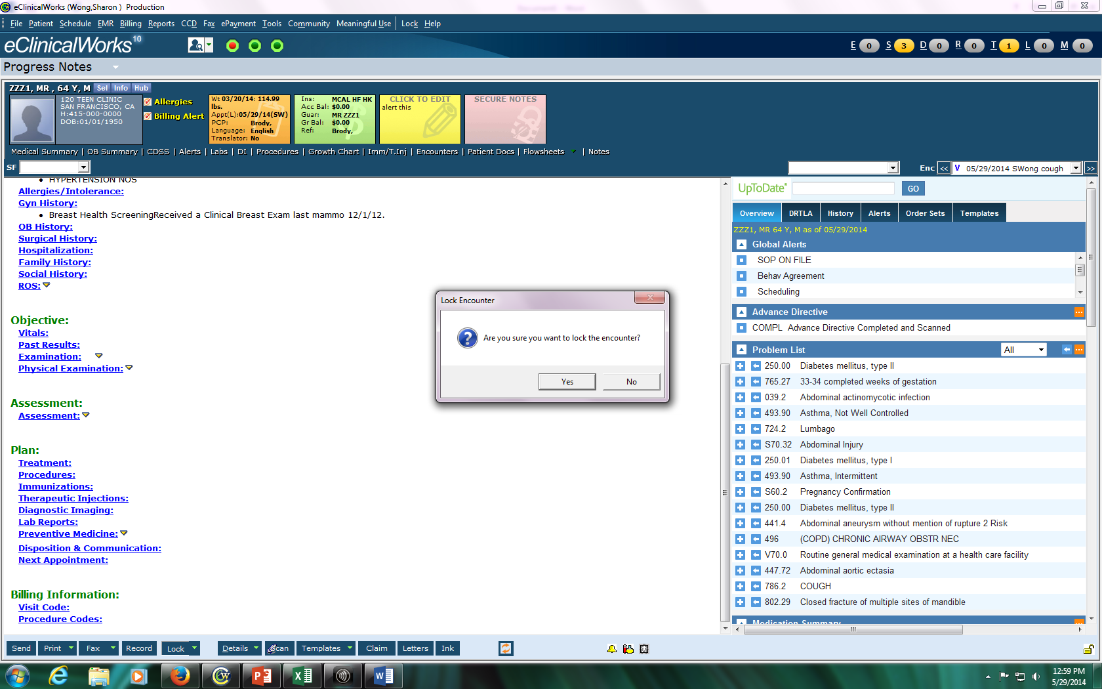
1-Lock Notes
Click on the “the “Lock” button

Slide 29
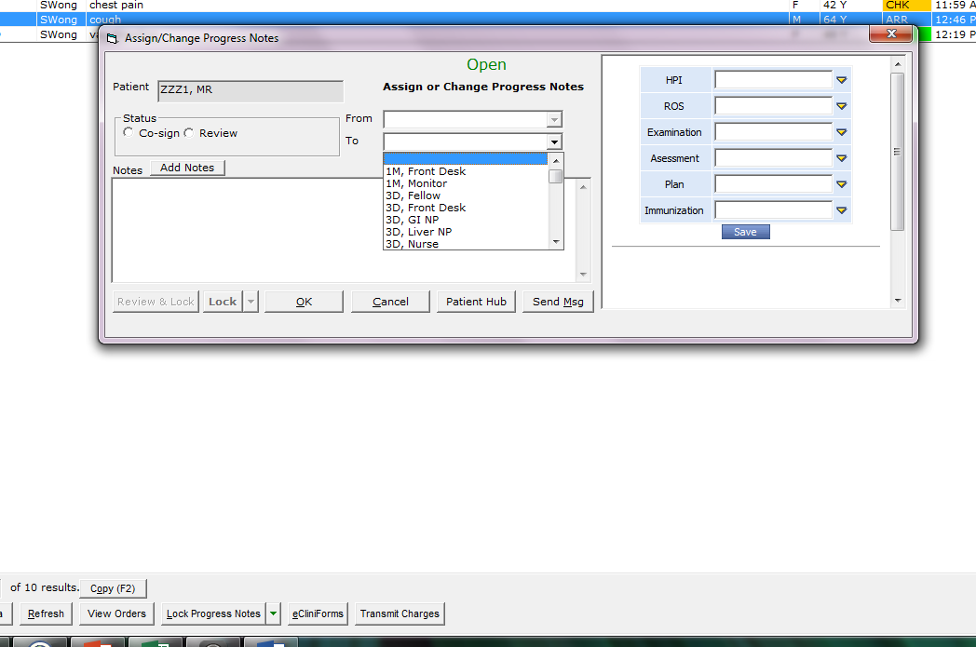
Select the name of the provider you want to review/cosign the note
Check the review or cosign box
Select the name of the provider

Slide 30
Evaluation and Performance Measurement

Slide 31
Our Toolkit includes:
Improvement measurement
TAPS Provider Template
Script
  Patient Survey
  Triage Nurse
Surveys
  Patient
  TAPS Provider
Implementation Budget

Slide 32
Improvement Measurement
Metric | Description | Purpose | Method/Frequency | Data Source
Patient Satisfaction Survey | Telephone survey for patients who are referred to TAPS See below for sample survey | Clinical follow up and overall patient feedback for program | RN who referred patient to TAPS is responsible for follow-up call within a week of visit. | Survey responses
Productivity Rate | Number of visits per 4 hour session | Measure of patient demand and utilization of program | Physician Lead is to review the number of visits seen in a 4 hour session weekly. | Provider logs¹
Inappropriate Calls | Number of calls to the NAL that do NOT fall under the following: Acute Care Health Ed Lab results Self – care advice | Assess the impact of TAPS on patient referrals to Urgent Care and Primary Care Clinic appointments | A designated Health Worker will pull referral rates on a weekly basis. This information will be shared with Management Teams at the clinic. | Relay Care Report²
Provider Surveys | Survey emailed to all Primary Care Providers See below for sample survey | Elicit feedback from PCPs and identify improvement areas | Data coordinator will be responsible to email survey on a quarterly basis | Survey responses
Notes:
¹Provider logs – Tracking sheet updated by TAPS Providers that captures MRN, date of visit, patient concern, and whether a resolution or referral was made (see attached template)
²Relay Care Report – Database that the NAL documents each telephone encounter

Slide 33
Improvement Measurement
Metric | Description | Purpose | Method/Frequency | Data Source
Chart Audit | TAPS providers/ Physician Lead will review patient charts for appropriateness and quality of care | Ensure high quality of service and identify improvement areas | At least 10 of patient charts for new on-boarding providers will be audited. After, providers will be expected to audit another provider’s charts on a monthly basis. | Chart Audit Validation Checklist³
TNAA (not specific to TAPS) | Number of days for the third next available appointment | Evaluate the impact of TAPS on a system level | SFHN wide measurement of patient access, collected on a weekly basis by the clinics | TNAA report
CG-CAHPS (not specific to TAPS) | Patient survey administered for the evaluation of their experiences | Evaluate the impact of TAPS on a system level | 12-month quality improvement survey | CG-CAPHS report
Notes:
³Chart Audit Validation Checklist – Details for this measure is yet to be determine

Slide 34
Provider Log Template
Provider logs is a tracking sheet updated by TAPS Providers that captures MRN, date of visit, patient concern, and whether a resolution or referral was made.

Slide 35
Script for Patient Surveys
Hello, my name is ________. I am calling from the San Francisco Department of Public Health for (patient's name) regarding the telephone visit that happened on (date of visit). This is a patient survey to get feedback on how we can improve our telephone services. Do you have a few minutes to answer a couple of questions about your experience? Ask questions. Thank you and have a nice day!

Slide 36
Survey Processes
Patient Survey
  RN who referred patient to TAPS is responsible for follow-up call within a week of visit.
Provider Survey
  Data coordinator will be responsible to email survey on a quarterly basis

Slide 37
Patient Survey - Questions
  I received the call by the time I was given (Yes / No)
  The provider answered all of my questions (Yes/No)
  This telephone service is something I would use again (Yes/No)
  On a scale of 1-10 with 1 being the worst and 10 being the best, how you rate the overall experience with the provider?

Slide 38
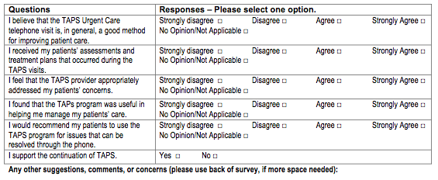
6 Question Provider Survey

Slide 39

Implementation Budget

Slide 40
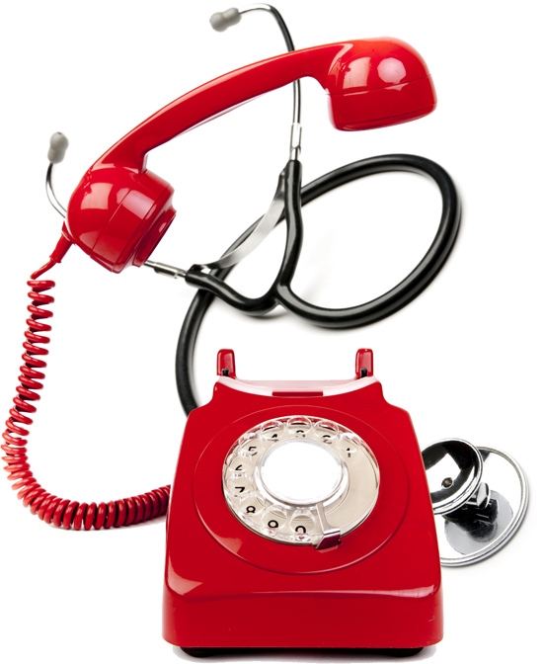
Thank You

