Slide 1
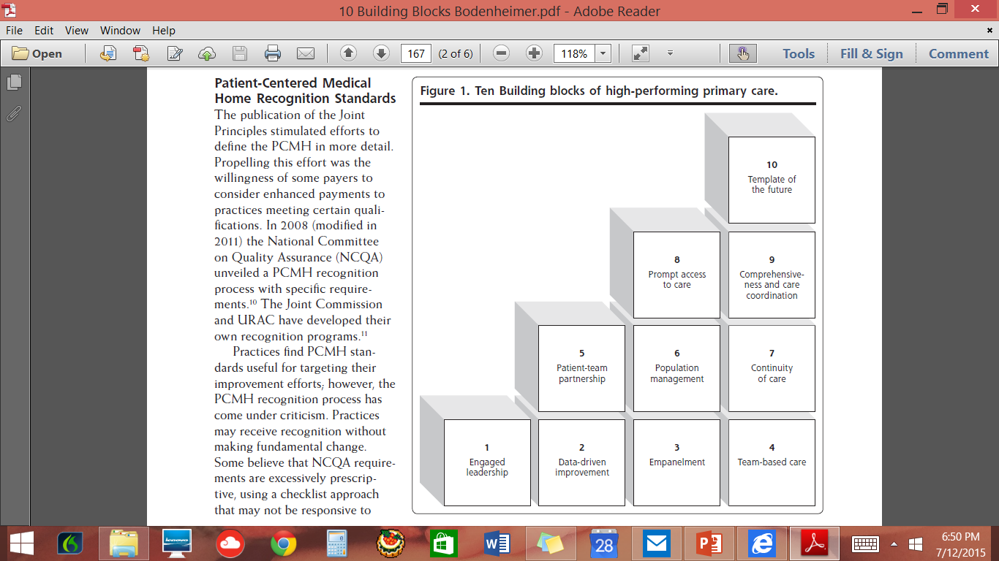
High Value Care– What’s Needed?
Org-wide infrastructure changes
Practice level changes
Engaged leadership at all levels
  Clear vision, and goals
  Adaptive leadership style
  Extending population health beyond medical and into the community
Robust data systems, measurement and reporting
  Financial/operational analytics
  Clinical informatics
  Performance monitoring
  Data for clinical decision making
  Collecting, monitoring and acting on social determinants of health data
  Data sharing and monitoring across sectors
Training and knowledge management
  Institutes, programs
  Training that assists clinicians and care team in eliciting the patient’s story
  and assessing for vulnerabilities and points of resilience
Continuous improvement and innovation
  Improvement methodology
  Human centered design training
  Clear plan for spread and scale
Community partnerships
  Tools for building collaboration to identify and engage community partners across sectors
Eliciting the “patient’s story” to assess for vulnerabilities and points of resilience
Source: Tb.
Notes:
Successful organizations focus first on the patient and their health. They don’t teach to the test – they don’t focus on a specific measure or set of measures to improve. They start with the patient
They focus on developing people, processes and systems to provide quality care, regardless of the measure. These are proactive versus reactive organizations.
They have systems in place to understand their patients, identify care gaps, provide care interventions at the right time, by the right person and at the right place
Technology enabled care
Non traditional visits

