Slide 1
Driving change Through social systems
Kristene Cristobal, MS April 24, 2015

Slide 2
What will we accomplish this hour?
Discuss the importance of social systems in the implementation and spread of your initiatives
Apply helpful models to strengthen our social systems
Rogers’ Innovation and Adoption Curve
IHI’s Spread Framework
Bevan’s Large Scale Change

Slide 3
How do we get people to join us in our important efforts?
From a "lone nut" to a movement

Slide 4
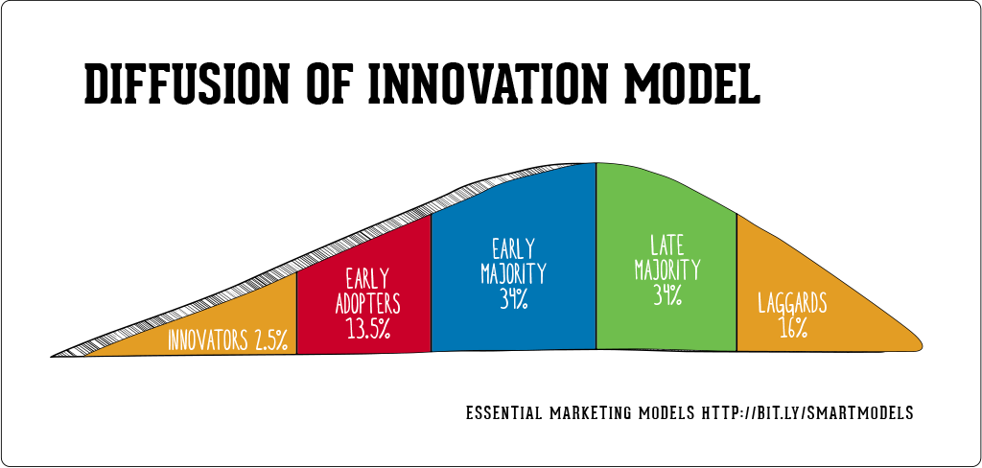
Who are your stakeholders?
Opinion Leaders
Change Agents
First Follower
“It’s how we
do business”
Radicals
Mavericks
Lone Nut
Traditionalists
Tipping Point
Rogers, Everett (16 August 2003). Diffusion of Innovations, 5th Edition. Simon and Schuster.

Slide 5
What leads to successful spread?

Slide 6
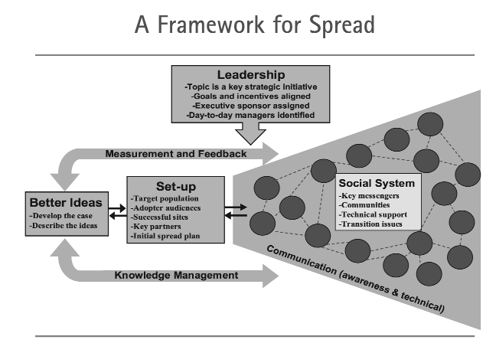
Massoud MR, Nielsen GA, Nolan K, Nolan T, Schall MW, Sevin C. A Framework for Spread:
From Local Improvements to System-Wide Change. IHI Innovation Series white paper. Cambridge,
Massachusetts: Institute for Healthcare Improvement; 2006. (Available on www.IHI.org)

Slide 7
The People in Social Systems Matter
Need to spread explicit knowledge
Benefits for different audiences
Comparative data
Successful sites’ learnings
Need to spread tacit knowledge
Effective transfer of tacit knowledge generally requires extensive personal contact, regular interaction and trust.[1]
This kind of knowledge can only be revealed through practice in a particular context and transmitted through social networks.[2]
Notes:
[1] Goffin, K. & Koners, U. (2011). Tacit Knowledge, Lessons Learnt, and New Product Development. J PROD INNOV MANAG, 28, 300–318.
[2] Schmidt, F. L.; Hunter, J. E. (1993). "Tacit knowledge, practical intelligence, general mental ability, and job knowledge". Current Directions in Psychological Science 2: 8–9
Tacit knowledge: Unwritten, unspoken, and hidden vast storehouse of knowledge
Explicit knowledge is knowledge that can be readily articulated, codified, accessed and verbalized

Slide 8
Informal Networks are Important
Key messengers
Opinion leaders
Influencers
Super users
Designated change agents – clinicians, managers, MAs, front desk clerks… Anyone!
Early wave adopters can influence later waves

Slide 9
Formal Networks are Important Too
Use formal networks to foster:
Making successes of colleagues visible
Design of peer-to-peer interactions
Designated change agents:
Local champions – physician leaders and managers
Venues can include:
Meetings and events that highlight the practice; get peers talking with peers
Webinars, group coaching
Local collaboratives

Slide 10
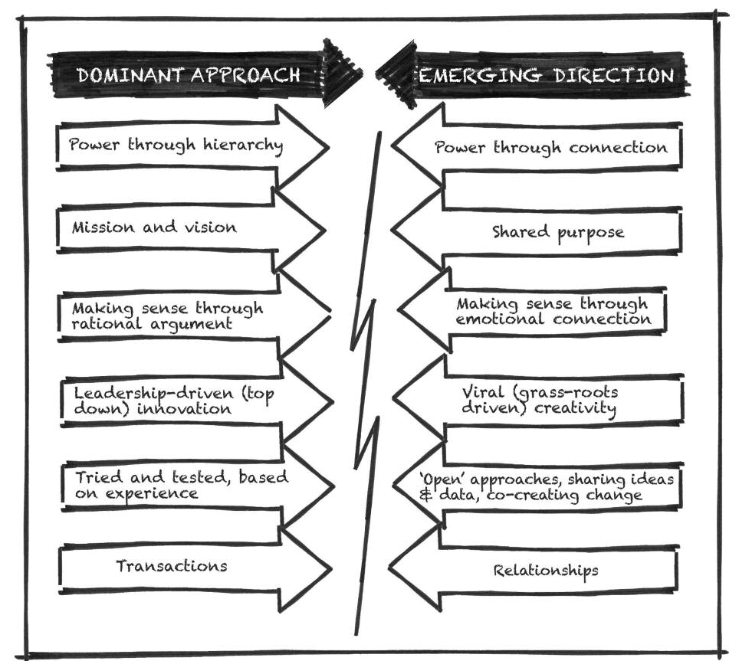
Change In The Way We Make Change
Helen Bevan and Steve Fairman, The new era of thinking and practice in change and transformation: A call to action for leaders of health and care, NHS Improving Quality

Slide 11
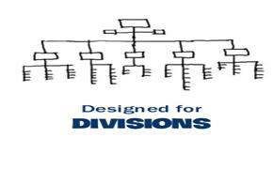
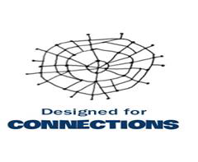
From ‘have to’ to ‘want to’
Helen Bevan, It’s time to rewrite the rules of change in health and care , APAC Forum
Wednesday 3rd September 2014

Slide 12
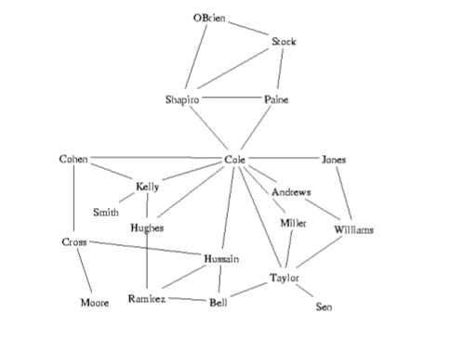
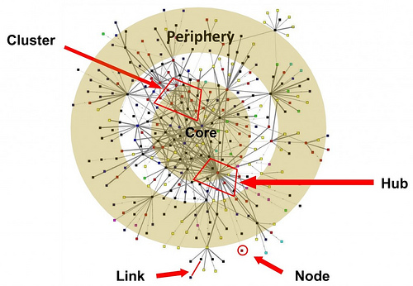
Social Network Analysis
From Complex & High Tech to Simple & Low Tech

Slide 13
Bevan’s Key Takeaways
Frame the issues in ways that engage and mobilize the imagination, energy and will of a large number of diverse stakeholders in order to create a shift in the balance of power and distribute the leadership
Build shared purpose in an explicit way, focusing on the shared premise, (asking ‘who needs to be part of the change?’ and ‘what unites us?’) and the purpose (asking ‘why are we making this change?’)
Regard everyone as a leader and encourage many acts of leadership, beyond the formal leadership system
Build your extended network of weak tie social relationships for new ideas and inspiration
Take steps to be a more social leader, investing in your digital skills and social connections and leading through networks as well as formal leadership systems
Helen Bevan and Steve Fairman, The new era of thinking and practice in change and transformation: A call to action for leaders of health and care, NHS Improving Quality

Slide 14
Lots of Tools Used in Social Systems
Low Tech
Newsletters, videos, posters, “ask me” buttons, articles, storytelling
High Tech
YouTube, Twitter, Facebook, LinkedIn, blogs, intranets, video ethnography, hackathons

Slide 15
If you only remembered three things…
Balance your formal networks of influence with informal networks
Understand who the opinion leaders are in the social system and enlist them to help influence others
Strive for greater connectivity and partnerships

