Slide 1
Changing the Face of Pediatric Care Pediatric Partners & The Center for Primary Care Innovation
September 29, 2016
Notes:
Scott

Slide 2
Agenda
Pediatric Partners overview
Clinical Integration journey
Current capabilities
Reinforcing the Medical Home
Pediatric care and support programs
Reduction in unnecessary healthcare spend
HEDIS focused clinical outcomes
The future is now
Notes:
Scott

Slide 3
Pediatric Partners Overview
A physician led network organized under section 162.001(b) of the Texas Occupations Code – Children’s Health is sole member
More than 260 general pediatricians and 70 pediatric specialists
Includes physicians who care for both commercially and government insured patients
Affiliate of Children’s Health, home of nationally ranked, award-winning pediatric care and the sixth largest pediatric hospital in the country
Notes:
Scott

Slide 4
Pediatric Partners Overview
Governed by a board of directors consisting of nine physicians
40 Physician members actively participating in:
Quality Committee (Pathway and Metric Development)
Governance Committee (Operational Guidance)
Service Excellence Committee (Patient Experience)
Clinical Optimization Committee (Best Practices)
Managed Care Contracting Committee (Payer Relations)
Monthly committee meetings / Quarterly membership meetings
A new way for Children’s Health to carry out its mission to make life better for children
Notes:
Scott

Slide 5
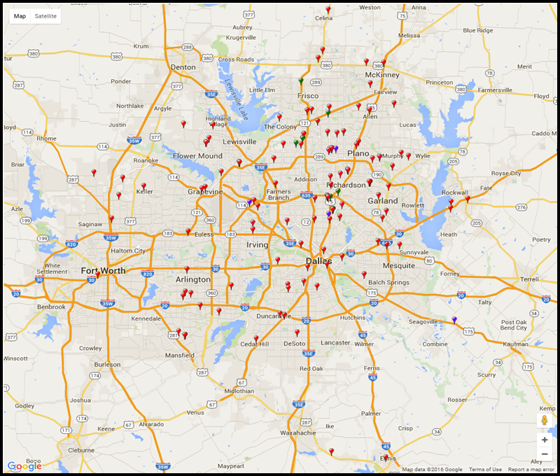
Pediatric Partners Overview Our Physicians
150 Practices / 346 Physicians
(260+ Pediatricians, 70+ Pediatric Specialists)
Notes:
Scott

Slide 6
Pediatric Partners Overview Clinical Integration Journey
Pediatric Partner’s Clinical Integration Journey
270 Physicians with mapped EMR/PM Data
Aug 2016
Rules & Sanctions Policies & Procedures Implemented
Sep 2015
Hire Medial Director
Sep 2012
Establish Monthly Fee
Oct 2014
Clinical Pathways & Quality Metrics Established
April 2015
262 Members Enrolled
June 2015
Self Assessment of Clinical Integration Requirements Completed
Dec 2015
129 Members Enrolled
July 2014
Launch CG – CAHPS Initiative
Jan 2015
Establish Board
& Governance
Structures
Aug 2014
Establish Physician Engagement Requirements
March 2015
1st Quality & Care Opportunity Reports Distributed
July 2015
308 Members Enrolled
Dec 2015
Complete Participation Agreement
April 2013
Launch Nurse Advice Line
Oct 2014
102 Physicians with mapped EMR/PM Data
June 2015
2016 Shared Savings Methodology Determined
Nov 2015
Discussions underway with all major payers
September 2016
Notes:
Scott

Slide 7
Our Journey Clinical Integration Journey
“Clinical Integration is commonly defined as a health network working together, using proven protocols and measures to improve patient care, decrease cost and demonstrate value to the market”
Opportunity for development in our clinical integration program
Source: Becker’s Hospital Review
Notes:
Scott

Slide 8
Unique Pediatric Care Capabilities Reinforcing the Medical Home
Virtual Health
Asthma Management Program
Behavioral Health
Weight Management Program
Nurse Advice Line
Type 2 Diabetes Prevention
Utilization & Care Coordination
Patient Experience
“A Pediatric Physician knows that children are not just little adults. As we battle the rise in obesity, hypertension, diabetes and psychiatric problems in our youth, we are making a dramatic impact on their future as adults..” – Susan Badaracco, M.D.
Notes:
Victoria

Slide 9
Pediatric Care Programs Weight Management & Type 2 Diabetes Prevention
By your side for fitter families.
Promote healthy life-styles and set nutrition and activity goals for the whole family
Reduce risk of serious illness like diabetes and heart disease
Partnership with Children’s Health and the YMCA of Metropolitan Dallas
Childhood obesity has more than quadrupled in past 30 years
Children age 6-11 increased from 7% obesity in 1980 to 18% in 2012
Children age 12-19 increased from 5% to 21% in 2012
Get Up & Go program outcomes:
88% increase in responses on Behavioral Change Questionnaire
79% increase on PACER (Progressive Aerobic Cardiovascular Endurance Run) Test
92% maintained or experienced a decrease in BMI Percentile
Notes:
Victoria

Slide 10
Pediatric Care Programs Asthma Management 3-6 Month Program
Offered to families that resided within the seven surrounding counties of DFW
One home visit by a Registered Respiratory Therapist providing one-on-one age-specific asthma education
Tool Kit which includes a peak flow meter, spacer, spacer bag, hypoallergenic pillowcase, asthma diary, and action plan
Home evaluation to identify specific asthma triggers
6 Bi-weekly telephone Education calls with a Registered Nurse- Certified Asthma Educator
Goal setting, QOL Measures, ACT, and Trigger Mitigation
Medical social worker services to address socioeconomic barriers to care and living conditions
Notes:
Victoria

Slide 11
Pediatric Care Programs Asthma Metrics & Findings
Clinical/Healthcare Utilization
Emergency Room
Inpatient Admissions*
Unscheduled PCP visits
Trigger Mitigation*
Asthma Control*
Participant Satisfaction
Child/Patient Satisfaction
Physician Satisfaction
Quality of Life Measures
Missed days of School
Caregiver missed days of Work
PedsQOL (Asthma Symptoms Scale, Varni)*
*Metrics for The Joint Commission
2016 Program Findings
*100% reduction in asthma related inpatient admissions
*30% improvement in trigger mitigation
*8% increase in asthma quality of life scores
*91% with optimal Asthma Control scores following education
Notes:
Victoria

Slide 12
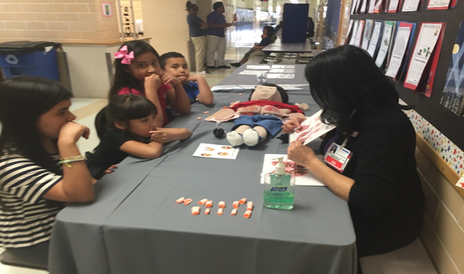
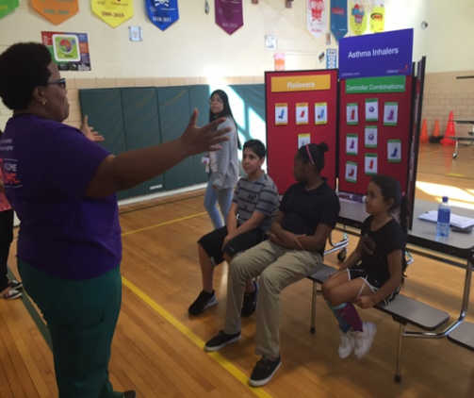
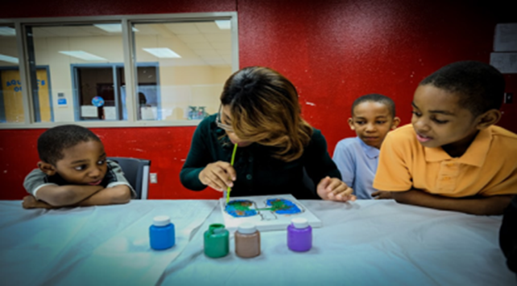
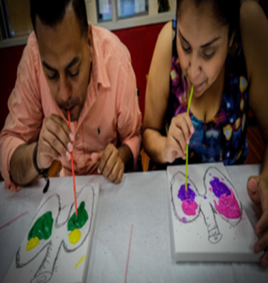
Pediatric Care Programs Asthma Community Education Classes
Provided
Afterschool Programs
Recreational Centers
Libraries & Physician Practices
“Breathing is An Art” Community
Classes
Family share same emotional experiences
Address how asthma alters or can alter your everyday routine.
Expression of how your child could feel during an “attack”
Notes:
Victoria

Slide 13
Reinforcing the Medical Home Virtual Care and Medical Home
By your side where you need us.
Reinforcing the Pediatrician as the medical home
Providing quality care, established clinical pathways and protocols, avoiding potentially unnecessary tests and screenings
Reducing fragmentation in care
Connecting with patient families where and when they need us
We are building a Medical Home support structure for network members to enhance value of care.
Notes:
Dr. Kincaid

Slide 14
Pediatric Care Programs Behavioral Health
By your side for healthier minds.
Manage potential development of chronic diseases caused by abuse, neglect or other ‘toxic stress’
Provide mental and emotional assessment and support as extension of PCP office
Utilize tele-health capabilities for short-term interventions and school advocacy
On site Licensed Clinician Pilot underway, eleven participating practices
2015 Beyond ABC Report Dallas/Collin Counties
Developmental Disabilities | 13.6%
Emotional Disturbance (9 – 17 year olds) | 11.3%
 | May | June | July | Aug
Non-CHPG Referrals | 17 | 26 | 39 | 64
CHPG Referrals | 334 | 269 | 292 | 424
Total Referrals | 351 | 295 | 331 | 488
% of non-CHPG referrals | 4.84% | 8.81% | 11.78% | 13.11%
Notes:
Dr. Kincaid

Slide 15
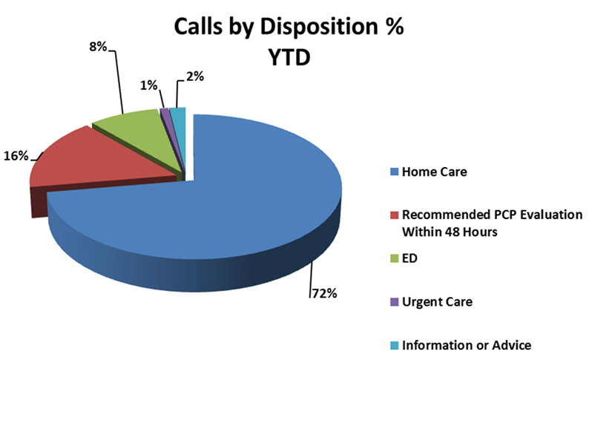
Reinforcing the Medical Home Nurse Advice Line
By your side when you need us.
Staffed by 37 Registered Nurses with Pediatric Emergency Room experience
Patient satisfaction=98%
Physician satisfaction=97%
2016 Statistics:
17 sec average speed to answer (URAC standard is 30 sec)
3.9% abandonment rate (URAC standard is 5%)
29,418 calls thru Aug 2016
250 Physician Members
118 Sites
8% Referral Rate to ED
Notes:
Dr. Kincaid
MOST IMPORTANT / MOST VISIBLE - SET UP DR. GOH Section

Slide 16
Working Together to Build Processes: Bridging the Quality Chasm
Notes:
Darla

Slide 17
Financial Impact: Reducing Low Acuity Visits
Average Low Acuity ED visit = $867 in charges
Notes:
Darla
In the first half of 2016, ED visits for a defined cohort of high utilization patients achieved a 64% reduction from baseline.
This accounts for an annualized volume reduction of 150 visits
At an average of $867 in charges for low acuity visits, this reduction equates to approximately $130,050 in payer savings. (Average charge for low acuity visit provided by finance on 8/26/2016. Detail available. Medicaid rates are actually higher)
Given the stress a patient and family experiences during ED visits, reduction of utilization also enhances family wellbeing
Overall, the improved utilization, reduced payer expense and improved experience represent an exemplar Triple Aim outcome.

Slide 18
Best Practice/ Improving Health Outcomes HEDIS Quality Metrics
Notes:
Jana Neal
All physicians are top of class, nobody misses anything….

Slide 19
Improving Health Outcomes HEDIS Quality- Provider Educational Tools – QJR
Notes:
Jana

Slide 20
Well Child Care in our member offices
For the first time ever there is a report of patients to address their gaps in care; patients can then be contacted to scheduled for well child care
In looking at the report:
Practices had to shift resources to contact families and bring them back
Now there is improvement and sustainability with engaged practices
As a result, Pediatric Partners is moving the needle on 3 – 6 year old metrics
How did you do that in Texas?
Independent practices; thus, the national interest
Engagement, Connectivity and Improvement science
This is first P4P in our system as a test of working together to achieve it - Sustainability
Notes:
Jana

Slide 21
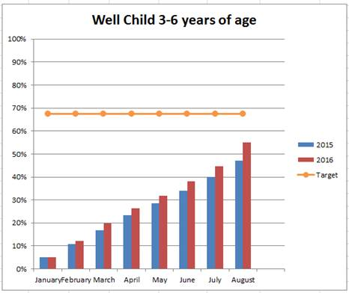
Pediatric Partners WC 34 Results 2016 Month Over Month Comparison
2016 Goal: Documented 5 percentage point increase.
Projected End of Year Results of 77% would be equivalent to a 15% increase above 2015
Notes:
Jana Neal

Slide 22
Improving Health Outcomes Clinical Pathways- Provider Educational Tools
1
Upper Respiratory Infection (URI)
Metric: Appropriate Treatment for Children with Upper Respiratory Infection (URI) Pathway
Measure Description: The percentage of patients 3 months to 18 years of age who were given a sole diagnosis of upper respiratory infection (URI) and were not ordered an antibiotic.
Best standards of care and appropriate use of antibiotics
Yes
No
2
Group A Streptococcal Pharyngitis
Provider
Metric: Appropriate Testing for Children with Pharyngitis (CWP)
Measure Description: Percent of patients age 2-18 years of age who had a sole diagnosis of pharyngitis and a prescription for an antibiotic who had a group A streptococcus (strep) test during the measurement year
Weight Assessment and Counseling
3
Best standards of care and reinforcing healthy lifestyles
Metric: Patients 3-17 years of age with an outpatient visit with a PCP or OB/GYN should have: (1) BMI percentile documentation, (2) Counseling for nutrition, and (3) Counseling for physical activity during the measurement year.
Notes:
Jana

Slide 23
Specialists are On the Team
Better connections between specialty care and the medical home may be one of the answers in a value based world.
Notes:
Scott

Slide 24
Volume to Value Understanding the Care Continuum
We will continue exploring innovative relationships that can reinforce our clinical integration program and provide incentives to mobilize our capabilities…
Reduce unnecessary ED utilization
Mobilize TeleHealth capabilities for after-hours care and Behavioral Health
Reduce Asthma IP admits
Develop and drive appropriate Formulary utilization
Care Alignment for chronically- ill population
Specialty Care Cost Containment
Clinical Pathways- Outcome improvement
Imaging and Facility Use
Referral Guidelines
Reduce Asthma ED admits
FFS
P4P
Narrow Networks
Shared savings (upside/ downside)
Total Risk
Value Based Reimbursement Continuum
Notes:
Scott

Slide 25
Questions

