Slide 1
Geovisualization of Social Determinants of Health: Providing Community Context
Jennifer Rankin, PhD March 3, 2016

Slide 2
Who is HealthLandscape?
We are an enterprise of the American Academy of Family Physicians
Connected in mission and projects (and physically) with the Robert Graham Center
The team at HealthLandscape is dedicated not only to data democratization and data visualization, but also to research related to health, health care and social determinants of health. We are actively
Researching how our social circumstances affect our health and access to health care;
Applying geospatial and statistical techniques to help answer questions about disparities in health outcomes; and
Creating new visualization methods.

Slide 3
Who is the Robert Graham Center?
The policy arm of the American Academy of Family Physicians
Editorially independent
Aims to improve individual and population healthcare delivery through the generation or synthesis of evidence that brings a family medicine and primary care perspective to health policy deliberations from the local to international levels
http://www.graham-center.org/rgc/home.html

Slide 4
HealthLandscape- the Platform
Originally conceived as a data democratization tool by the HL director and as a translational tool by the current RGC director
Has evolved over the years (we are currently on HL v3 and already working on HL v5)
Includes at least 20 separate projects

Slide 5
Where to find HL Tools
www.udsmapper.org/HealthLandscape.cfm
http://www.graham-center.org/rgc/maps-data-tools.html
Most of our tools are free and open to the public
Some tools are password protected
UDS Mapper and HealthLandscape use the same password
HINT: register for the UDS Mapper first and then use that password for the HealthLandscape website

Slide 6
Health Workforce & Graduate Medical Education Applications
Tools that display the distribution of health workforce and the geographic reach of graduate medical education
Med School Mapper
Residency Footprinting Mapper
American Medical Association – Health Workforce Mapper
GME Outcomes Mapper

Slide 7
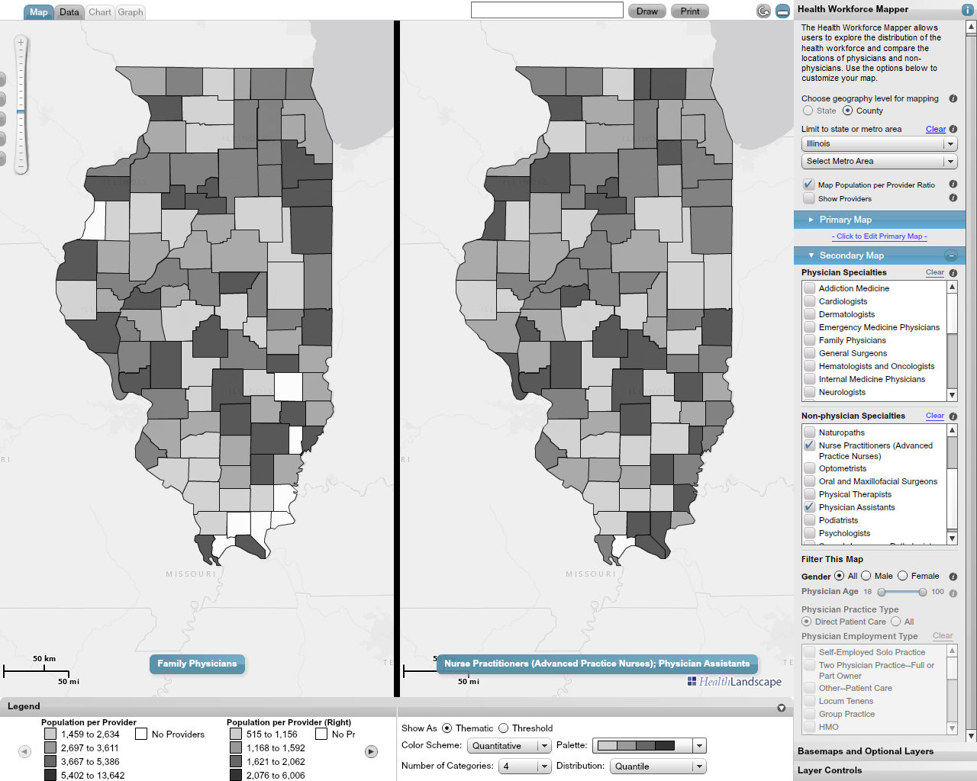
Demo of AMA Health Workforce Mapper

Slide 8
Site Explorers
Tool allows users to quality evaluate performance across multiple sites. Sites are colored red, yellow, or green based on relevant criteria, providing users with a quick visualization of site performance and allowing users to quickly pinpoint high-performing or low-performing sites.
The Accountable Care Organization (ACO) Quality Explorer
The Hospital Readmissions Explorer
The Hospital Value Based Purchasing (HVBP) Explorer
The Nursing Home Star Ratings Explorer

Slide 9
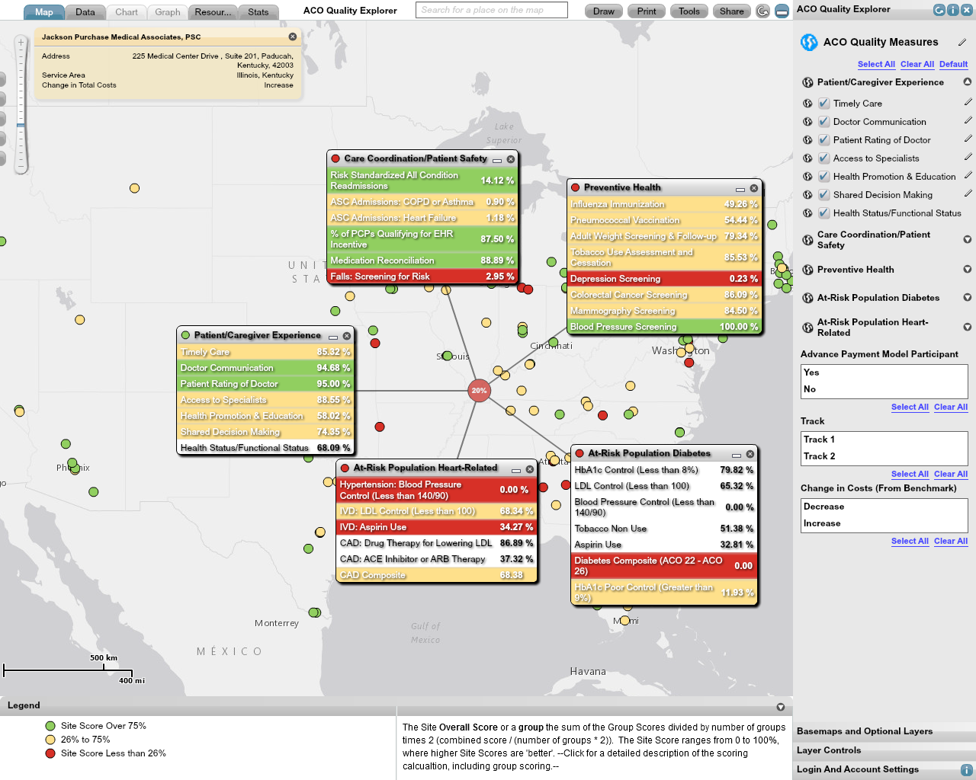
Demo of ACO Explorer

Slide 10
Population Indicators Tools
Tool allows users to set thresholds and overlay multiple indicators to identify areas of need or bright spots.
Arizona First Things First – The Children's Health and Education Mapping Tool
The Population Health Mapper
The Social Determinants of Health (SDOH) Mapper

Slide 11
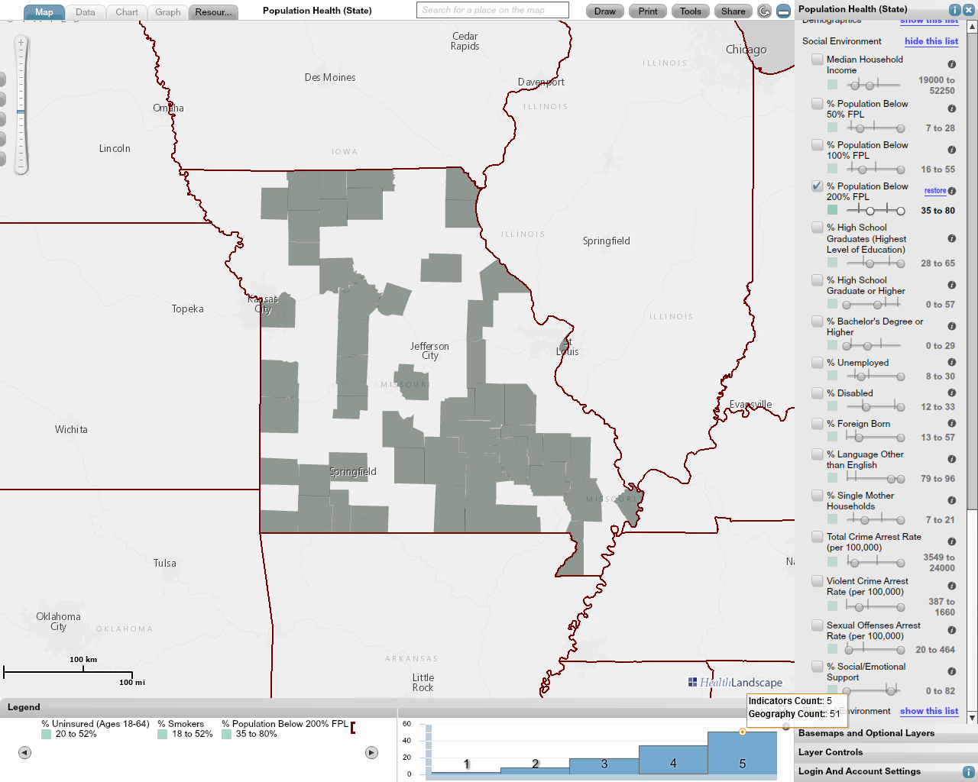
Demo of Population Health Mapper

Slide 12
Community Data Portals
Tool allows users to visualize data using charts, graphs, and maps across a variety of topics.
Facts Matter (Greater Cincinnati Data Portal)
North Carolina Health Information Portal (NC-HIP)
The Medicare Data Portal
The Appalachia Data Portal

Slide 13
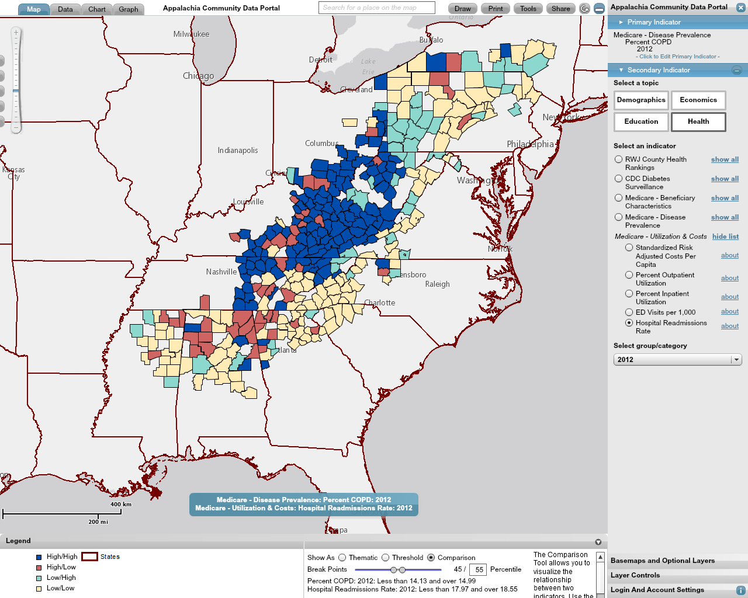
Demo of Appalachia Data Portal

Slide 14
UDS Mapper
Tool allows users to visualize the geographic reach of the federal health center program- where patients are coming from to receive services at the health centers combined with demographic data and social determinants of health. Users can also upload their own data into the UDS Mapper.

Slide 15
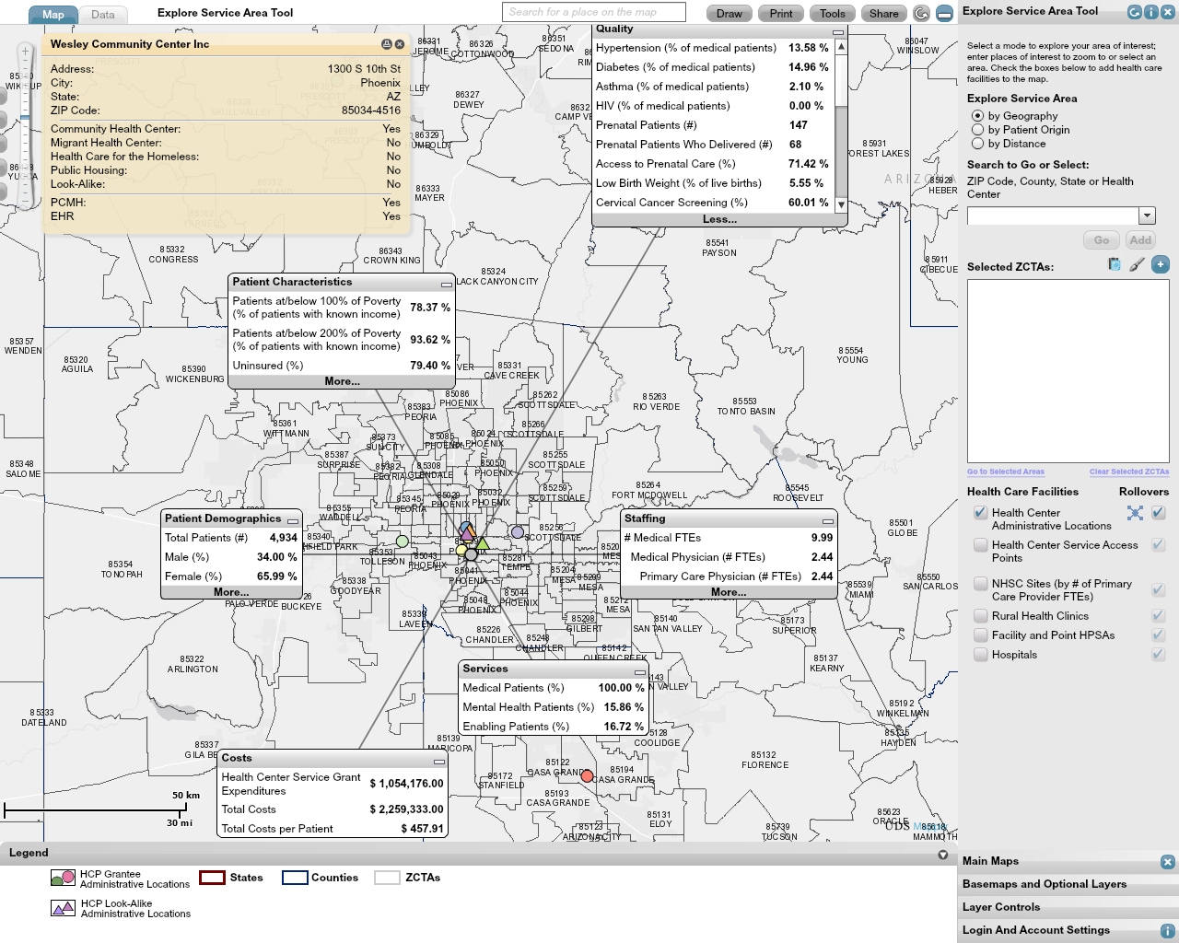
Demo of UDS Mapper

Slide 16
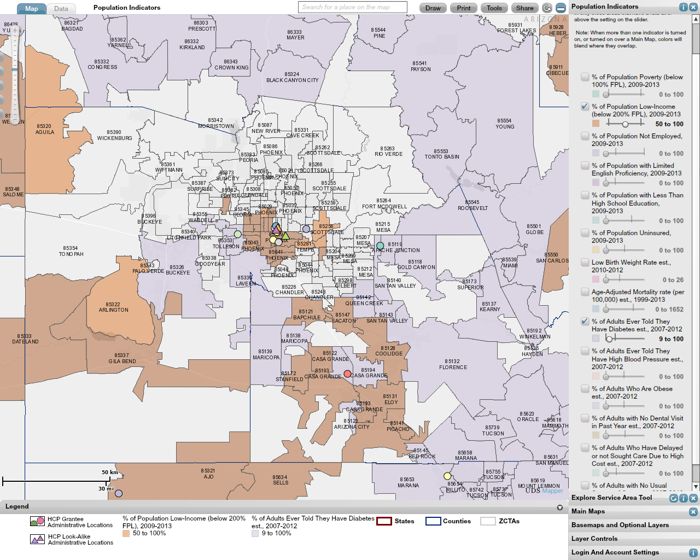
Demo of UDS Mapper

Slide 17
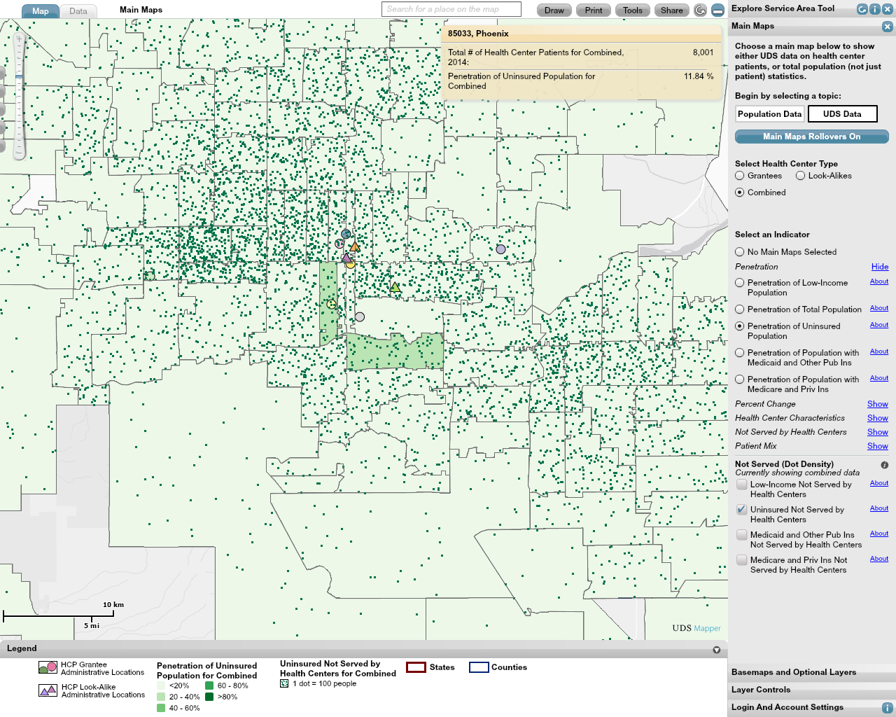
Demo of UDS Mapper

Slide 18
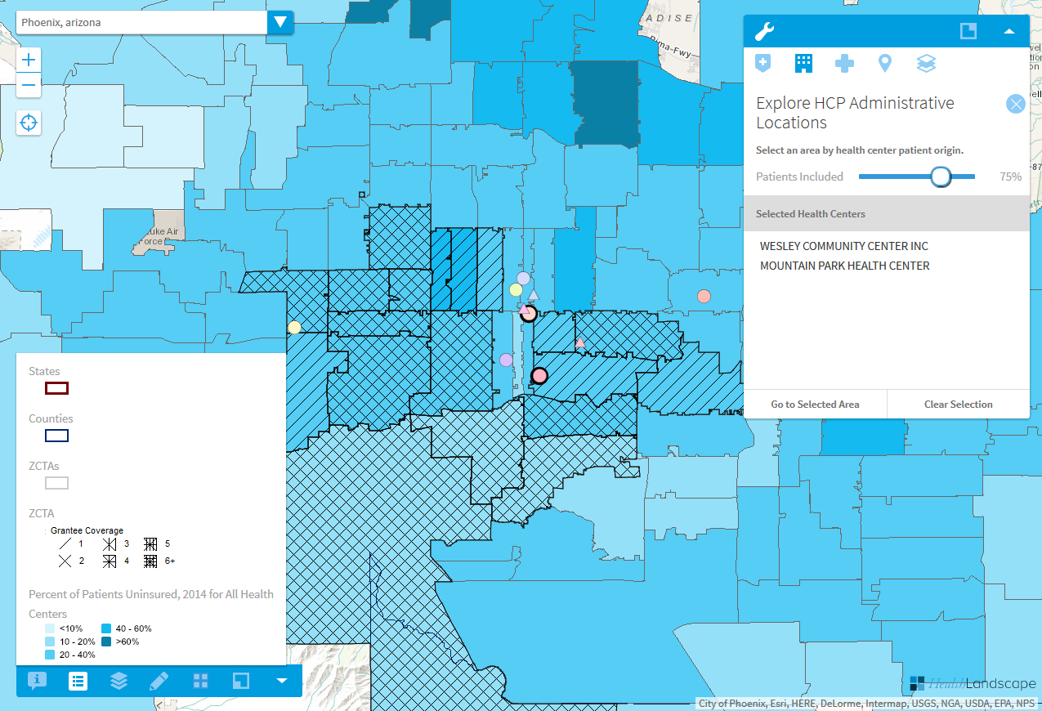
Demo of UDS Mapper

Slide 19
Geoenrichment and Community Vital Signs
Tools are being developed to append demographic and social determinants of health data into EHRs. Currently working to understand best visualization techniques for researchers, providers and care teams.

Slide 20
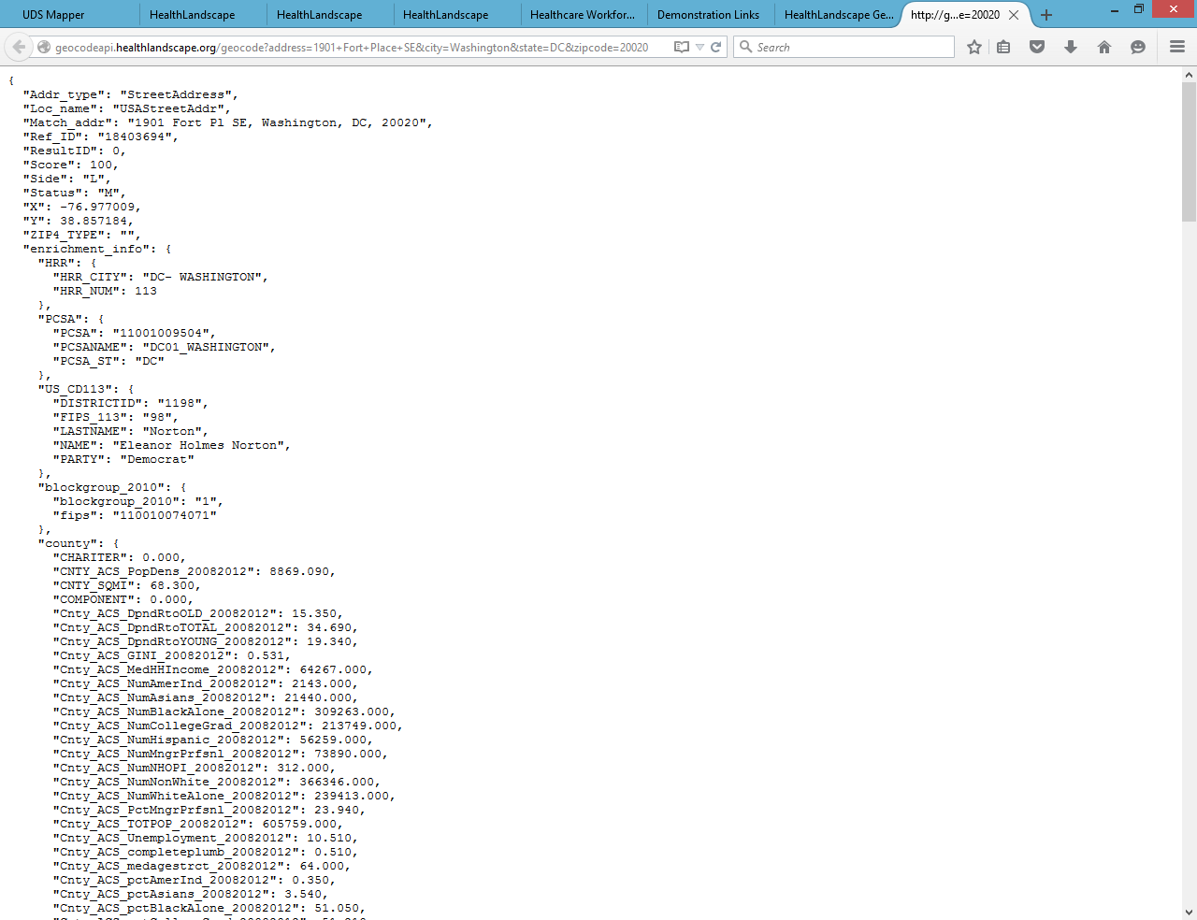

Slide 21
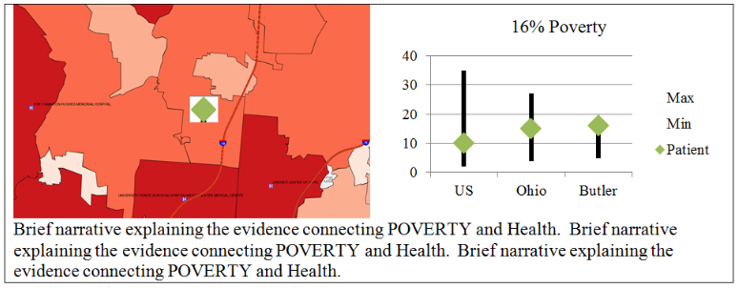
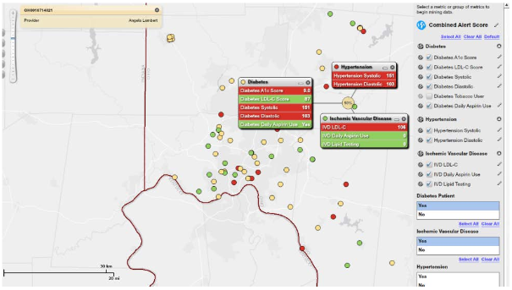

Slide 22
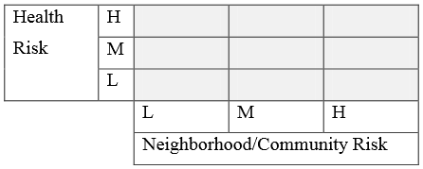
Risk Assessment Box

Slide 23
Thank you!
Jennifer Rankin, PhD
Senior Manager, Research and Product Services
HealthLandscape
jrankin@healthlandscape.org

